Slide 1
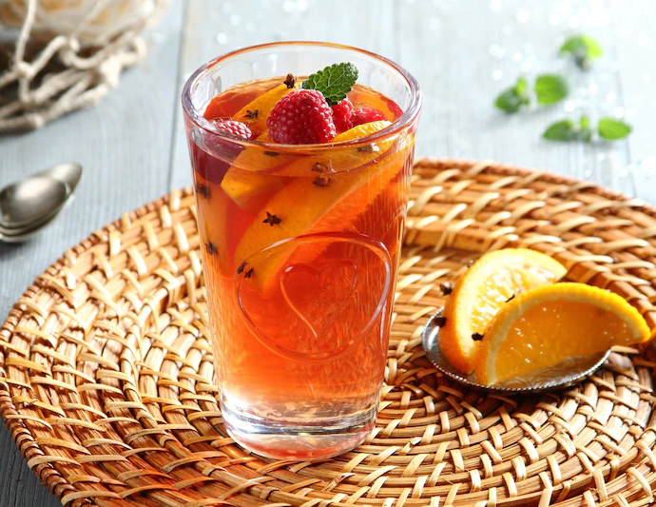
TEA WITH GINGER JUICE AND RASPBERRY JUICE

Slide 2
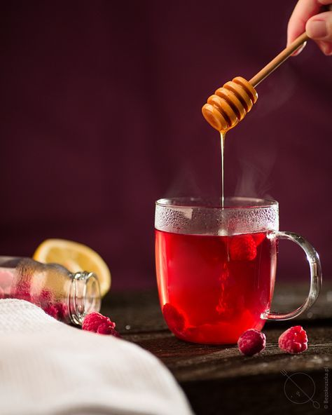
THINGS YOU NEED
Ginger- ginger is a plant which you can use as an agent with healing properties, effective against viruses and nausea.
Tea
Lemon
Hot water
Honey
Raspberry juice- they contain a lot of vitamins and minerals, and also many other substances valuable for health.

Slide 3
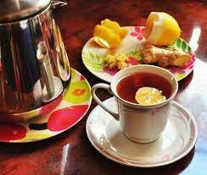
WHAT IS THE PURPOSE TO USIE IT?
you can drink it when you have a cold or when you feel unwell.

Slide 4
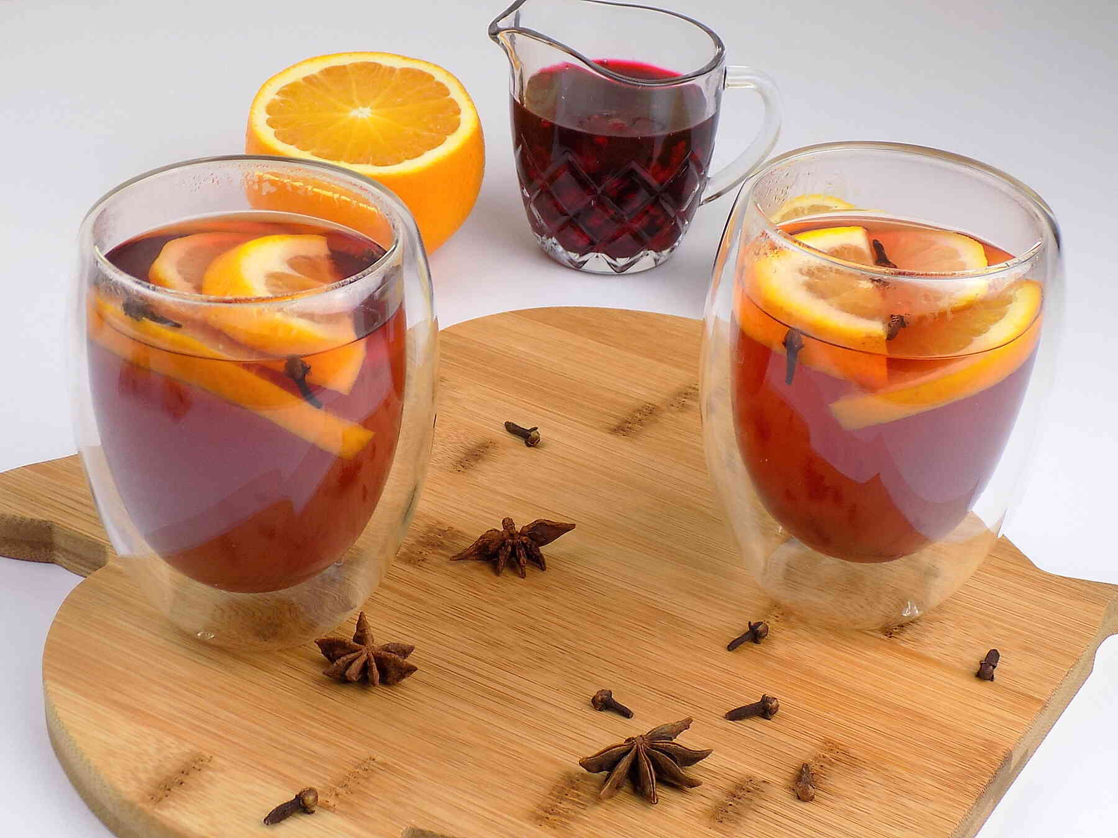
RECIPE HOW TO PREPARE IT
Peel the ginger and lemon from the peel
Cut into thin slices
Put in a glass and pour hot water
Leave for 15 minutes
Before drinking the tea, add the honey and mix it. optionally, you can add raspberry juice.

