Slide 1
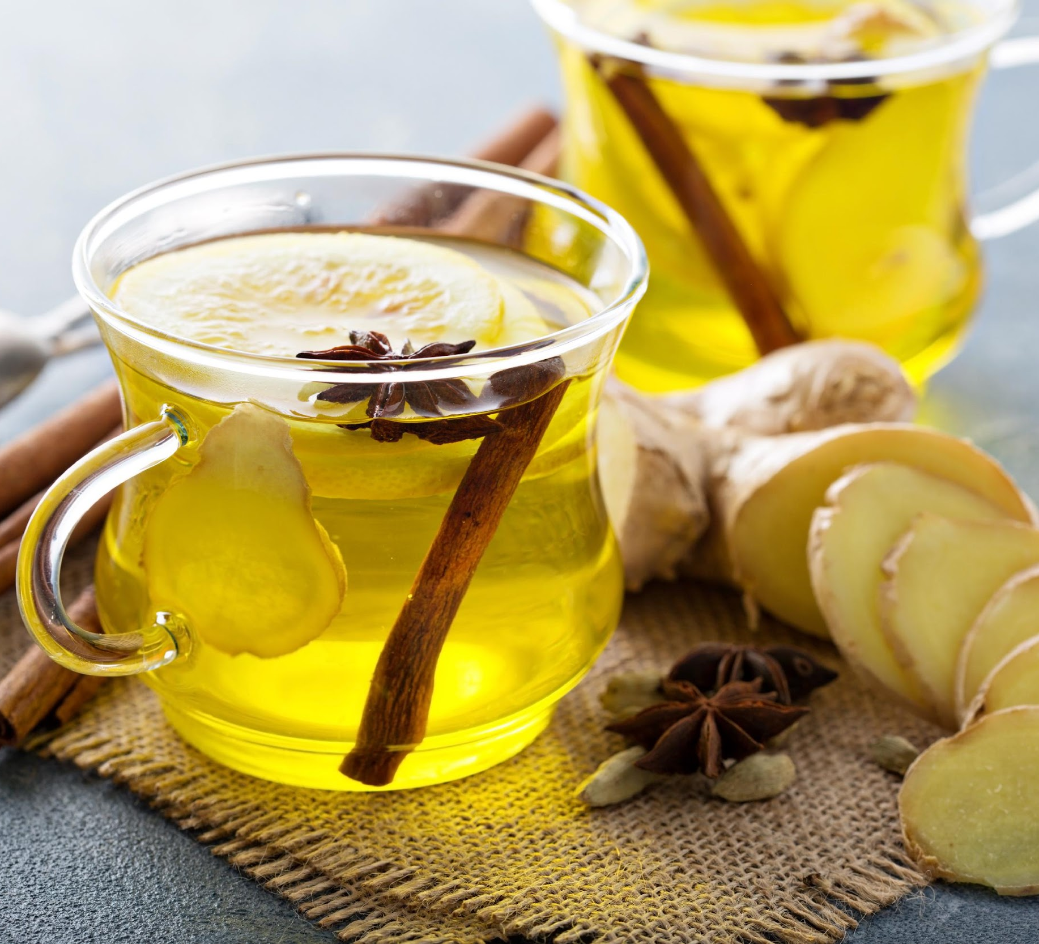
Ginger Juice
.

Slide 2
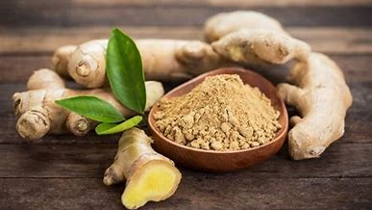
Ginger
ginger is classified as an edible and cosmetic plant. The ginger stalk grows to a height of about 100 cm, the leaves are large and its flowers are yellow-purple. ginger root is thick, fibrous, light brown in color and has a pungent taste - it is used for edible and cosmetic purposes

Slide 3
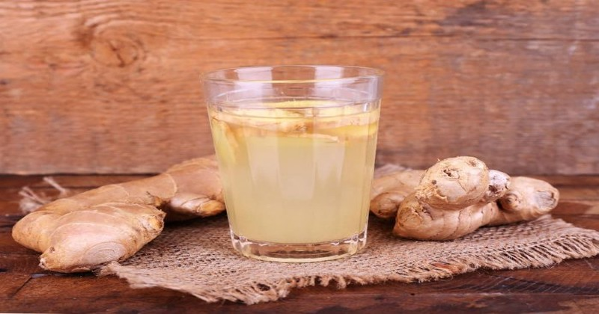
when is it worth using ginger juice?
The drink has a great effect on the body's immunity, so you should drink it, especially in high season. In addition, ginger juice is great for warming and has antiviral, anti-inflammatory, antibacterial and antifungal properties. For this reason, it will help you fight the first symptoms of a cold, flu or other infection. The natural remedy can also help relieve pain. It allows you to reduce the intensity of, among others period pains as well as migraines. it can also relieve the nausea that accompanies you from motion sickness or pregnancy. Some people also use ginger juice for weight loss as it helps to detoxify the body.

Slide 4
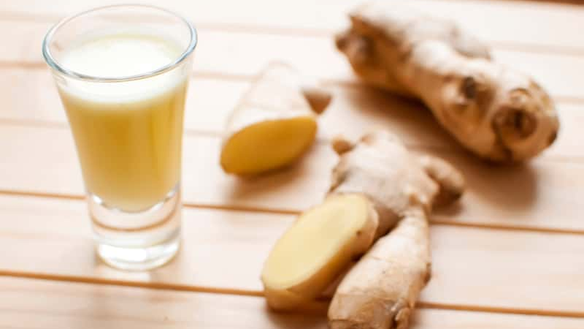
what's in ginger juice?
You will prepare ginger juice with the root base of this amazing plant. Beneficial properties for health result from the substances it contains. although it is 80% water, it also contains protein, fats, carbohydrates, dietary fiber, folic acid, essential oils and vitamins, especially A and B vitamins. In addition, it is rich in minerals important for your health. Ginger root is a relatively good source of iron, magnesium, potassium and sodium. They also contain zinc, phosphorus and copper .

Slide 5
recipe:
Peel the ginger with a teaspoon and then cut it into smaller pieces.
Put the root particles into the juicer, cover with a glass of water and blend.
Pour the remaining water into a pot, add lemon juice and sugar to it and bring it to the boil. after boiling, add the mixed ginger to the stock and let it stand for at least 2 hours.
Pour the ginger juice through the strainer and pour it into jars or bottles.
You can keep this ginger juice in the refrigerator for about a month. Drink 2-3 teaspoons a day, preferably by adding them to tea .

