Slide 1
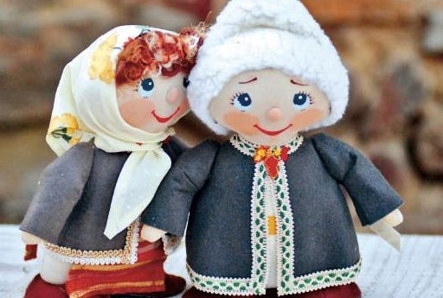
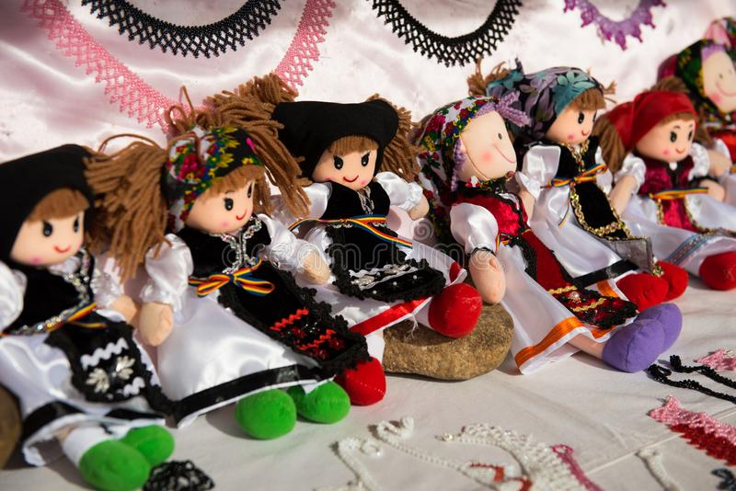
Dragobete vs. Valentine’s Day

Slide 2
Dragobete is a traditional Romanian holiday celebrated on February 24. The day is particularly known as “the day when the birds are betrothed”. It is around this time that the birds begin to build their nests and mate. On this day, considered locally the first day of spring, boys and girls gather vernal flowers and sing together. Maidens used to collect the snow that lay on the ground in many villages and then melt it, using the water in magic potions throughout the rest of the year.

Slide 3
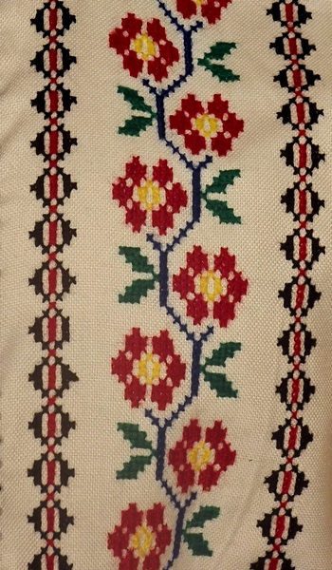
Those who take part in Dragobete customs are supposed to be protected from illness, especially fevers, for the rest of the year. In Romania, Dragobete is known as a day for lovers, rather like Valentine’s Day.
In the countryside there is an old tradition with girls and boys going into the woods to pick flowers. When they return home, the traditions says that boys were running after girls to kiss them. If the girl liked the boy she lets him kiss her. There is a saying in Romania that makes a lot of sense regarding this: ”Dragobete kisses the girls”.

Slide 4
Valentine’s Day is a celebration marked on Valentine’s Day, a Roman priest who officiated marriages in secret, and was therefore imprisoned by Emperor Claudius II. Because he refused to renounce Christianity, the priest was executed on February 14, 269 or 270. In 496 he was sanctified and considered since then the protector of love and lovers. The old traditions related to Dragobete Day have lost their importance today. If before, in the village world, it was a holiday where young people gathered and it was an opportunity to make their love public or to make new relationships, today is just another opportunity for those who love each other to make gifts and he says words of love.

Slide 5
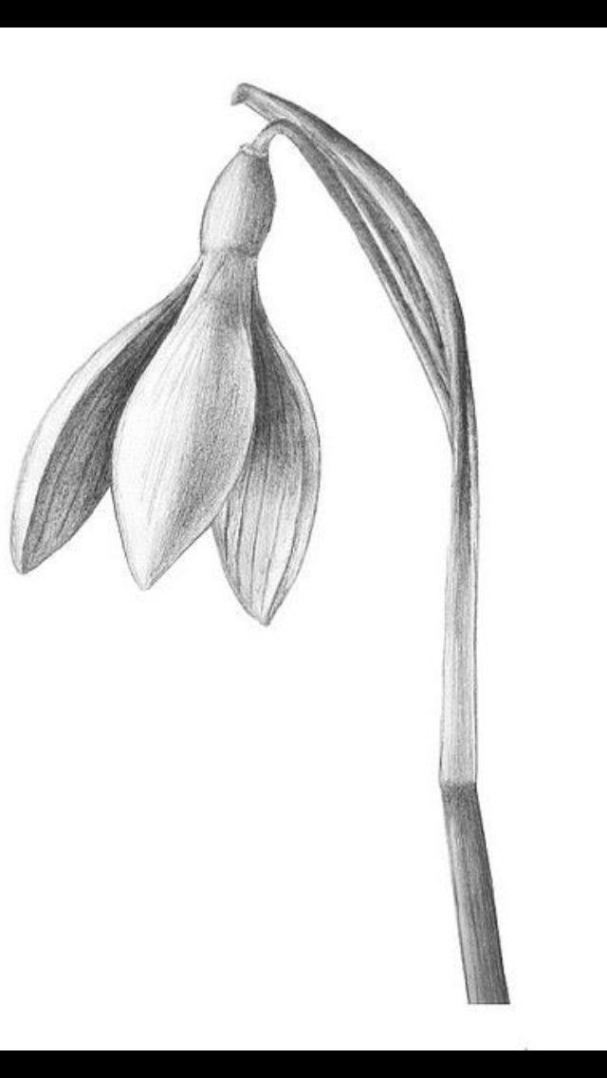
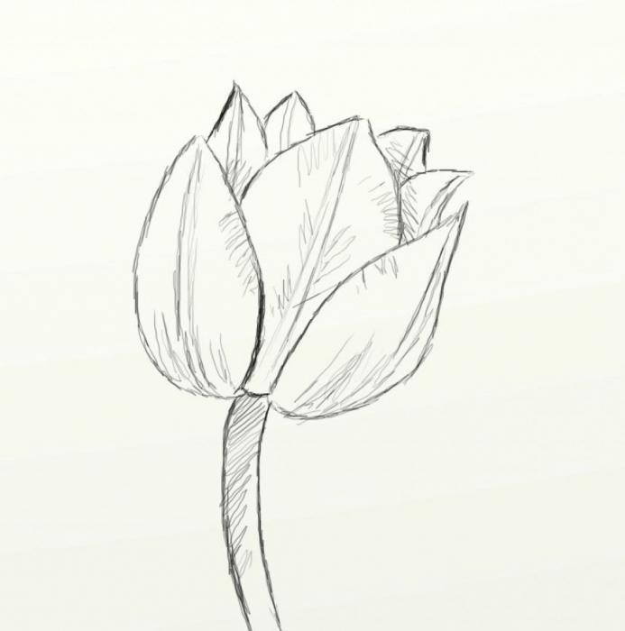
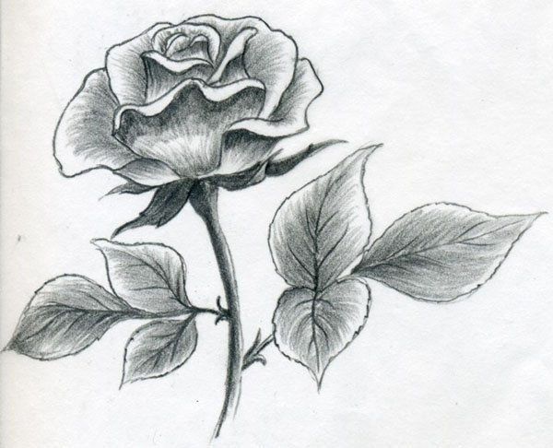
At present, therefore, there are no significant differences in the way the two love holidays are celebrated. When we talk about gifts, flowers remain Dragobete’s main gift, with which lovers pamper their girlfriends. Therefore, in the name of these two holidays, of the love on earth and of the friendship between the project partners, let us always draw flowers with pleasure.

Slide 6
The pupils of ”Constantin Noica” Theoretical High School Sibiu, Romania, thank you for
watching this short presentation.

