Slide 1
“Rigena and the Castle of Agios Ilarionas”

Slide 2
The castle of Agios Hilarion or Ai Larkos, is located in Cyprus in the occupied province of Kyrenia. It was built by the Byzantines in the 11th century AD. at the homonymous peak of Pentadaktylos.
The most famous and mysterious person in Cypriot history, the beautiful and heartless Rigena, is associated with many stories of the island. But more with the history of medieval castles, which hide its secrets.

Slide 3
According to the legend, the ruthless Regina chose the top of the now occupied Pentadaktylos to build her fortress. During the construction of this Castle, Regina wanted to be present and supervise the work that was being carried out.
Sitting on a high cliff, she watched the workers work while giving them instructions. From early in the morning until late at night the workers worked non-stop.
When the building was finished, Regina went and sat by the window of one of the rooms of the castle, under which stood a huge cliff that anyone who saw it was stunned.

Slide 4
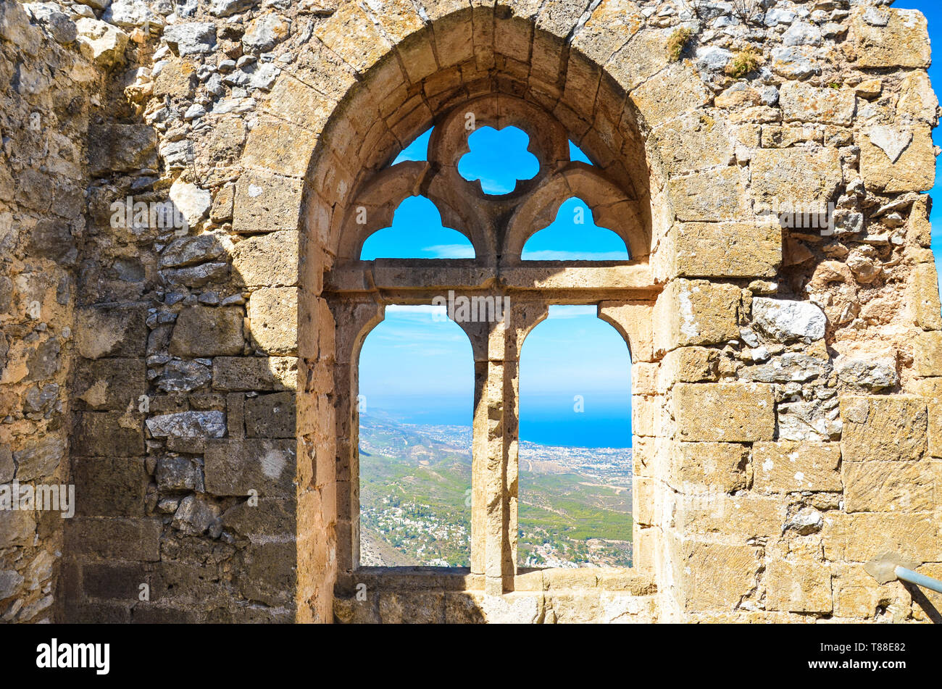
The heartless Regina, having soldiers next to her, called the workers one by one to the room, ostensibly to pay them for their work. When the workers approached to get their money, Regina ordered her soldiers to kill them and throw them out the window on that huge cliff.
The cliff was filled with the lifeless bodies of the workers.
Regina had planned this plan a long time ago, as she
did not want any of the workers to leave the castle
alive, for fear that one of them would betray the
hiding places and the secrets of the castle.
Thus the secrets of the fortification would never
be revealed. Their bones, according to legend,
are still there....

Slide 5
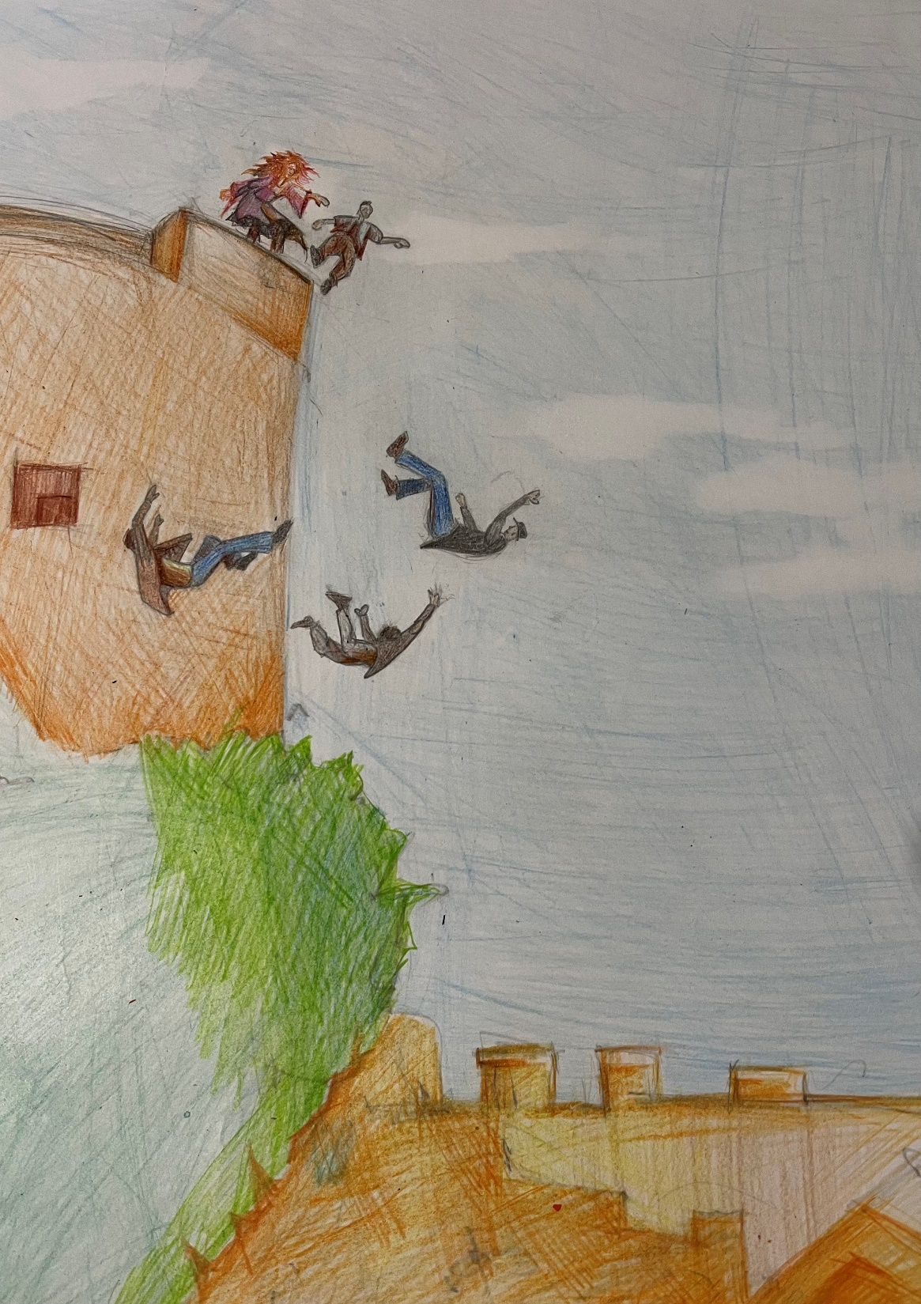
DRAWING FROM THE STUDENTS:
SOLONAS ZENONOS
THODORIS SYMEONIDES

