Slide 1
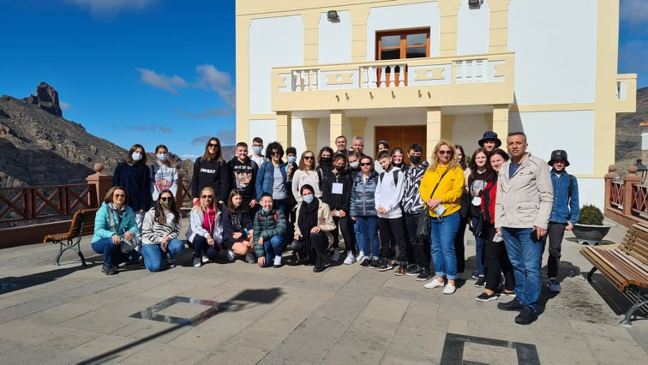
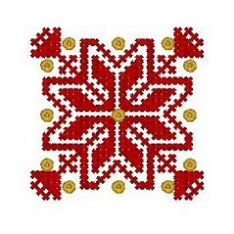
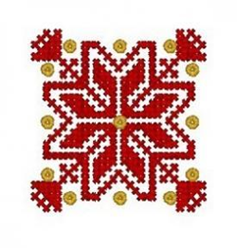
The Dissemination of the Mobility in Gran Canaria within the Erasmus+ project
”Folklorica” 2019-2022

Slide 2
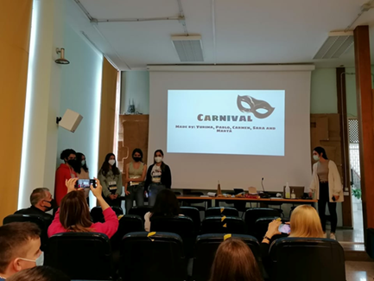
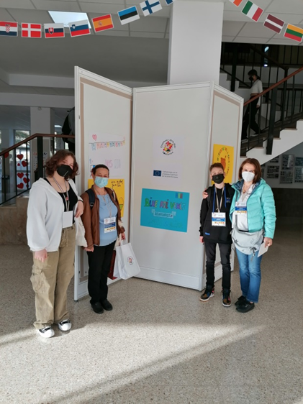
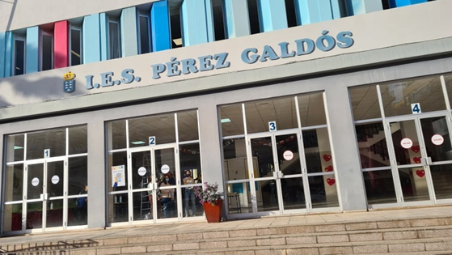
The first day of the short-term exchange of groups of pupils began with a warm welcome at school. All the guests were kindly greeted by the Spanish team and the school authorities. After the welcome speeches of the Spanish coordinator and the director of IES Peres Galdós, it was time for presentations on the theme of the carnival and Valentine’s Day in the partner countries, prepared and presented by each participating group.

Slide 3
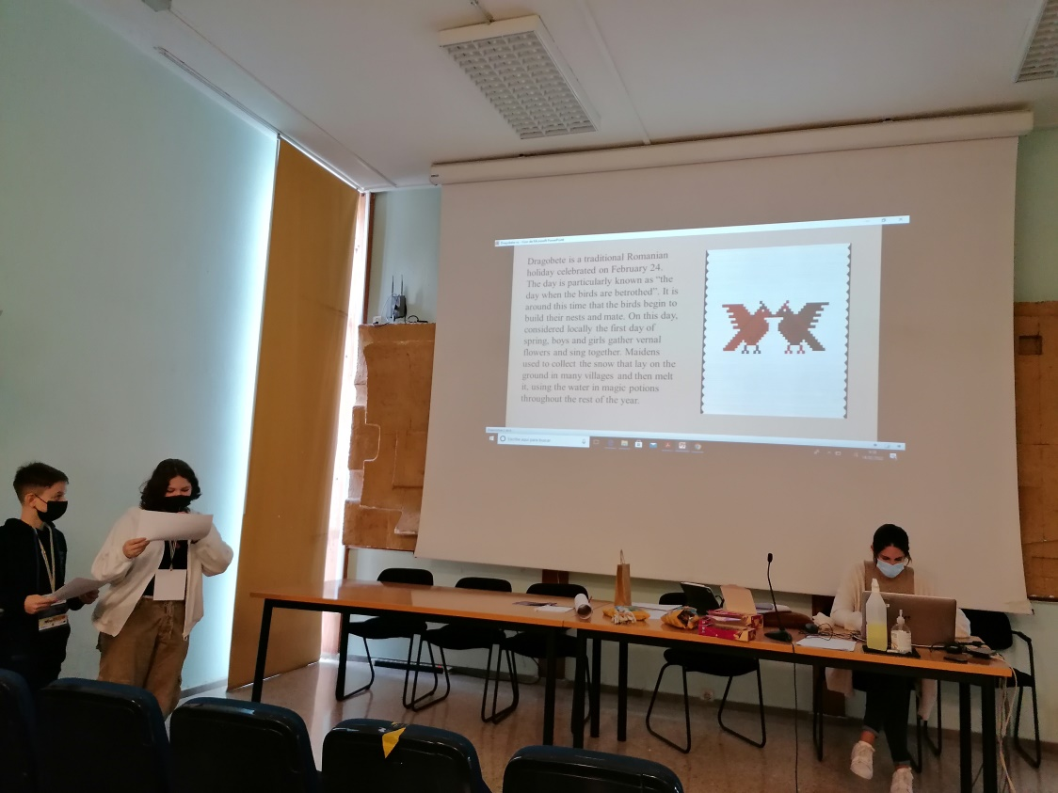
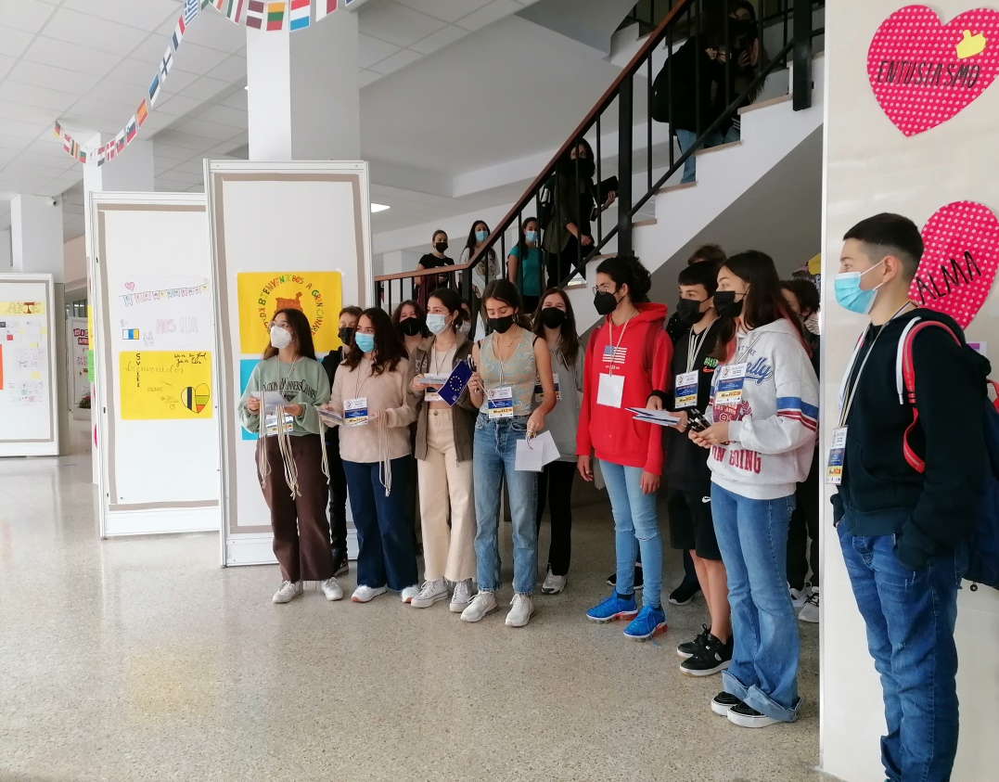
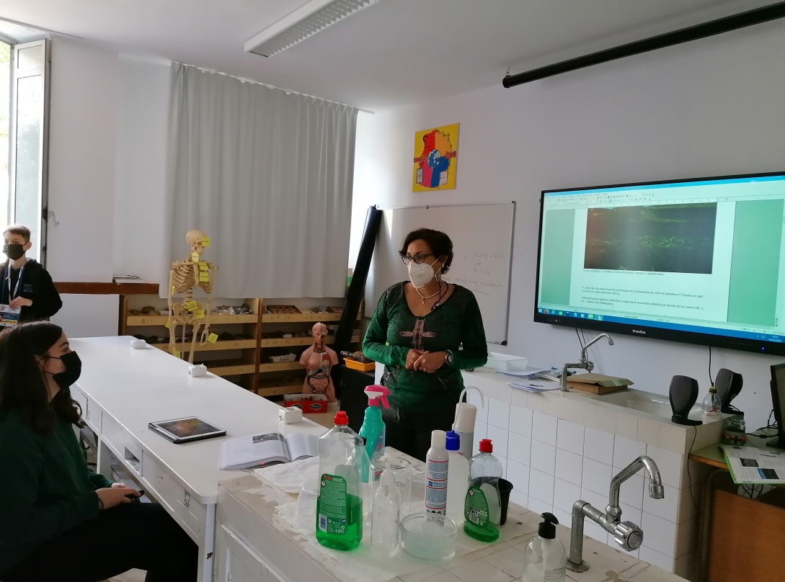
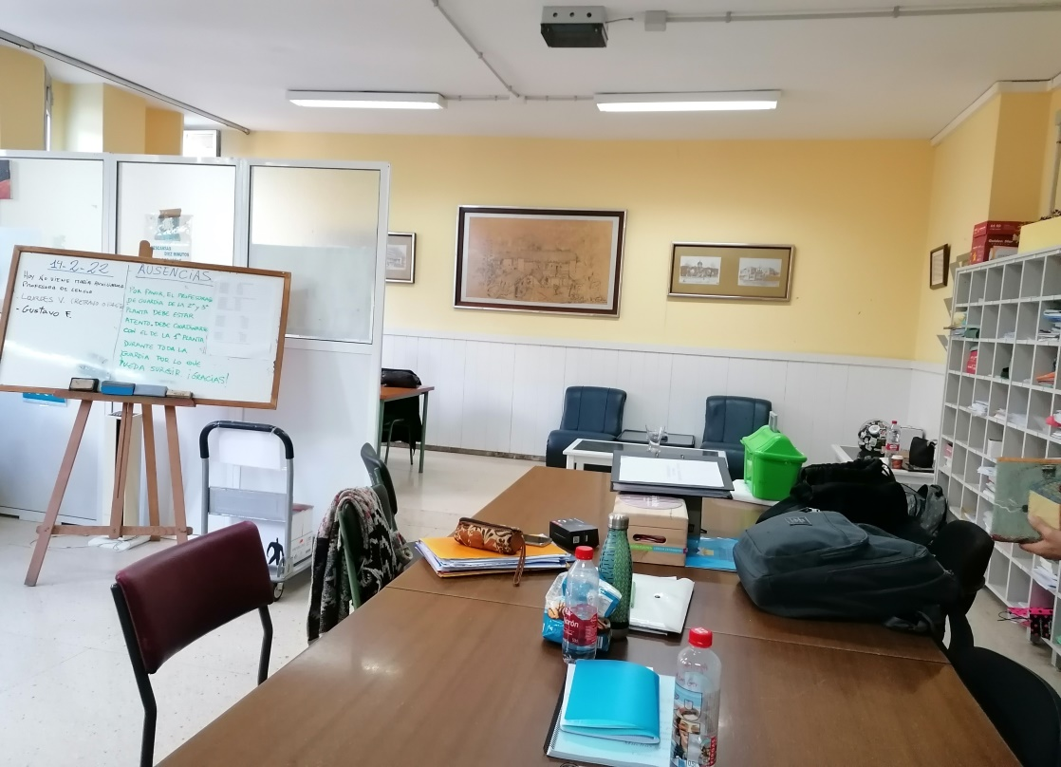

Slide 4
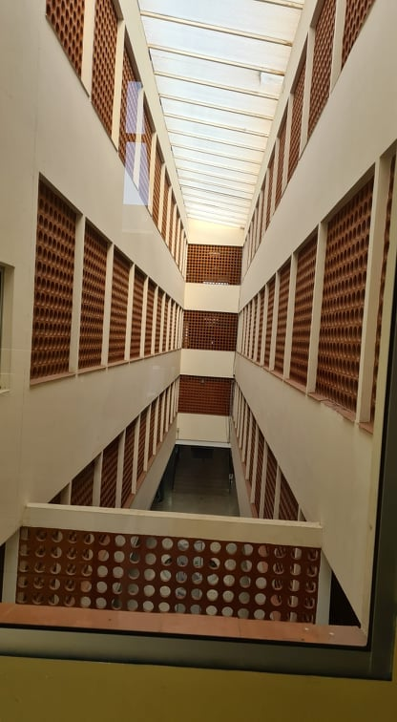
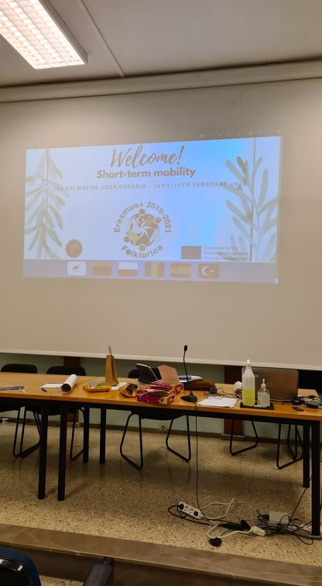
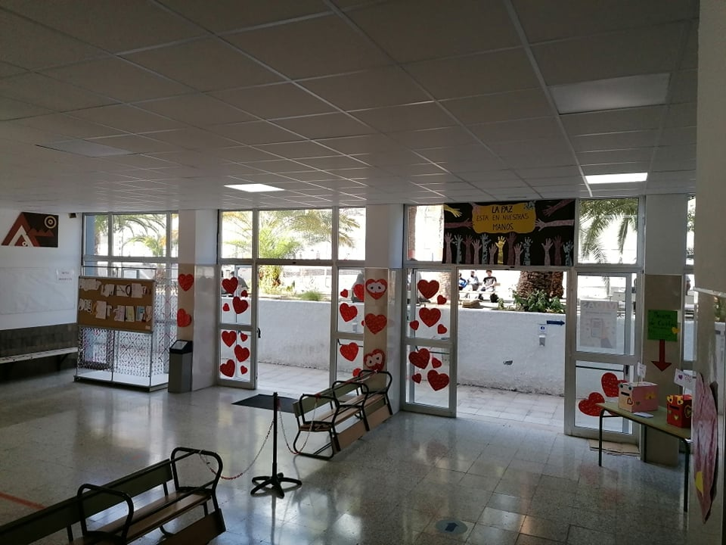
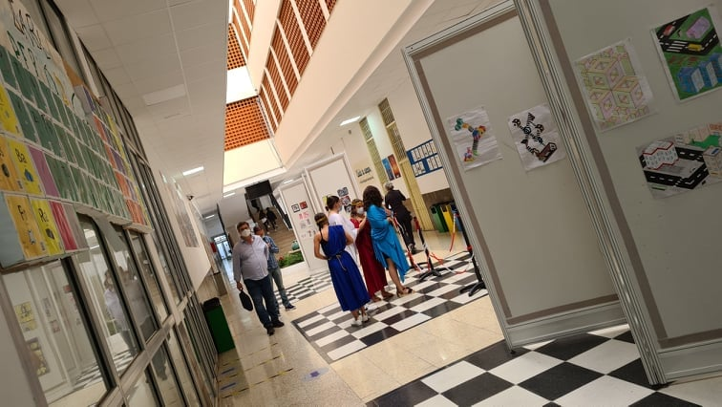
During a trip around the school, all the guests were impressed by the school decorations related to the celebration of Valentine’s Day, as well as the rehearsal of the song that shows the origin and evolution of this festival. The participants in the meeting were also shown the classrooms and, due to COVID-19 restrictions, took a very short part in lessons on various subjects.

Slide 5
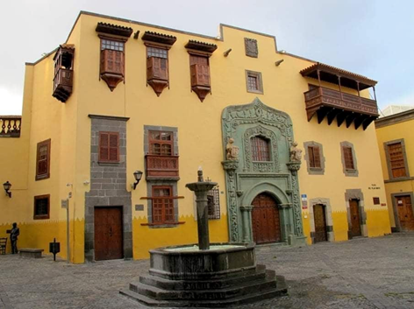
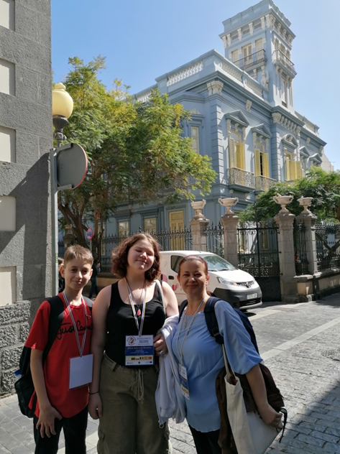
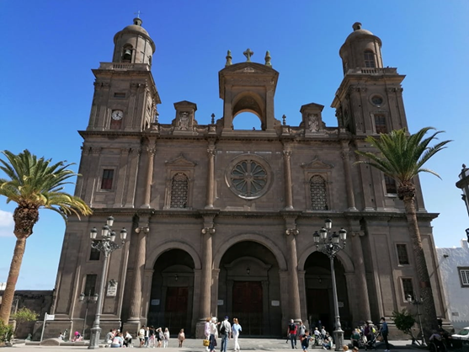

Slide 6
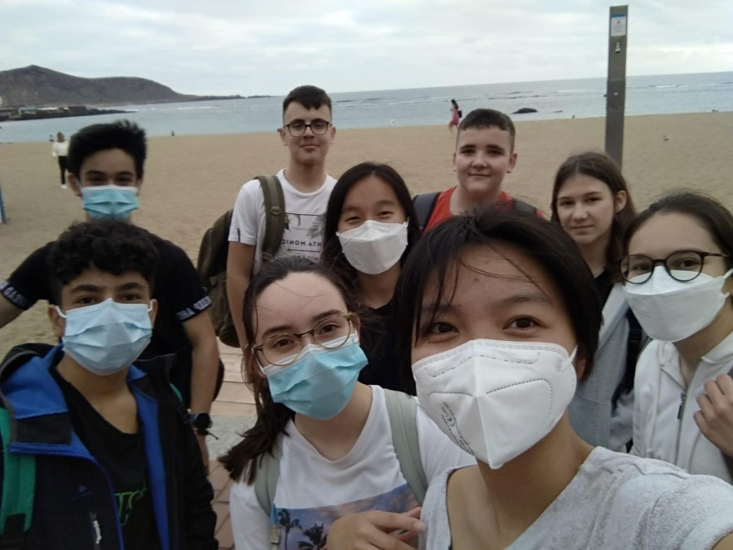
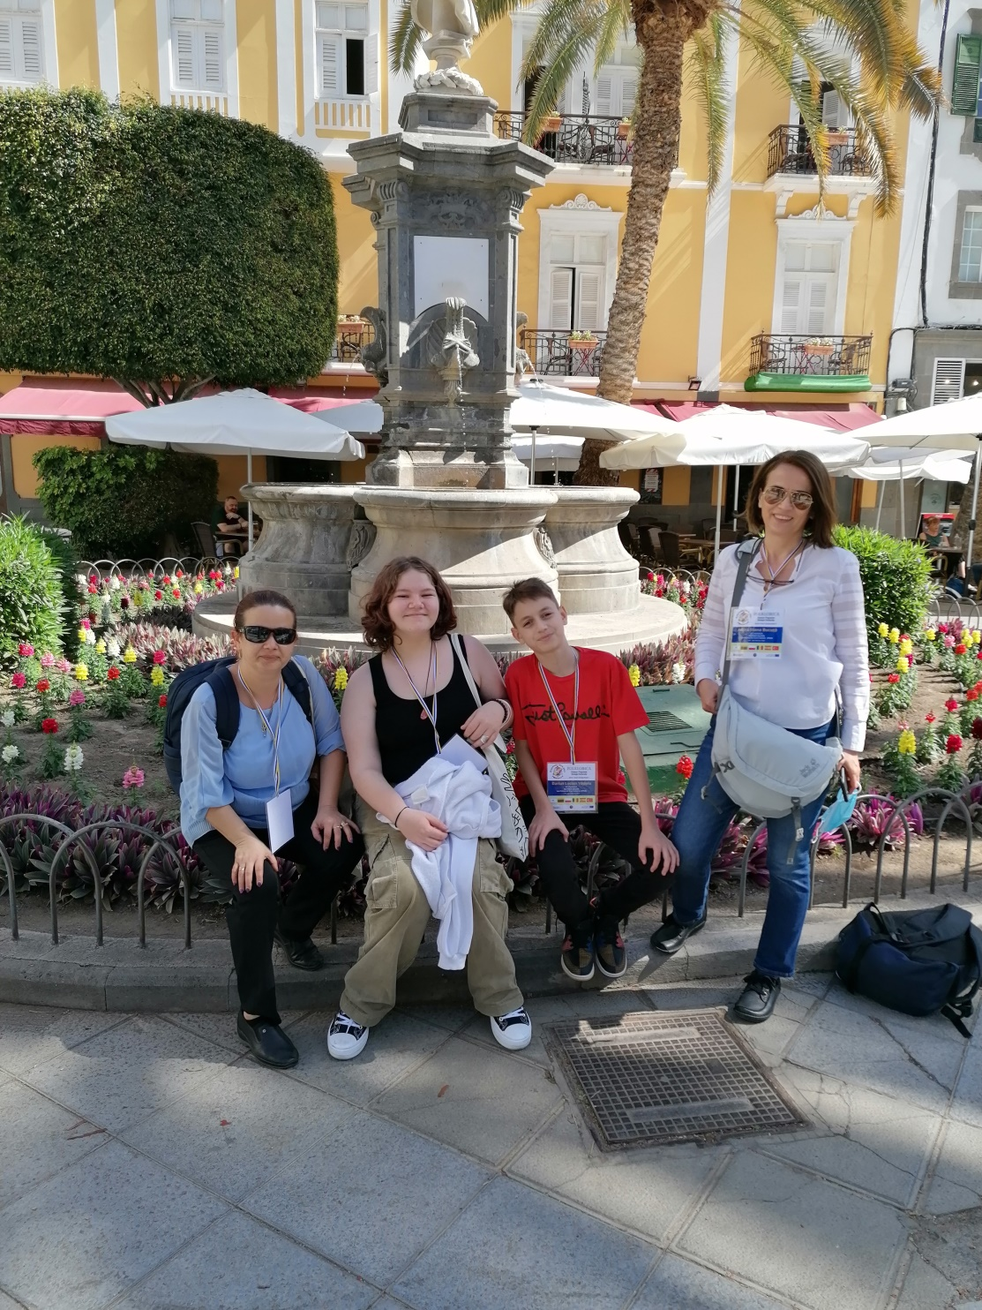
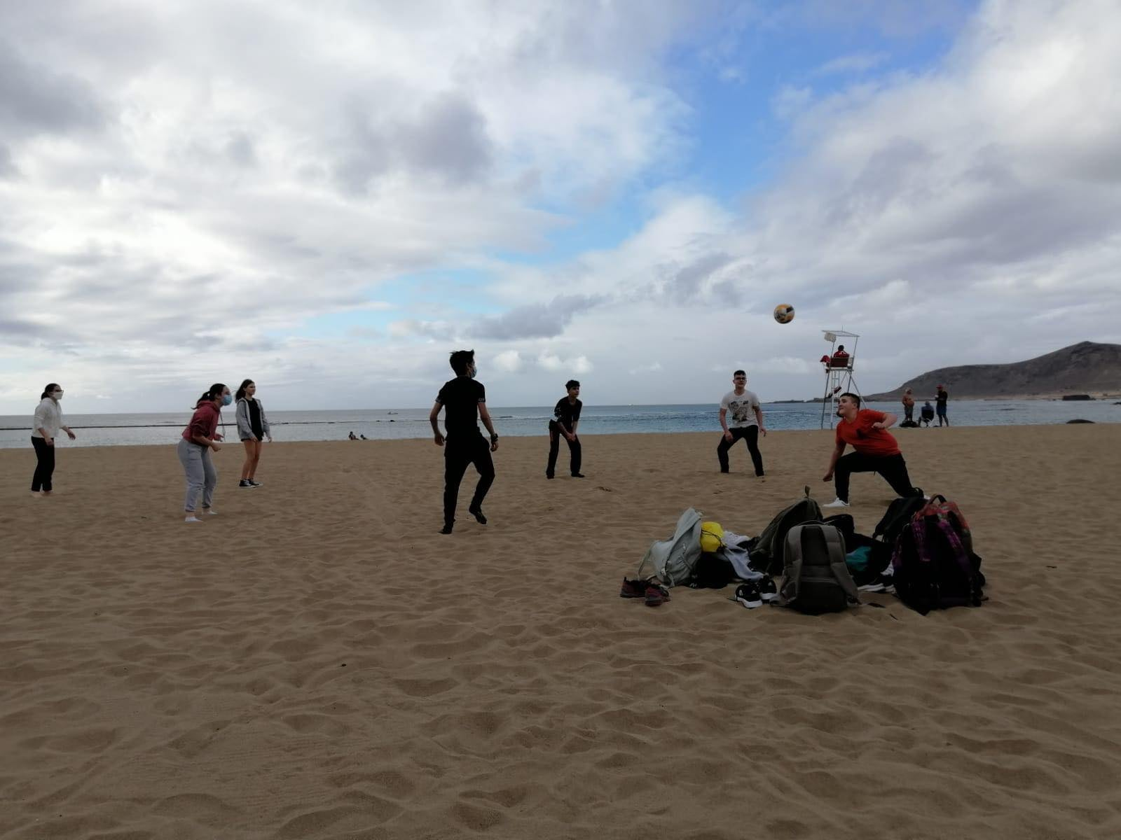

Slide 7
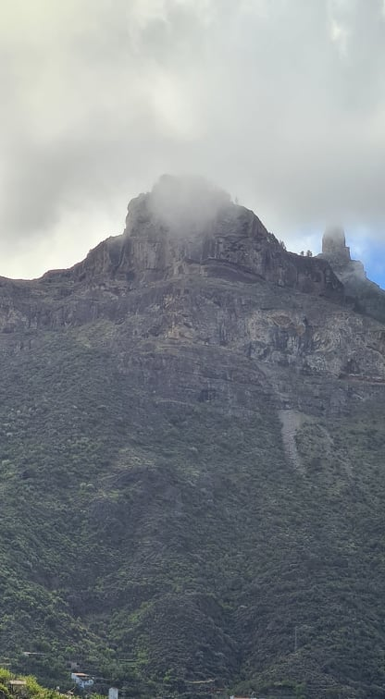
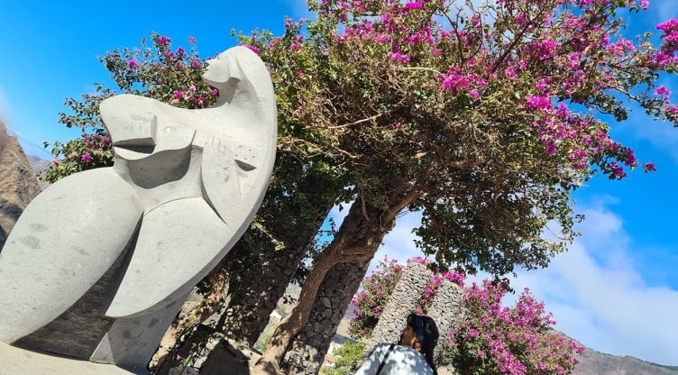
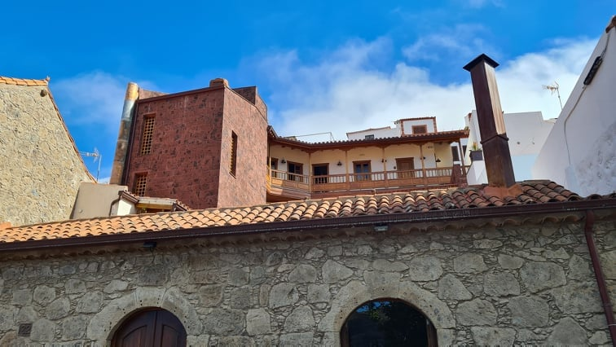
The second day of the historical and cultural adventure began with a trip to Tejeda - a village considered one of the most beautiful villages in Spain in a remarkable mountainous area that is on the UNESCO list of world cultural heritage.

Slide 8
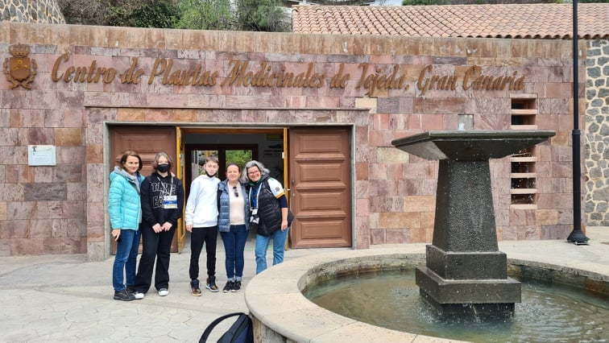
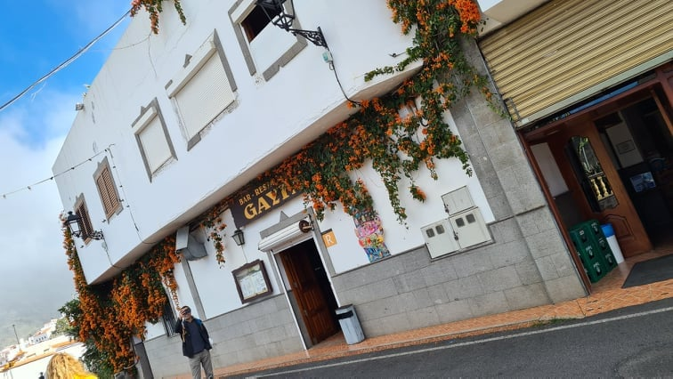
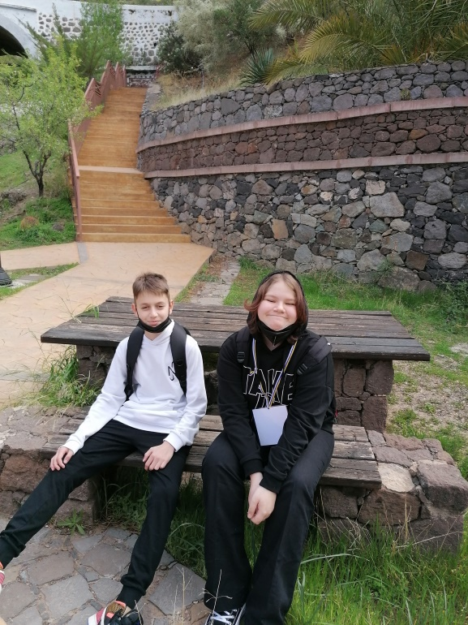
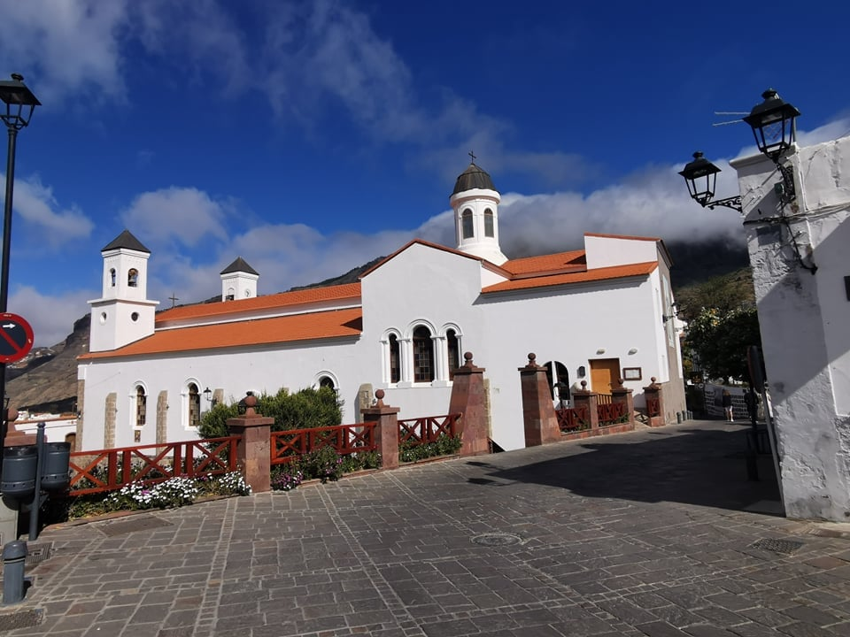

Slide 9
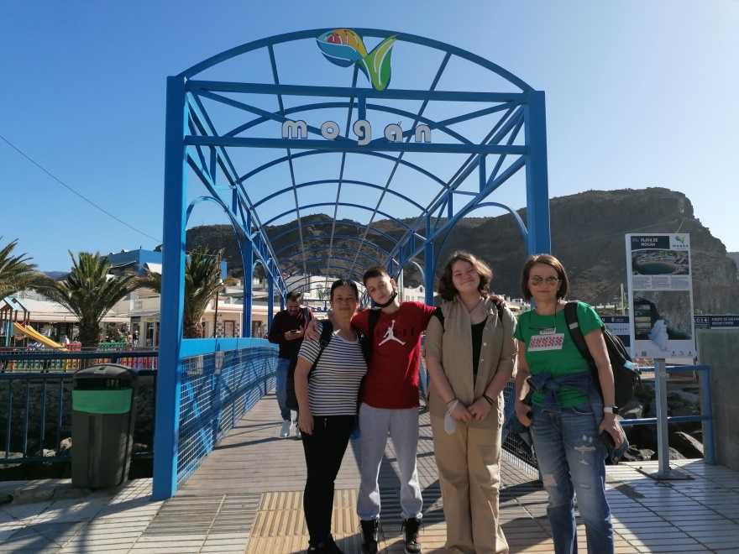
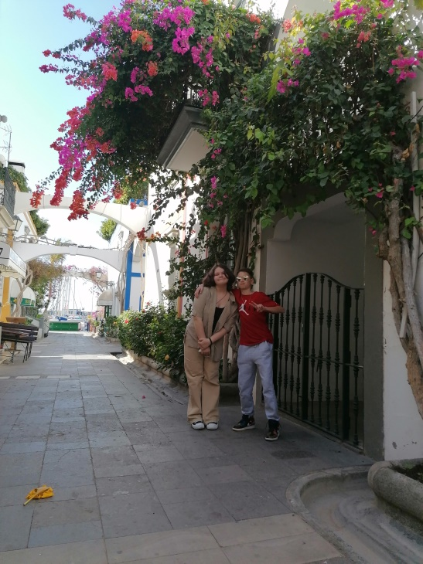
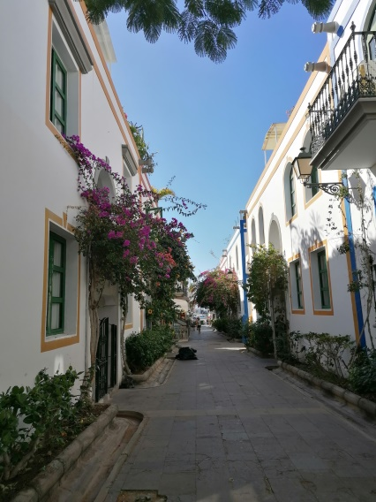
On the third day of the visit we were awakened by the beautiful sun. Our first stop was Mogán, well known for having one of the best climates in Europe.Finally, we visited Las Dunas de Maspalomas, protected sand dunes, nature reserve since 1987. They were formed from the sand on the now sheltered sea shelf, when it was laid dry in the last ice age and the wind blew the sand towards the coast of the island.

Slide 10
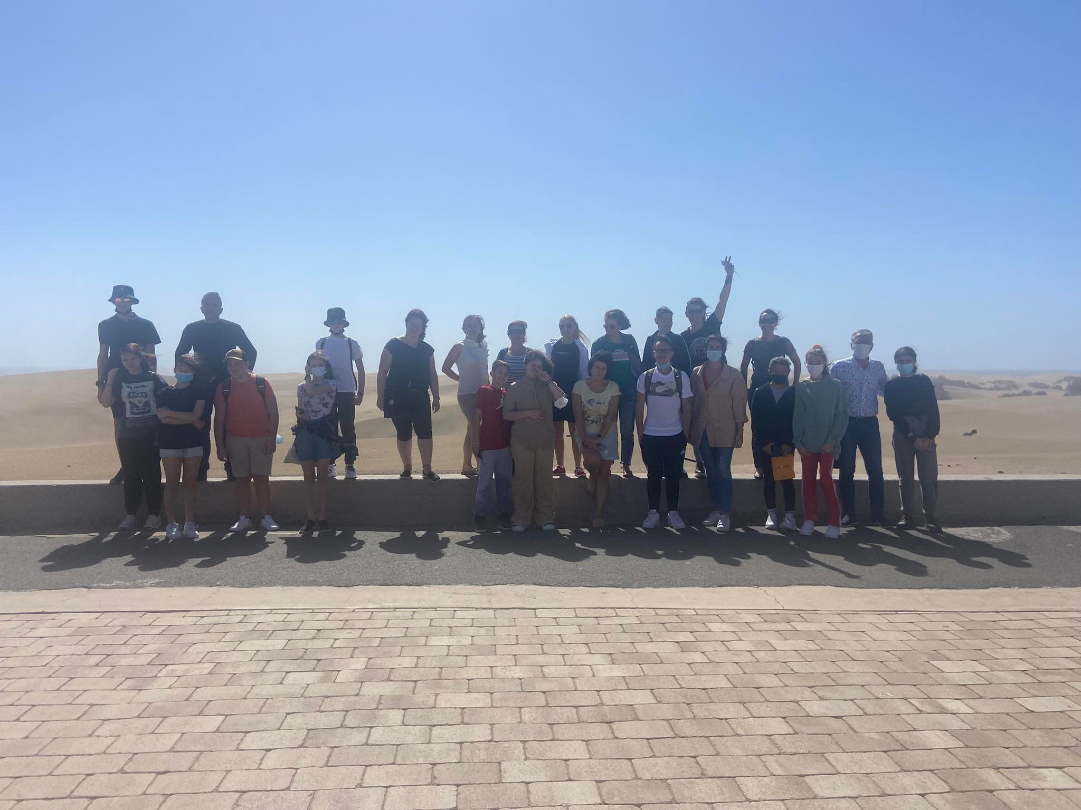

Slide 11
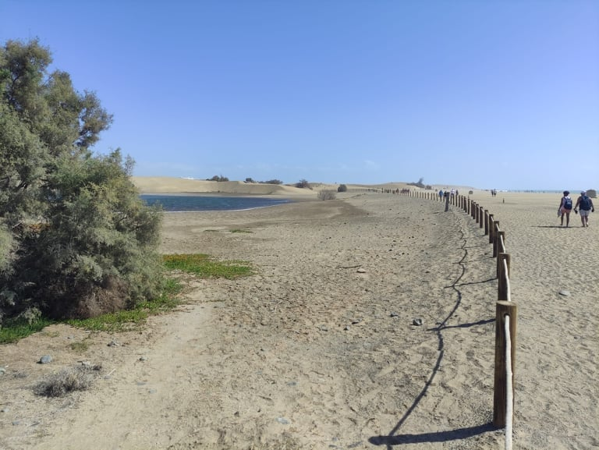
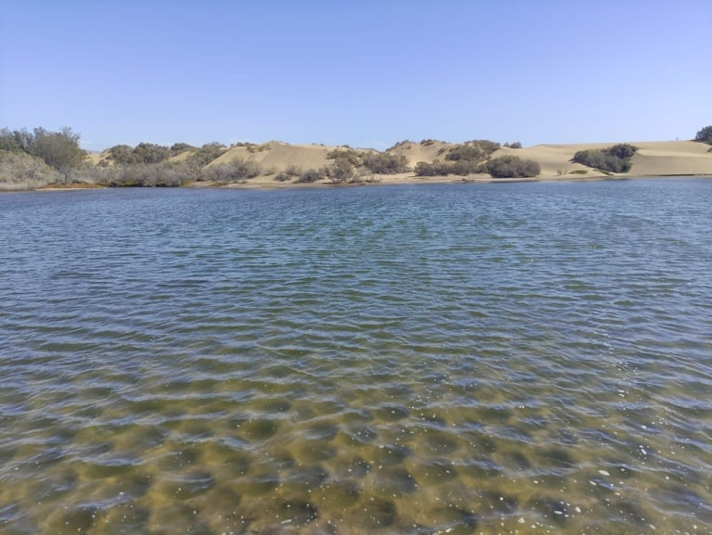
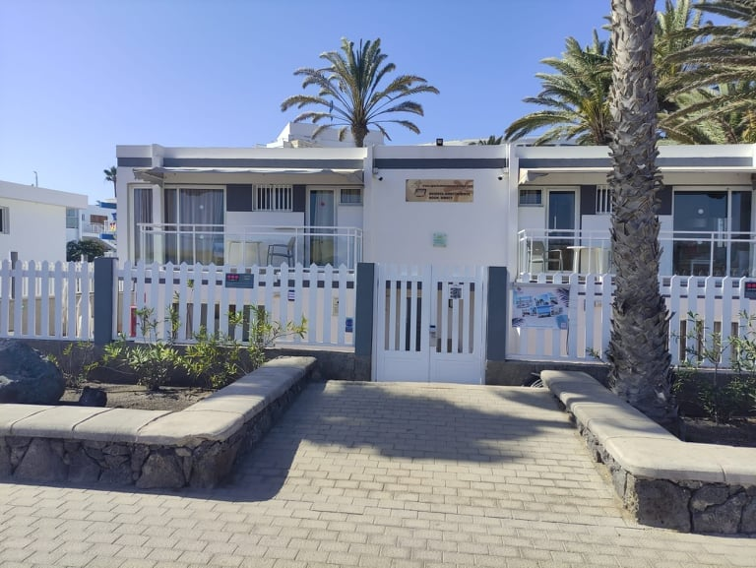
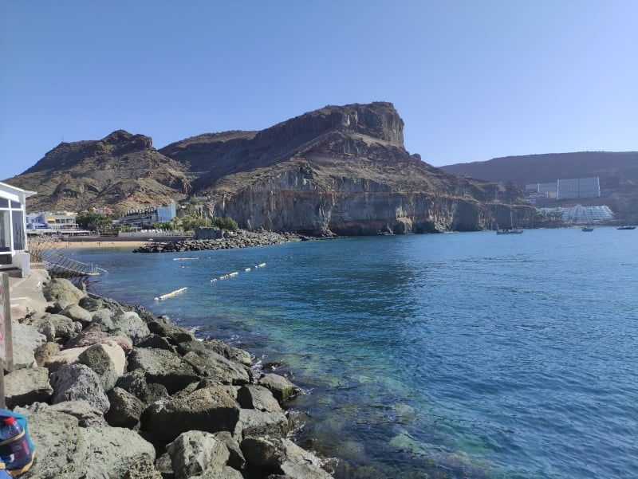

Slide 12
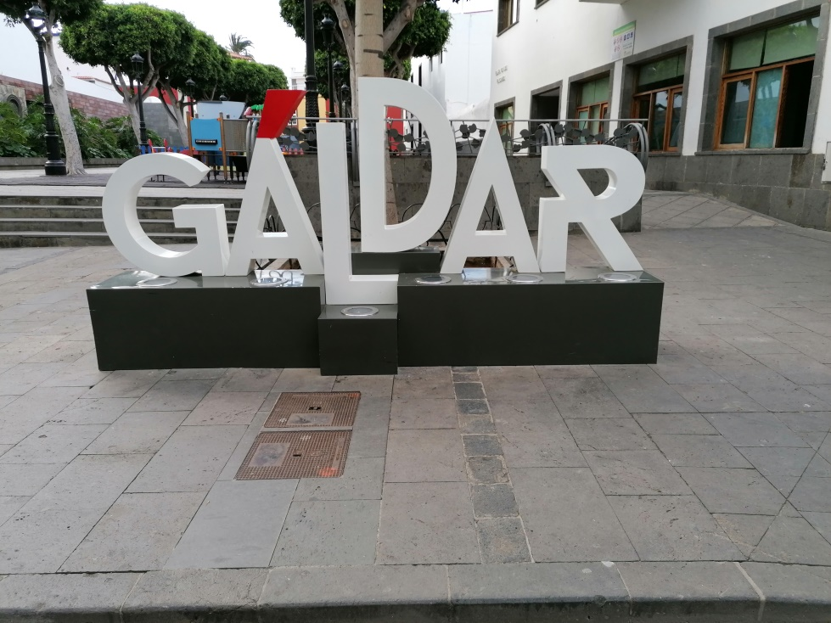
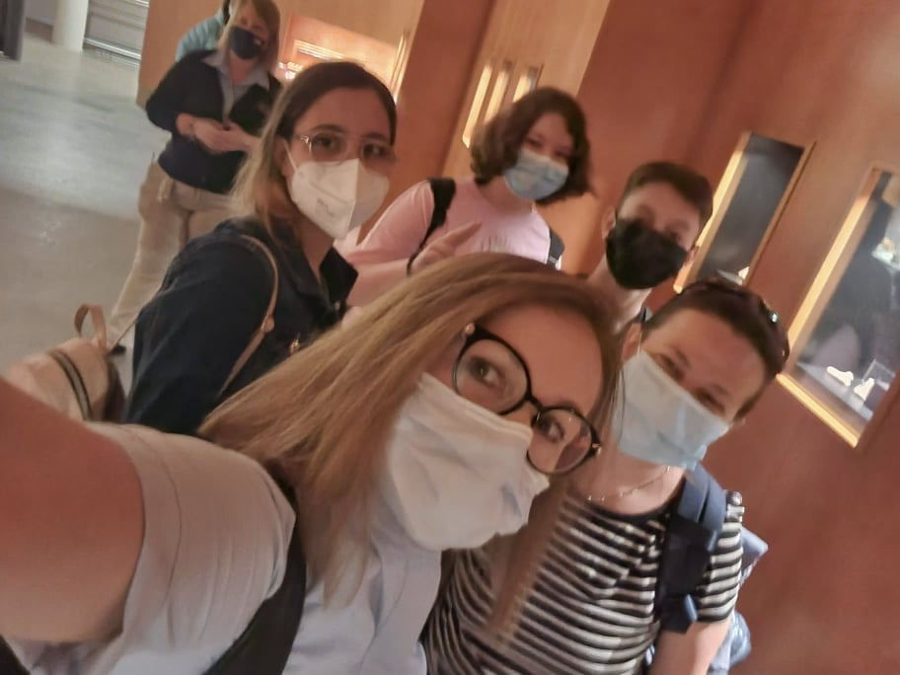
For the fourth day of the visit we left for the northern part of the island. We first stopped in the town of Gáldar, which is an area that formed one of the two kingdoms in which the island was divided in Aboriginal times. Here we visited the Cueva Pintada museum.After that, we traveled to Arucas, a town very close to the city of Las Palmas de Gran Canaria, where we visited the Iglesia Matriz de San Juan Bautista, an impressive neo-Gothic church that is also one of the symbols of Gran Canaria.

Slide 13
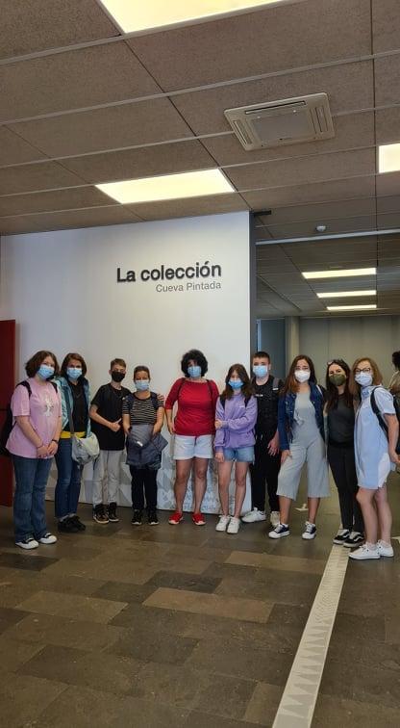
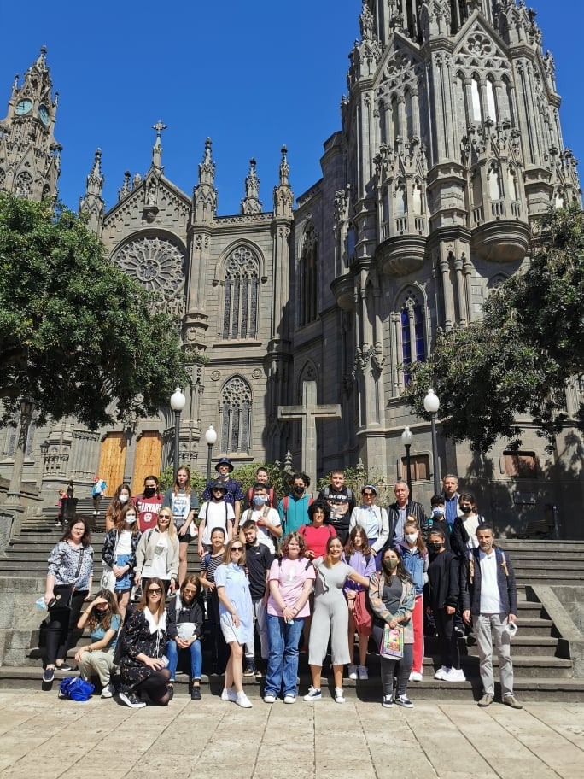

Slide 14
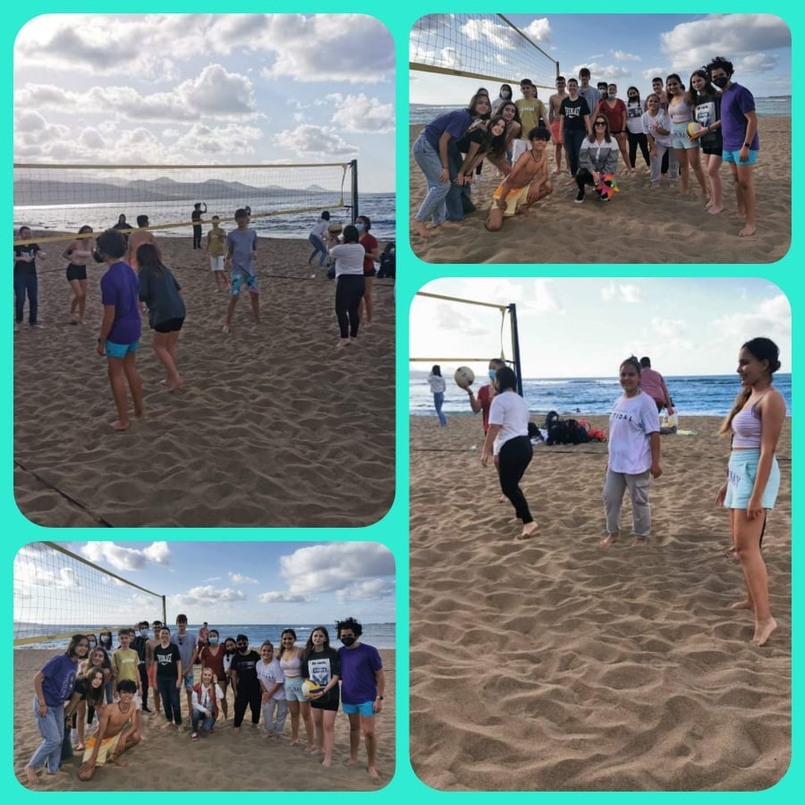

Slide 15
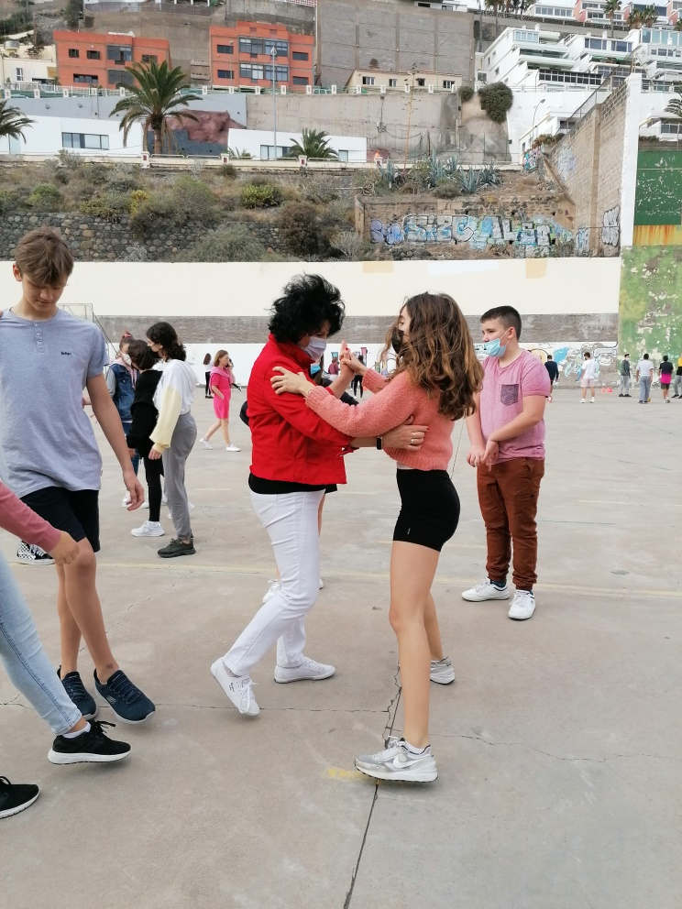
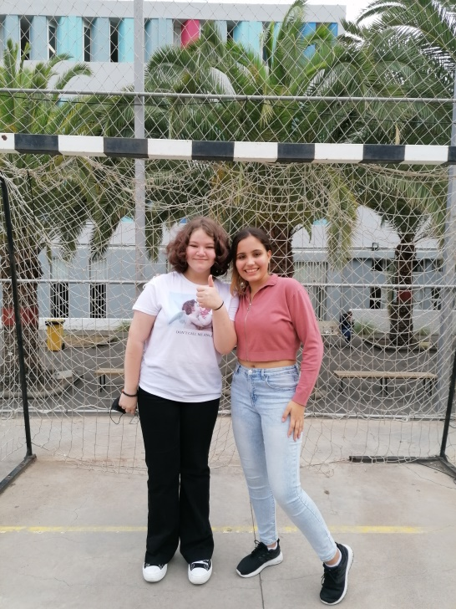
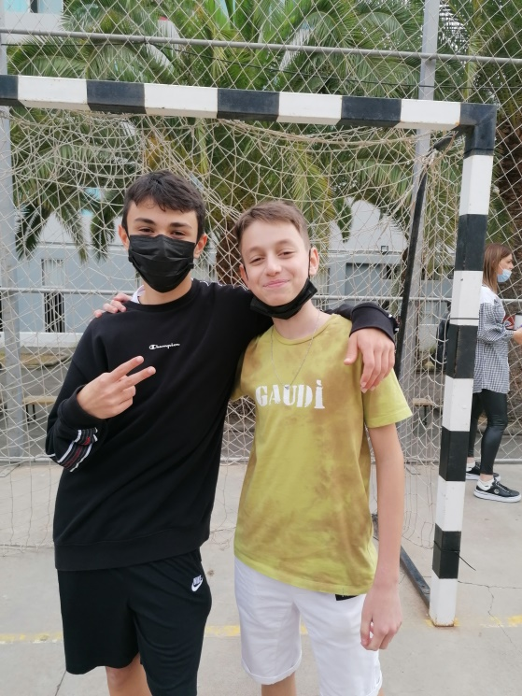
On the last day, students and teachers said goodbye to high school. The first hour I spent was learning the “Sedan” dance, a typical folk dance on the island of La Palma. While the teachers had the final staff meeting, the pupils were able to participate in a carnival workshop organized by the VET students of the high school in order to commemorate the famous carnival in Las Palmas de Gran Canaria.

Slide 16
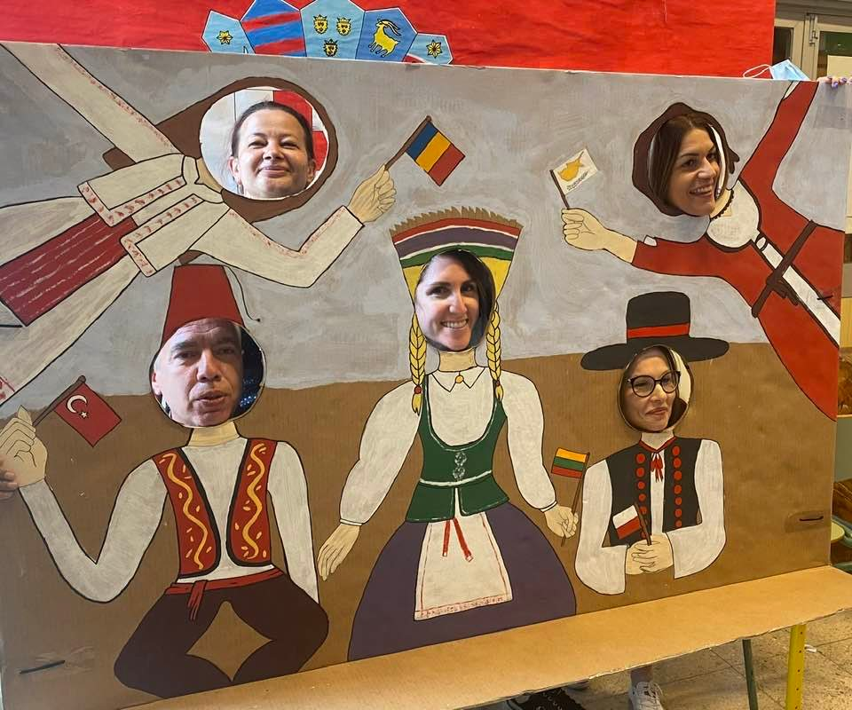
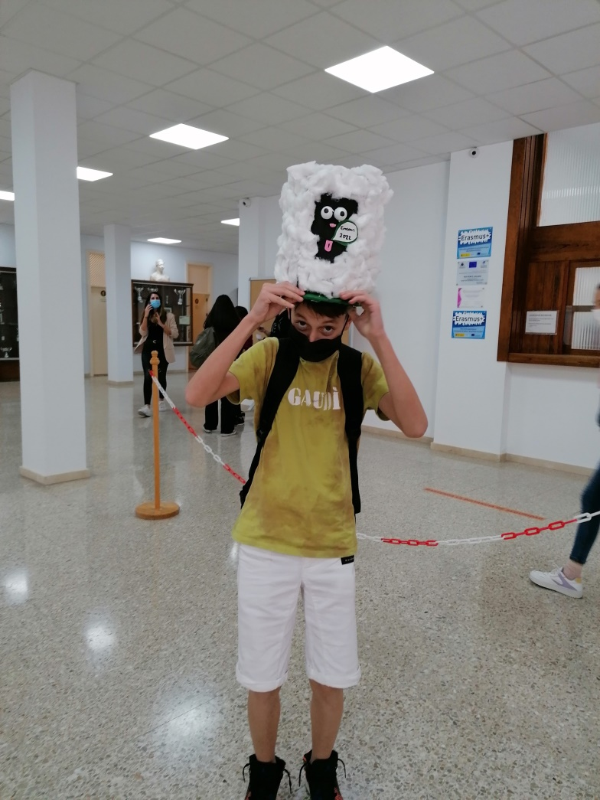
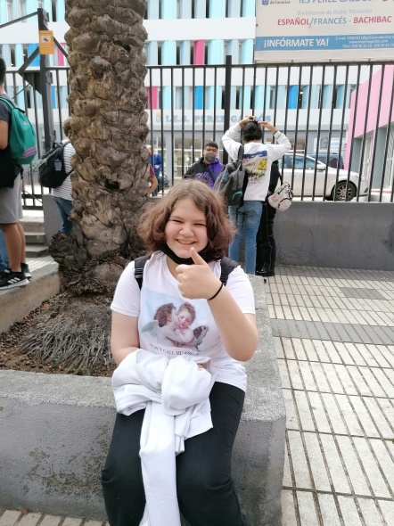
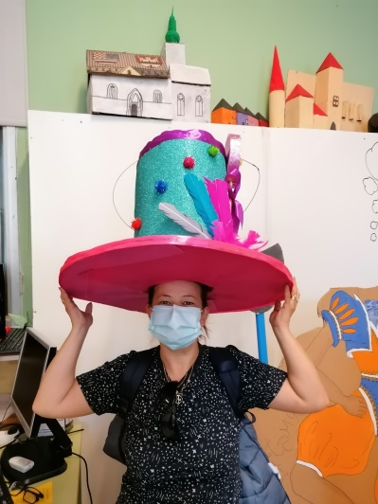

Slide 17
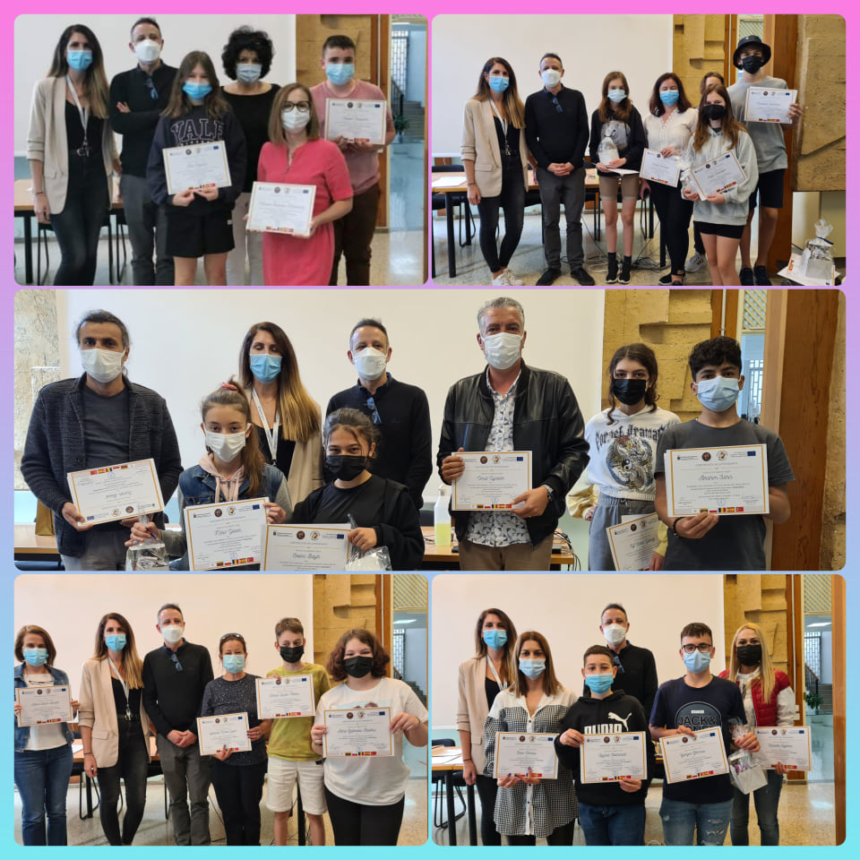

Slide 18
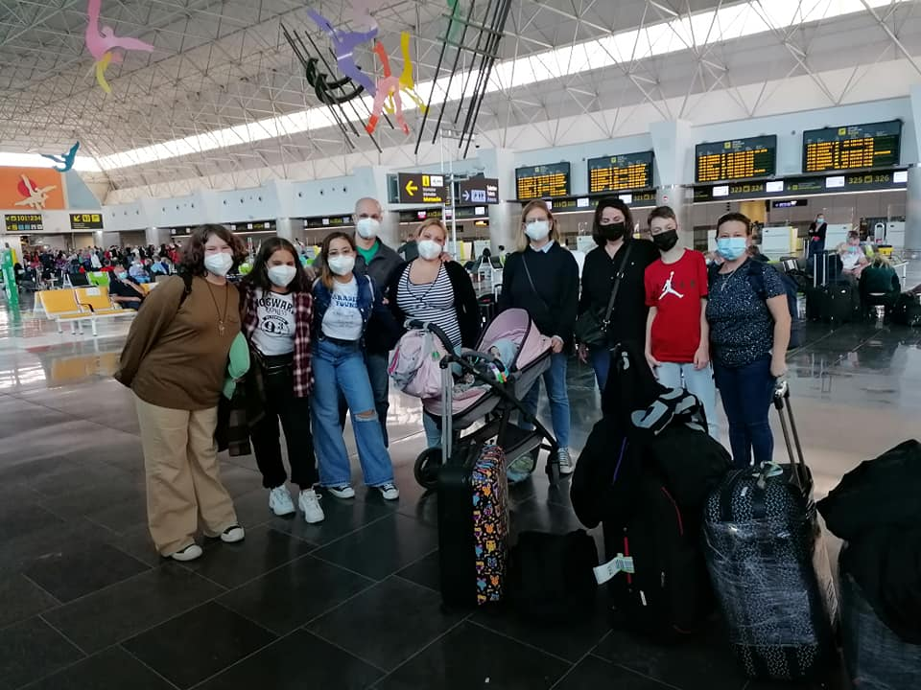
Thank you for your attention!

