Slide 1
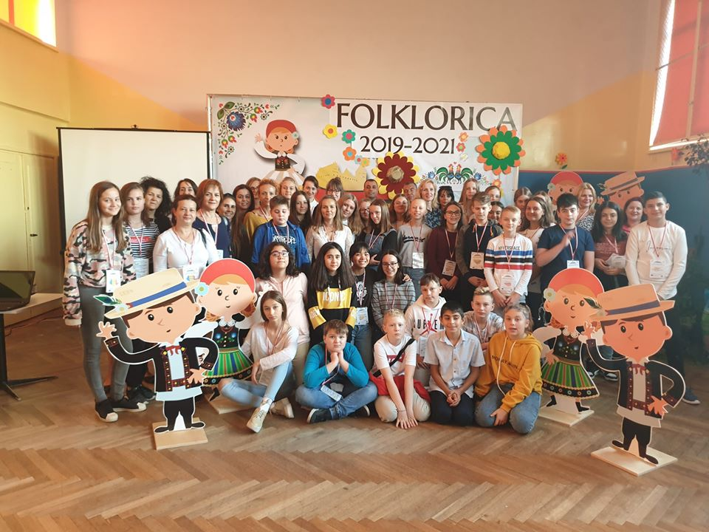
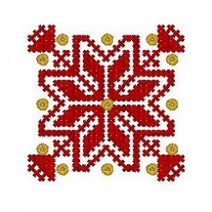
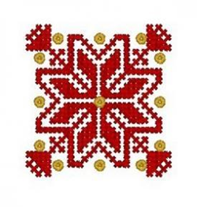
The Dissemination of the Mobility in
Poland within the Erasmus + project
”Folklorica” 2019-2021

Slide 2
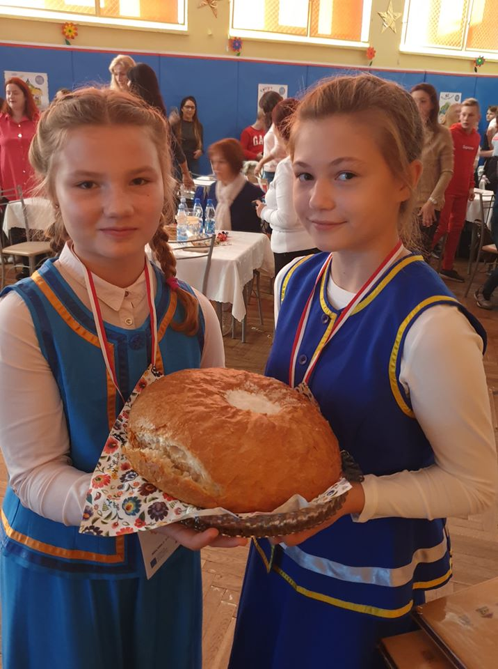
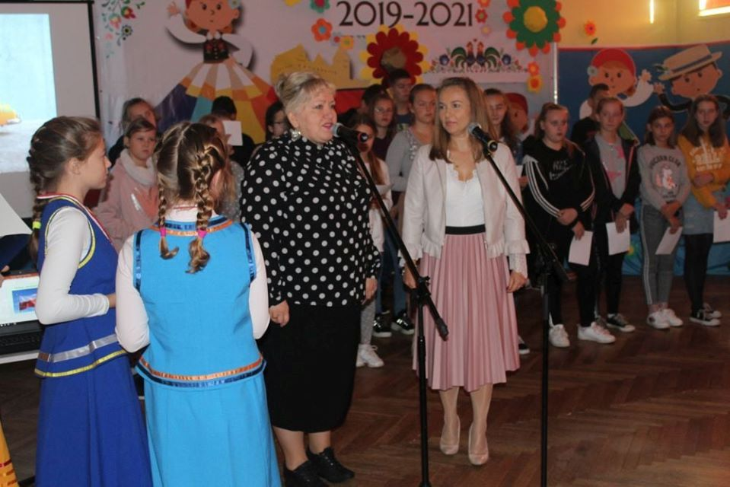
The first day of mobility in Poland, the coordinating country of
the project, we all spent it at school. The participants were
welcomed in a traditional manner with bread and salt by the
Erasmus + team, led by Mrs. Dorota
Dorozińska, the headmaster of the
host school from Nidzica and
Mrs. Mariola Podolska-Maculewicz,
the coordinator of this project.

Slide 3
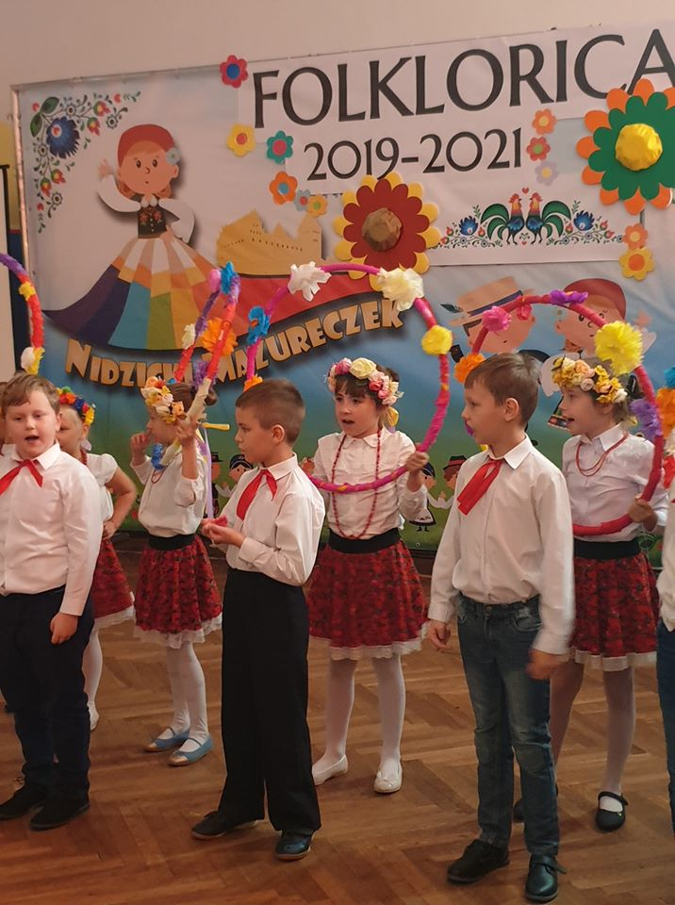
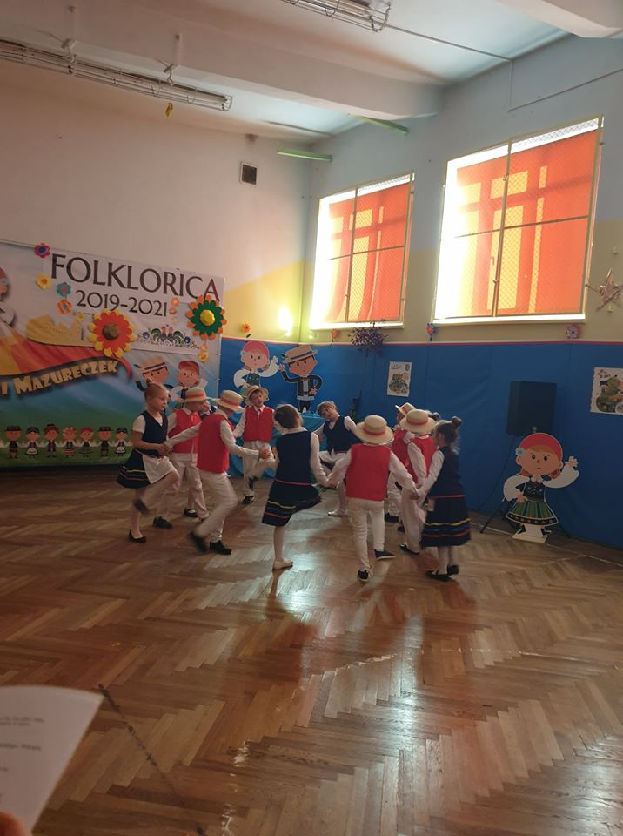
Then Polish dances and wedding songs were presented,
prepared and interpreted by the smallest pupils of
the school, as well and a modern cheerleading dance.

Slide 4
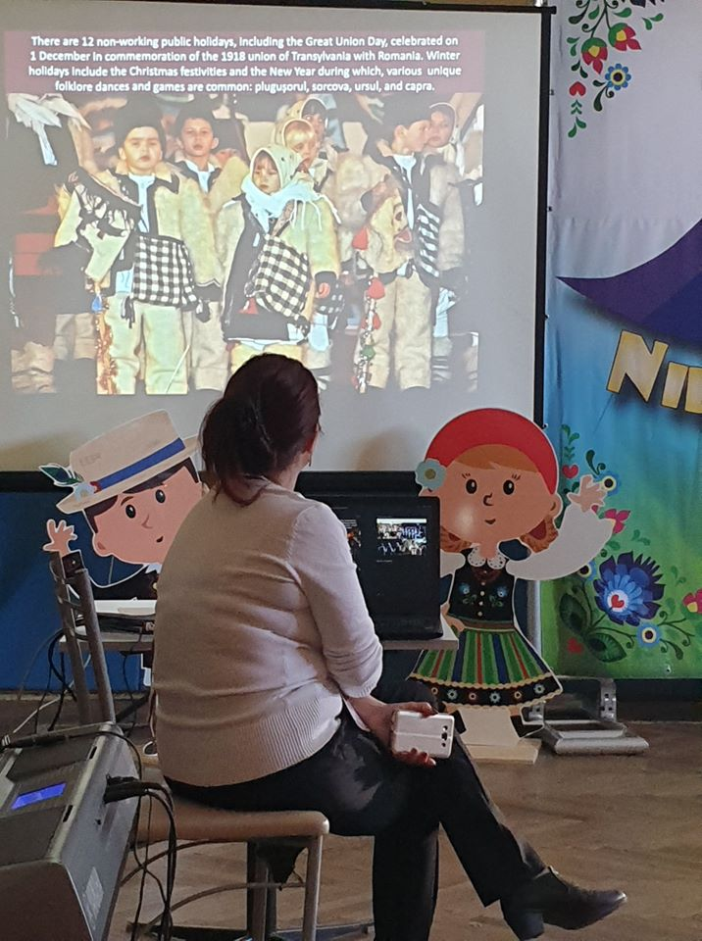
In order to get to know each partner country better, a
guessing game was held on partner countries related to
national symbols and other important information. The
pupils from each partner school also presented some
important aspects of their countries, cities and schools
through video presentations.
In the afternoon, we chose the logo of the project. It was not
an easy task because they were many interesting drawings. The winning logo was designed by
a gifted pupil from Gaziantep, Turkey.

Slide 5
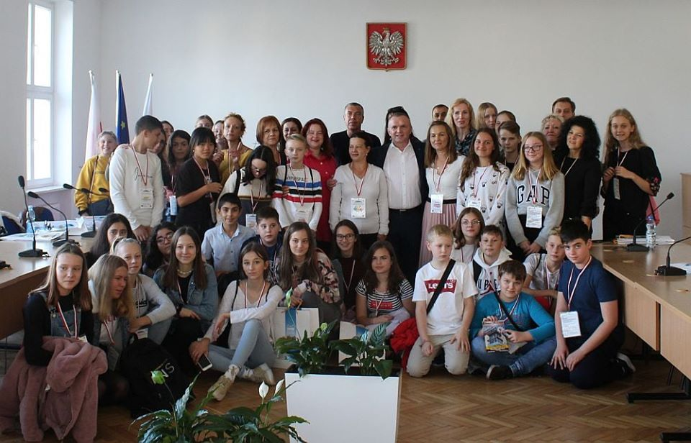
Also in the afternoon, we visited the Town Hall and had a meeting with
the mayor of Nidzica, Mr. Jacek Kosmala, who familiarized the
members of the Erasmus project with the city and the region, also
responding to questions related to aspects of the Polish educational system.

Slide 6
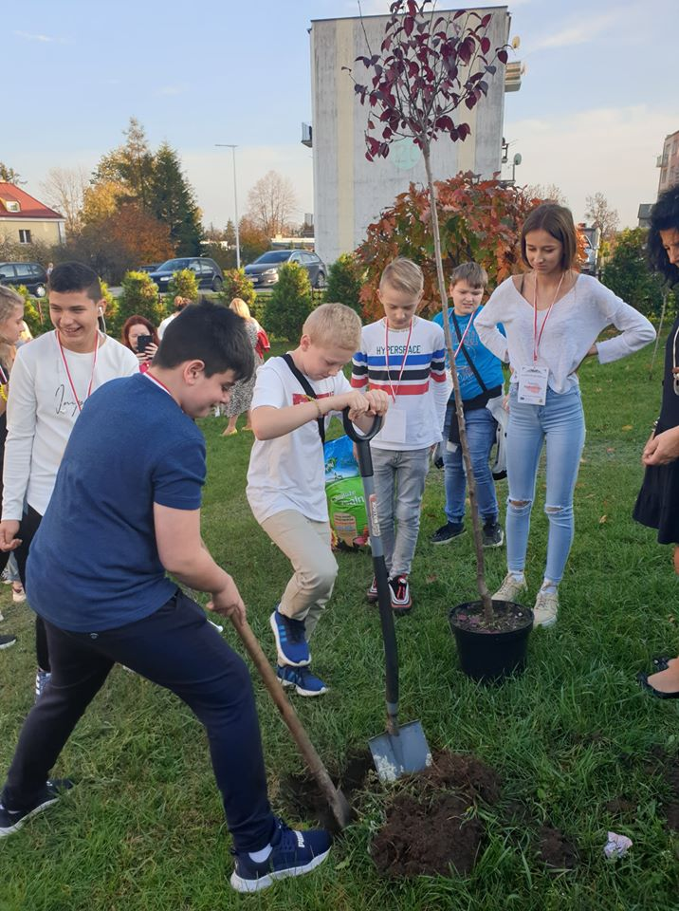
In order to symbolize the beginning of our common journey through the world of folklore, all the pupils participating in this mobility planted the ”Folklorica” Erasmus+ tree, which is certainly a very good starting point for our cooperation.

Slide 7
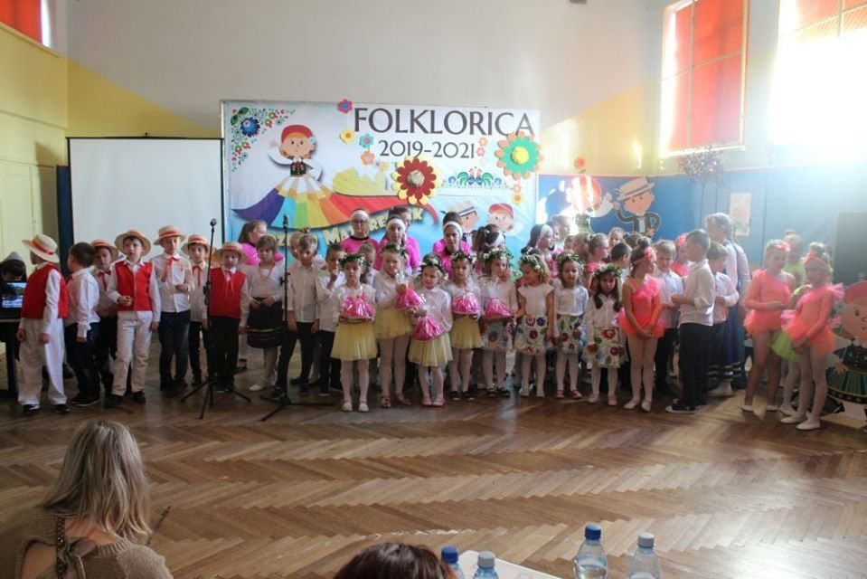
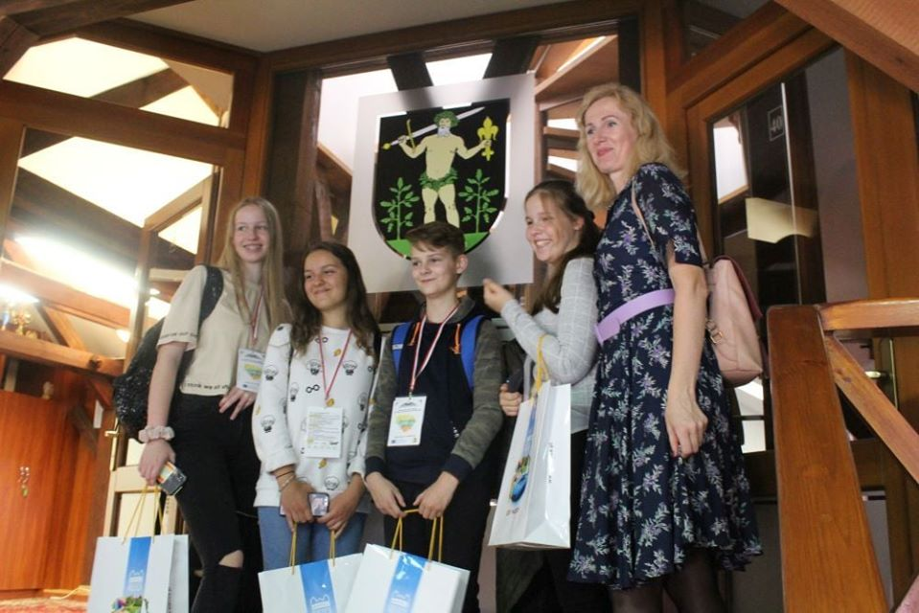
The day ended with a lot of fun. The pupils from all countries were taught the regional dance called "Szot". Not only did they learn it fast, but they also proved to be very good dancers. The teachers participating in the mobility had a meeting, during which they discussed the most important aspects of the project. In the evening, in the houses of Polish hosts, the pupils had the chance to learn about traditional customs.

Slide 8
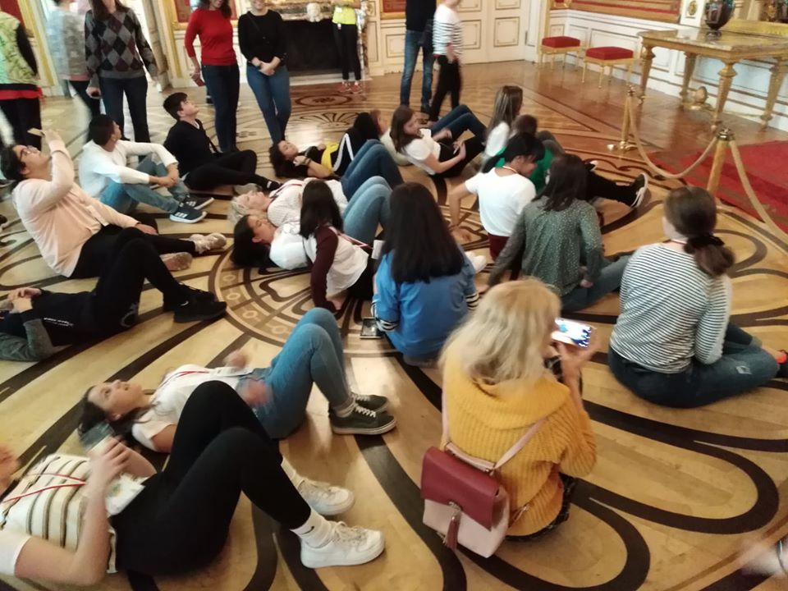
The second day of the mobility in Poland started early in the morning
and it was full of interesting, useful and appropriate activities.

Slide 9
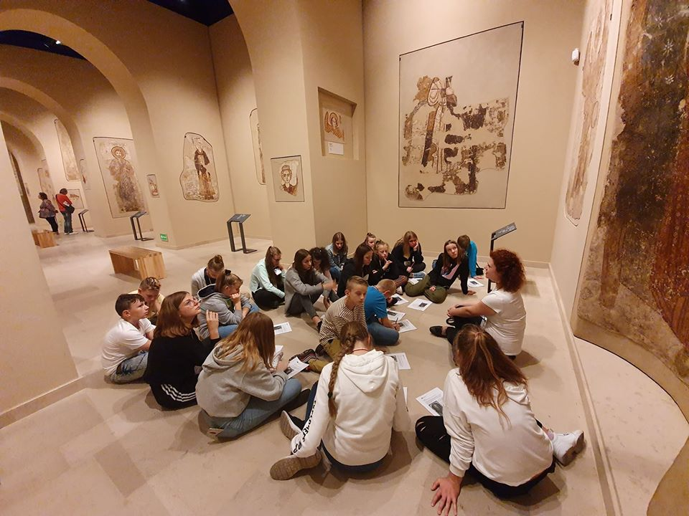
It was the day we got to know and admire a
lot of Polish culture and cultural heritage.

Slide 10
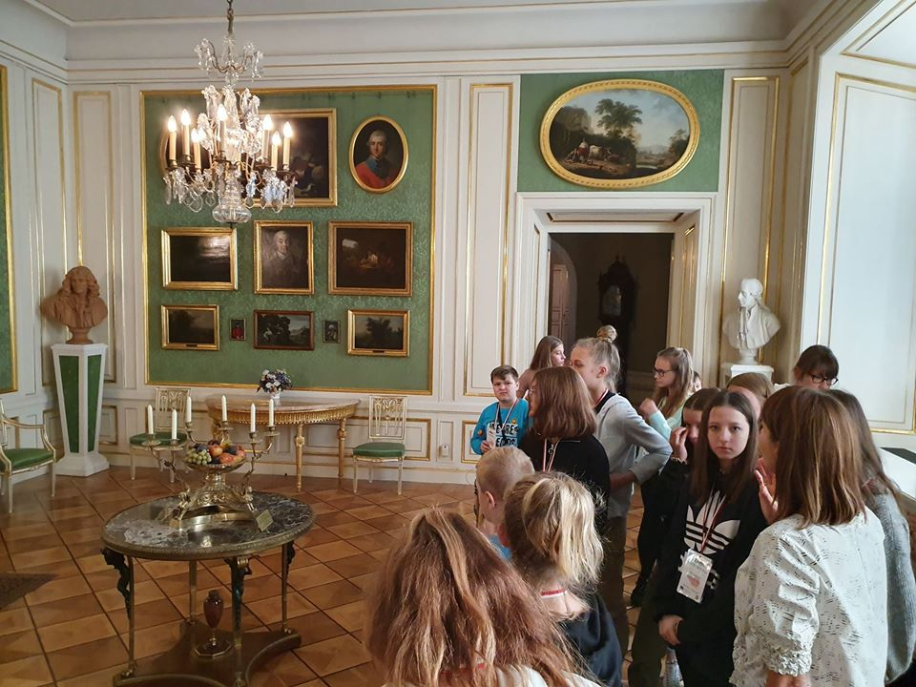
We visited many tourist places in Warsaw, the capital of Poland.

Slide 11
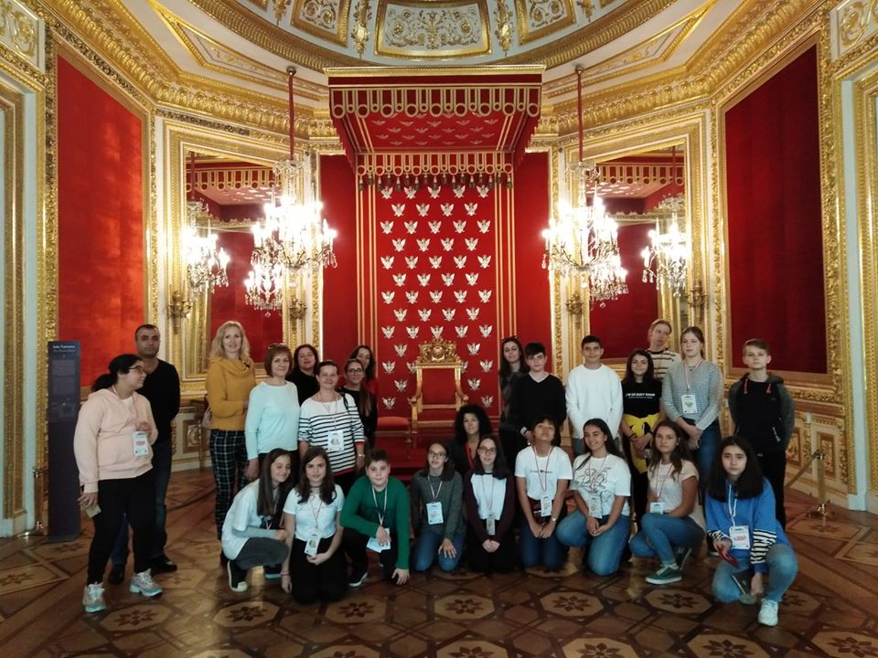
We were shown the Royal Castle and the National Museum by guides.

Slide 12
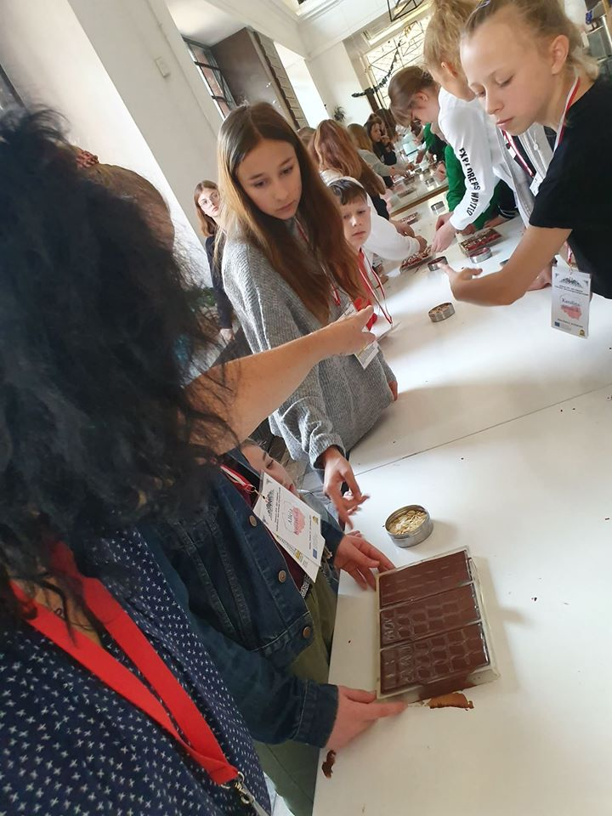
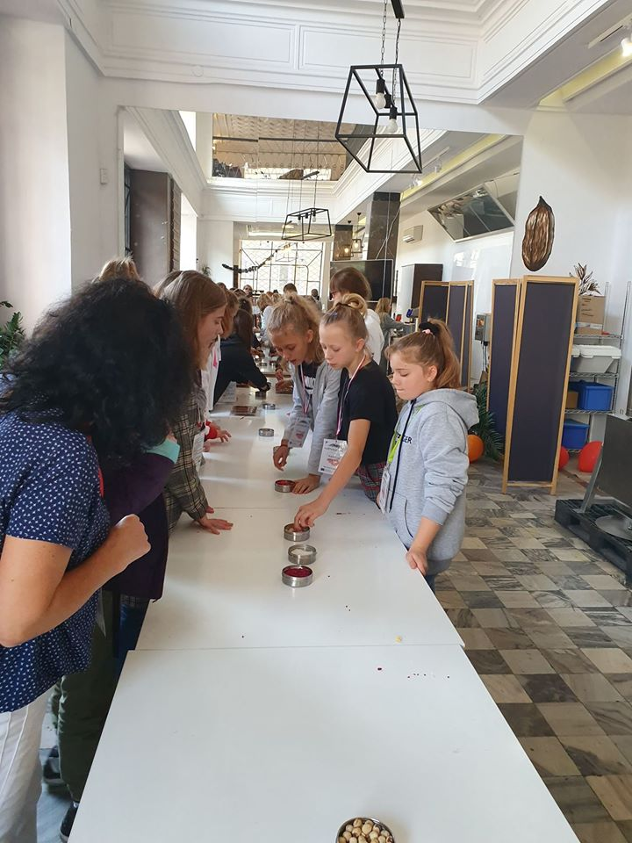
We also took part in a workshop to make a delicious Polish
chocolate. Tired, but satisfied with the fact that the guests knew
so much Polish national heritage, we returned late in the evening.

Slide 13
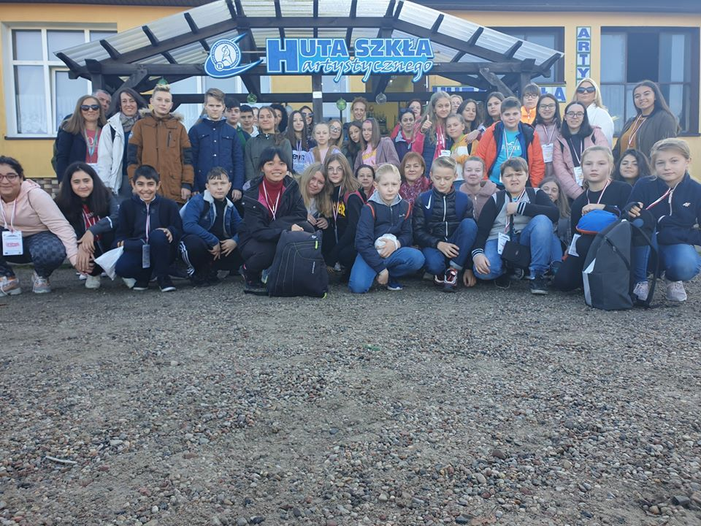
The third day of mobility took us back in time, starting with a visit to a small glass factory where we could find out how artistic glass
is traditionally produced and admired the art of workers’ work.

Slide 14
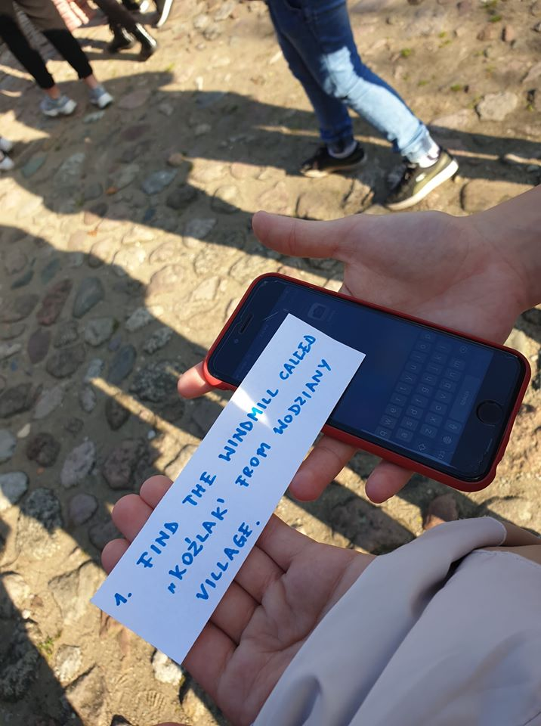
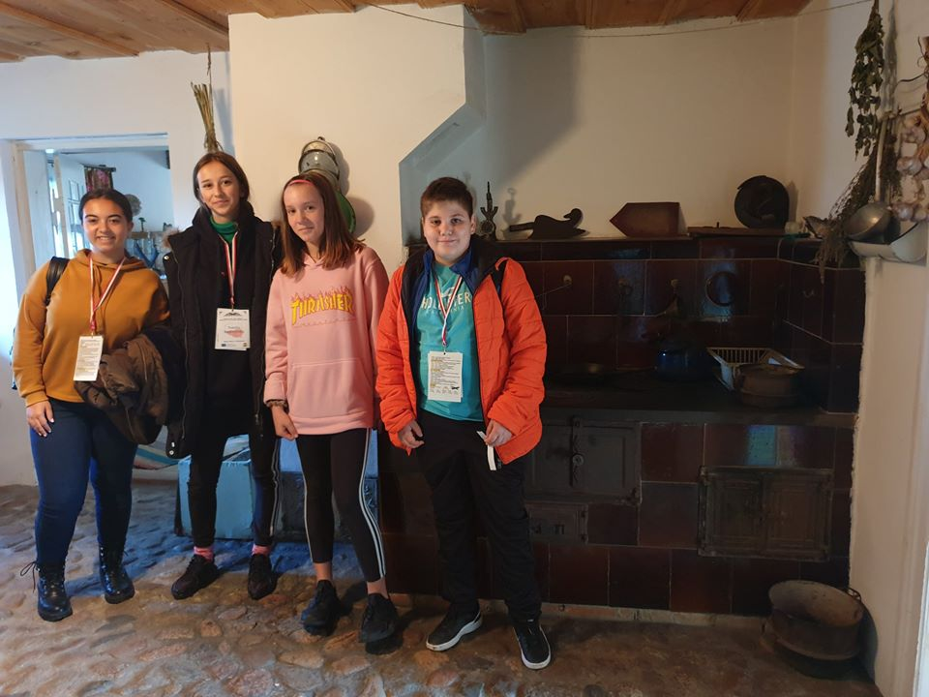
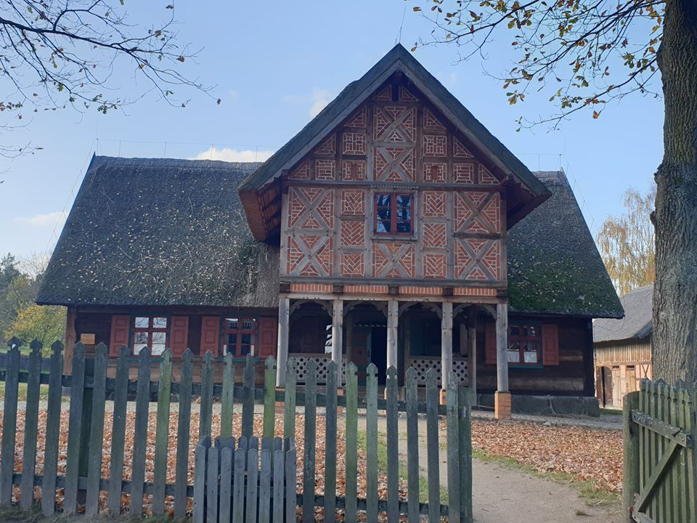
At the Outdoor Ethnographic Museum in Olsztynek, the pupils
had to find some objects there, such as an old windmill or
a small chapel and take pictures to make a themed poster.

Slide 15
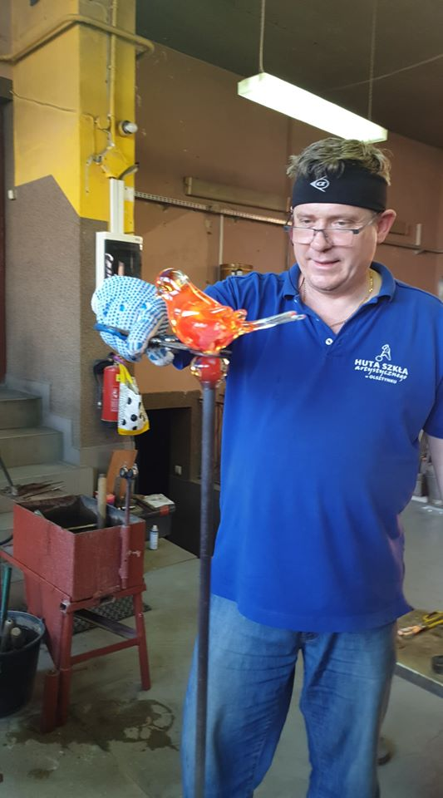
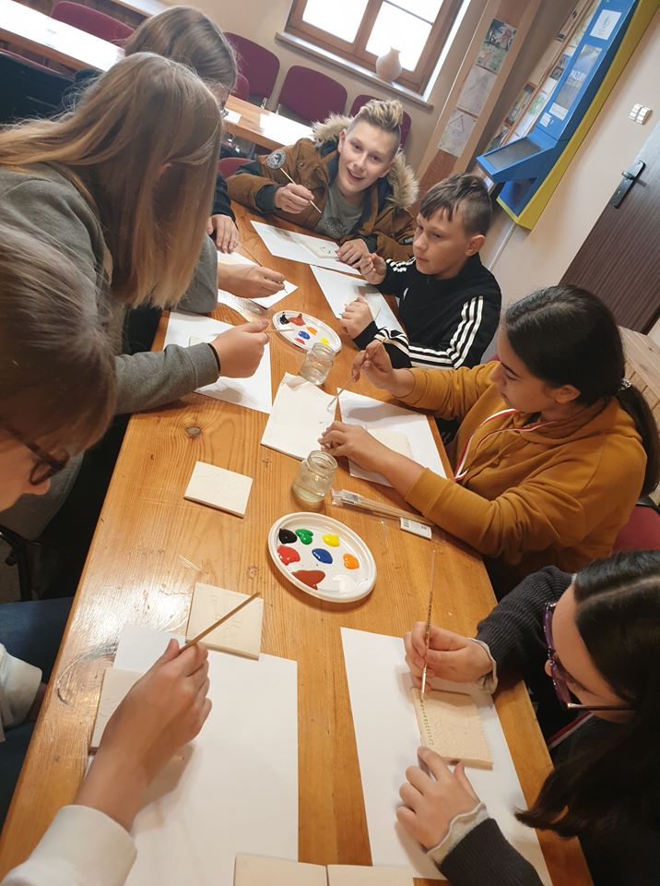
Then, we took part in two very interesting workshops. One
was a painting on glass with regional artistic motifs, and the
other was a plate decoration, as the Poles used to do in the past.

Slide 16
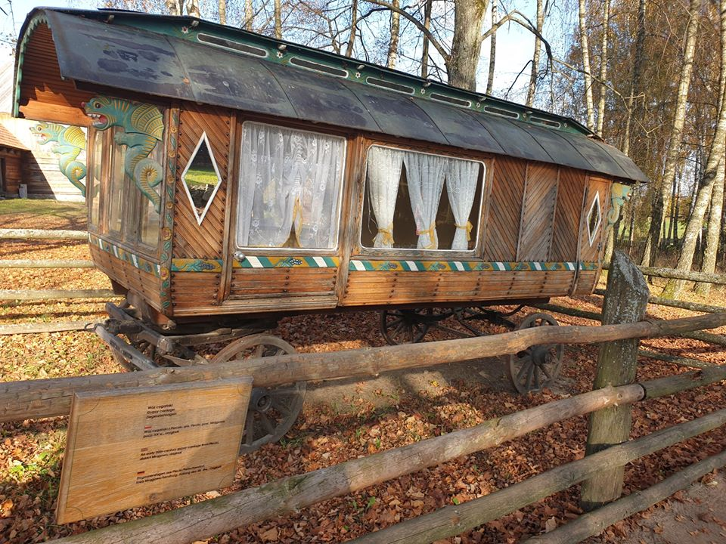
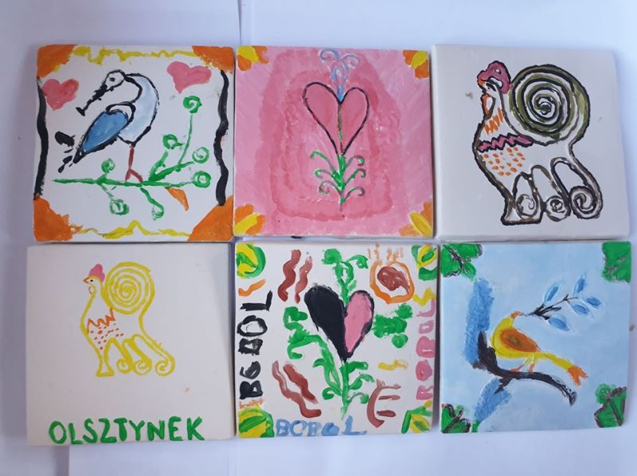
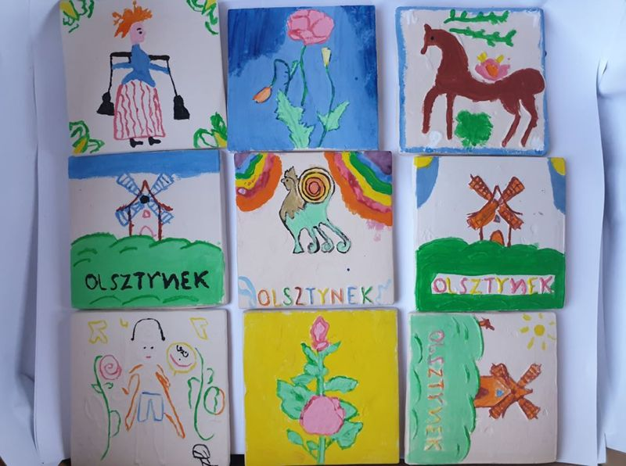
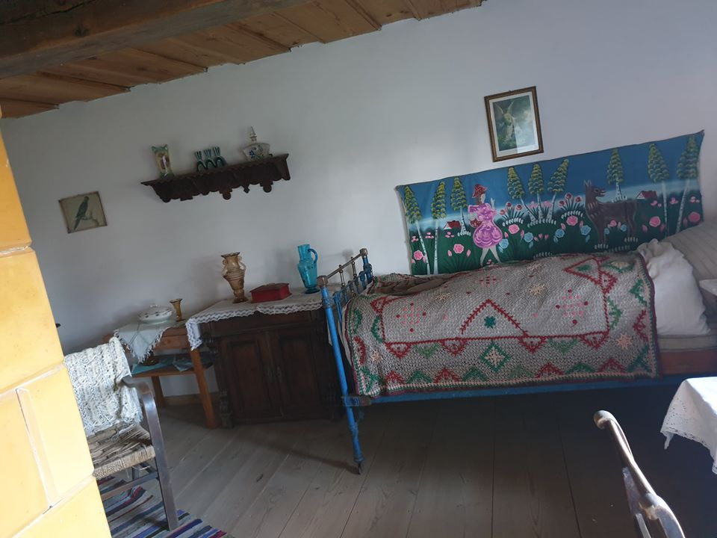
“Learning” through “doing” was the goal of all Erasmus+ activities planned that day.

Slide 17
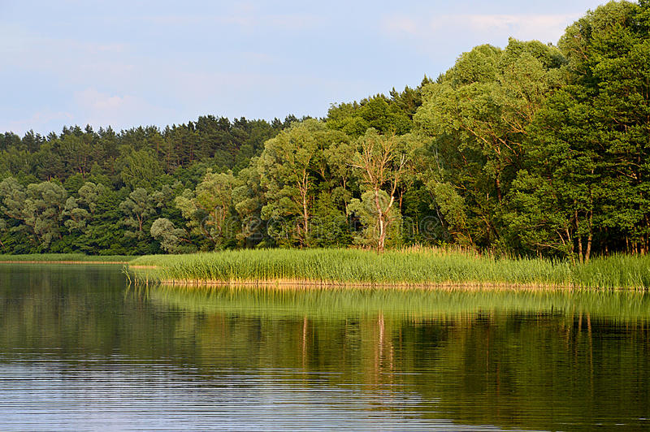
We spent the afternoon in the Olsztyn region, namely in the capital
Varmia and in Masuria. On the way back everyone could admire
the beauty of the region full of lakes and forests, to feel the golden
Autumn Polish and try the traditional Polish cuisine served by the lake.

Slide 18
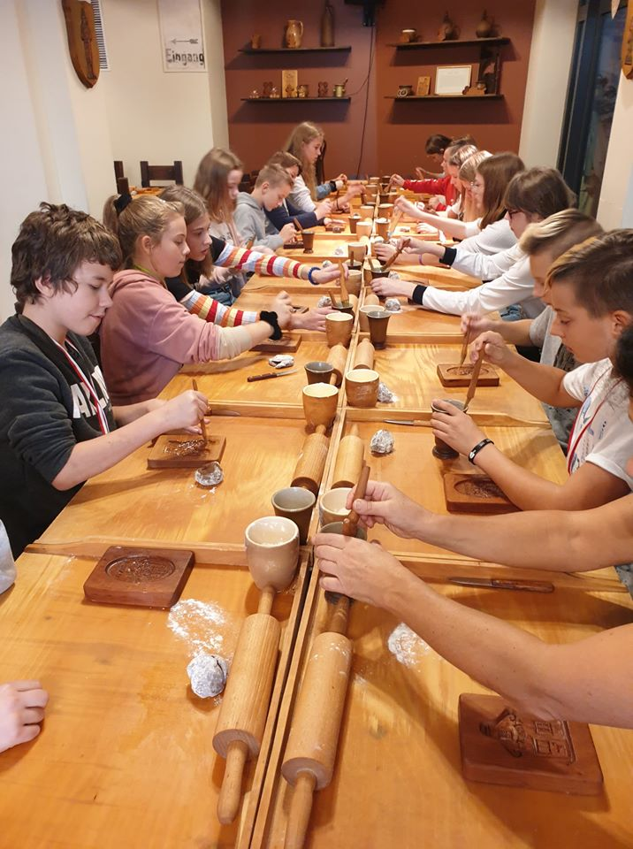
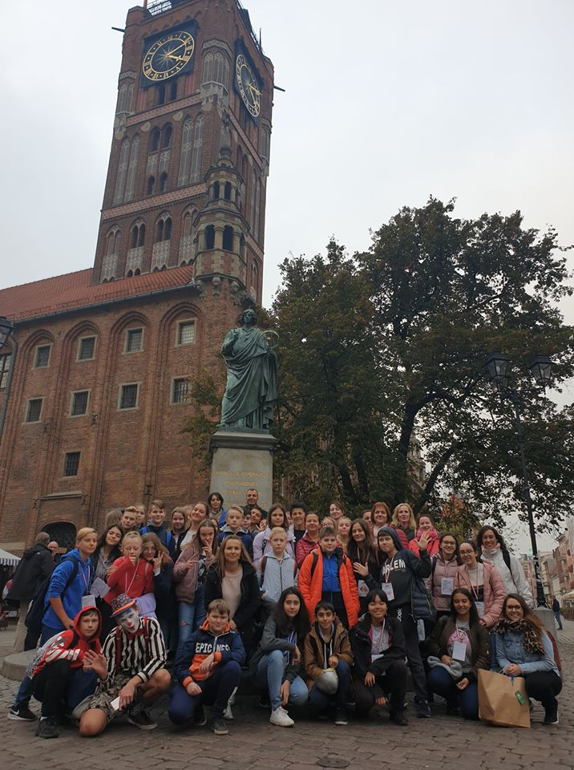
The fourth day we spent in Torun, which, due to the beautiful weather,
invited all of us not only for a walk in the streets of the beautiful old
town, full of Polish national heritage, but also interesting workshops.

Slide 19
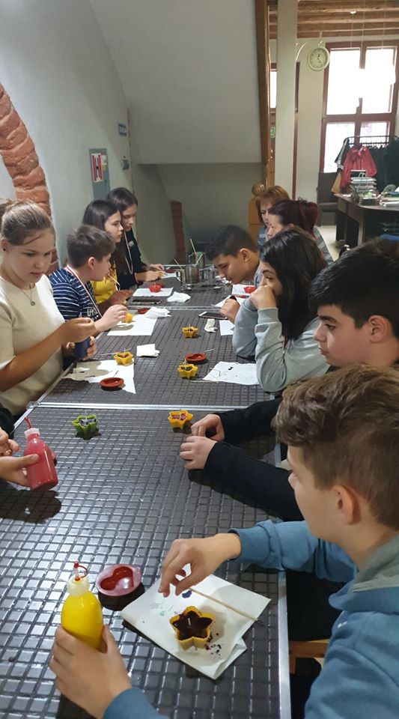
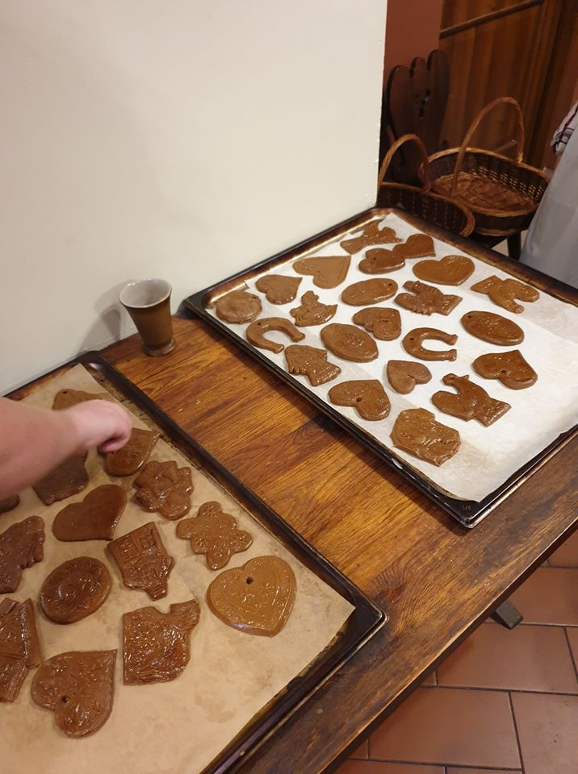
All participating pupils had fun making sweet cake,
according to the old recipes of the Sweet Cake Museum.

Slide 20
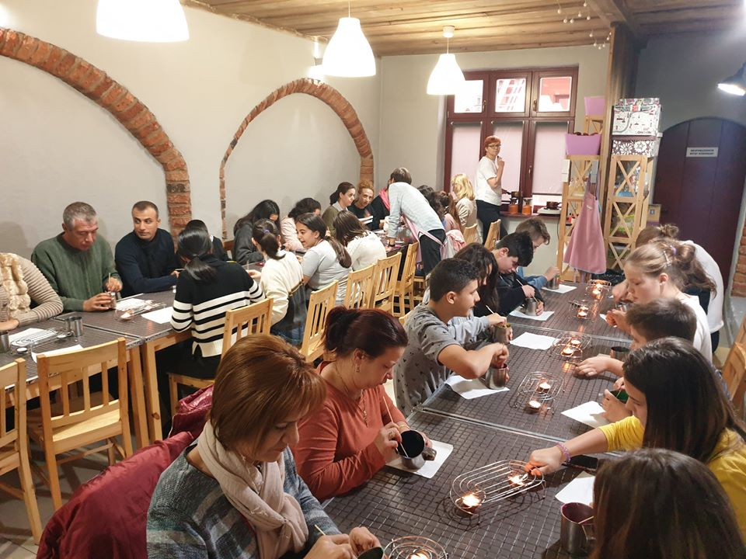
In the candle and soap factory we also spent
beautifully, making candles and soap, as to each
of those present liked. Creativity was welcomed.

Slide 21
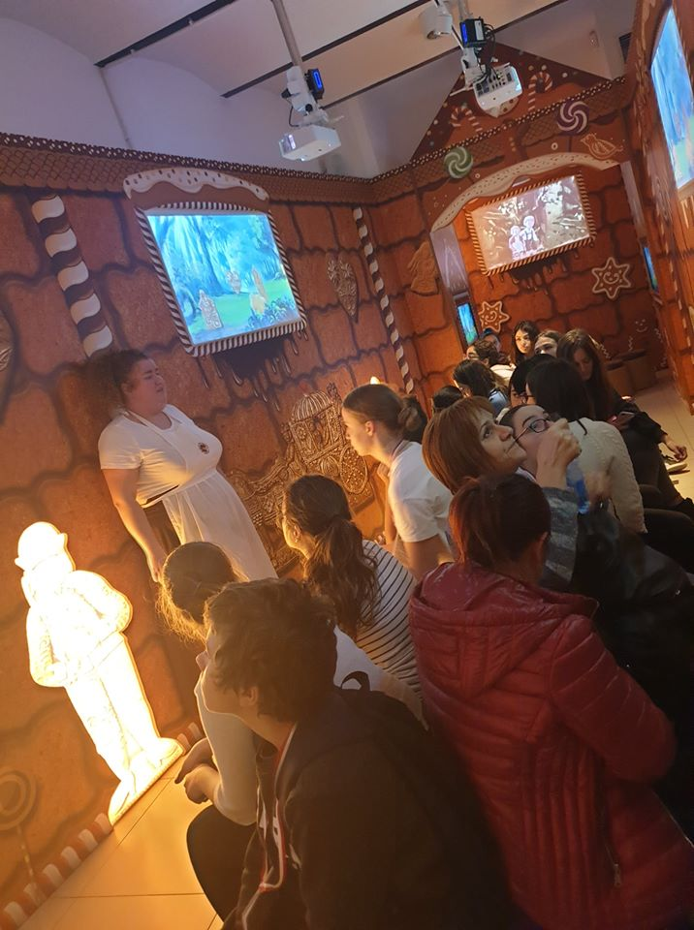
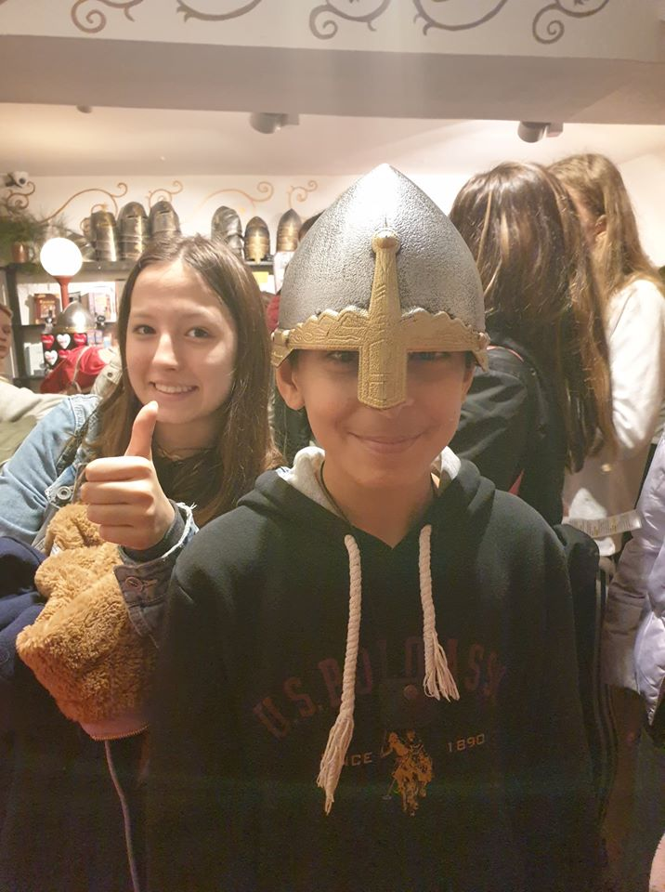
The day ended with a fascinating activity. All the pupils liked the Polish
legends seen in the ”House of Legends”, interpreted by ”people of the past”.

Slide 22
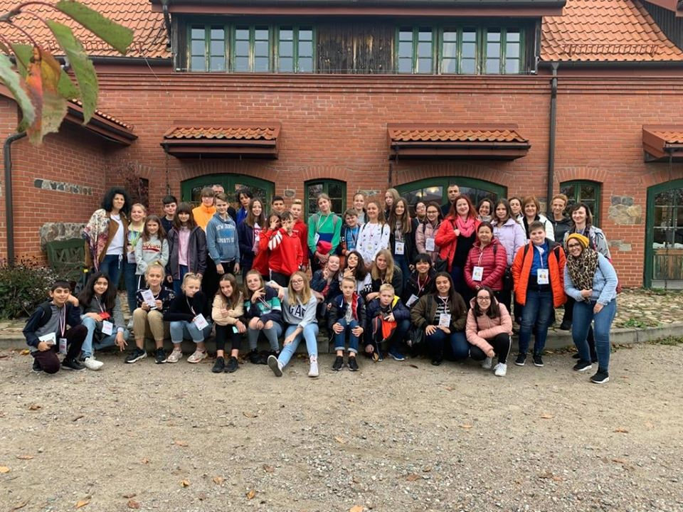
The fifth day of the mobility in Poland started by taking part in lessons
learned at school, which was a good way to compare the education systems
of partner countries. Another activity at the host school was the creative
workshop for pupils who could develop their artistic skills working with
popular motifs. The accompanying teachers evaluated their work.

Slide 23
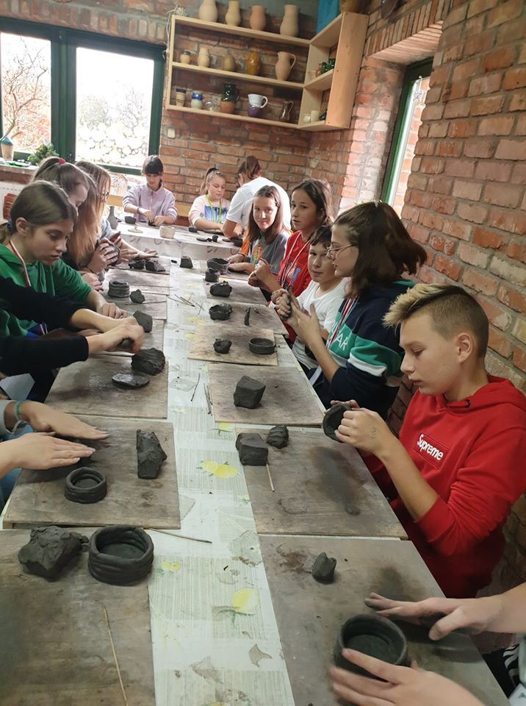
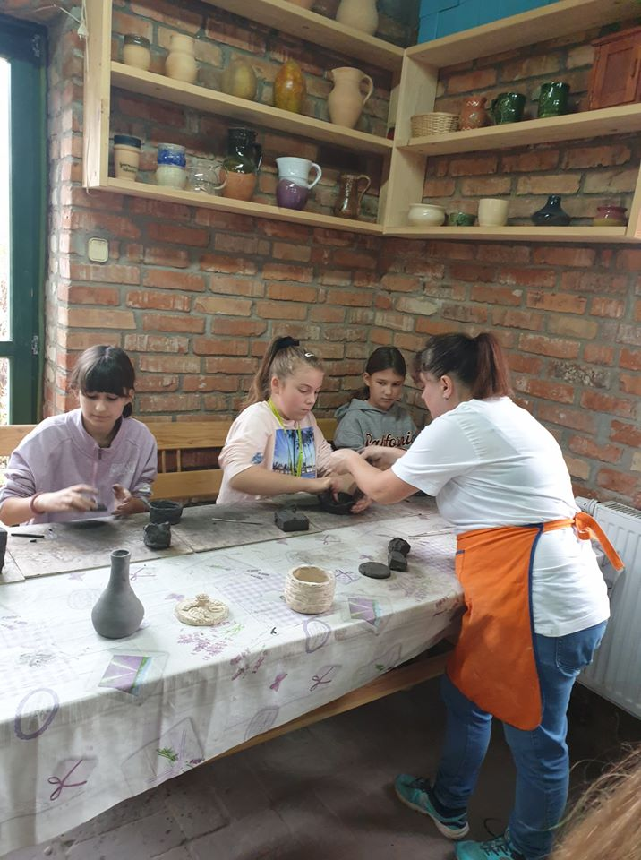
The day was also designed as a culinary day, so we went to a pottery
village called Kamionka, first to prepare some clay pots and then
to prepare lunch that consisted of typical dishes from the
region, such as ”kopytka” and dumplings with vegetables.

Slide 24
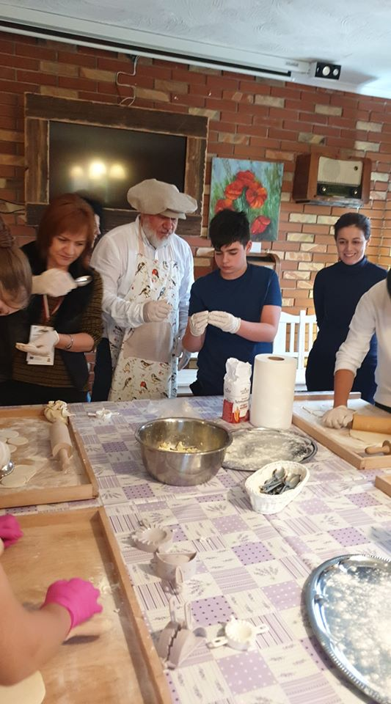
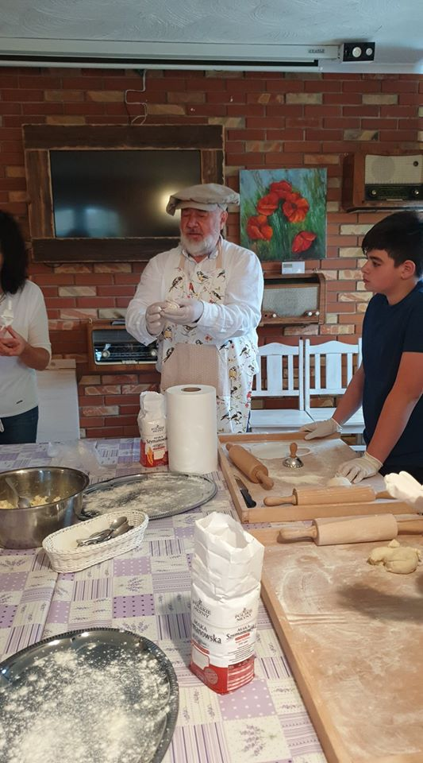
After the lunch prepared by the pupils, which was really
delicious, we returned to Nidzica to take a closer look at the
16th century Teuton Castle and listen to their most important
facts, our guide being a graduated pupil of the host school.

Slide 25
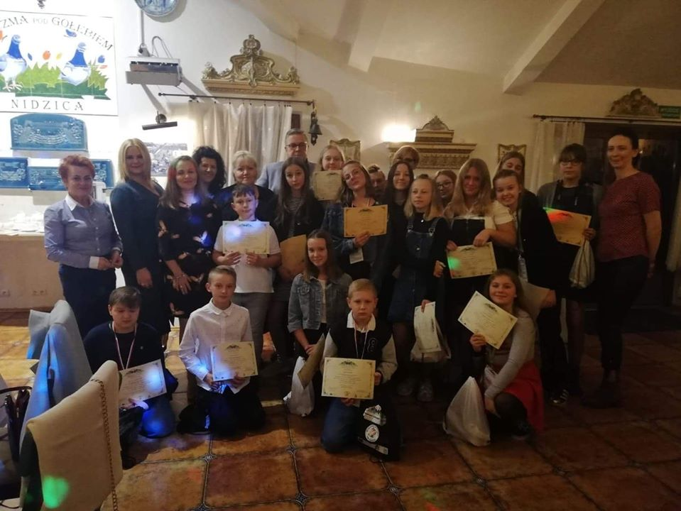
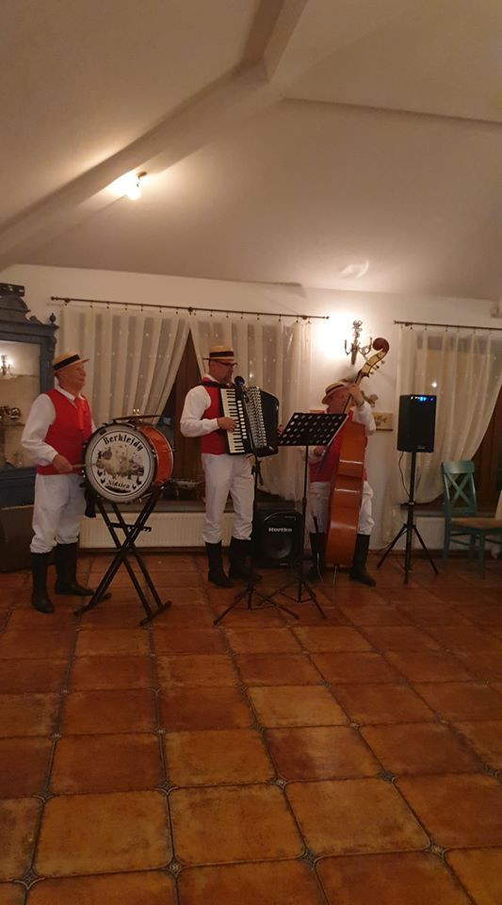
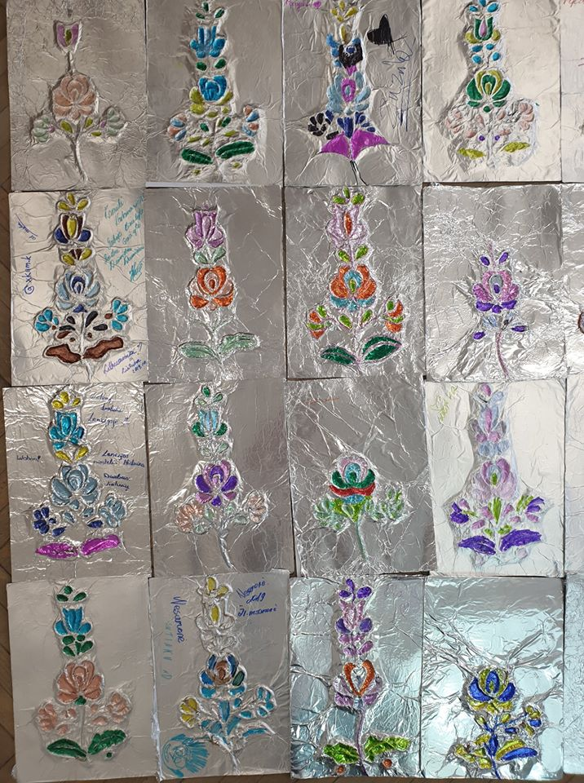
The pupils then had free time, spent with the host families, after which they prepared for the last meeting,
the farewell dinner. After the
official part, in which the
certificates of mobility were distributed to the participants,
we had fun dancing traditional
dances and listening to traditional music sung by the folk band ”Berklejdy”. At last, the pupils changed their email addresses
and with their eyes full of tears
they returned home to spend the
late evening together. The Polish adventure in the world of folklore
has come to an end, and we are looking forward to the next
one in Romania.

Slide 26
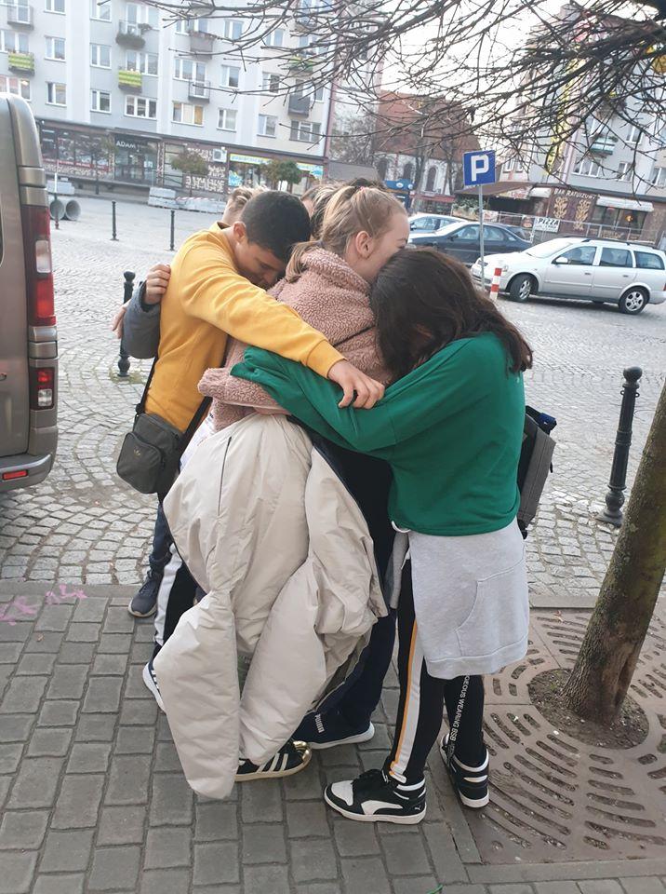
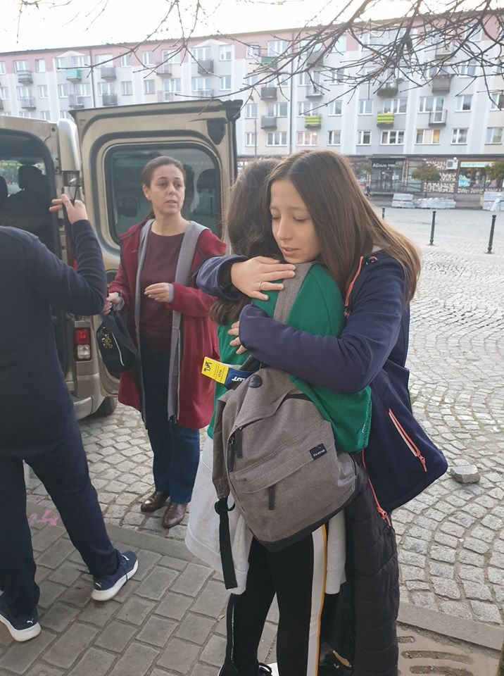
The sixth day was a very sad one for us all. It was the day of separation.
The tears on the faces of all the pupils spoke louder than the words.

Slide 27
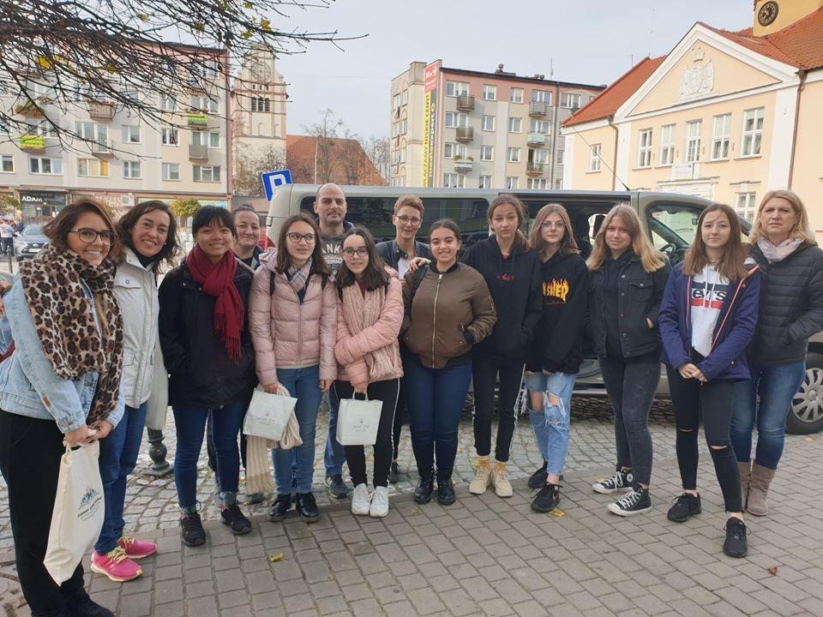
The new friendships born during the mobility in Poland will last a long
time. Fortunately, the next mobility would be very soon, in Romania, in
a completely traditional way, between Saint Andrew and Saint Nicholas.

Slide 28
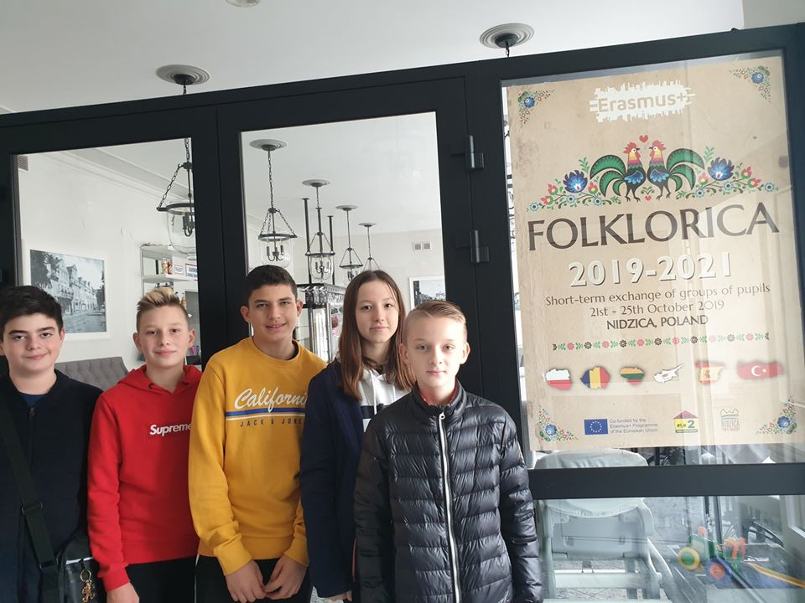
Thank you for watching!
Project coordinator in Gimnazjum Nr 2 z Oddziałami integracyjnymi im. Michała Kajki: Mariola Podolska-Maculewicz

