Slide 1
POLISH SUPERSTITIONS

Slide 2
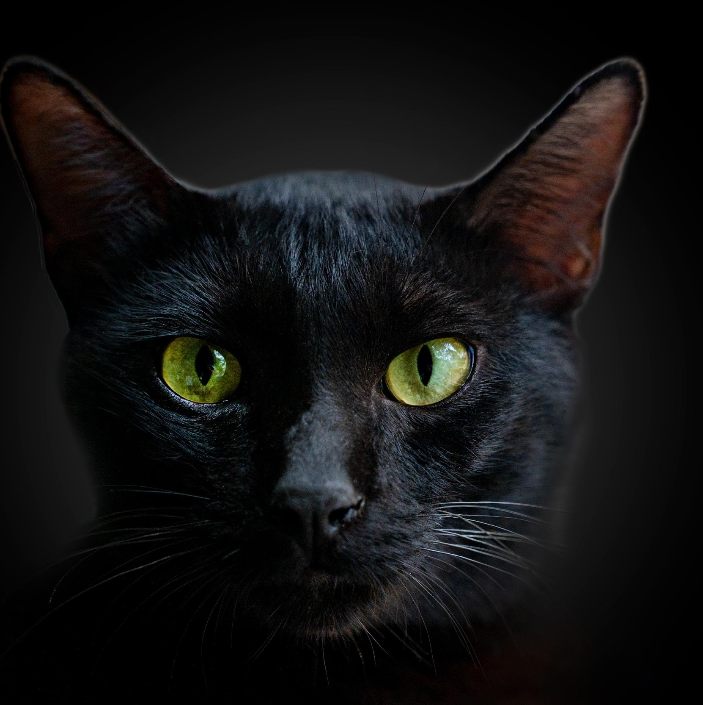
A BLACK CAT CROSSING THE PATH BRINGS BAD LUCK
The black cat is only a cat, and most often it is friendly.
This superstition may originate from the primitive cultures of the Middle Ages, where the cat was synonymous with evil and demons lived in it. Tormenting and killing cats was a popular folk pastime activity.

Slide 3
UNLUCKY 13
This number in Poland and in many countries is considered unlucky.
The biggest bad luck is on Friday the 13th.
This superstition goes back to antiquity, when the number 12 was considered perfect and ordering. The 13 that followed, however, was called the "Devil's Dozen," as the first beyond the perfect number.
Additionally, unlucky Friday is the day of Jesus' death, so in combination with "13" it is very disturbing.

Slide 4
GOING UNDER THE LADDER BRINGS BAD LUCK
Better not to walk under an unfolded ladder,
because it can fold up or a man standing on it
might drop something.
The origin of this superstition may come from the early Christians, because the standing ladder, when unfolded, resembles a triangle, which is a symbol of the Holy Trinity. Walking through this symbol was considered a sin because it could weaken faith and release evil forces.

Slide 5
HORSESHOE OVER THE DOOR
is supposed to stop the demons
The superstition comes from a time when iron was new and it was believed that ghosts fear iron.
In addition, its form resembled a crescent - an ancient symbol of happiness and prosperity.
Better not to hang the horseshoe over
the door, as it may injure the head if it falls.

Slide 6
SPILLED SALT
Throwing it over the left shoulder with the right hand is to create a magical barrier that is to protect us from evil.
In fact, better protection will be given by sweeping the spilled salt, because if we slip on it, we can actually hurt ourselves.
The superstition is about 2,000 years old. The soldiers of the Roman Empire were paid with precious salt at that time (hence the word "salary" in many languages comes from salt (salaris, salary). Soldiers, however, often drank their salary in a pub - throwing a handful of salt on the table for the bartender. The drunk salt caused fights and marital quarrels that is misfortune.

Slide 7
"BLESS YOU!"
AFTER A
SNEEZE
Achoo...
This superstition is very old. People believed that the human soul could escape when sneezed, and the wish for health repelled the demons.

Slide 8
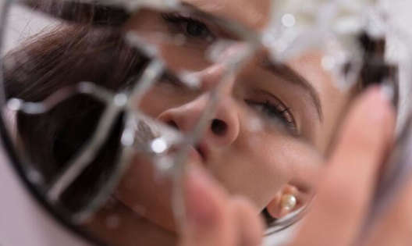
BROKEN MIRROR
The superstition comes from time
when the Romans believed in the seven-year period of body renewal and the mirror image is the image of the soul.
Covering the mirrors in the house of the deceased prevents the deceased from taking the reflection of the living soul with him to the afterlife.
brings 7 years of bad luck

Slide 9
THE END

