Slide 1
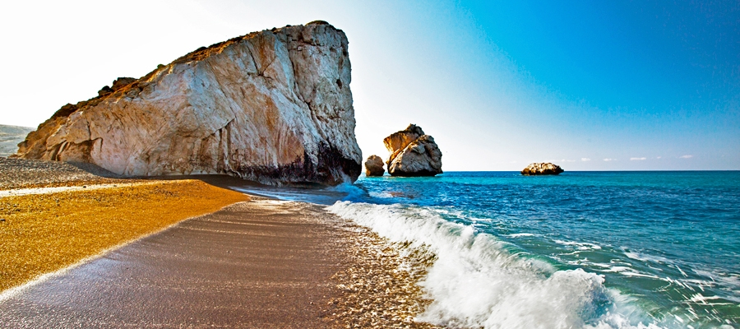
CYPRUS
PAPHOS

Slide 2
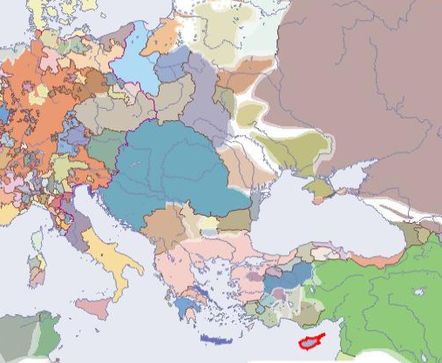
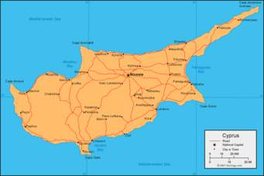
CYPRUS
Cyprus is the third largest and the most densely populated island in the eastern Mediterranean sea . The island has been an independent country since 1960.

Slide 3
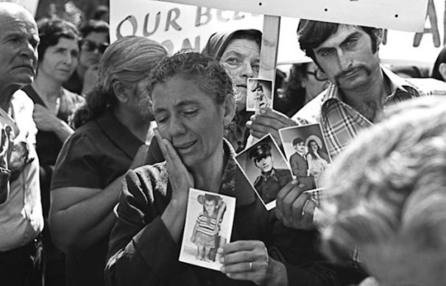
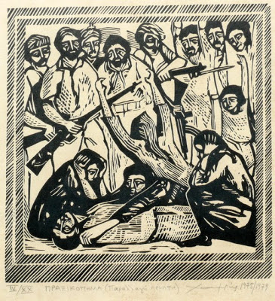
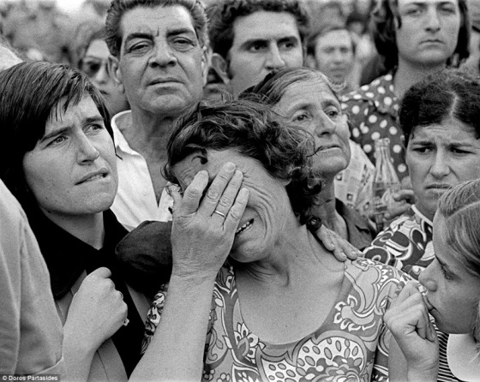
Political PROBLEM
In 1974 the Turkish troops invaded Cyprus , occupying 35% of our land, killing thousands and leaving more than a hundred thousand people homeless. Until this day the Greek Cypriots try to stand up for their right of returning to their homeland.

Slide 4
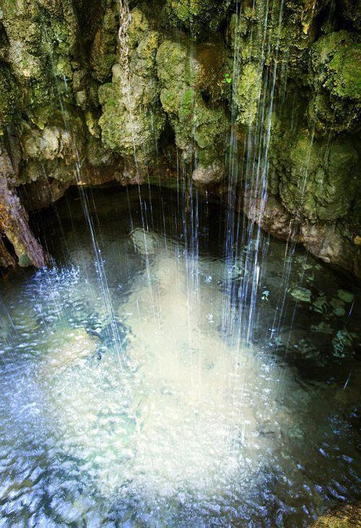
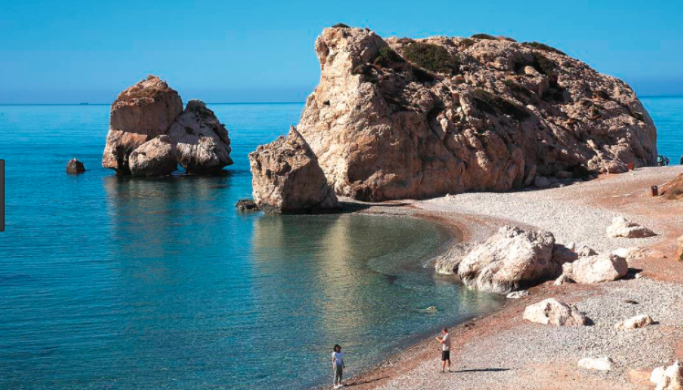
Paphos is the legendary birthplace of Aphrodite, the Greek goddess of love and beauty. That’s why there are many attractions linked to her in Paphos and nearby, such as Petra tou Romiou, and her baths.
PAPHOS Sights-attractions

Slide 5
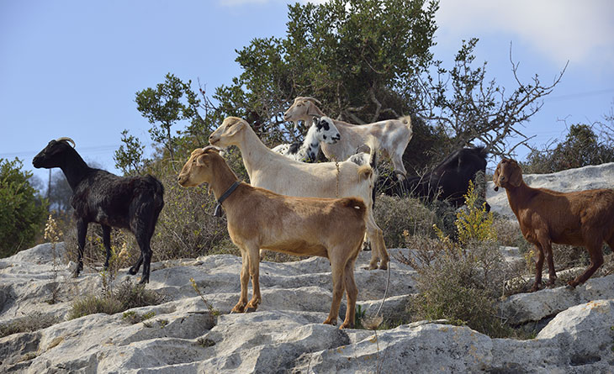
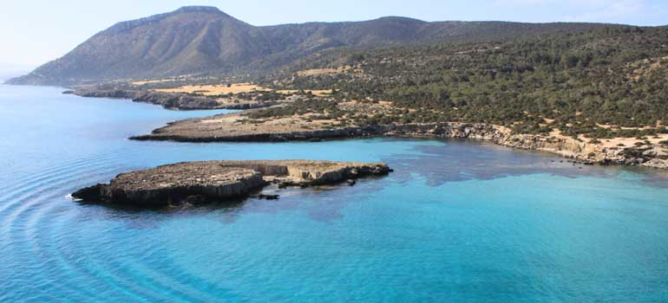
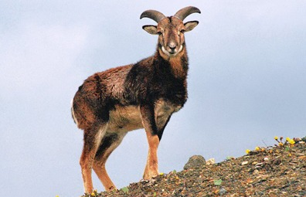
AKAMAS PAPHOS
The akamas peninsula is located in the western angle of Cyprus in Paphos and its considered as one of the most popular places to visit.The name akamas originate from an Athenian warrior,the son of Theasus who came to the peninsula after the Trojan war.

Slide 6
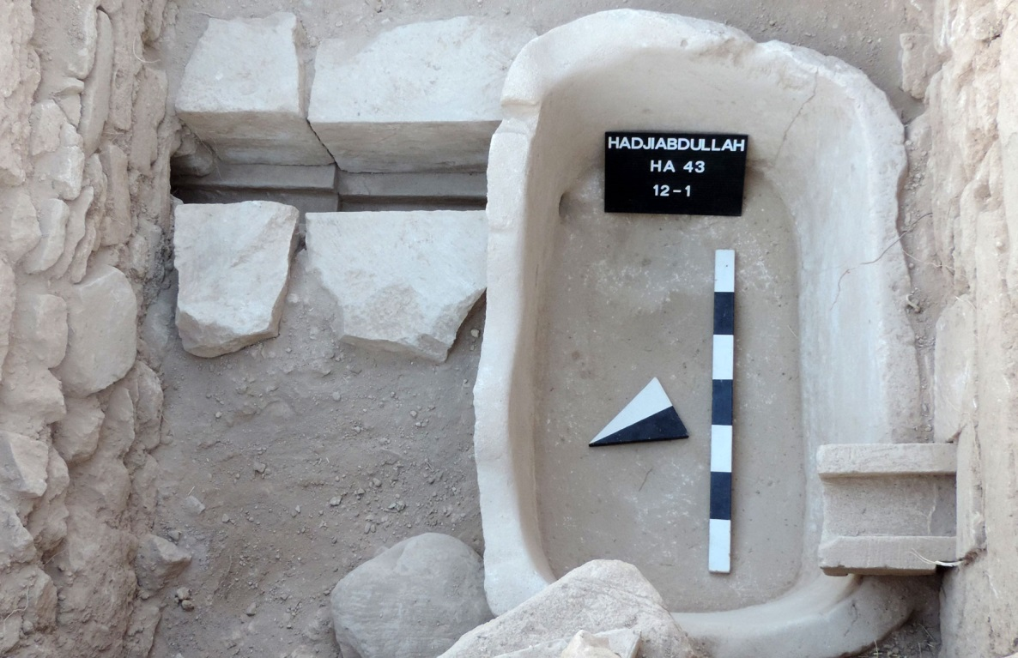
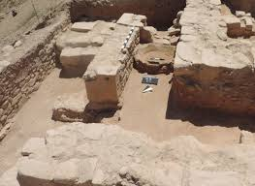
PAPHOS Sights-attractions
Paphos was the capital of Cyprus for many centuries, called Palaipaphos it was said to be established by either king Kiniras in the 12th cetury B.C, or King Agapinor of Peloponese.

Slide 7
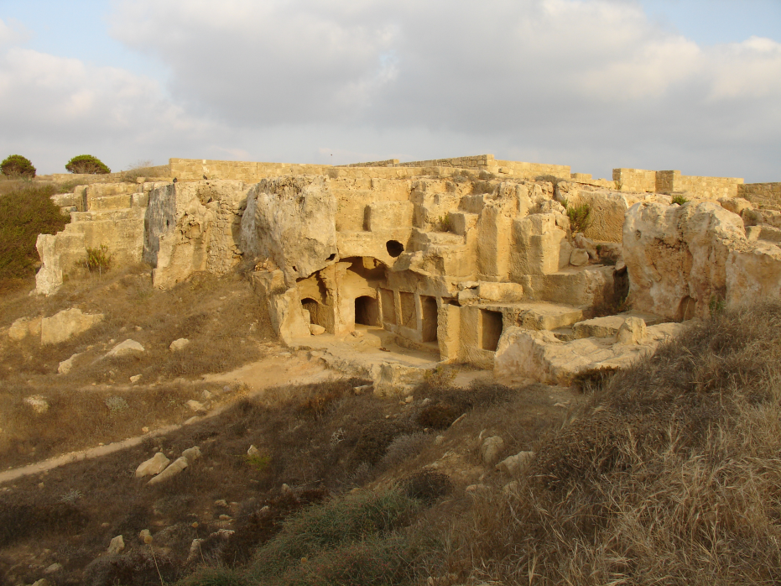
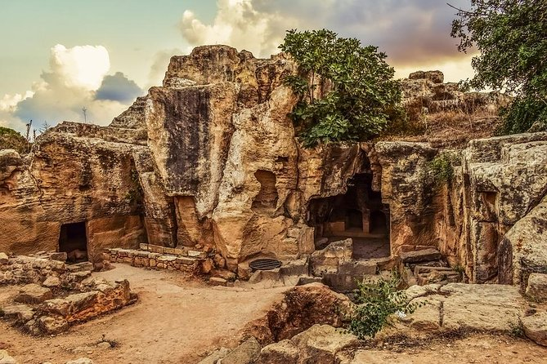
PAPHOS Sights-attractions
The Tombs of the Kings is a large necropolis lying about two kilometres north of Paphos harbour in Cyprus. It is a UNESCO World Heritage Site.
ancient Egyptian tradition.

Slide 8
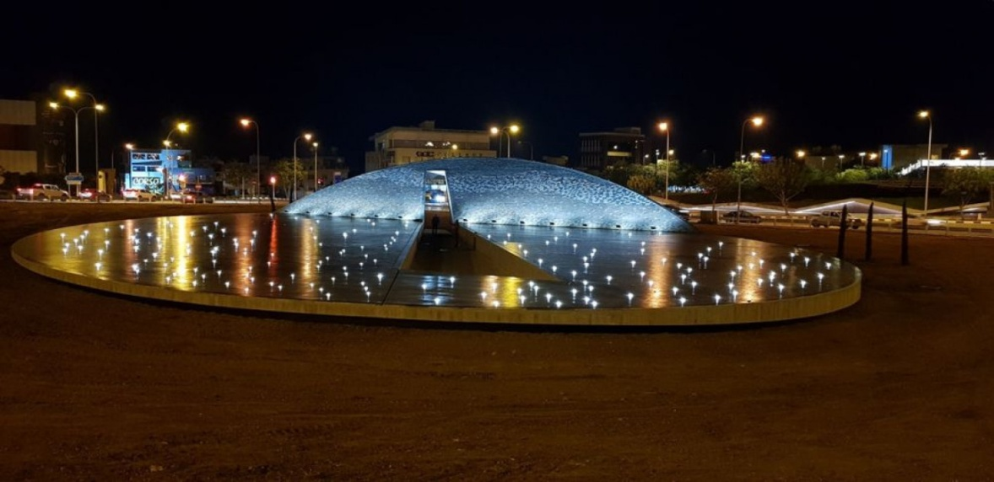
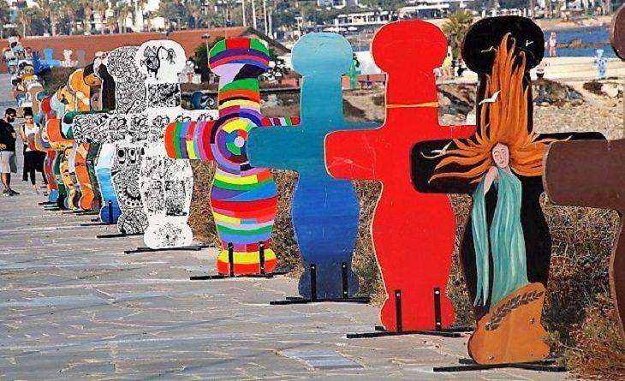
Modern Paphos
In 2017, Paphos was chosen as the cultural capital of Europe, and many extravagant projects and events took place during the process. This is one of our city’s biggest accomplishments since it caused tourism to blow up, and made us, the citizens, proud of these changes . This gave Paphos the opportunity to construct numerous sites.

Slide 9
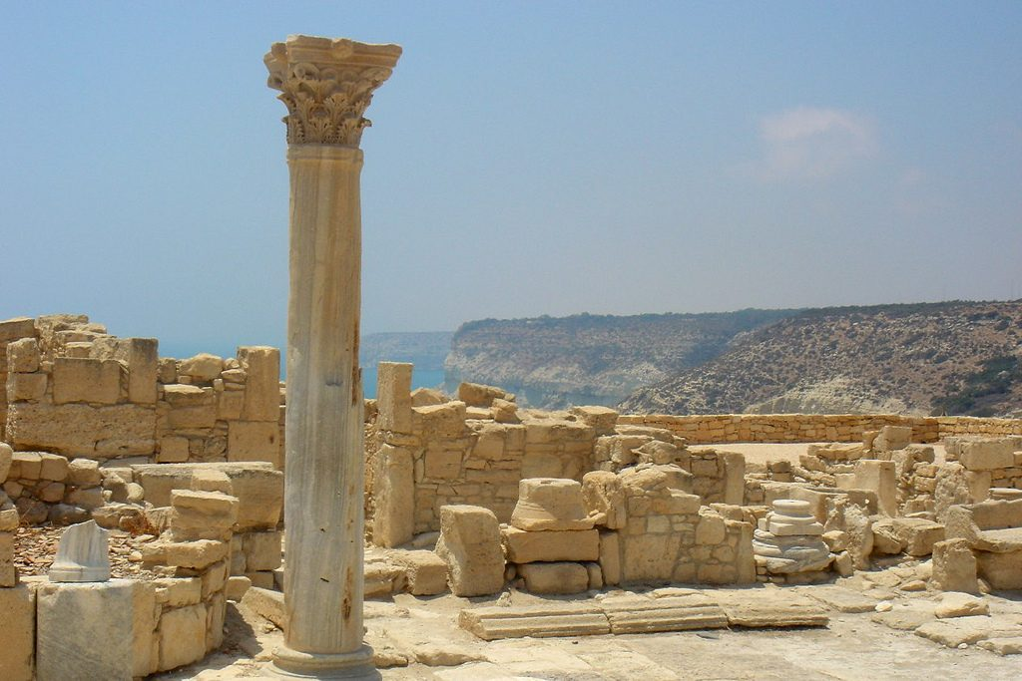
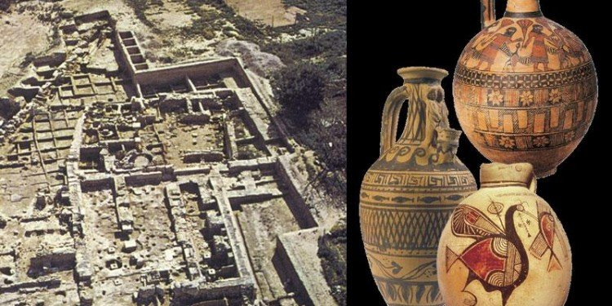
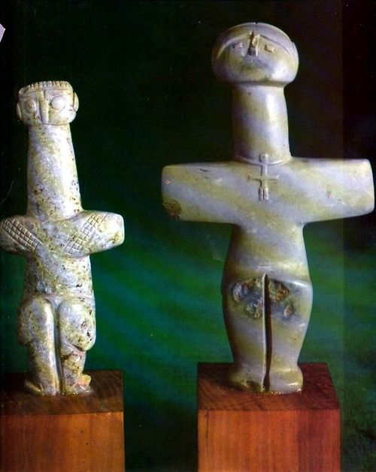
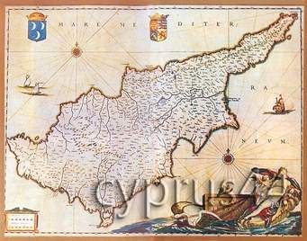
HISTORY(1/2)
The history of Cyprus is a long and complicated affair. Cyprus's history goes back to the Neolithic Age (10 000 B.C.)
One of our most characteristic arts are cross shaped figurines dating back to the Bronze Age (around 3000 B.C.). These are some examples of art and life during Cypriot Antiquity.

Slide 10
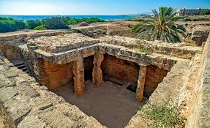
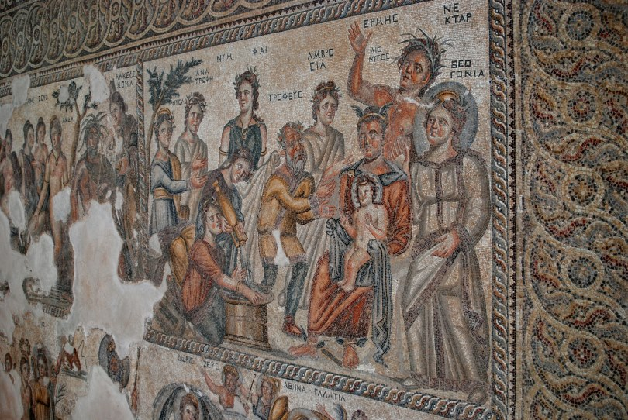
HISTORY(2/2)
Paphos is a town in Cyprus whose history dates back to the Neolithic period . Paphos Roman mosaics are considered to be among the best in the Eastern Mediterranean and are part of the Archaeological Park of Kato Paphos.
Moreover, the Roman period has left Paphos with many important monuments.

Slide 11
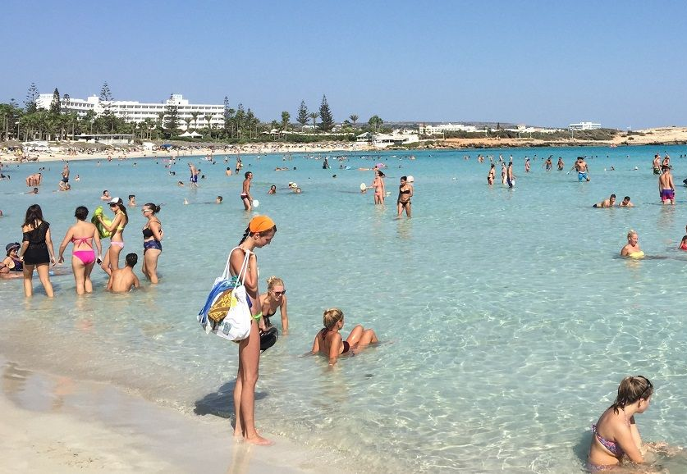
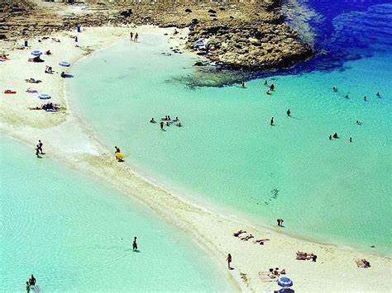
OUR every day life
We are the country with 300 days of sunshine yearly. This means that we spent many months enjoying the beach, and this is the main reason why over 2 million people visit Paphos each year. Swimming, fishing, scuba diving is one of our everyday activities.

Slide 12
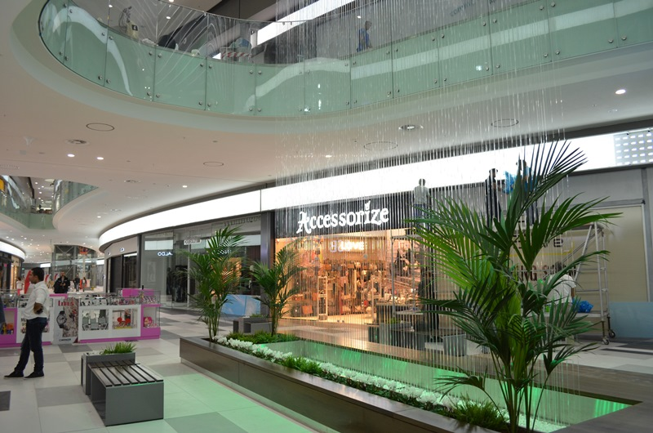
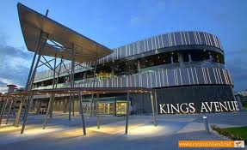
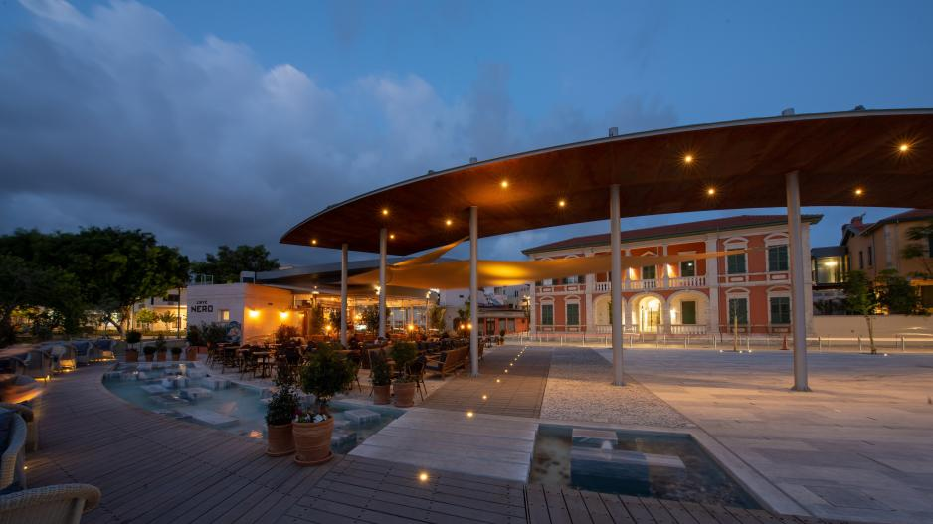
OUR FREE TIME
However, young and old people tend to spend their free time at the shopping center doing all kind of activities, like:
Shopping
Going to the cinema
Eating food

Slide 13
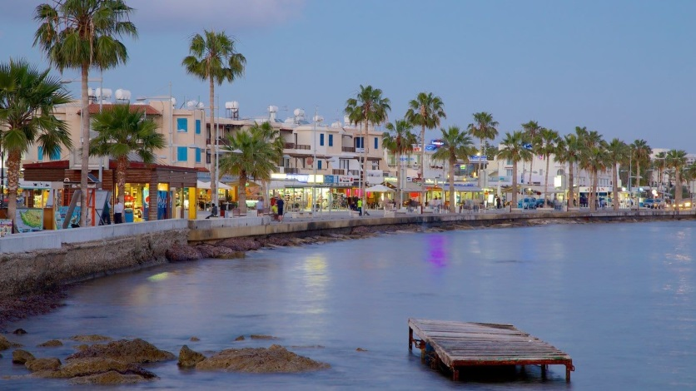
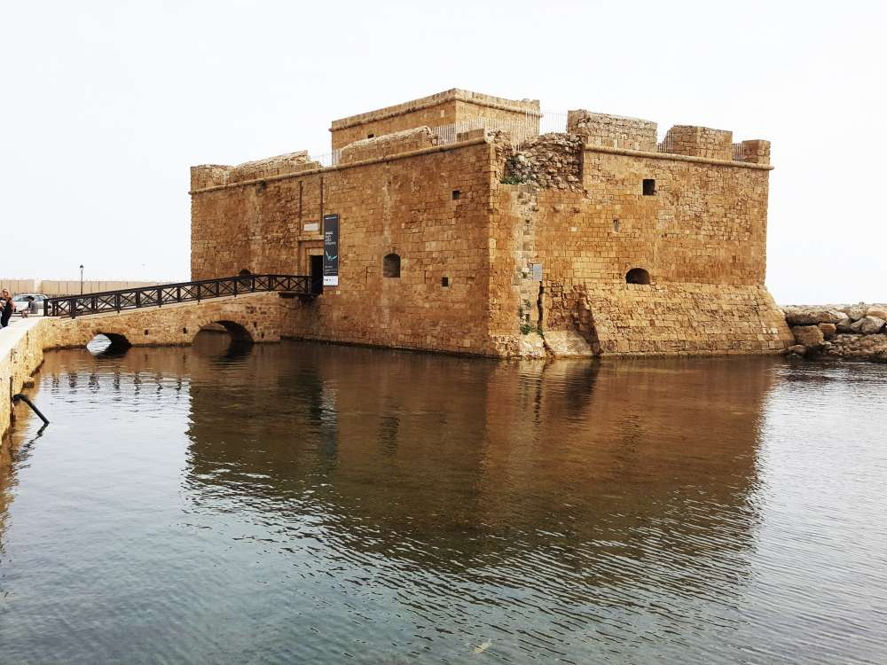
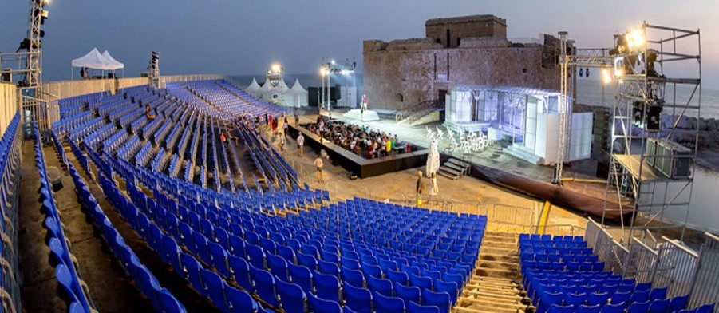
Paphos harbour
There is also the harbour, which is one of our greatest attractions, with plenty of things to do and admire the beauty of. It’s a really great place to hang out with friends and have lots of fun.
Furthermore, many concerts take place there and you can visit the medieval castle, which is also one of our best attractions.

Slide 14
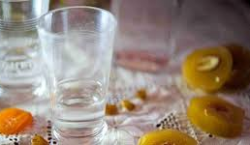
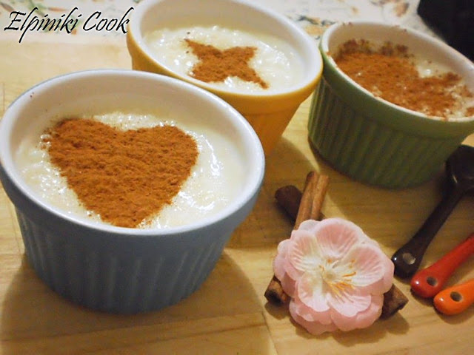
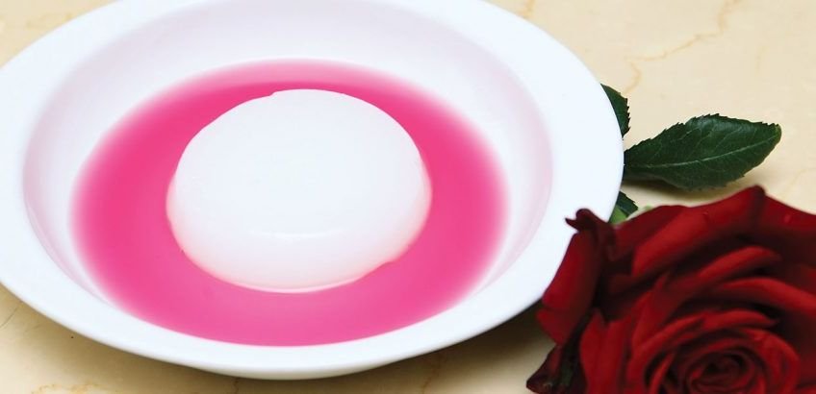
Our Traditional foods & drinks
DRINKS:
Zivania
Brandy
Commandaria
SNACKS:
Maxalepi
Shoushoukos
Rizogalo

Slide 15
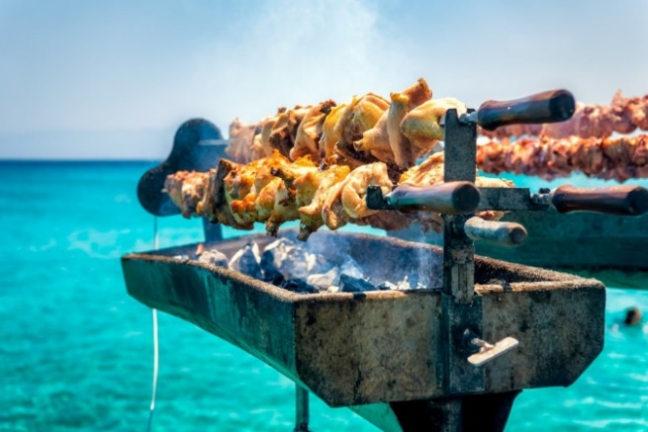
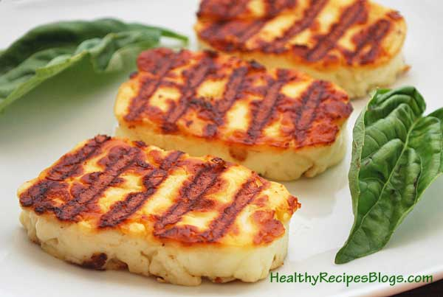
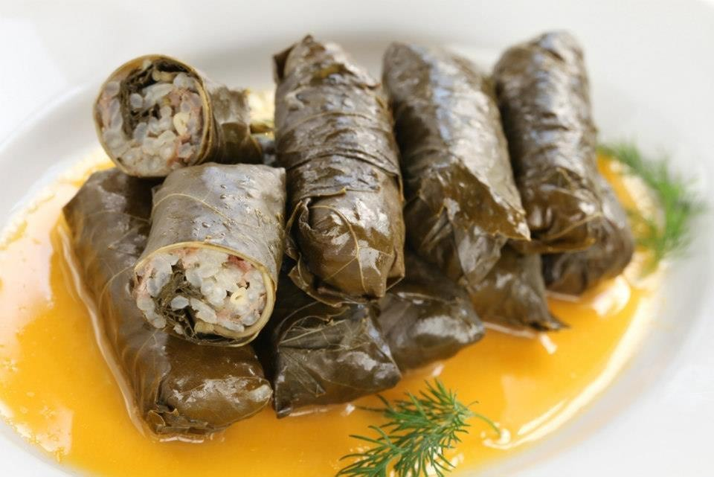
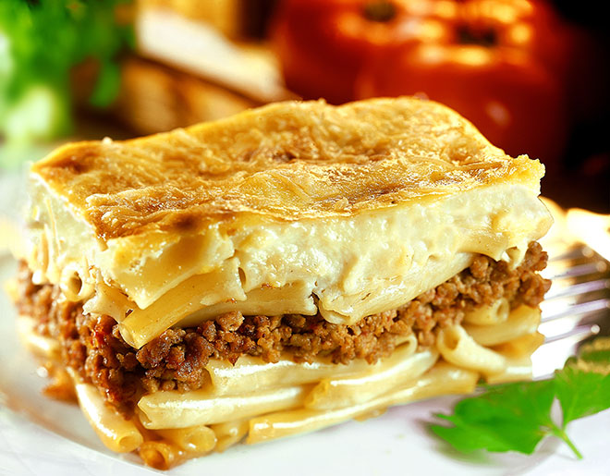
Our Traditional foods & drinks
FOOD:
Souvla
Souvlakia
Sheftialies
Makaronia tou fournou
Haloumi
Koupepia

Slide 16
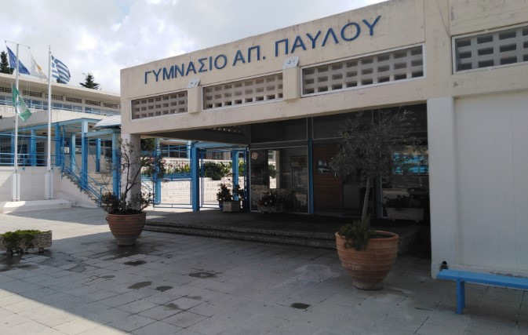
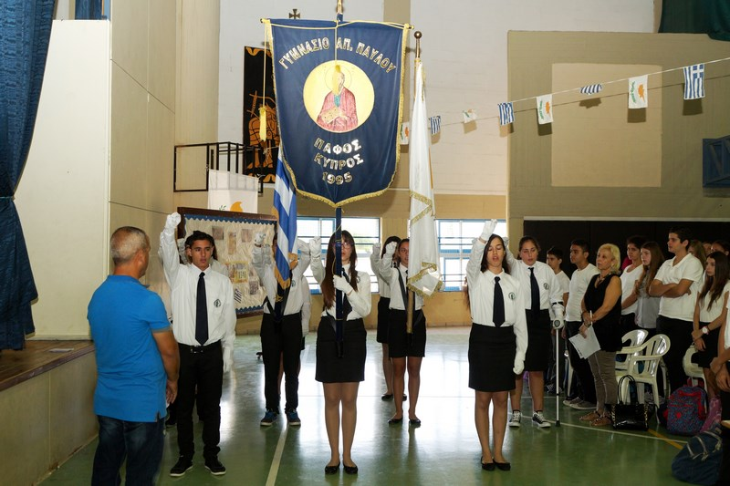
OUR SCHOOL: Saint pavlos middle school
Our school is the biggest middle school in paphos with over 600 students,3 grades and 30 class rooms . In addition to that we also have special education classes.
This is our school’s timetable:
7:30 – 8:15
8:15 – 9:00
15΄ brake
9:15 – 10:00
10:00 – 10:45
30΄ brake
11:15 –12:00
12:00 – 12:45
5΄ brake
12:50- 13:35
-

Slide 17
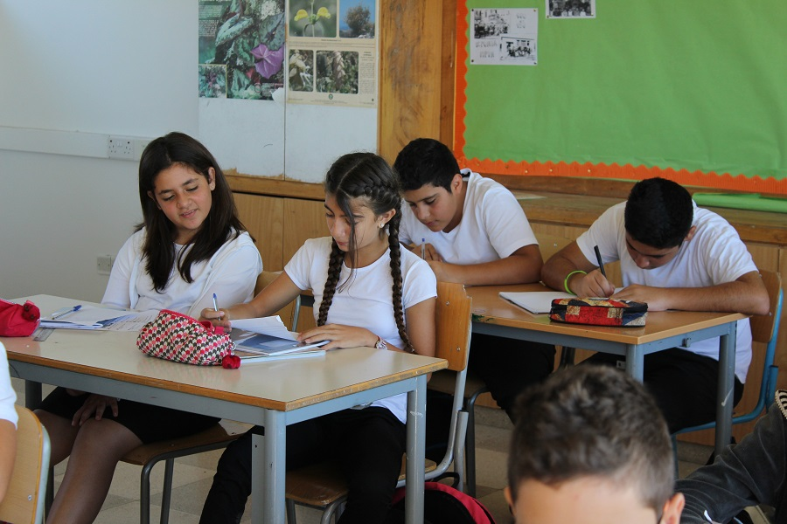
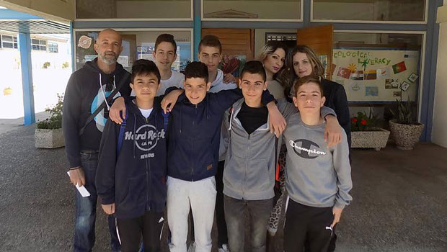
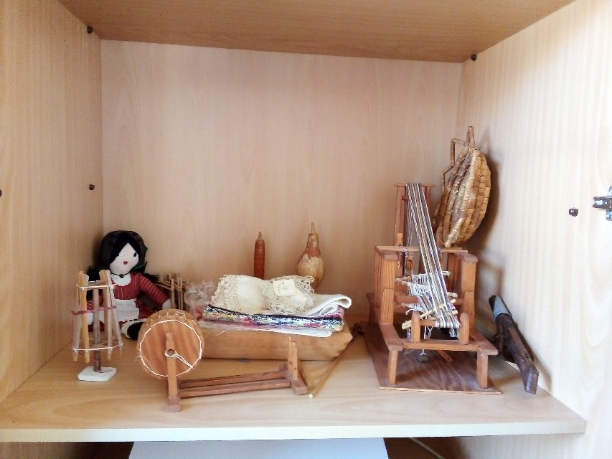
OUR SCHOOL: Saint pavlos middle school
In our school the following subjects are taught:
Maths, Modern Greek, Ancient Greek Language and Literature, Music, English, History, Science, Physics, R.E., P.E., I.C.T.

Slide 18
THANK YOU
Thank you all for welcoming us into your country with pleasure.
And thank you for your time and kindness.

