Slide 1
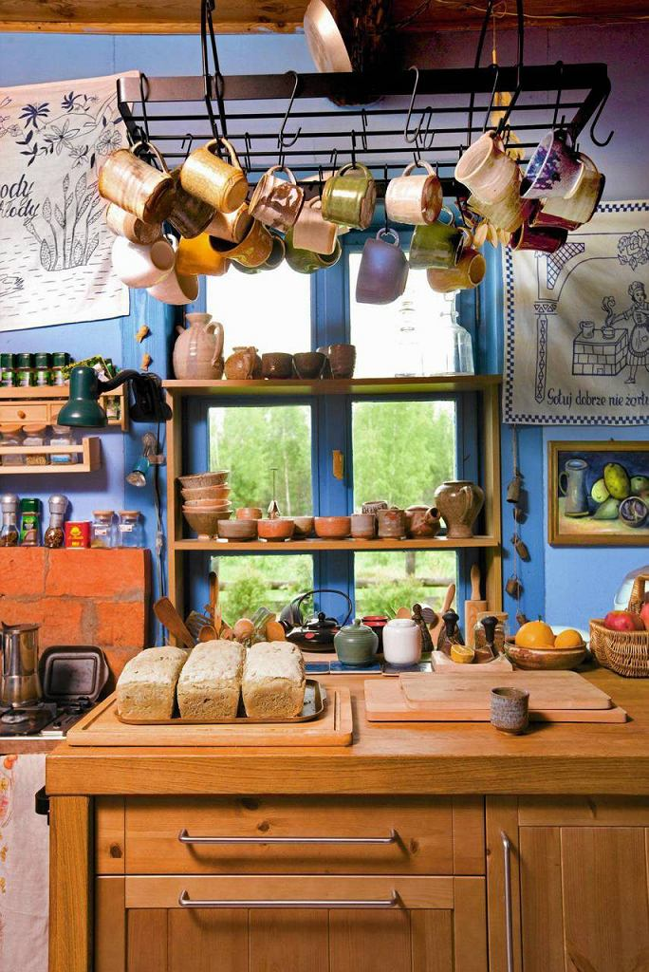



„Faworki”
Ingredients:
2 cups of flour
4 yolks
1 tbsp of spirit
½ cup sour cream
Vanilla sugar
(Lard for frying, powdered sugar for sprinkling)

Slide 2
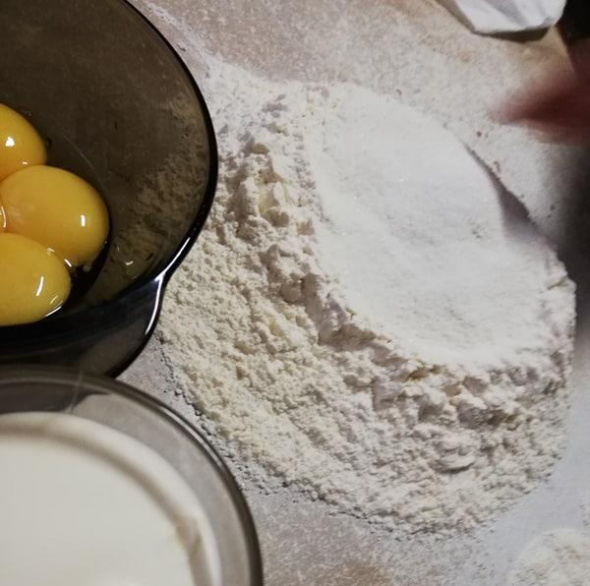
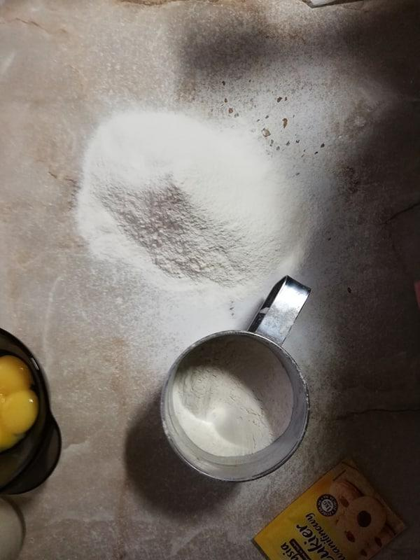
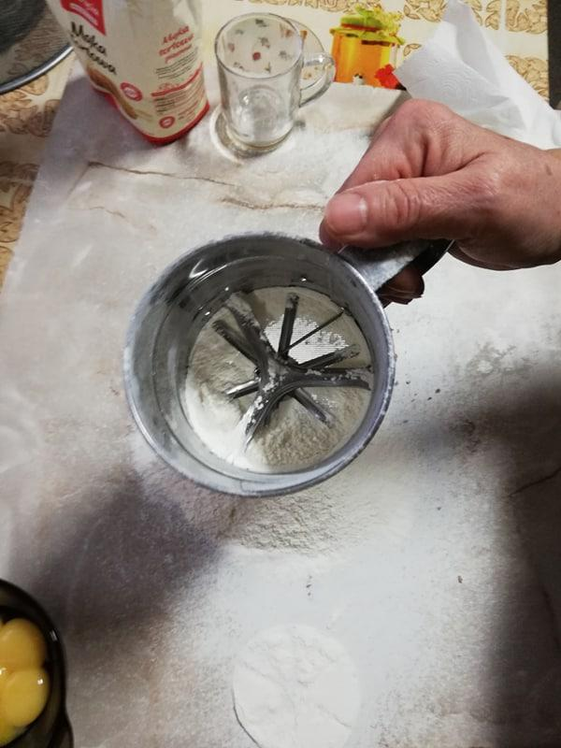
We sift the flour and mix it with other ingredients to knead the flexible dough.

Slide 3
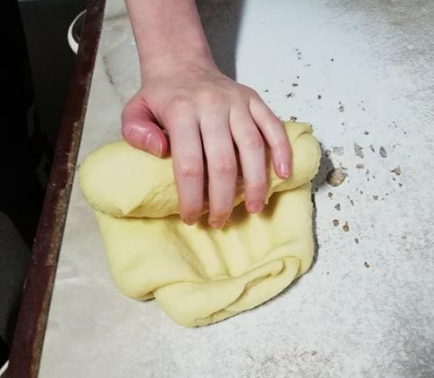
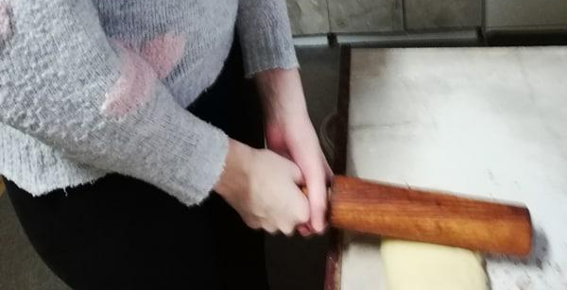
Then, beat it with a wooden roller and roll it up, repeat this action until air bubbles appear.

Slide 4
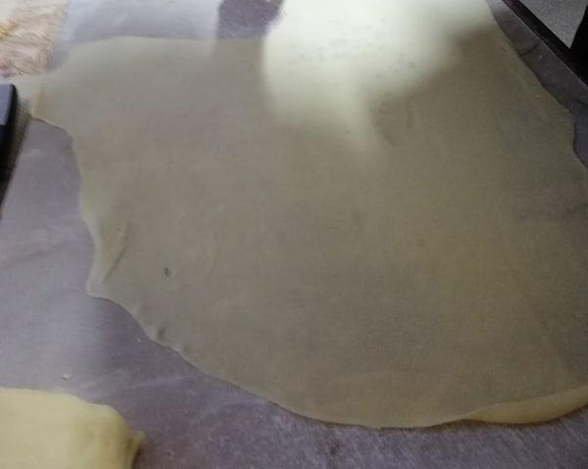
Divide the dough into parts and roll thin patties.

Slide 5
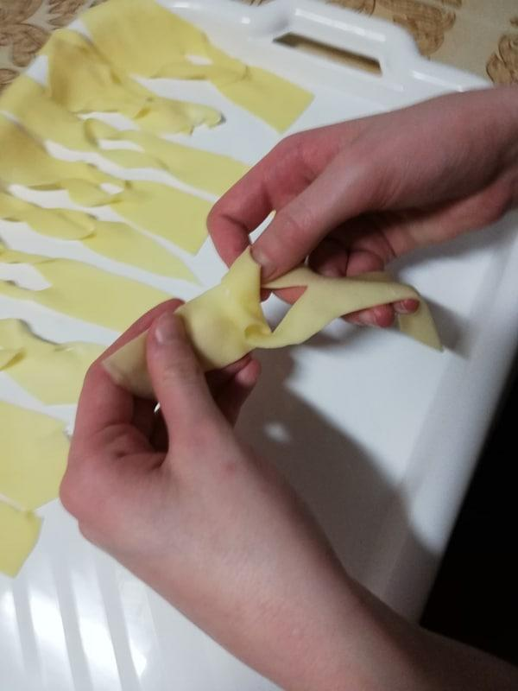
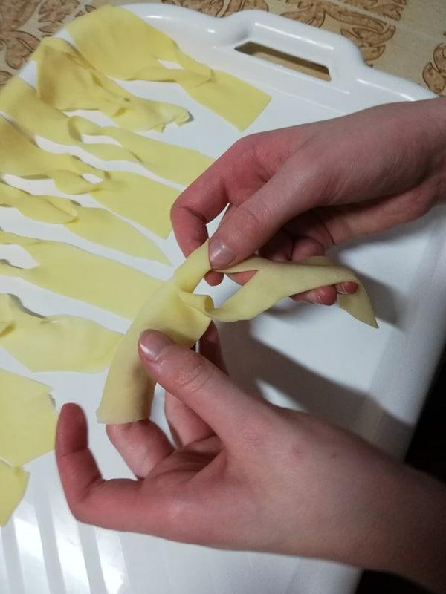
Cut each cake into thin strips making an incision on each one and rewinding it as in the picture.

Slide 6
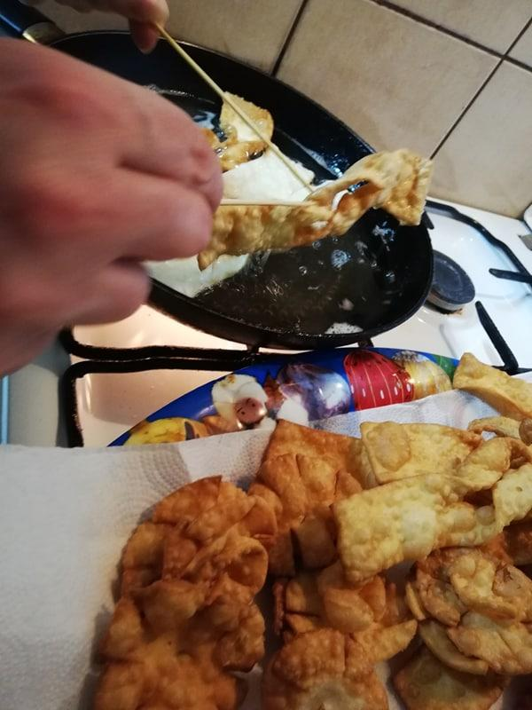
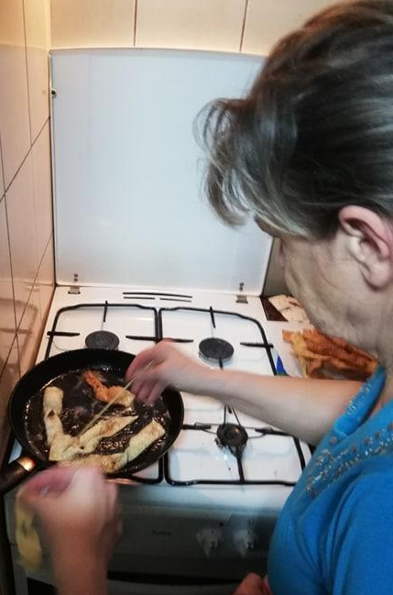
„Faworki” deep fry then sprinkle with powdered sugar and it’s ready!

Slide 7
