Slide 1
Encyclopedia of health
Set of grandmothers’ recipies

Slide 2
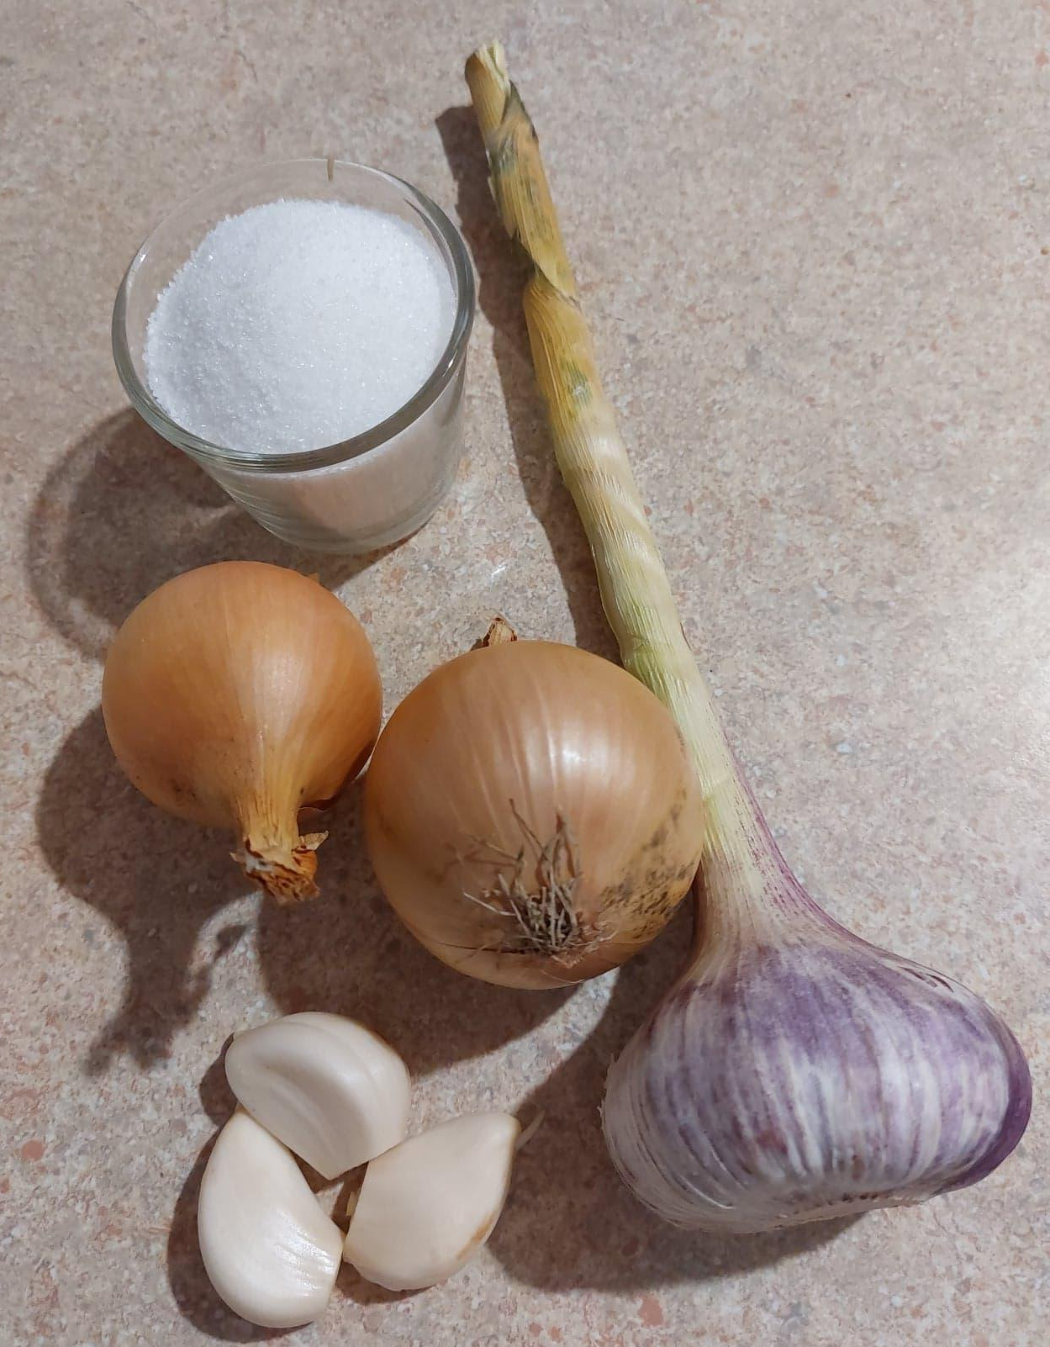
Onion and garlic syrup
Cough and cold remedy

Slide 3
Onion and garlic syrup
Ingredients:
1 medium onion
3 cloves of garlic
50 grams of liquid honey/sugar

Slide 4
Onion and garlic syrup
Chop up the onion
Crush and chop up the garlic
Preapre 1 coverd glass
Layer small amount of chopped onion in the glass
Layer small amount of chopped garlic
Layer small amount of honey/sugar
Repeat point 4-6 until you use all the ingredients.
Cover the glass with the cover
Leave it at room teperature for few hours

Slide 5
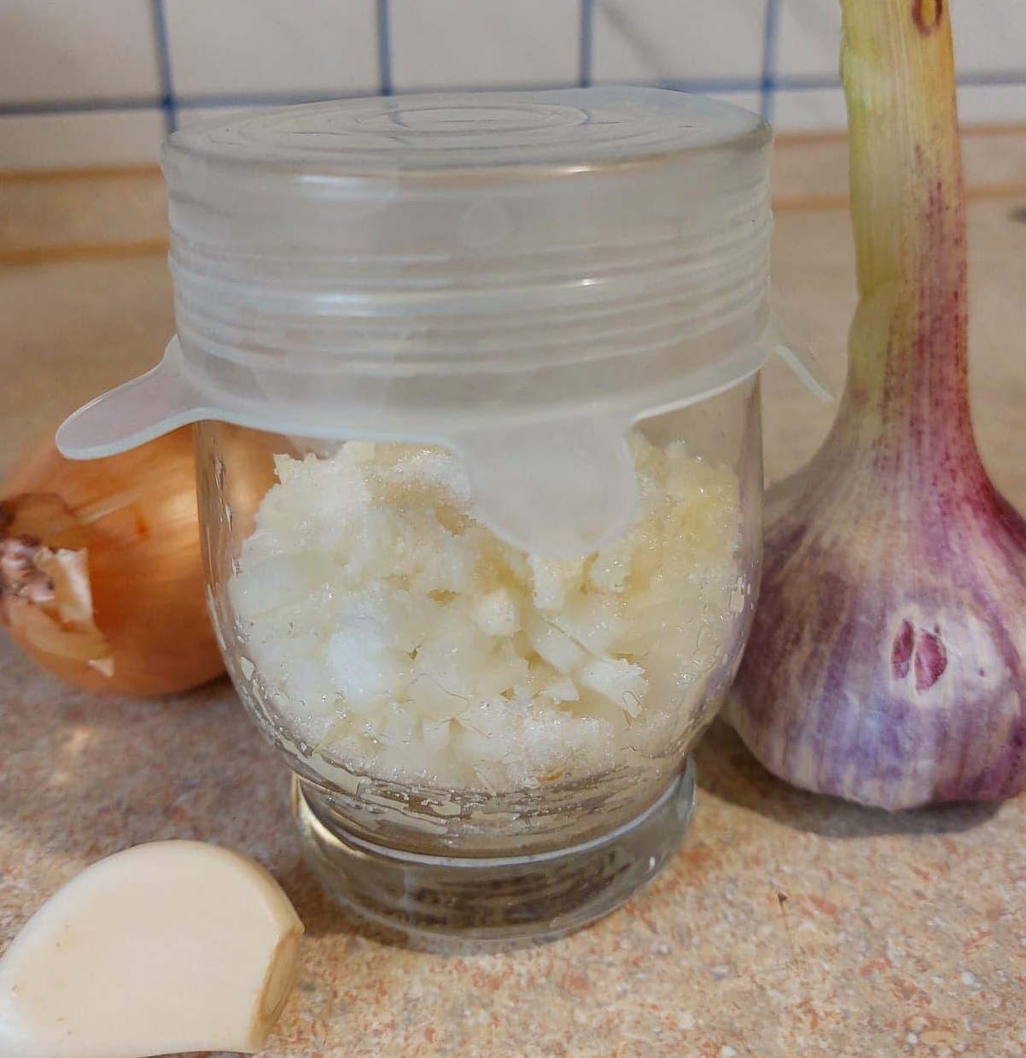
Onion and garlic syrup
You can starin the syrup and pour it to the clean coverd glass
Store in the fridge for 3 days.
Serve by the tablespoon 3 times a day.

Slide 6
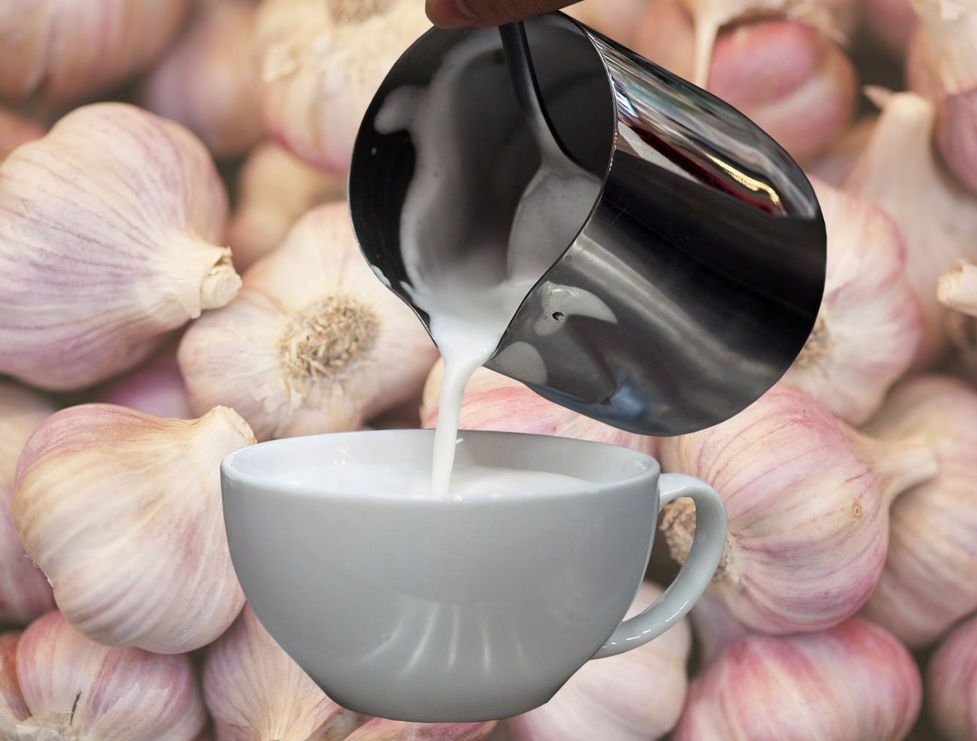
Garlic milk
Cures cough and cold
Treats pneumonia
Reduces cholesterol
https://soyummy.com/garlic-milk-new-trend-serious-health-benefits/

Slide 7
Garlic milk
Ingredients:
1 cup of milk
2-3 cloves of garlic
1 tablespoon of honey

Slide 8
Garlic milk
Crush the garlic.
Pour the milk and garlic in the pot.
Bring it to a boil.
After the mixture is colled down add honey

Slide 9
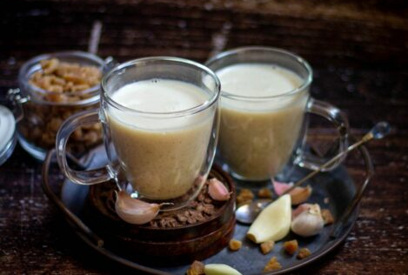
Garlic milk
Serve the milk when it is warm
https://www.vidhyashomecooking.com/garlic-milk-poondu-paal/

Slide 10
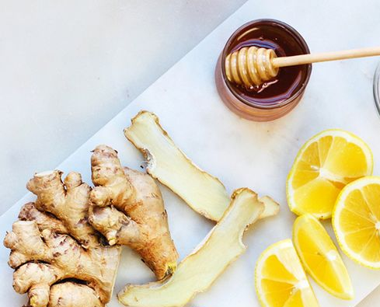
Ginger lemon honey tea
Remedy for:
sore throat
cold
cough
https://pl.pinterest.com/pin/540994973984925202/

Slide 11
Ginger lemon honey tea
Ingredients
Glass of tea
2 cm of ginger root
½ lime
2 tablespoons of honey

Slide 12
Ginger lemon honey tea
Brew the tea.
After it is colled down squizze into it lemon juice and add honey.
Peel the ginger, slize it into half and press it out, to your tea, using the garlic press.
Mix the tea.

Slide 13
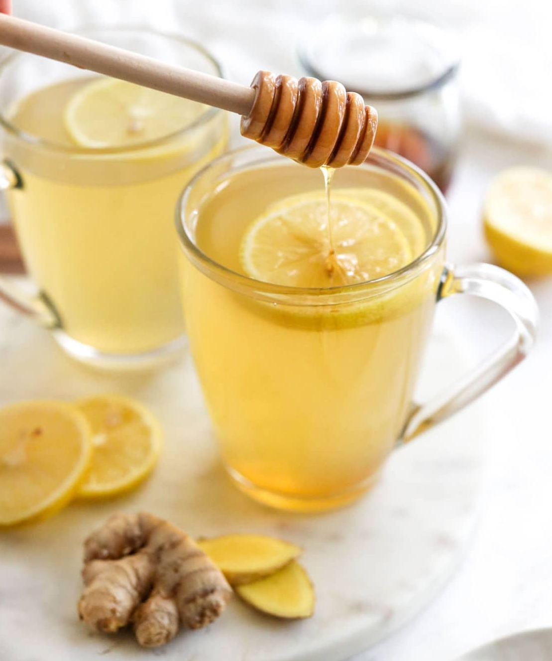
Ginger lemon honey tea
Serve the tea when its warm
https://detoxinista.com/ginger-tea/

Slide 14
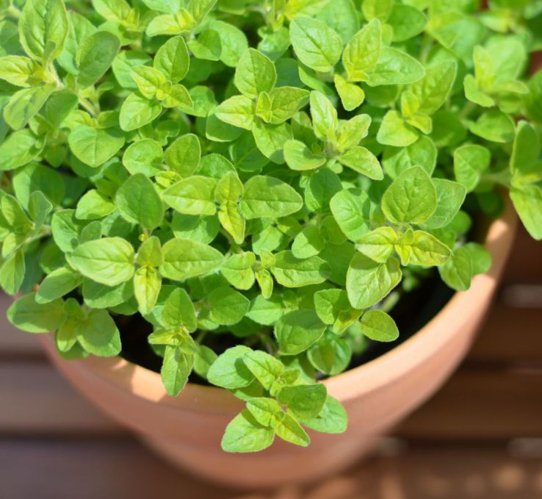
Marjoram tea
Stimulates digestion
Relieves:
body pain
the symptoms of runny nose
https://www.sosrodzice.pl/majeranek-na-kaszel-i-katar/

Slide 15
Marjoram tea
Ingredients:
Glass of water
Tablespoon of marjoram herb
Optionally:
1 teaspoon of honey
Dash of lemon

Slide 16
Marjoram tea
Add the marjoram to a cold wather in a pot.
Simmer it for 15 minutes.
Strain it into a cup.
When its colled down you can optionally add dash of lemon and honey.

Slide 17
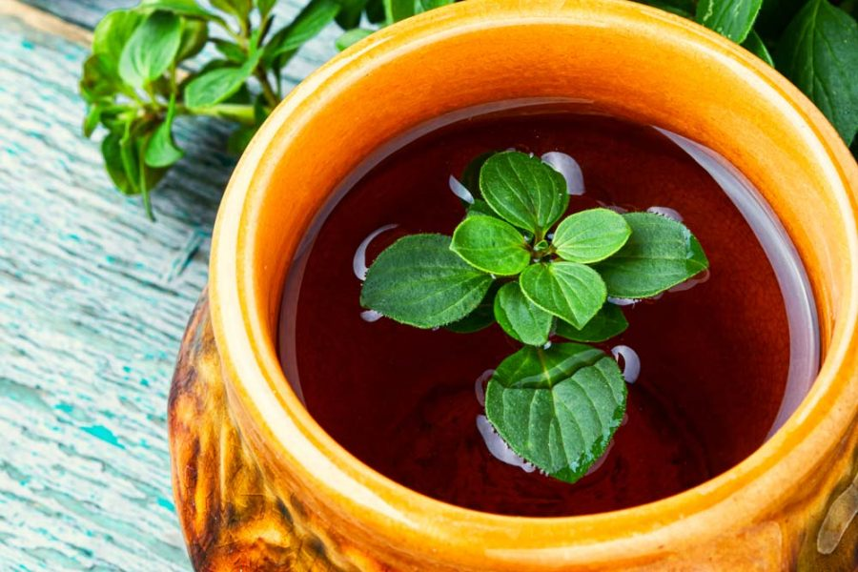
Marjoram tea
It is recommended to take up to three cups of marjoram tea in a day
https://www.hekmac.com/en/hypothyroidism-with-marjoram-tea/

