Slide 1
Cypriot Superstitions

Slide 2
Everyone’s a little bit superstitious sometimes…

Slide 3
Quirky and bizarre superstitions that Cypriots/Greeks believe are legion. While the younger generations don’t believe them as strongly as their elders, superstitions have been passed down from one generation to another and are part of the country’s cultural identity. Here are some Cypriot/Greeks superstitions that might make you smile or surprise you.

Slide 4
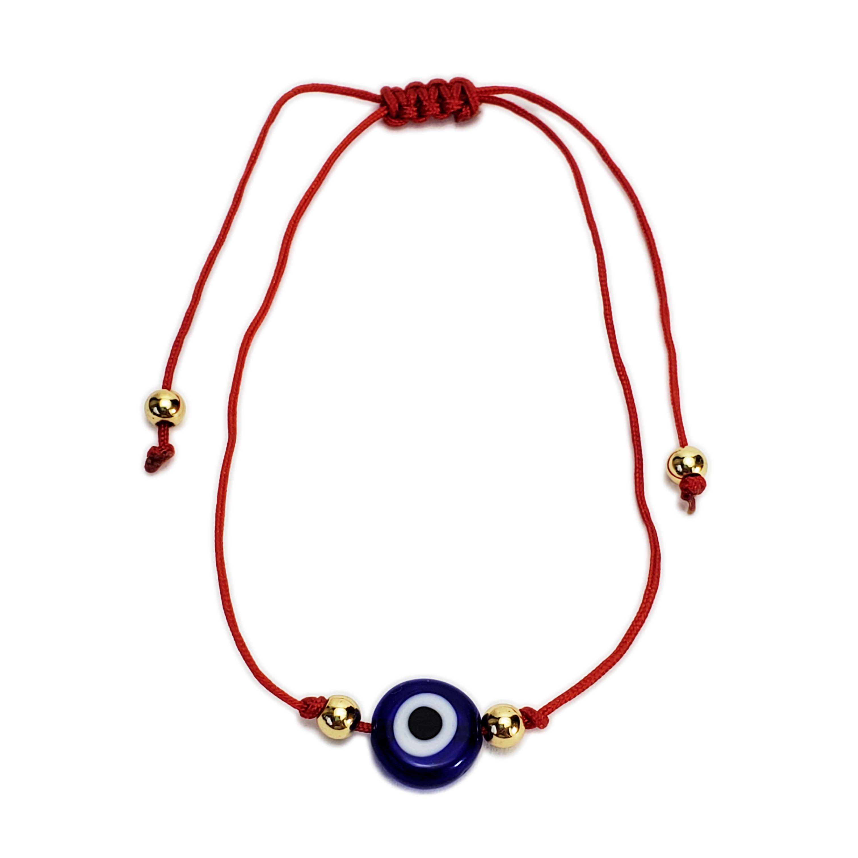
The evil eye (to mati)
One of the well-known superstitions in Cyprus but also in numerous other countries, the ‘evil eye’ is believed to be caused by a compliment or jealousy. Repercussions range from illness, misfortune, harm and sometimes even death. To ward off any curse, people wear charms in the shape of an eye; to remove the curse, the receiver usually asks an elder woman (mother, aunt, even a priestess) to recite a secret prayer. Other techniques include spitting (don’t worry, no actual saliva is required), or by throwing salt over the shoulder.

Slide 5
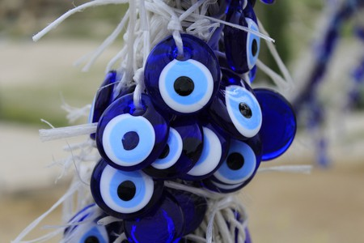
Spitting to bring good fortune
Spitting, or rather the spitting sound (ftou ftou ftou, always three times to represent the Holy Trinity) is believed to protect against the curse of the evil eye. It is not rare to also hear someone say ‘ftou ftou ftou’ when they hear about someone’s misery or misfortune to protect themselves or their loved ones from it. But the most common occurrence is with babies, where people make the spiting sound to protect the child from any harm.

Slide 6
Sneezing
According to an old superstition, sneezing is thought to mean that someone is talking or thinking about you. To know who that person is, simply ask someone to give you a three-digit number; add each digit together and find the corresponding letter in the alphabet, and that’s the first initial of the person thinking about you.

Slide 7
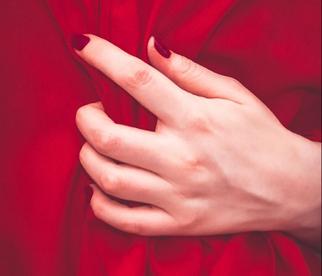
Touch red (piase kokkino)
When two people speak the same words at the same time, CypriotGreeks believe this to be a sign that the two will get into a fight. To avoid the argument, they have to touch something that is red (piase kokkino) immediately.

Slide 8
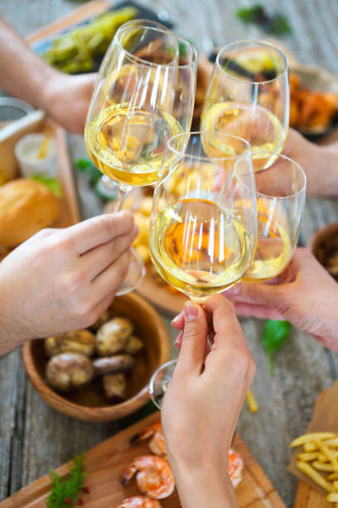
Cheers (Gia mas)
Just like anywhere in the world, Greeks cheer by saying “Gia mas” with alcohol, be it with wine, zivania, ouzo, beer or tsipouro. But one thing they will never do is cheer with coffee, which is said to bring bad luck.

Slide 9
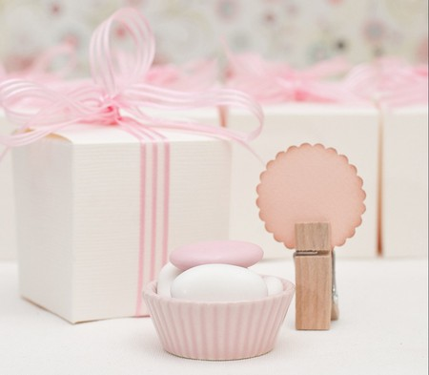
Tradition has it that if a single woman places the bag of dragées (sugared almonds given as wedding favors) from a wedding under her pillow before sleeping, she will dream of the man she will marry.
Dragees (koufettes)

Slide 10
- "Αδκειασερός παπάς, θάβκει τζαι τους ζωντανούς" → "A priest without a job buries the living" Meaning: whoever doesn’t have a job does the unnecessary - When you see a black cat means bad luck. - When you visit a house, leave by the door you came in - Otherwise, the embassies are spoiled. - At night, you don't carry olive oil. - When the pregnant woman is hungry, she must eat the food of her desire – Otherwise, a mark will appear on the child - Don't walk over a baby – Stay short
Some daily proverbs and superstitions:

Slide 11
If your nose eats you, you will cry. If your right hand eats you, you will give money. If your left hand eats you, you will get money. If your back eats you someone will beat you. If your right eye closes, you will see a loved one. If your left eye closes, you will see someone you don't like. If your right ear whistles you are praised, if your left ear they curse you. If a bud (a type of butterfly) comes to your house, you will have visitors. Friday's laughter in Saturday's tears.
Superstitions that were also told to children

Slide 12
Thank you
Simoni Papanearchou
Eleni Omirou

