Slide 1
Tomato soup
Recipe and photo

Slide 2
Ingredients:
~ 2 chicken drumsticks (about 0,5 kg)
~ 4 carrots
~ 2 parsley roots
~ piece of celery (about 10 decagrams)
~ large leek – only the white part
~ medium-sized onion
~ 2 tbsp tomato puree
~ 0,5 cup sour cream 30%
~ 1 tablespoon of wheat flour
~ bay leaf
~ 2 grains of allspice
~ 5 peppercorns
~ 0,5 teaspoon sugar

Slide 3
Ingredients:
~ salt
~ freshly ground black pepper

Slide 4
PReparation:
1. Wash the chicken legs, pour 6 glasses of water into a pot, add allspice, peppercorns, bay leaf and after the soup starts boiling, cook on medium heat for about 30 minutes.

Slide 5
PReparation:
2. Peel all vegetables, wash thoroughly and cut into large pieces. Add to a pot with meat and cook until medium soft. Add the tomato puree to the soup, season with salt, pepper and sugar.

Slide 6
PReparation:
3. In a cup, mix the cream and flour very thoroughly so that there are no lumps. Pour a few tablespoons of hot soup into the cream and mix again.

Slide 7
PReparation:
4. Pour the cream into the boiling soup, mix and keep it on fire for a few moments.

Slide 8
PReparation:
5. Take the soup off the heat, taste the soup again – season with salt, pepper and sugar if necessary.

Slide 9
PReparation:
6. The soup will taste best if you let it rest covered for few minutes.

Slide 10
PReparation:
7. Serve with rice or noodles and lots of green parsley.

Slide 11
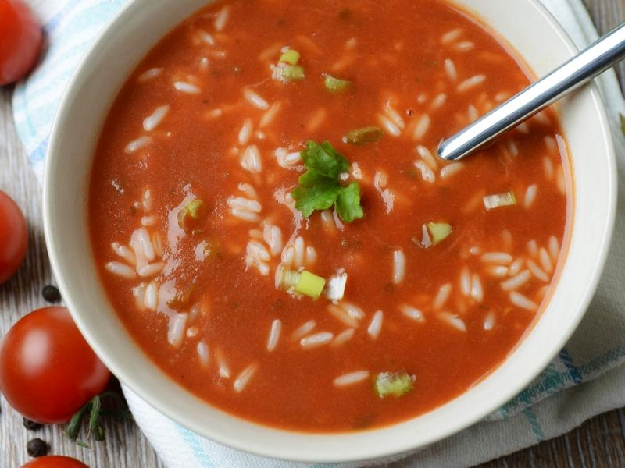
Photo:

