Slide 1
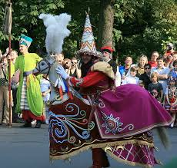
The LEGEND OF LAJKONIK
.

Slide 2
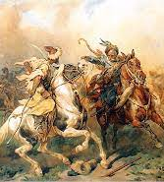
A long time ago Poland fought with Tatar hordes. During one of their invasions Tatars went to Kraków.

Slide 3
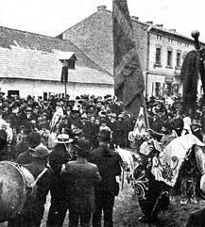
When the residents of Kraków were informed about the situation they gathered on a traditional procession. They were frightened and confused.

Slide 4
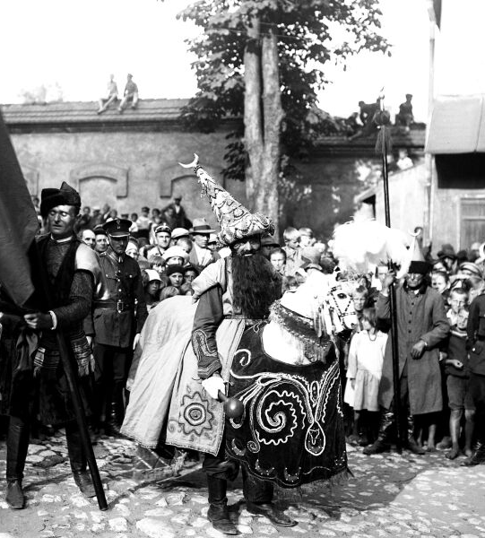
They didn't know what to do. They asked themselves if they should run or maybe fight.

Slide 5
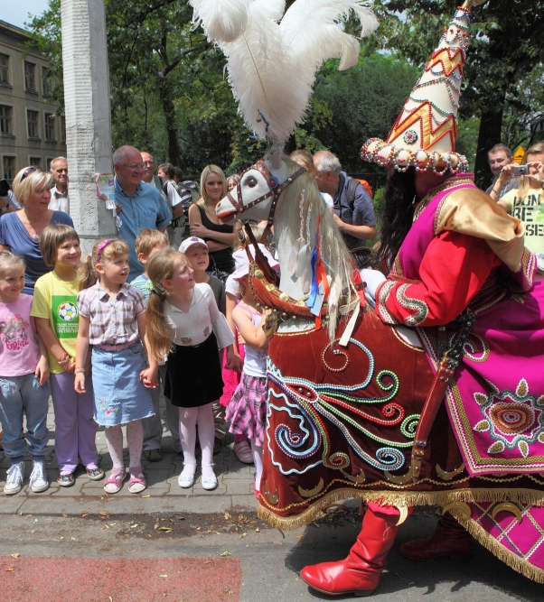
Then suddenly one of the rafters caught a banner with a white eagle and he shouted:
"If I had to die, I wouldn't allow to plunder our land"

Slide 6
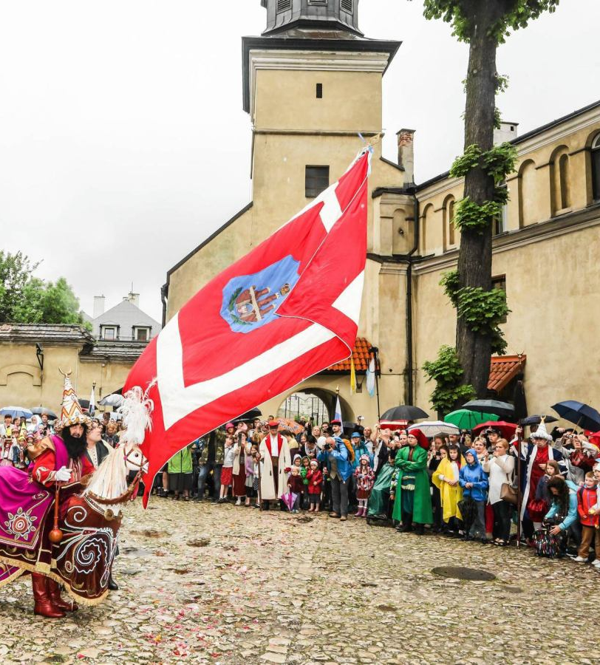
After these words he went to Zwierzyniec with people. A lot of people joined them. The fight was long and very dangerous but invaders were defeated.

Slide 7
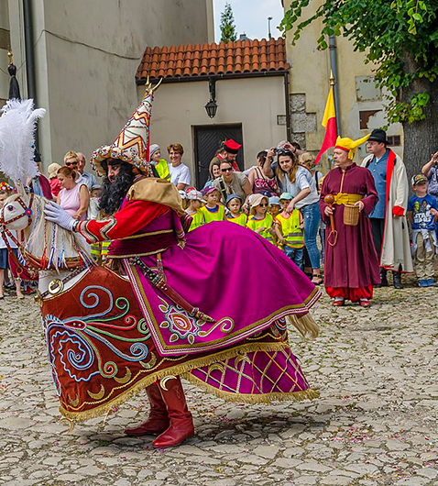
The boy who led residents of Kraków was welcomed with cheers at the city square. This procession is repeat every year. The boy is called Lajkonik.

