Slide 1
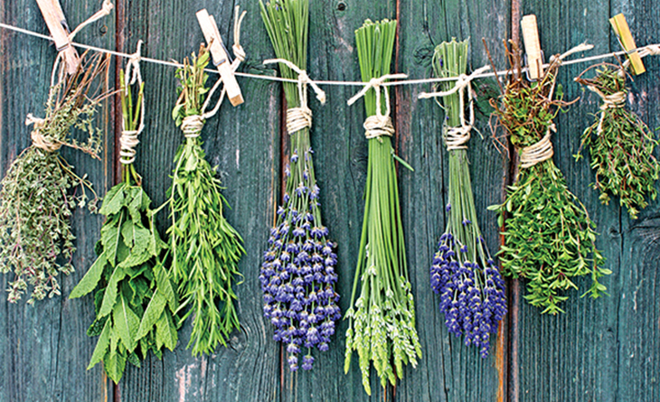
HERBS OF CYPRUS
Notes:
Line spacing + Page numbers

Slide 2
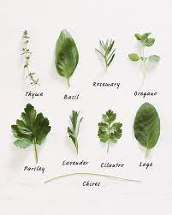
Introduction
01
Cyprus has a long history with herbs. Not only have they been referenced in archaeological and historical records, they have also been traded on the island from as far back at 2000BC.
There are reportedly some 600-herb species found across Cyprus today which is said to be due to the geology, weather, and location of the island.
So popular are the herb varieties here, many are exported across the globe. These include mint, oregano, chamomile, nettle, daphne, bay leaves and others.
Cypriots are also known to incorporate the use of herbs into daily life, not only for cooking, but also in beverages or as essential oils utilised in a range of massage therapies.

Slide 3
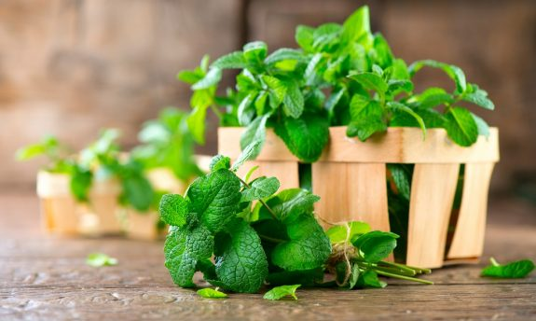
Mint (Diosmos) Cypriots love mint! It is perhaps the most common herb used in a wide variety of applications both in local cuisine and for healing. Mint will make an appearance in at least one of your dishes at any local restaurant on the island. It is typically found as an added flavour to any ‘tzatziki’ made in Cyprus, or a few leaves could be discovered tucked away in a packaged halloumi cheese for added flavour. Dried mint is also a favourite addition to halloumotes bread with halloumi cheese in it, or mince-meat for koupepia (stuffed grape leaves) or keftedes (Cypriot meatballs).

Slide 4
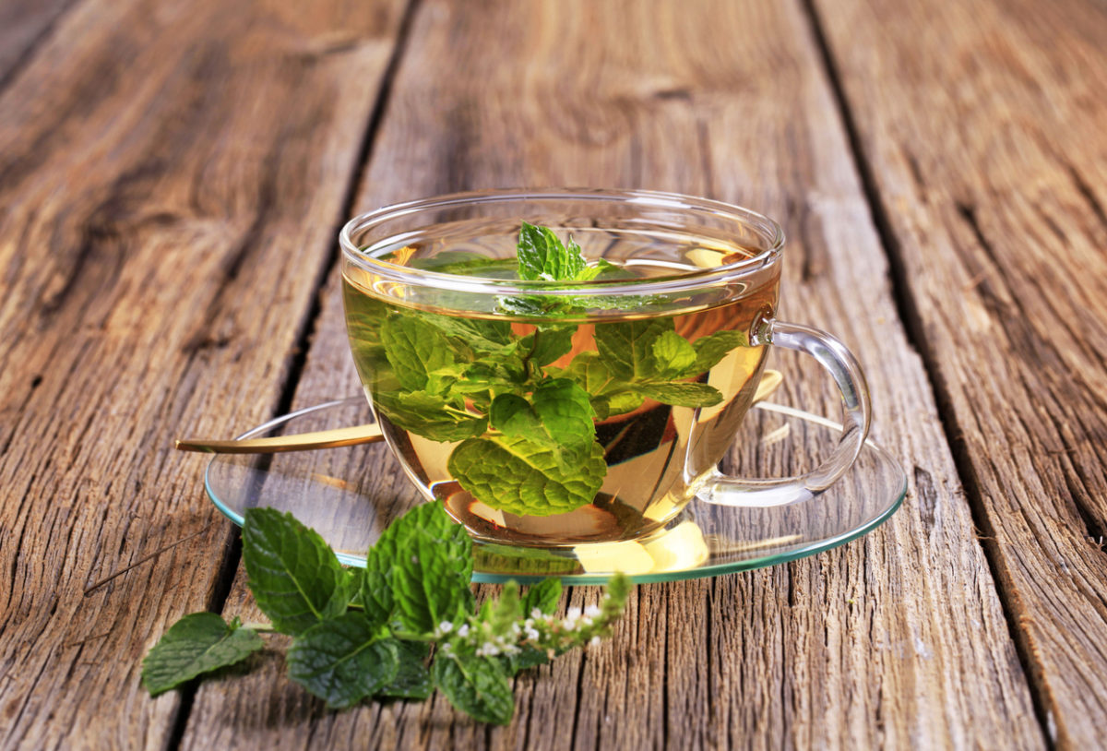
Tip from grandmother: You can boil dried mint leaves, add little honey and make a refreshing tea.
* Another tip is to use peppermint oil as a cold rub on the chest or inhale it through a casserole with water or vaporizer and you will find that your nasal congestion has disappeared.
Mint helps in ulcerative colitis, migraines, digestive problems, colds, sinusitis, help to improve memory and concentration. It has an antiseptic effect, used for treating bloating, and helps fight diarrhea.

Slide 5
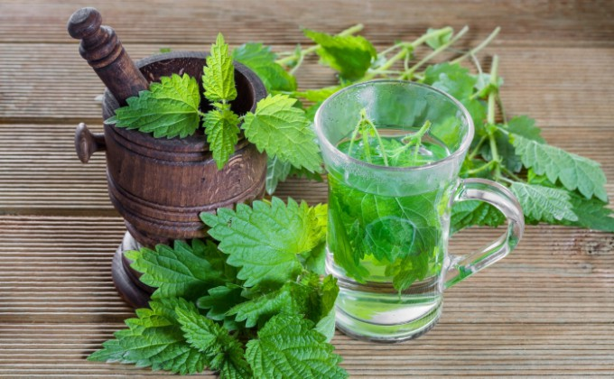
NETTLE (TSOUKNITHA)
In Cyprus this native health-boosting herb grows always in our yard and fields.
→ It is an anti-inflammatory, tonic, diuretic, hemostatic plant, rich in iron, proteins
and minerals.
Nettle relieves arthritis pain and eczema. Very refreshing, has anti-fatigue and anti-stress properties.
Nettle has been used since ancient times for its healing properties, for food and for the production of fabric. In the Bronze Age in Denmark were found savannas made of nettle fibers, which indicates that they were used to make fabrics. There is also evidence that in the Neolithic era it was used to create strings.
Many of us had the unpleasant experience of being stung, the poison causes a nasty stinging sensation and a skin rash. The poison that provides from in it's glandular hairs is the protective shield of the nettle but i did not know what it really do in our health this medicinal misunderstood but extremely vitamin curative plant-herb.

Slide 6
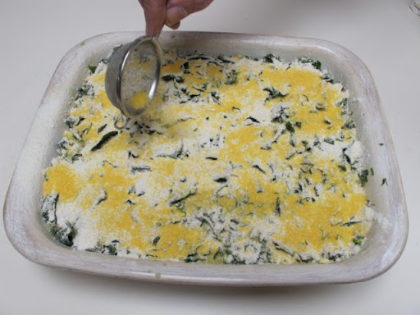
Grandmum’s tips:
1st Tip: For consumption considered best young and tender shoots. We can eat it boiled with oil and lemon or you can make a nettle-pie but even more delicious is the soup of nettle.
If we add the nettle in the soup just three minutes before the end of the cooking, the vitamins and minerals are not lost.
** Do not worry for the poison needles during the ingestion, are destroyed by cooking, boiling or baking.
2nd Tip: Use dry nettle shoots in warm foot bath to reduce phlebitis

Slide 7
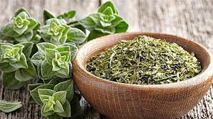
OREGANO (RIGANI)
The leaves of oregano (Oregano), in addition to its extensive use in cooking, can be used as a tea for colds, flu, cough and whooping cough.
Also oregano leaves are useful as a mouthwash during inflammation. For stress and headaches you can use tea from oregano. It is included in many medicinal teas.
Adding oregano to meat before cooking may help reduce the amount of toxic compounds created by the cooking process.

Slide 8
Chamomile (Hamomili)
A universally known herb that helps fellow plants, the animals that eat it, and us humans.
The ancient Greek doctor Hippocrates was one of the first individuals to identify its healing properties. Deriving from a flower that’s often mistaken for a daisy, one way to distinguish them is by smell: Daisies are odourless whereas chamomile flowers have a strong smell. It is mostly known to relieve anxiety and insomnia, so it’s recommended to consume it in the evening.
It can also help with a cold, flu, nerves, dyspepsia, migraine, neuralgia, dizziness, stomach aches, rheumatism, stress, menstrual pain, urinary infection, ulcerations and pains in the intestines.
Grandma's Tip: For baggy eyes or dark circles, you can place bags of chamomile on your closed eyelids to soothe the puffiness.
Grandma’s Tip: You can also place in a small towel chamomile extract and use it to treat skin disorders, sunburns, and reduces allergy symptoms.

Slide 9
Andria Kouta Class:G’8

