Slide 1




Herbs in Romanian Folk Medicine
- a presentation made by the pupils of the Romanian ”Folklorica” project team in ”Constantin Noica”
Theoretical High School Sibiu -

Slide 2
Rostopasca
Chelidonium
majus

Slide 3

Rostopasca, also known as the wart grass or blackberry, is an herbaceous plant easily recognizable by the yellow latex that browns in contact with the air. The leaves are simple, alternate, unstinned. The flowers are actinomorphic (with radial symmetry), bisexual, yellow, grouped in simple umbels. It blooms from April to September. The fruit is a capsule. Rostopasca is common in shady, ruderal places (around human settlements), in bushes, up to the mountainous region. Harvesting is done in nice, sunny weather, on days without rain (rain favors the browning of the plant, which leads to the degradation of active principles). We collect the aerial part of the plant (stem, leaves and flowers), being careful not to uproot the plant, which will then give other stems. The therapeutic indications of this plant are: acne, hepato-biliary disorders, digestive disorders, intestinal disorders, spleen disorders, angina pectoris, angiocolitis, arthritis, bronchial asthma, cerebral arteriosclerosis, bladder atony, warts, blepharitis, skin diseases persistent, cataract, bronchial catarrh, cancer, skin cancer and externalized tumors, gallstones, headache, baldness, keratitis, cysts, ovarian cyst, liver cirrhosis, cholecystitis, high cholesterol, biliary colic, atonic constipation, biliary dyskinesia, dyspepsia, liver, infectious eczema, epidermophytia, pharyngitis, intermittent fever, uterine fibroids, fistulas, gastritis, nausea, gout, chronic hepatitis, viral hepatitis (A, B, C), rebellious oral and genital herpes, hypertension, hyperopia, hirsutism, jaundice , indigestion, chronic skin infections, genital infections (with papilloma- candidatrichomonas), throat infections, intestinal infections, chronic eye inflammation intestinal inflammation, insomnia, heart failure, hysteria, laryngitis, lipomatosis, gallstones, lupus, migraine, biliary migraine, warts, restlessness, neurosis, tired eyes, panaritium, pancreatitis, intestinal parasitosis, spots on the cornea, pilosis, infected wounds, rheumatism, intestinal spasms, tachycardia, tuberculosis, externalized tumors, spastic or convulsive cough, duodenal ulcer, varicose ulcer (atonic, old wounds), chronic eye ulcers, venereal vegetation.

Slide 4
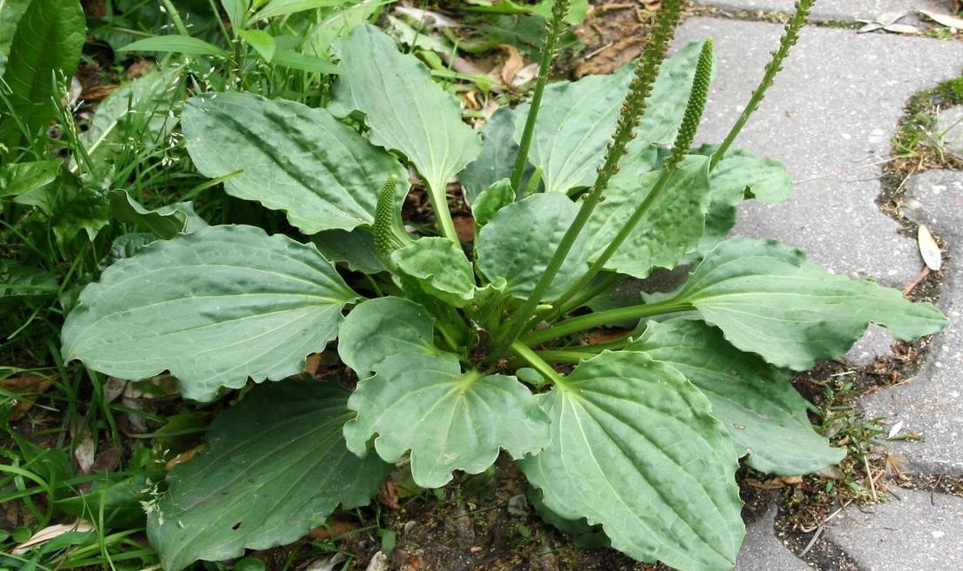
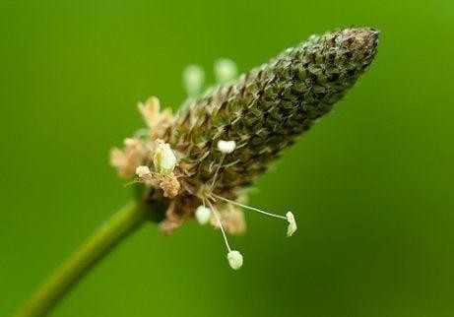
Pătlagina
Plantago

Slide 5

Plantain is a perennial herbaceous plant, 10-50 cm tall, with ovate or lanceolate leaves, straight flowering stems, spike-shaped terminal inflorescences and small, yellowish popcorn. Plantain is very widespread, vegetating in trampled places where other species do not grow. It grows on roadsides, in weeds, in pastures, crops, from the plains to the alpine area. Plantain leaves act as an emollient and expectorant, antihemorrhagic, healing, hypocholesterolemic, antiseptic, hypotensive. It is also used for gastric ulcer, catarrh (urinary or digestive), hypertension, wounds, varicose ulcers, laryngitis, stomatitis, tracheitis, hemorrhoids, conjunctivitis and blepharitis, etc. Plantain is a powerful anti- bacterial, anti-inflammatory and healing, so the crushed leaves can be a remedy for insect bites, in case of minor burns. Due to its anti-bacterial, anti-inflammatory properties, it is used to treat inflammatory diseases of the respiratory tract, to relieve coughs, and as an expectorant. Dissolves adherent mucus, promotes sputum formation (tracheobronchial secretion). It covers the mucous membrane and relieves inflammation, eliminates the cough reflex. Due to the lack of side effects, it is also used successfully in pediatrics. It is sometimes used as a laxative due to the fact that the core swells slightly. For external use, in folk medicine, it is used for superficial lesions, purulent wounds, cuts, ulcers that are difficult to heal and to relieve bleeding. Fresh plantain leaves are applied to wounds that heal slowly: it is antiseptic, astringent, closes the wound, and facilitates blood clotting.

Slide 6
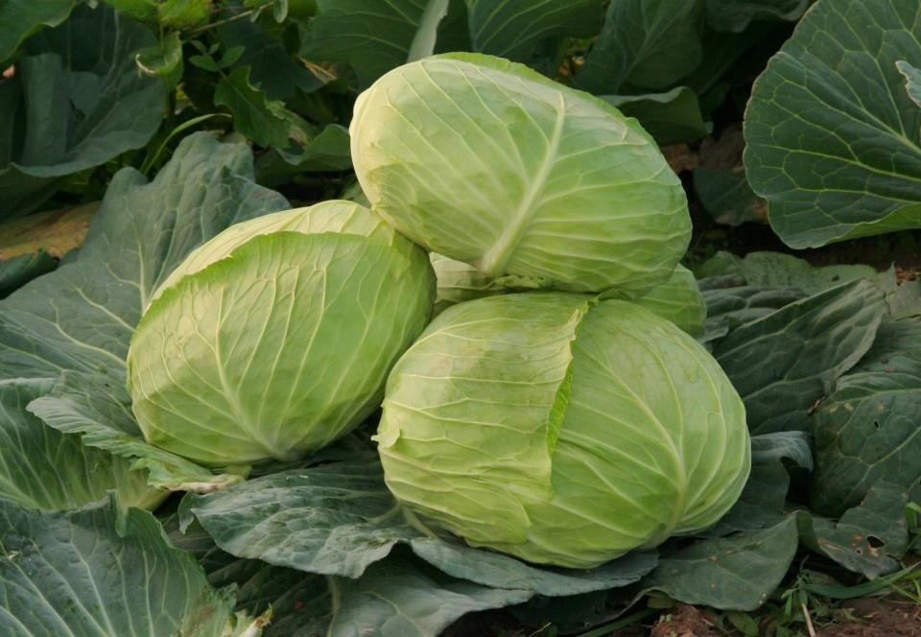
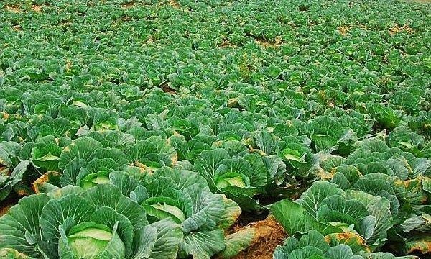
White Cabbage
Brassica oleracea

Slide 7

White Cabbage (Brassica oleracea) is an edible vegetable, one of the oldest vegetables known to man. It was known among alchemists as the raw material of food. White cabbage is a biennial plant: in the first year it vegetates, and in the second year it blooms. It is part of the Cruciferae family, so named because it has a type four flower, with the floral elements placed in the cross. The flowers are grouped in yellow inflorescences.
White cabbage is recommended for use in the treatment of anemia, diabetes, gallstones, cough (cabbage juice and honey), kidney disease, hemorrhoids, liver pain (raw cabbage in the form of poultices) and gastric ulcer. White cabbage acts as a laxative, a vitaminizer (for patients who recover after a period of lying down) and helps prolong life (vitamin A contained in cabbage delays aging, nourishing tissues). White cabbage can be eaten as sauerkraut, and in this case is an excellent remedy for treating alcoholism, strengthening the gums and treating intestinal infections; cabbage tea: it helps to cure chronic bronchitis, but also to treat diarrhea and constipation; Poultices with white cabbage leaves (applied topically), which helps to heal wounds, wounds and tumors.

Slide 8
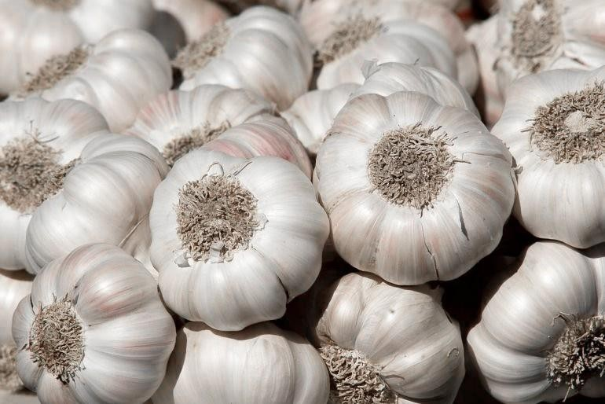
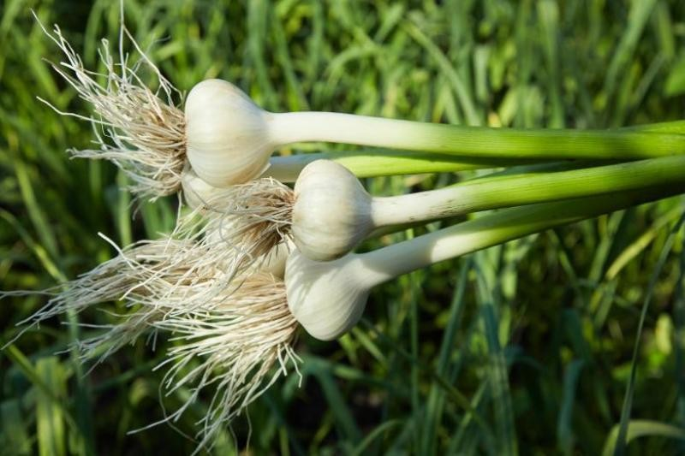
Garlic
Allium sativum

Slide 9

Garlic (Allium sativum) is an edible plant, used as food and spice. In folk medicine, it is considered, along with onions, a real medicine, due to its rich content of vitamins and minerals. In ancient Egypt and Roman times, garlic was known as a means of preventing contagious diseases. It was later established that the effect of garlic, in combination with honey, or other natural products, is beneficial in preventing or ameliorating cardiovascular disease, digestive disorders, or pneumonia. In addition to the antimicrobial effect, it also has an anthelmintic effect (against intestinal worms). One study showed that supplementing with garlic extract inhibits vascular calcification in human patients who have high blood cholesterol. Garlic is the food that works wonders for health by preventing obesity and fighting infections. The active ingredient in garlic, allicin, can also attack and destroy viruses or strong infections and is even recommended for children with asthma.

Slide 10
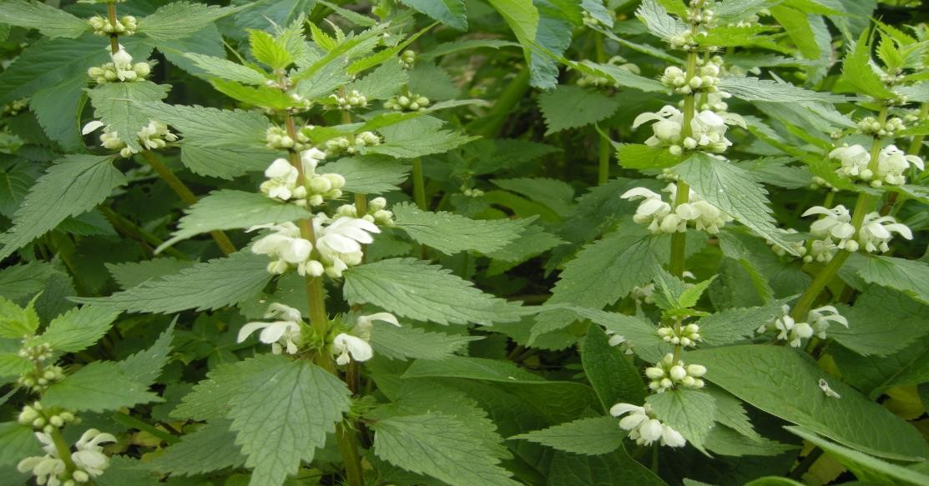
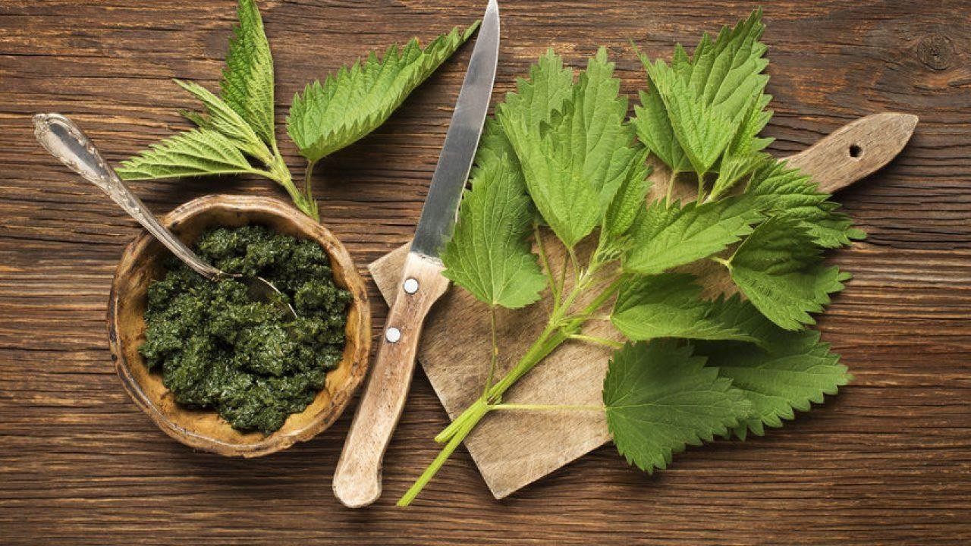
Nettle
Urtica dioica

Slide 11

Nettle (Urtica dioica) is a species of herbaceous, perennial plant, spread through uncultivated places in the plains, hills or mountains. You can see them from early spring to late autumn, near fences, on roadsides and in water, in gardens, orchards, on hills. The stem (with 4 obvious edges) and the leaves, opposite, oval, toothed on the edges, are covered with stinging hairs, the touch of which causes the skin to blister and itch. It can grow up to a meter in height. The flowers are dioecious, arranged on different plants, in panicles arranged in the axils of the upper leaves. The seeds are oval, greenish nuts with persistent danger. Nettles have the following medicinal properties: diuretic, hemostatic (stops bleeding), antiseptic, emollient, depurative, fights rheumatism and anemia, heals wounds and ulcers, stimulates hair growth, fights kidney disease, regulates blood pressure and blood sugar, stimulates the appetite laxative effect.

Slide 12

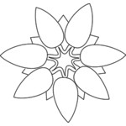
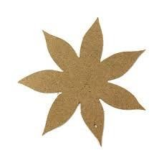





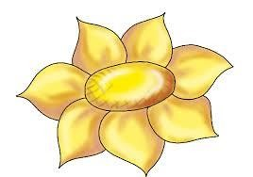
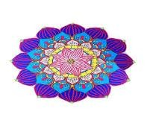
Together with our project coordinator, Mrs. Gabriela Mirela Jugar, we thank you for watching this presentation.
Take care of your health!
Life is beautiful.

