Slide 1
History of Croatia (VII.-XI. century)

Slide 2
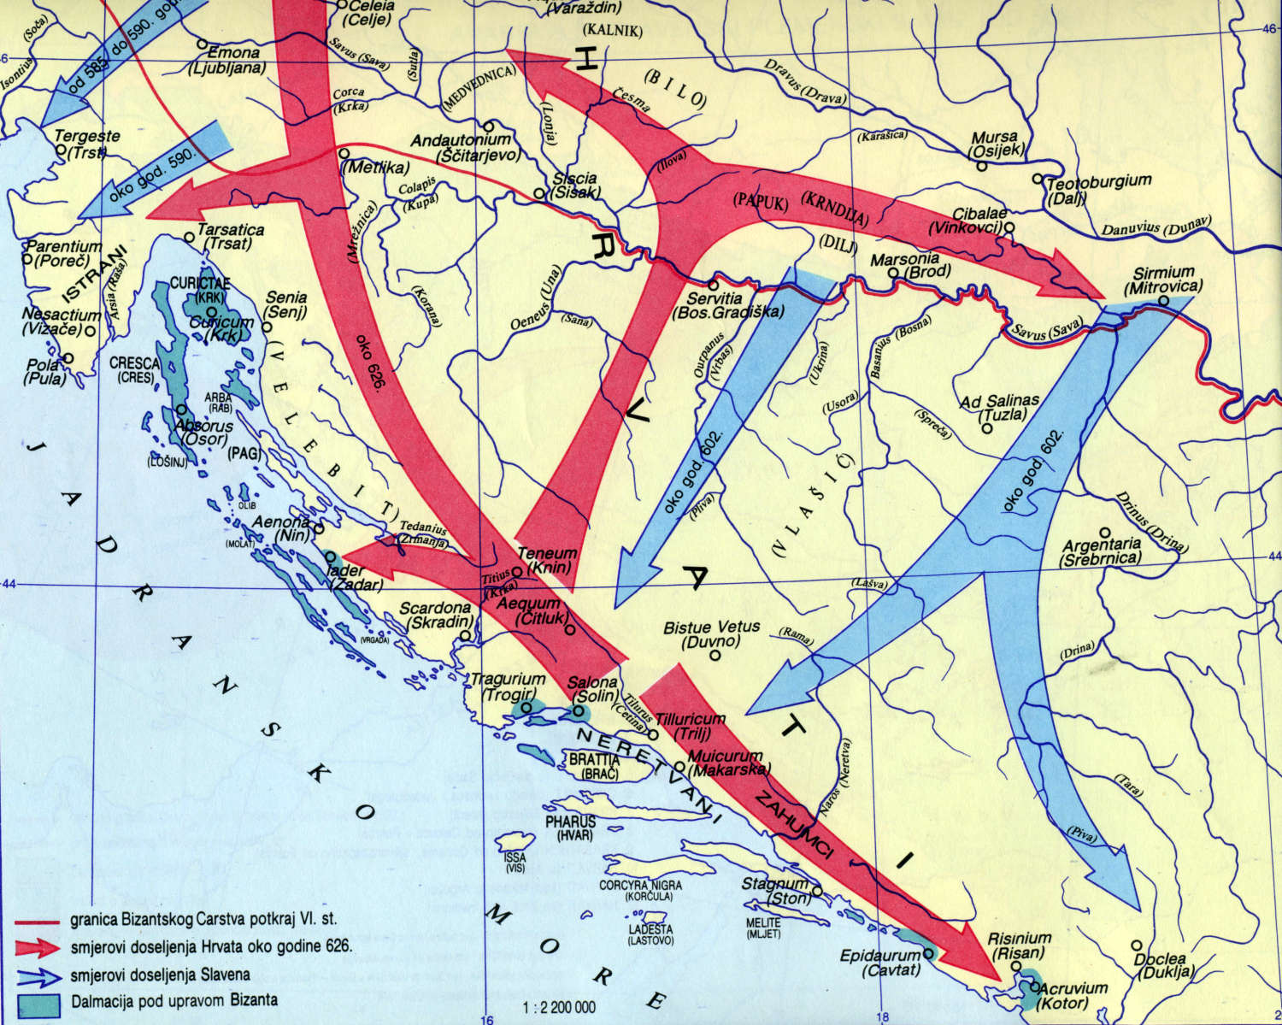
Migration of Croats
There are 4 theories about migration of Croats
Slavic theory
Gothic theory
Iranian theory
Dualistic theory

Slide 3
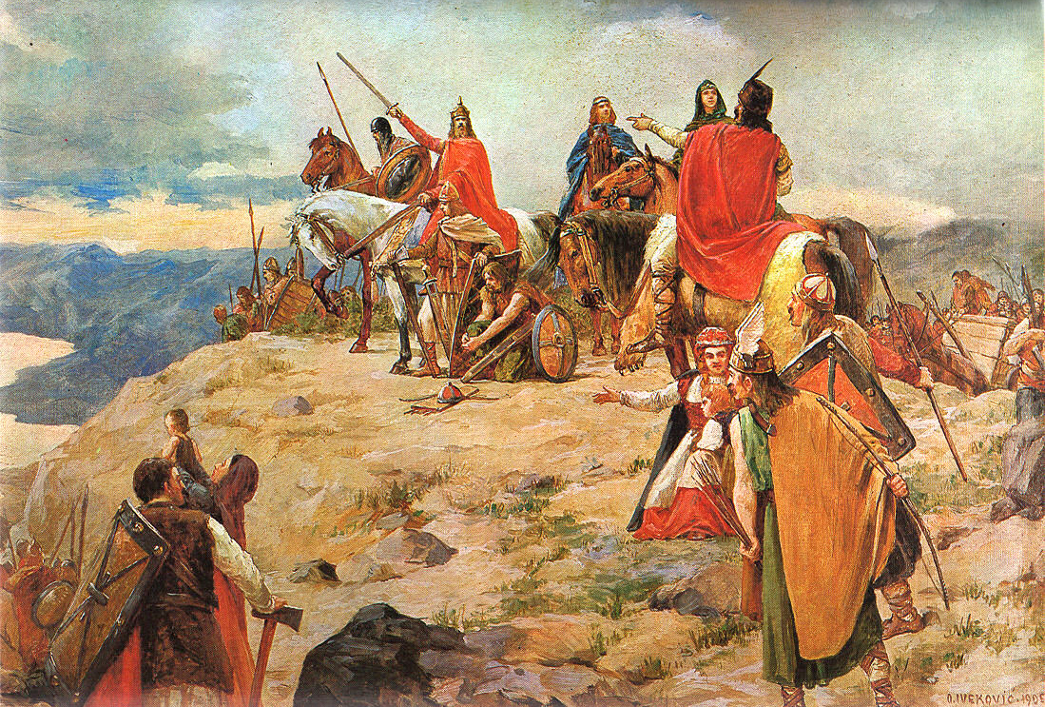
Arrival of Croats
7th century
Rivers Zrmanja and Cetina

Slide 4
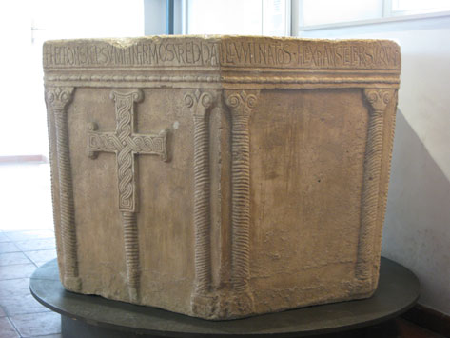
Christianization
Aquileia
Roma
Carigrad
Višeslav’s baptistery ( round 800. year)

Slide 5
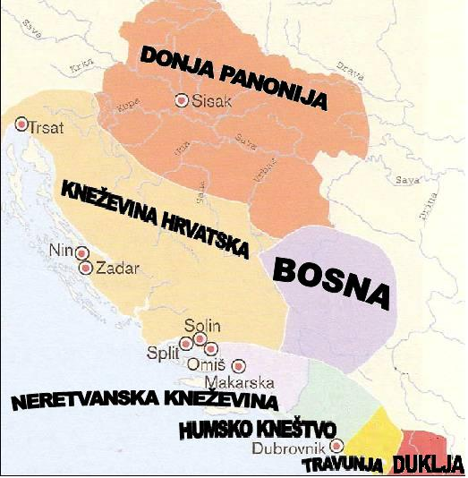
Sclavinias
Pagany
Zahumlye
Travunia
Lower Pannonia
County Croatia
Bosnia
Duklja

Slide 6
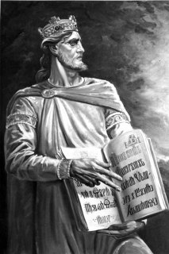
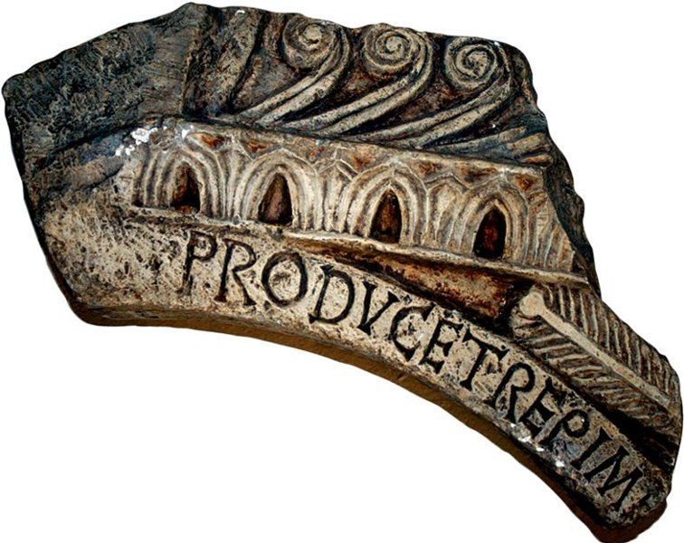
Count Trpimir
845.-864.
Dinasty Trpimirovichs
Fragment from Rižinice

Slide 7
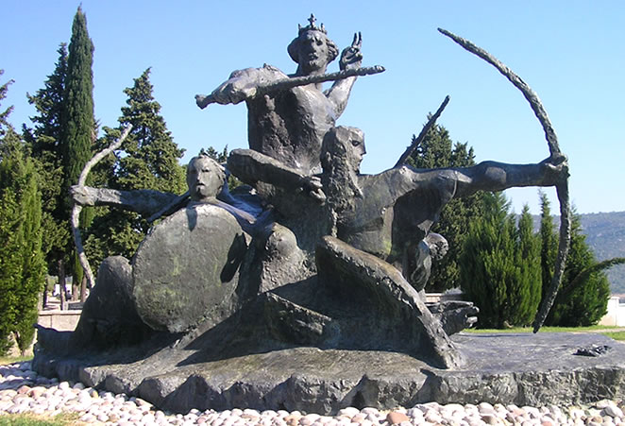
Count Domagoj
864.-876.
Battles against Saracens and Venetians
„The worst Slavic count”

Slide 8
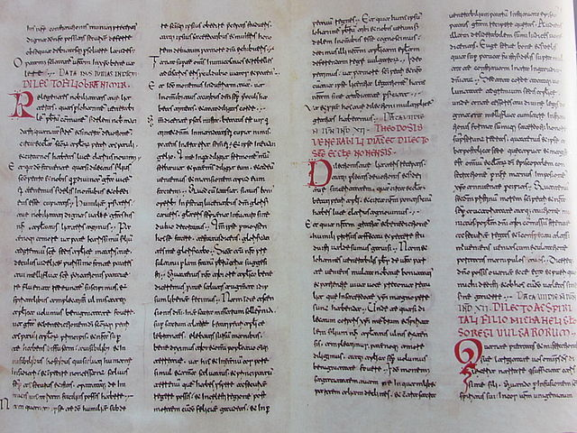
Count Branimir
879.-892.
Pope Ivan VIII.
Fragment from Šopot

Slide 9
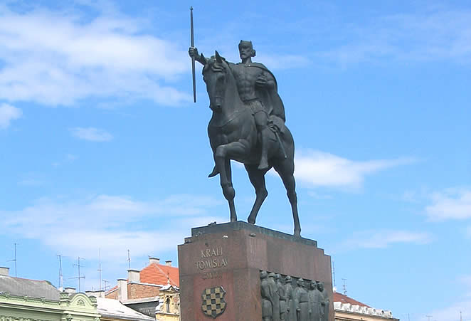
Count Tomislav
914.-925.
Wars against Hungarians and Bulgarians
925.-928. first Croatian king

