Slide 1
THE GAME ITALY MADE AND PLAYED
ERASMUS+ «CAN YOU TELLME THE WAY TO…? DISCOVERING OUR EUROPEAN HERITAGE ON FOOT».

Slide 2
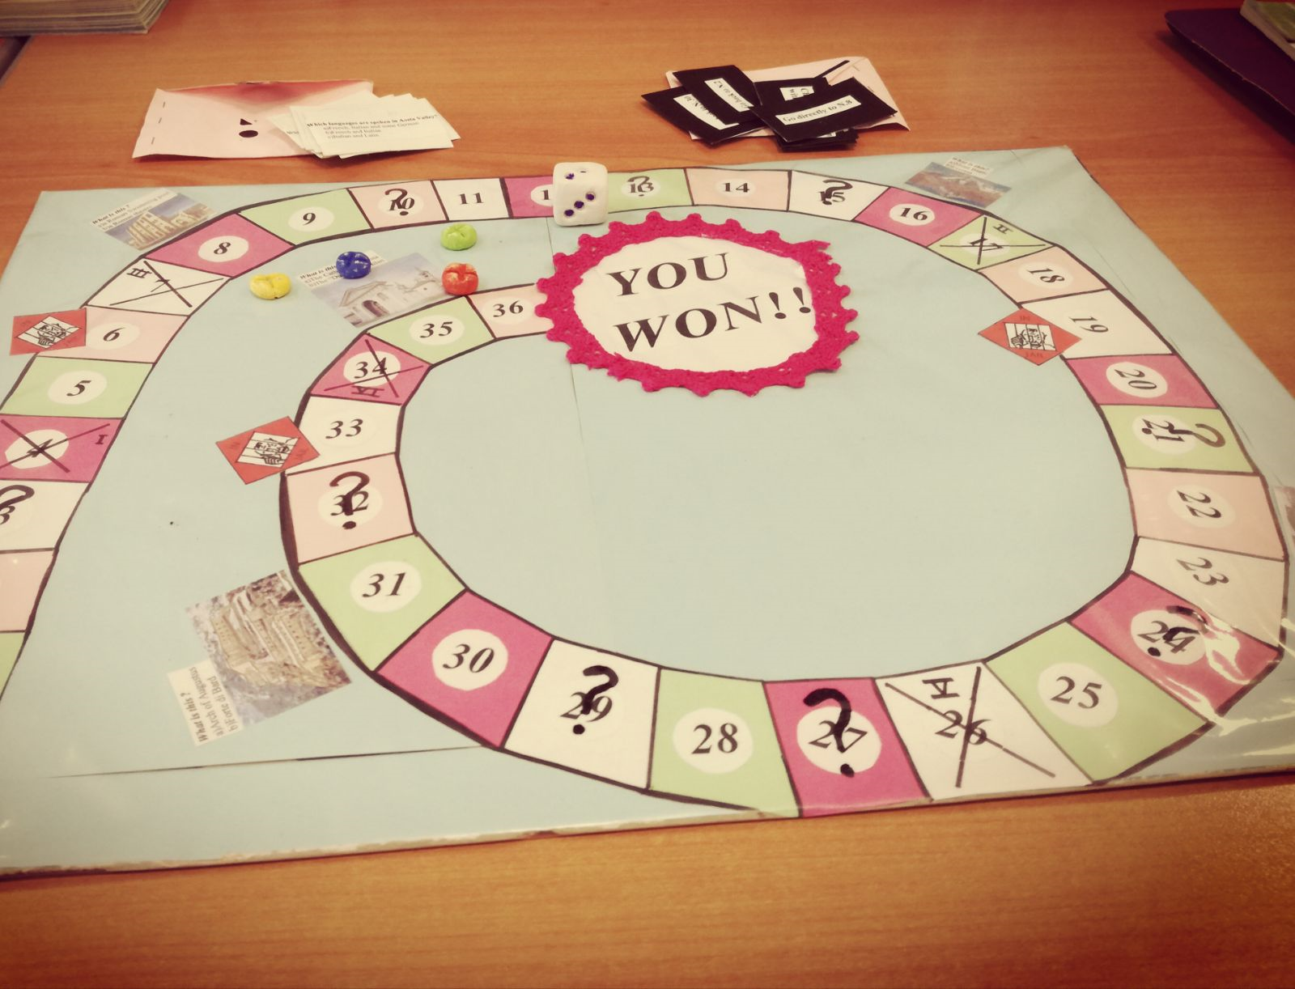
HISTORY HUNTERS

Slide 3
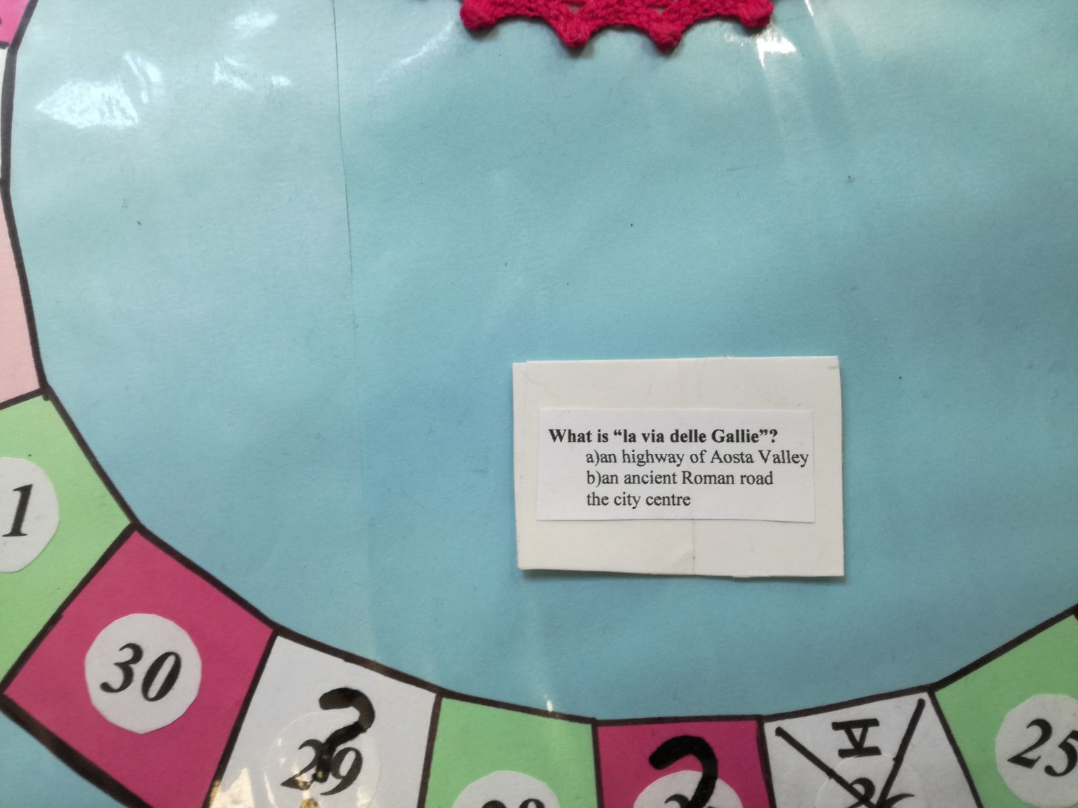
Findings from our research transformed into quiz cards

Slide 4
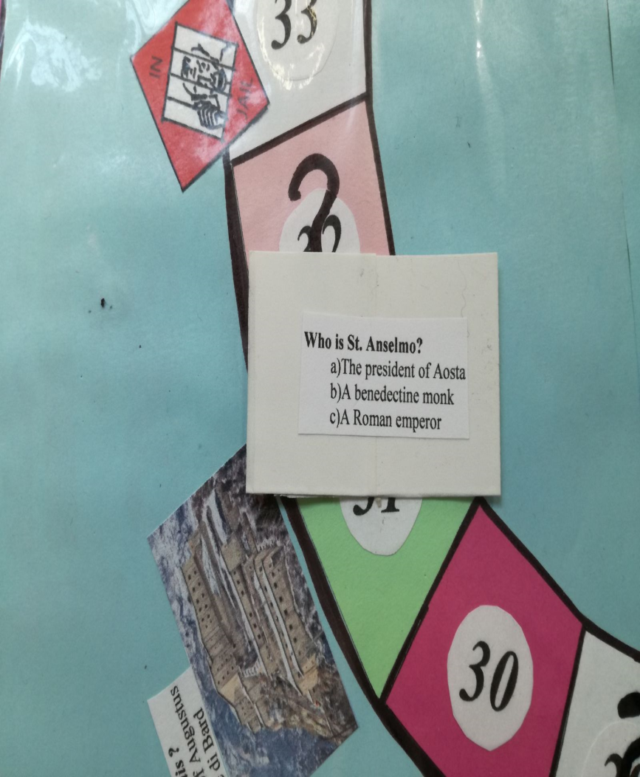
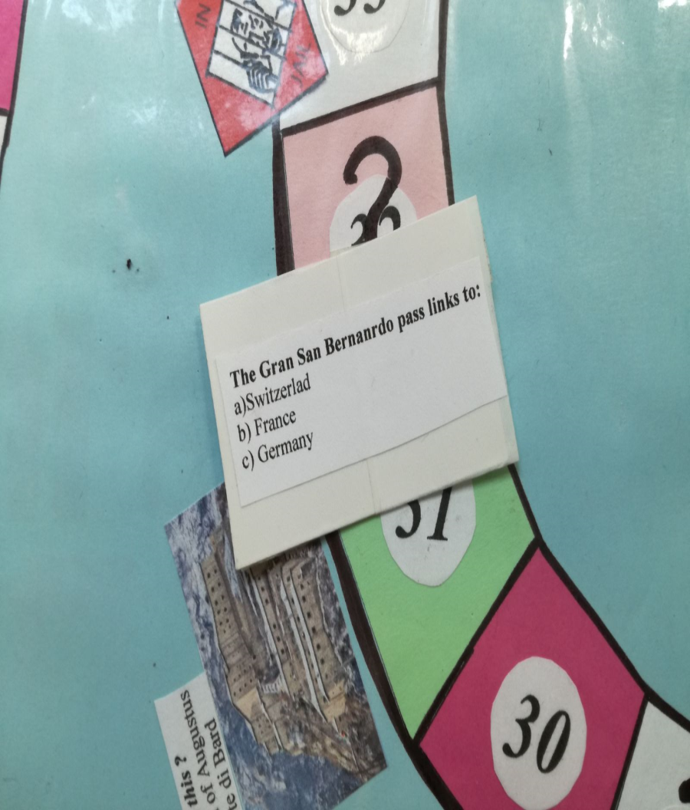
Questions on the history of our region and roads

Slide 5
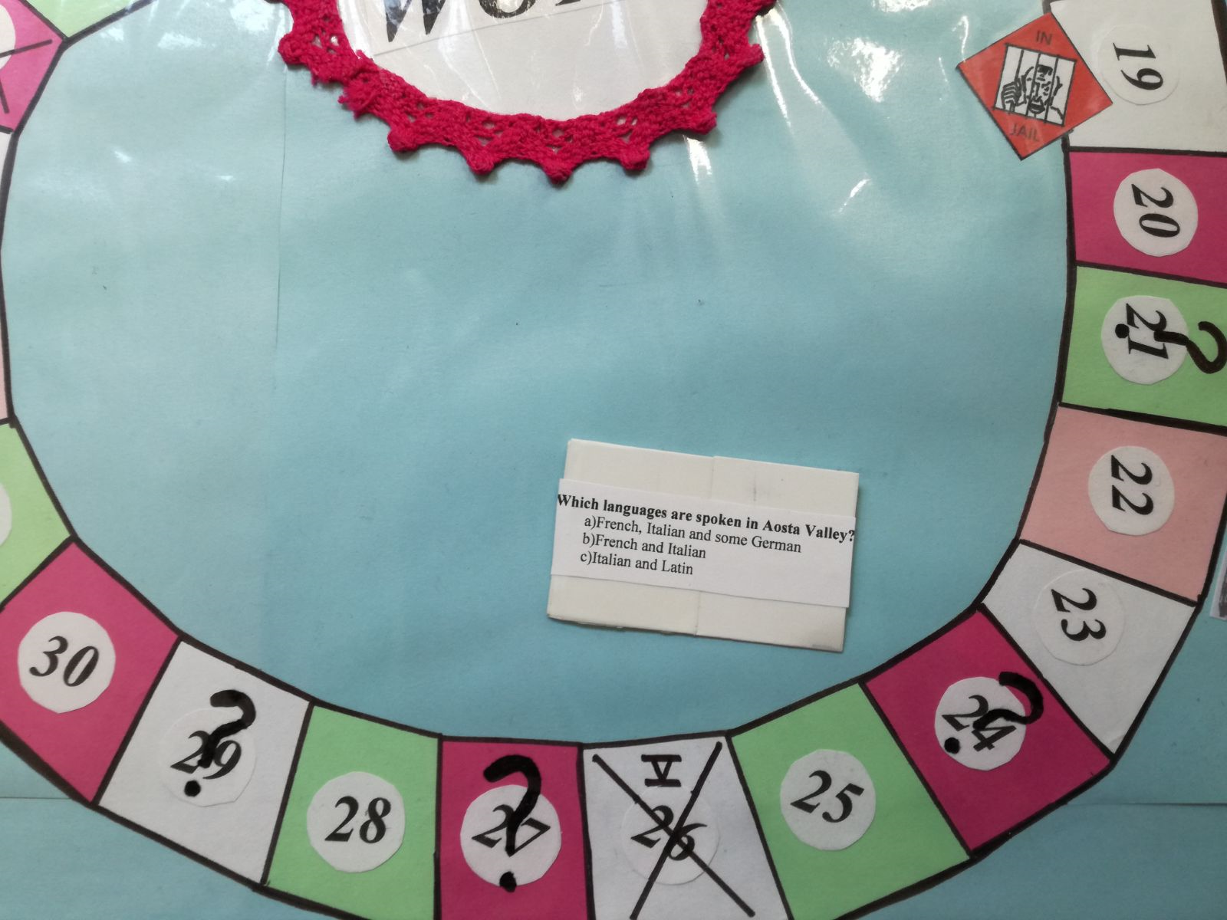
.

Slide 6
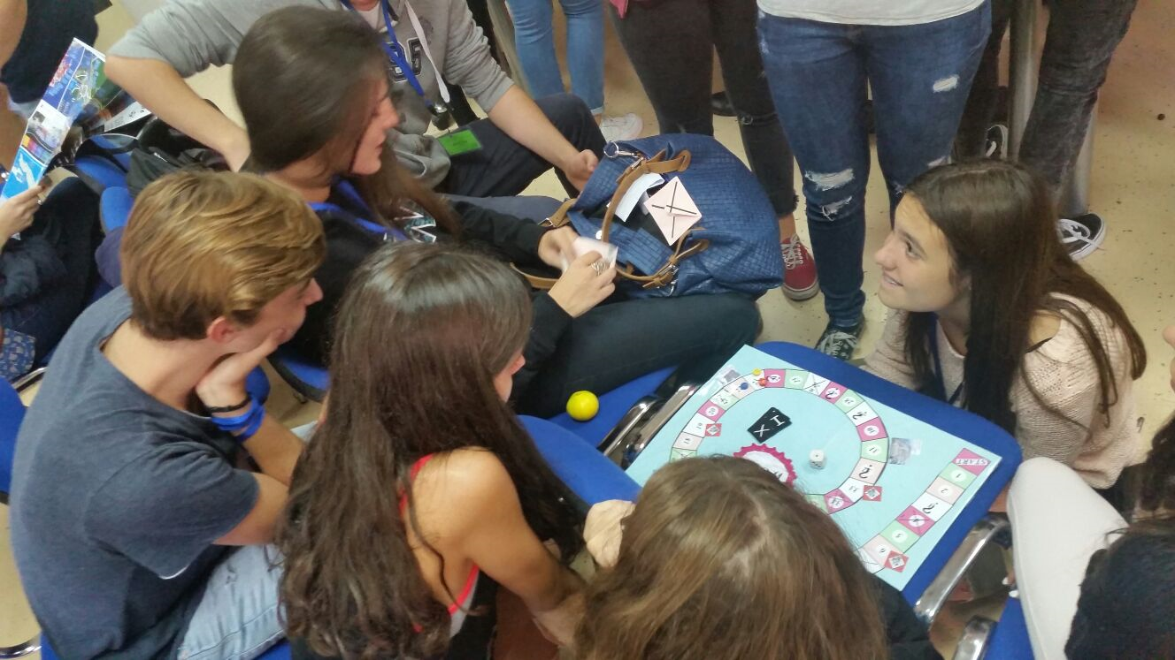
Our game put to the test!!!

Slide 7
AIMS ACHIEVED!!!
At our LTT meeting in Croatia, our game was tested on the pupils present from nine different countries, who were divided into mixed, international teams.
The results were extremely positive!
Language barriers were broken, lots of Aosta Valley culture and history was shared and, above all, there was heaps of fun and many laughs!

