Slide 1
Teaching module

Slide 2
A day in the life of…..
??????????????????????????????????????????

Slide 3
Step by step methodology
ELICIT
EXPLORE
EXPLAIN
ELABORATE
EXTEND
EVALUATE

Slide 4
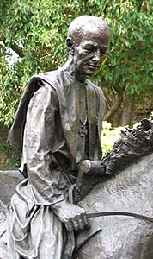
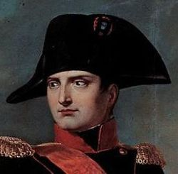
People who crossed the Great Saint Bernard Pass

Slide 5
elicit
Which noteworthy historic figures crossed the Pass?
During which historic period?
For what reason?
How did their journey end?
Prepare a final product to record findings

Slide 6
explore
Teachers of Italian, history, art, Latin, English and French provide bibliographies and sitographies for students to research
Bibliography
Strabo’s Geography – Peoples of the Alps (Book IV, chapter 6)
Svetonius – Life of Augustus (from: “The Life of 12 Ceasars”)
David G. Chandler, Le Campagne di Napoleone
Sitography
http://penelope.uchicago.edu/Thayer/E/Roman/Texts/Strabo/4F*.html
http://penelope.uchicago.edu/Thayer/e/roman/texts/suetonius/12caesars/augustus*.html
http://www.lovevda.it/it/banca-dati/10/memorie-storiche/saint-rhemy-enbosses/il-passaggio-di-napoleone/273
http://www.caisem.org/pdf/csc_2014/aliprandi_napoleone.pdf
http://www.storiavda.it/ottocento.html
http://www.academia.edu/2474246/Archbishop_Sigerics_Pilgrimage_to_Rome_in_990

Slide 7
explain
There were five different travellers chosen to research further, with the intention of choosing just three for the video
They were a Roman soldier, a Roman general, Sigerico Archbishop of Canterbury, Anselmo Archbishop of Canterbury and Napoleon.

Slide 8
elaborate
Students examine documents in Italian, French and Latin
They discover that Anselmo (1033-1109), native of Aosta and Archbishop of Canterbury, never crossed the Great St. Bernard Pass.
They choose three figures to portray in the video.
Historic facts are translated and transformed into English monologues.
Historically significant locations are chosen, costumes hired and a storyboard created

Slide 9
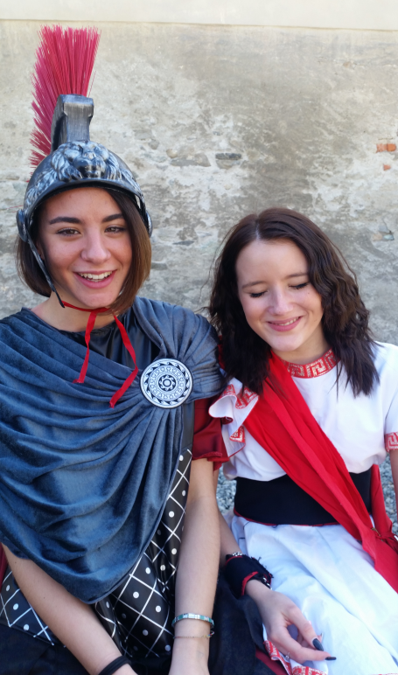
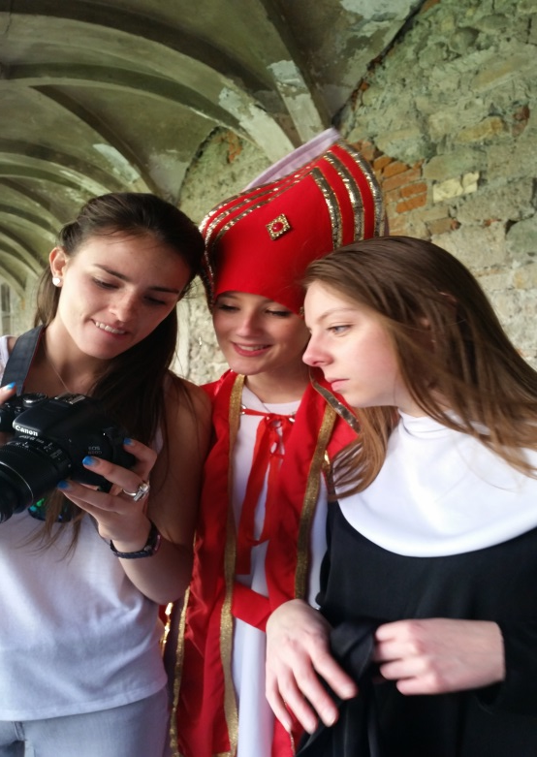
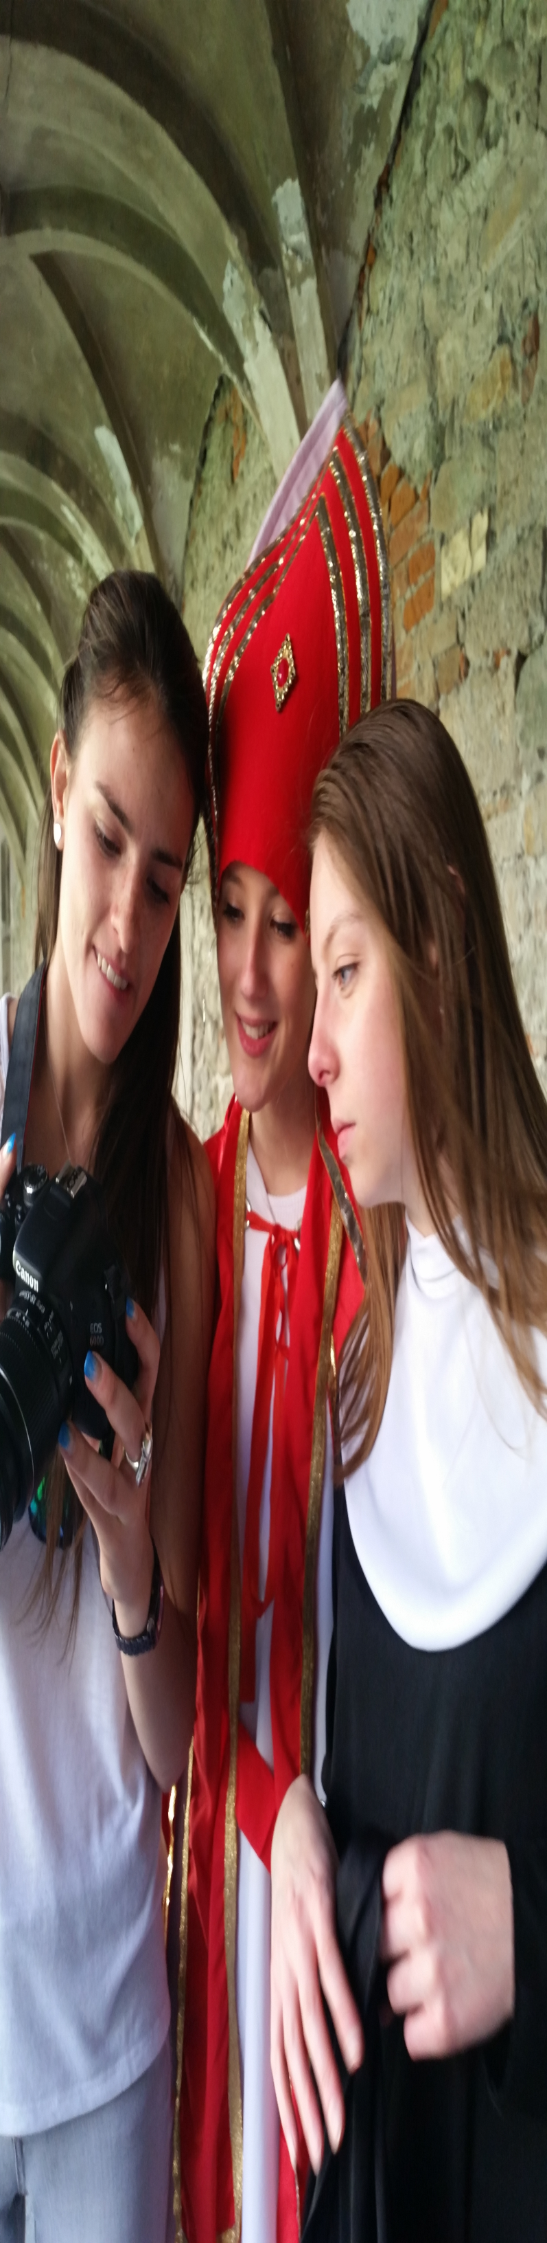
Extend
Pease go and see our short video «A Day in the Life of…»

Slide 10
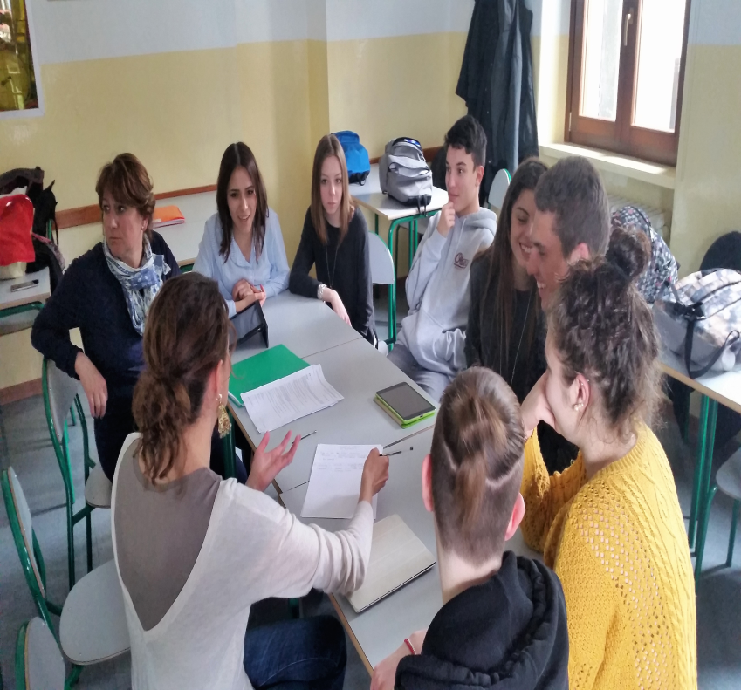
peer learning, peer teaching, peer assessment

Slide 11
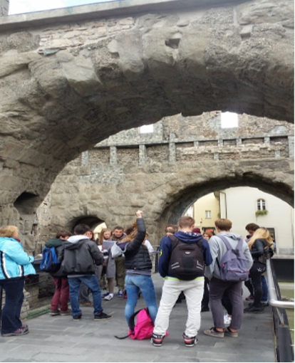
evaluate
Pupils succeeded in reading, translating, summarising and transforming documents
They acquired understanding of the changing commercial, religious and military importance of the Great St. Bernard Pass in its multi-millennial history and of historic figures who have crossed it.

Slide 12
evaluate
Pupils achieved the technical and organizational skills necessary to produce a short film
Pre-production
Pupils were able to:
-plan and get ready to film
-identify the idea
-write a script
-make storyboards
-choose actors, costumes, locations.
Production
Pupils were able to:
-control framing, light, focus and sound with their cameras
-use different shots for different functions
-collaborate as a working group
Post-production
Pupils were able to:
-edit material, using cuts, fade ins/outs, dissolves
-add music, credits and subtitles
- distribute finished product on social media

