Slide 1
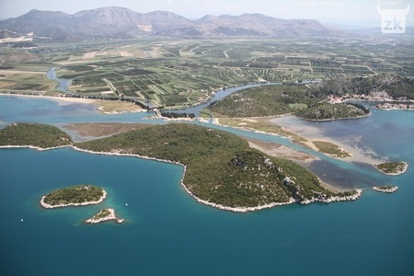
The wild life in the Neretva Valley
Teacher: Vera Modrić

Slide 2
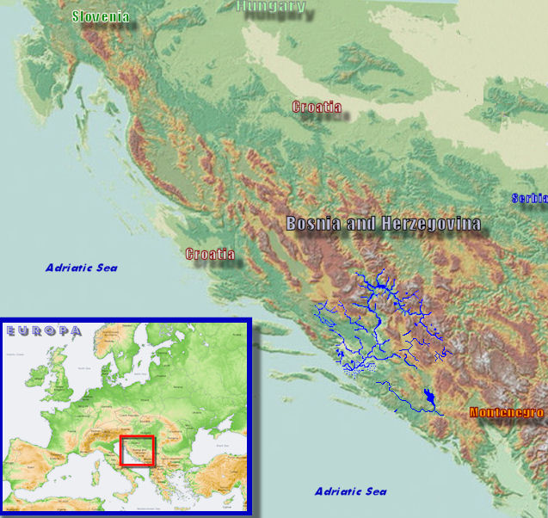
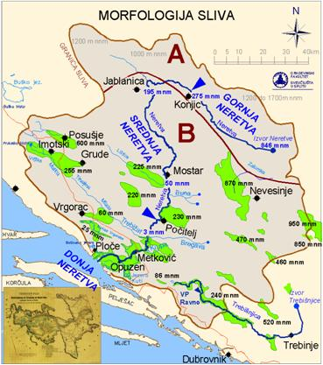
The Neretva River and its delta
The Neretva River is situated in the in the South of Croatia
The river forms a wide delta while it flows in The Adriatic

Slide 3
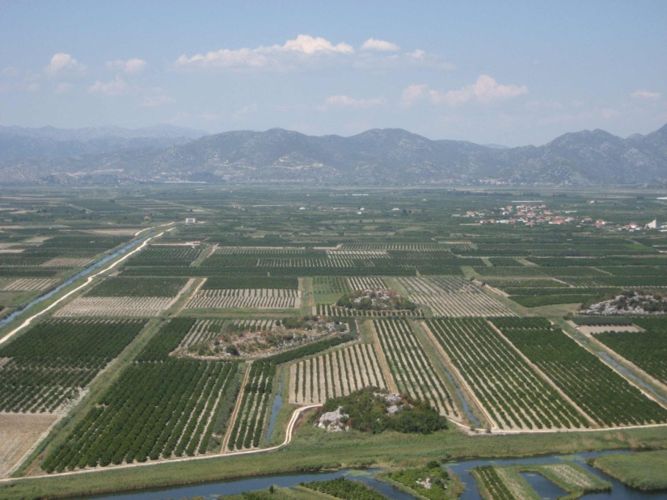
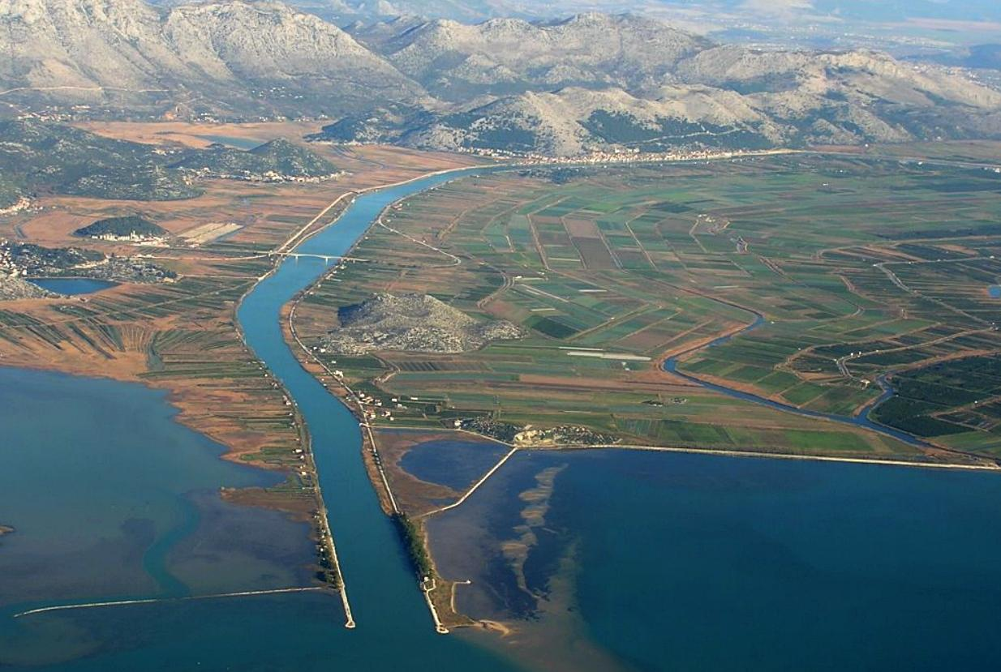
The Neretva River delta
The length of the lower Neretva river is about 20 km.
The delta has been significantly changed due to human interventions in the past

Slide 4
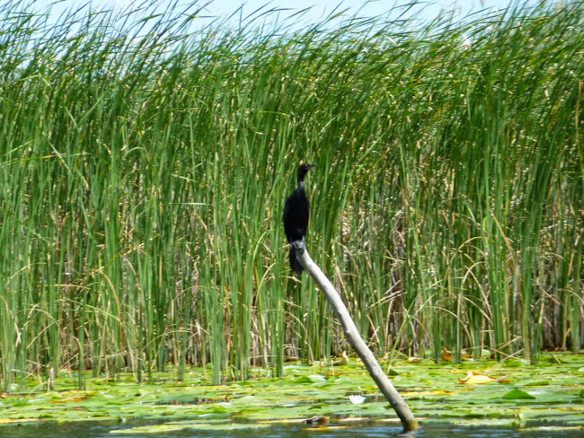
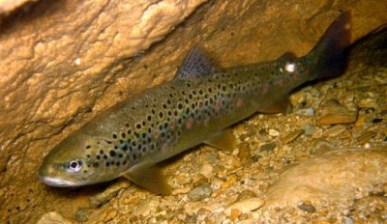
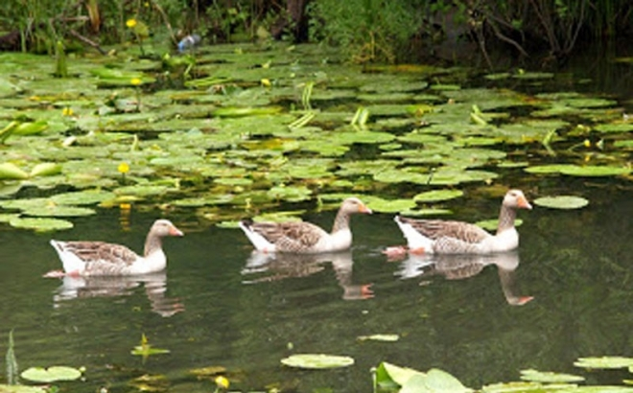
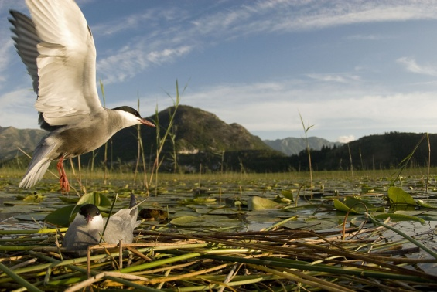
The ecology of the delta
In general, the swamps and river deltas are the most diverse and productive areas on the planet
The same can be said for Neretva river delta
It provides food and shelter for many migrating birds, local bird species and a wide diversity of other wild life

Slide 5
The bird life of the Neretva Valley
The birds found in the delta are both migratory birds and resident bird
The variety of bird species has the highest ecological importance for this area
During this lesson we will get to know some of these species along side other mammals, reptiles, amphibians and fish species that inhabit this area

Slide 6
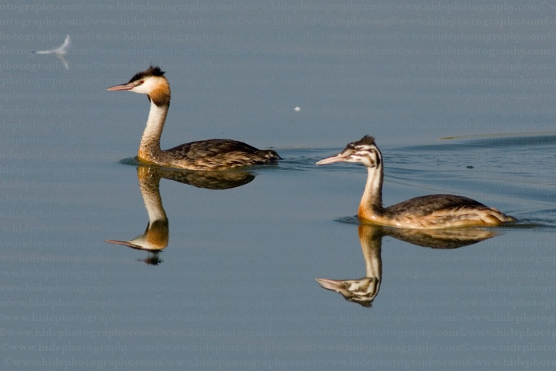
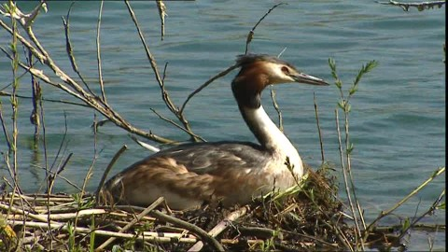
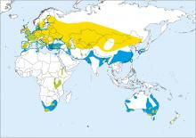
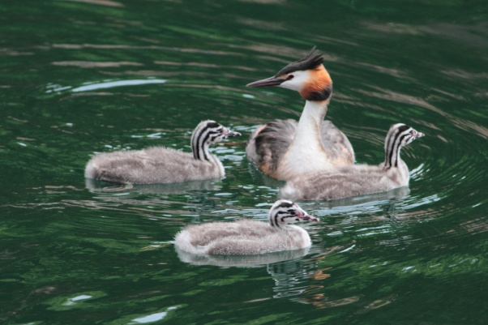
Great Crested Grebe (Podiceps cristatus)
Native to Europe, Asia and Africa
Lives on lakes in the mainland and on rivers surrounded by bulrush
During winter lives along the coastline and on larger lakes, in large groups
Feeds on fish, molluscs and small crabs

Slide 7
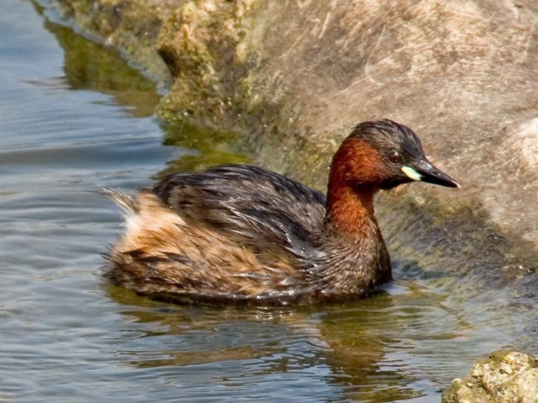
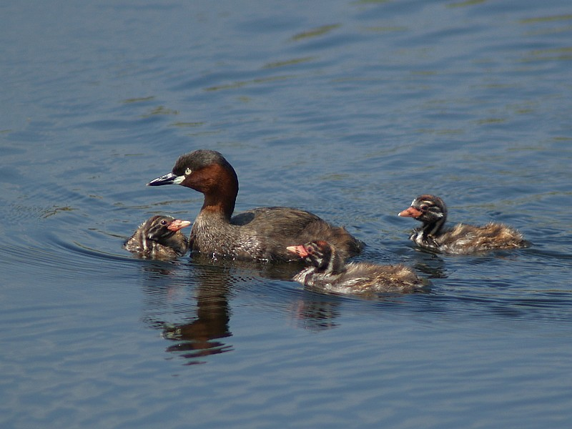
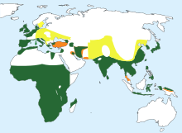
Little Grebe (Tachybaptus ruficollis)
Native to west, middle and south Europe, parts of Africa and Asia
Lives on lakes and small rivers
Nests on the whole Neretva river area
Feeds on insects and small fish

Slide 8
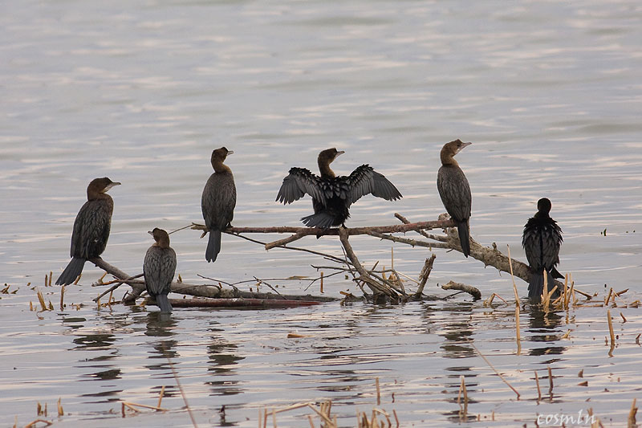
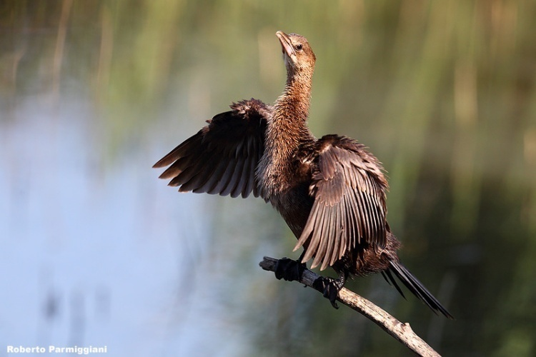
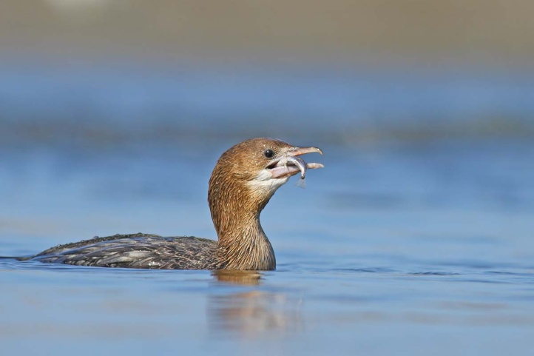
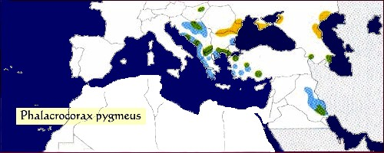
Pygmy Cormorant (Phalacrocorax pygmeus)
Native to the Balkans, parts of Asia around the Black sea
Lives in swamps, lakes and shallow sea coastline
The species lives in the Neretva Valley the whole year round
Feeds on fish, water arts and leaches
It is critically endangered

Slide 9
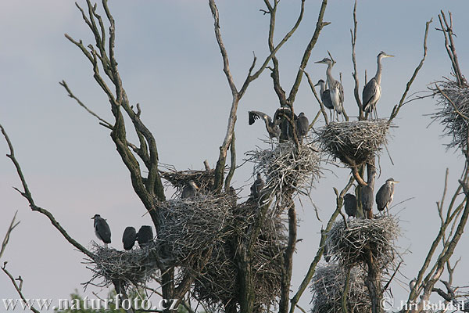
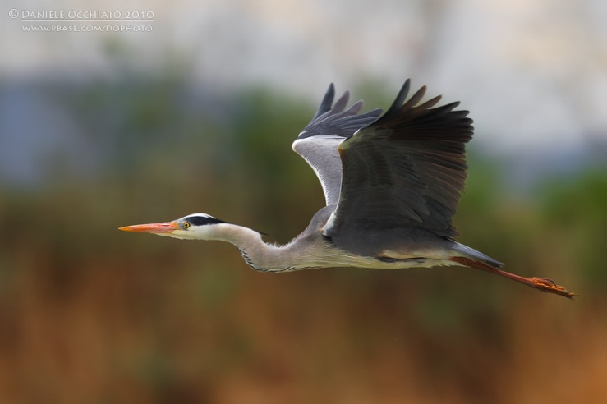
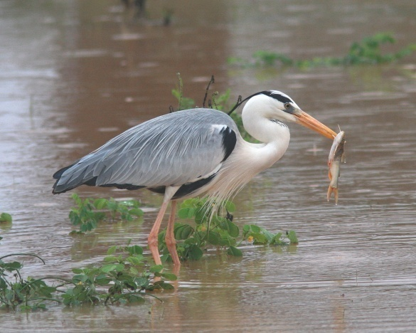
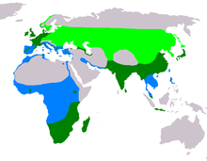
Grey Heron (Ardea cinerea)
Most common and widespread European heron
Lives near standing waters and on salt planes near the coastline
Lives in the Neretva Valley the whole year round, forms large, noisy colonies on trees near the water
Feeds on small fish, tadpoles, water insect larvae, small crabs, mice and other small mammals

Slide 10
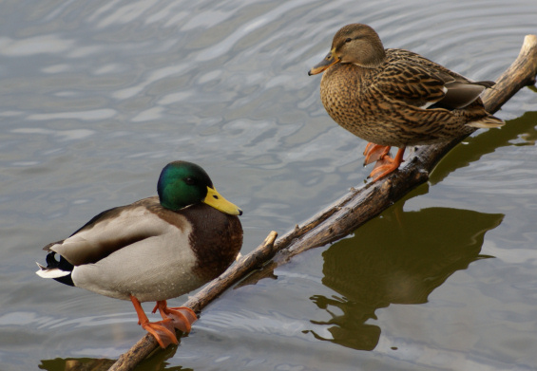
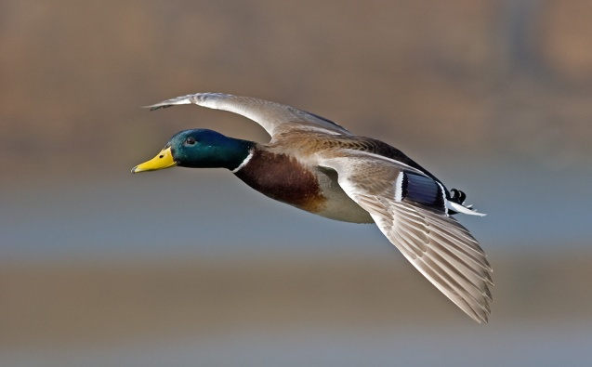
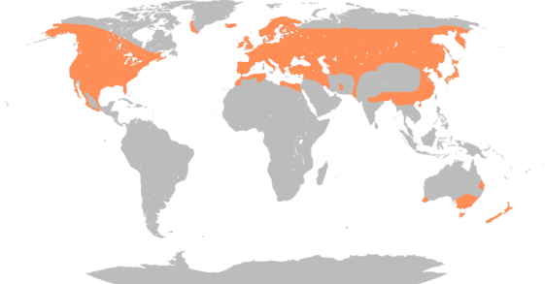
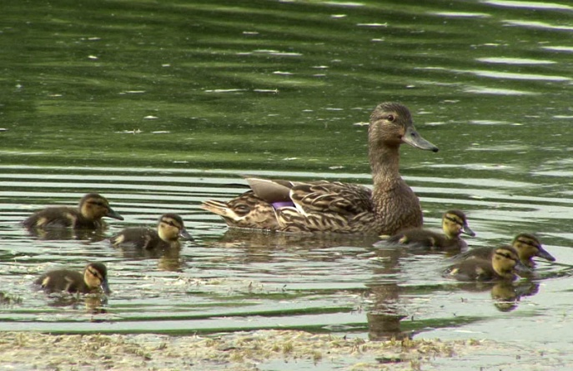
Mallard (Anas platyrhynchos)
Europe's most common duck
Lives on rivers, lakes, swamps and even in human settlements
Lives the whole year round in the Neretva Valley
Feeds on water plants, toadpoles, crabs, mice and worms

Slide 11
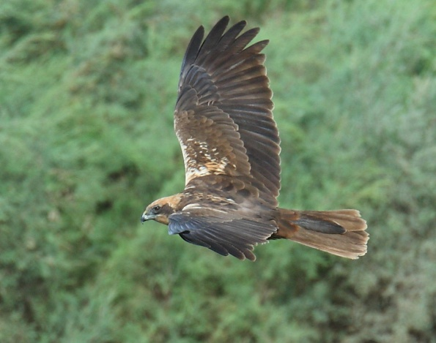
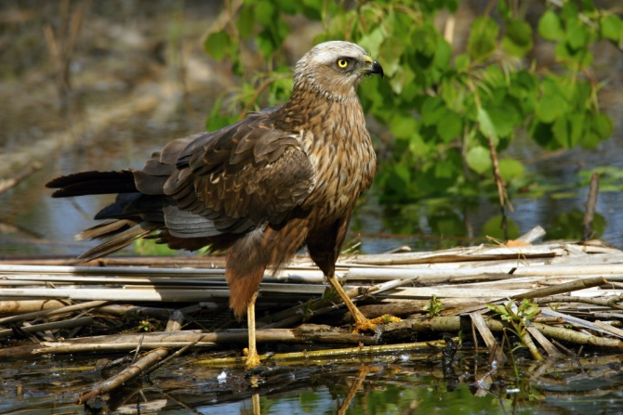
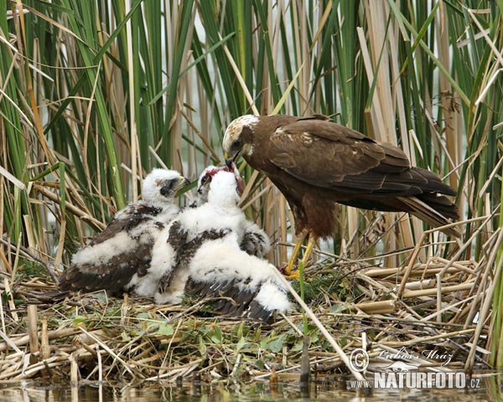
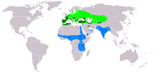
Marsh Harrier (Circus aeruginosus)
It is widely distributed across Europe
Nests in small plants by the coast
It is a hunter, feeds on birds, small mammals, frogs and ever eggs stolen from birds nests

Slide 12
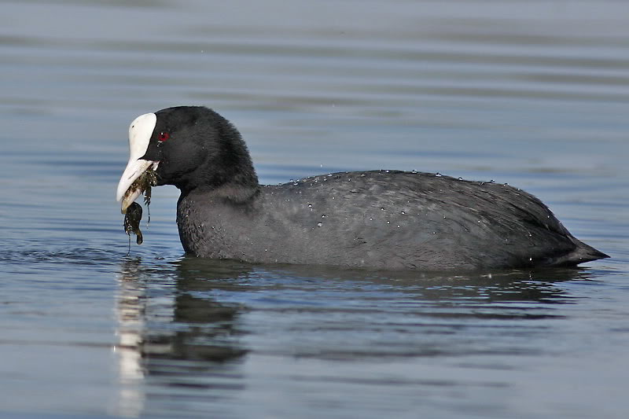
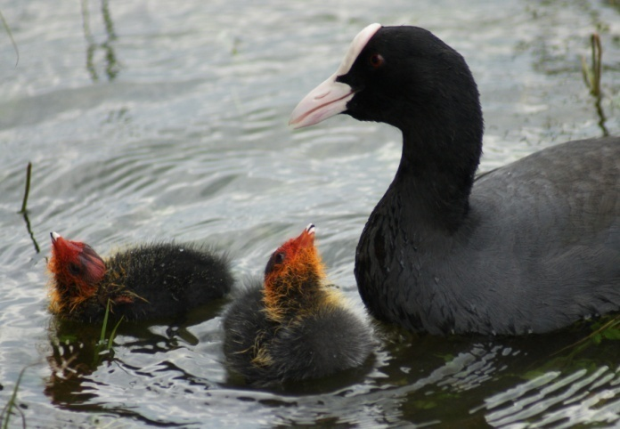
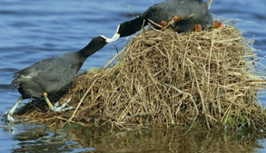
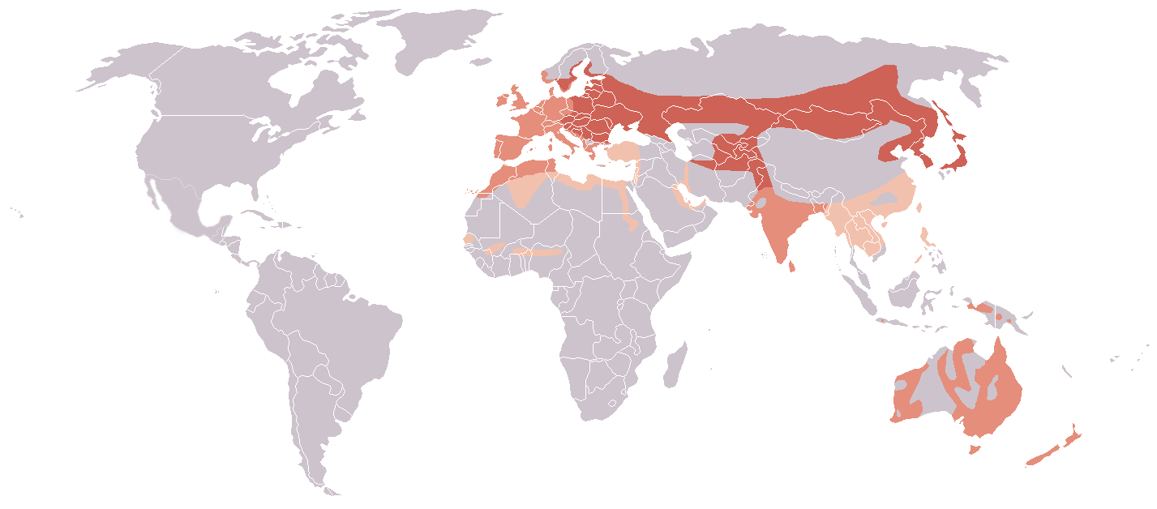
Coot (Fulica atra)
Native to west and south Europe and same parts of Asia
Lives and nests among water growth
Feeds on water plants, algae, small crabs, insects and shellfish.

Slide 13
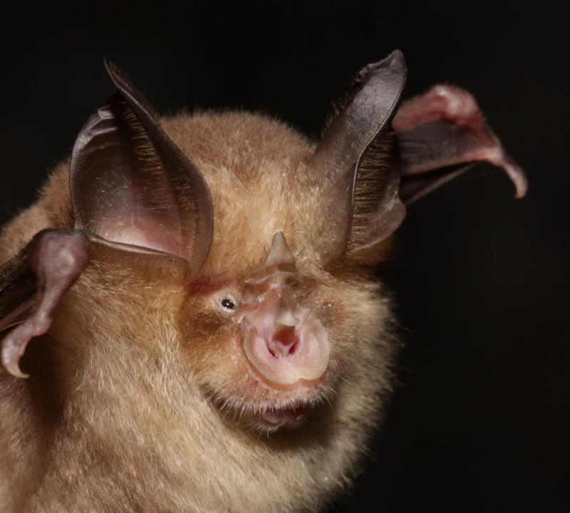
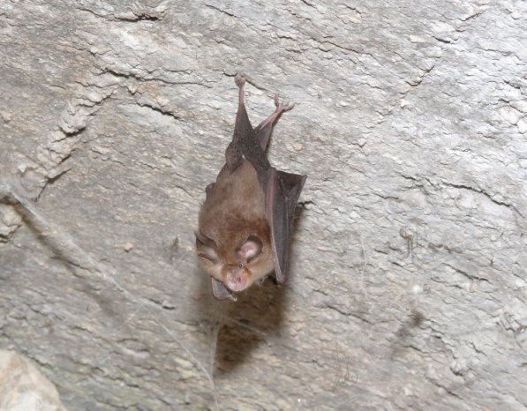
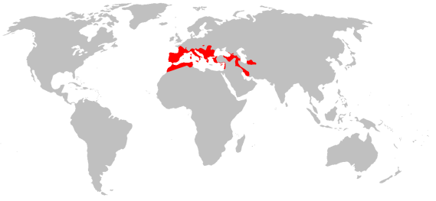
Mediterranean Horseshoe bat (Rhinolophus euryale)
Lives in the Mediterranean region and Balkan peninsula, as well as parts of Italy
lives in wooded areas in foothills and mountains, preferring limestone areas with numerous caves and nearby water
Feeds on moths and other small insects

Slide 14
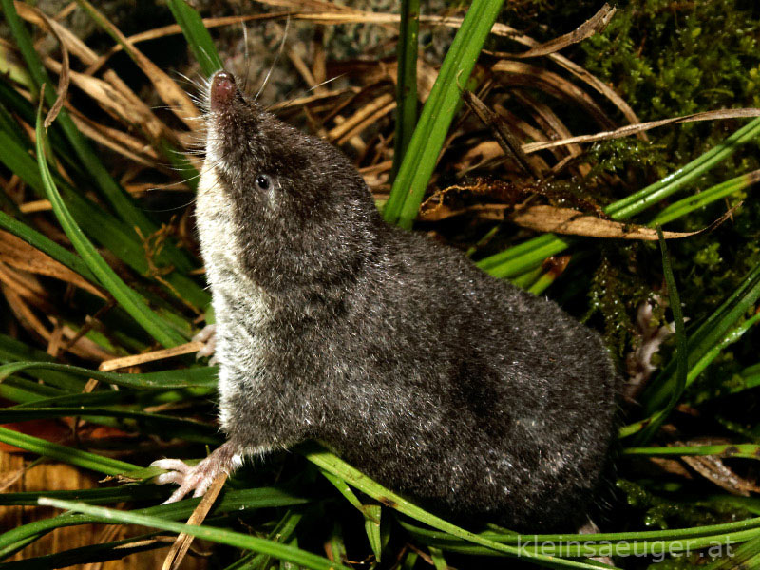
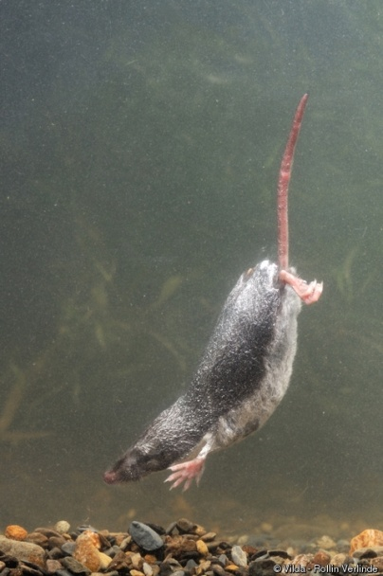
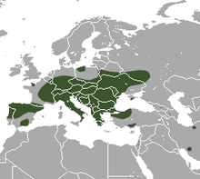
Miller's Water Shrew (Neomys anomalus)
Native to south and middle Europe
Feeds on amphibians and small fish, insects and worms

Slide 15
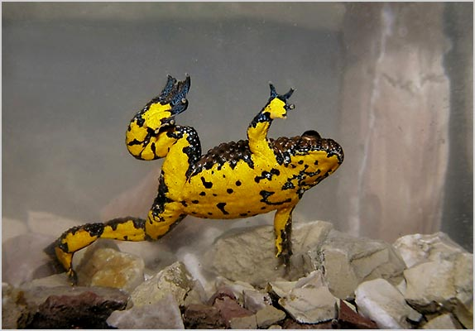
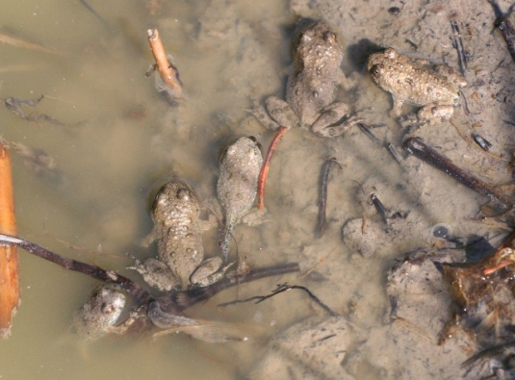
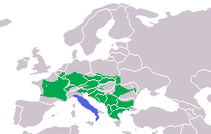
Dalmatian yellow-bellied toad (Bombina variegata)
Lives in mountainous and hilly
countries in middle and southern Europe
Lives along brooks and rivers
It breeds in ponds, wetlands, ditches, ruts, pools

Slide 16
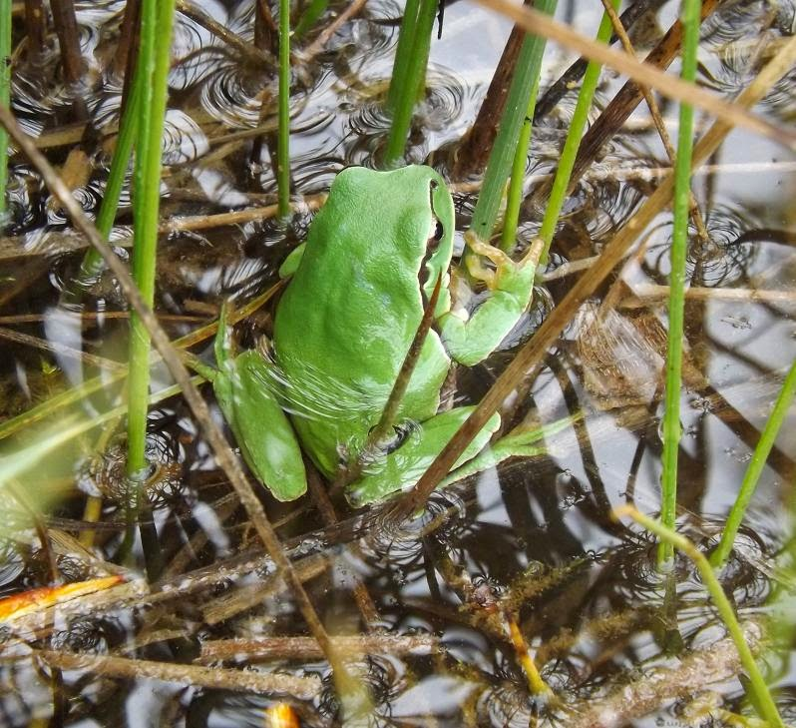
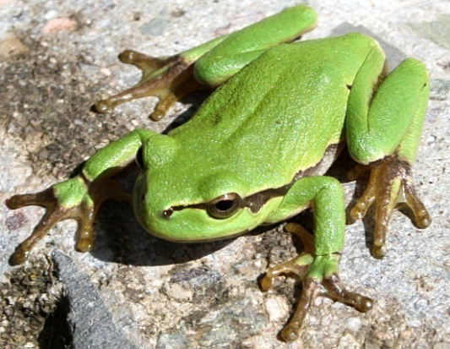
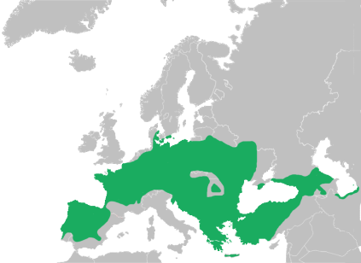
European tree frog (Hyla arborea)
Indigenous to mainland Europe and are found across most of Europe (except Ireland), northwest Africa, and temperate Asia to Japan
Feeds on variety of small insects and spiders

Slide 17
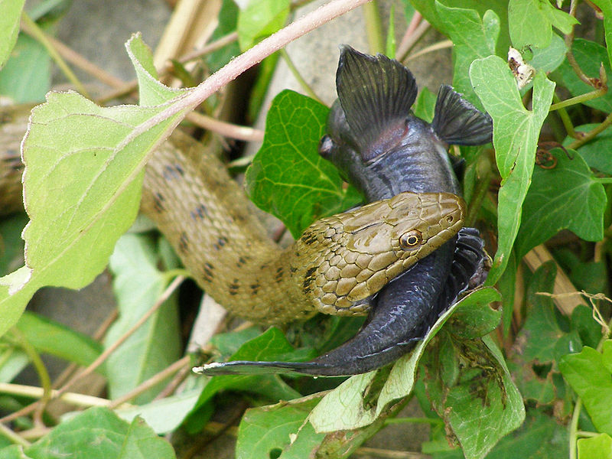
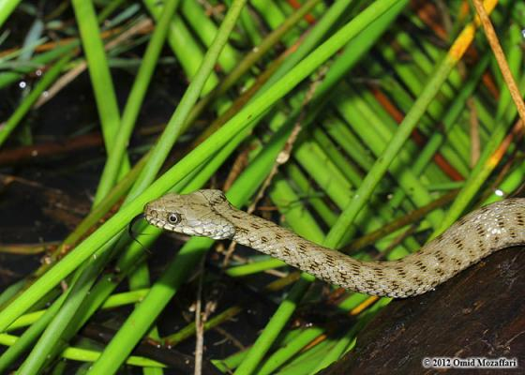
Dice snake (Natrix tessellata)
It is a European no venomous snake
Can be is found throughout Europe and Asia
Feeds on fish, amphibians like frogs, toads and tadpoles

Slide 18
European ratsnake (Zamenis situla)
It is a species of non venomous snake endemic to Europe, Asia Minor, and the Caucasus
Natural habitats of the European ratsnake are Mediterranean-type shrubby vegetation, pastureland, plantations, and rural gardens

Slide 19
European Eel (Anguilla anguilla)
The European eel is a critically endangered species
Distributed from Northern Norway, along the coast of Europe, all coasts of the Mediterranean and on the North African Coast
Is found in small streams, large rivers and lakes, and in estuaries, lagoons and coastal waters

