Slide 1
TRYING TO FLY
SOME STAGES
OF HISTORY OF FLIGHT

Slide 2
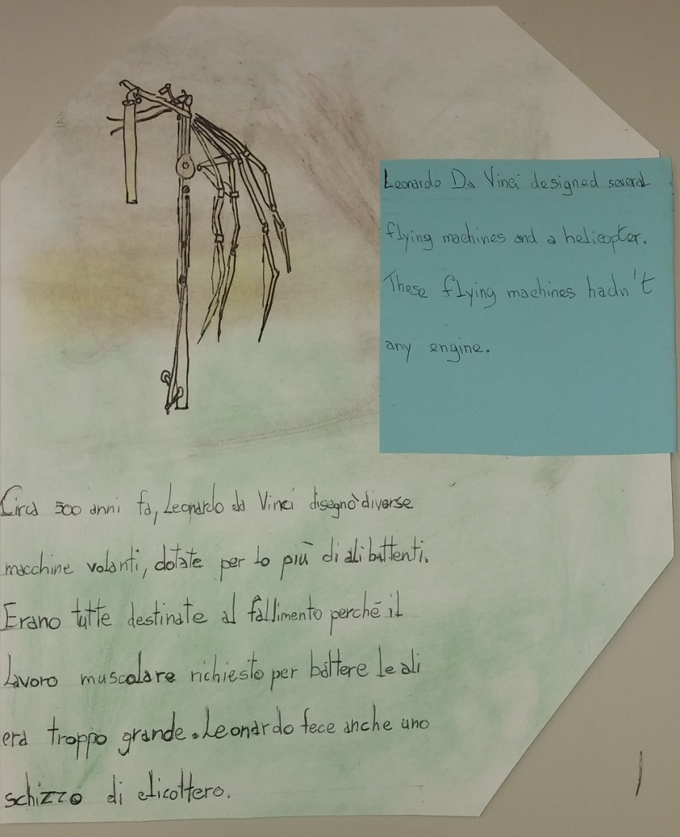
FLYING MACHINES OF LEONARDO DA VINCI

Slide 3
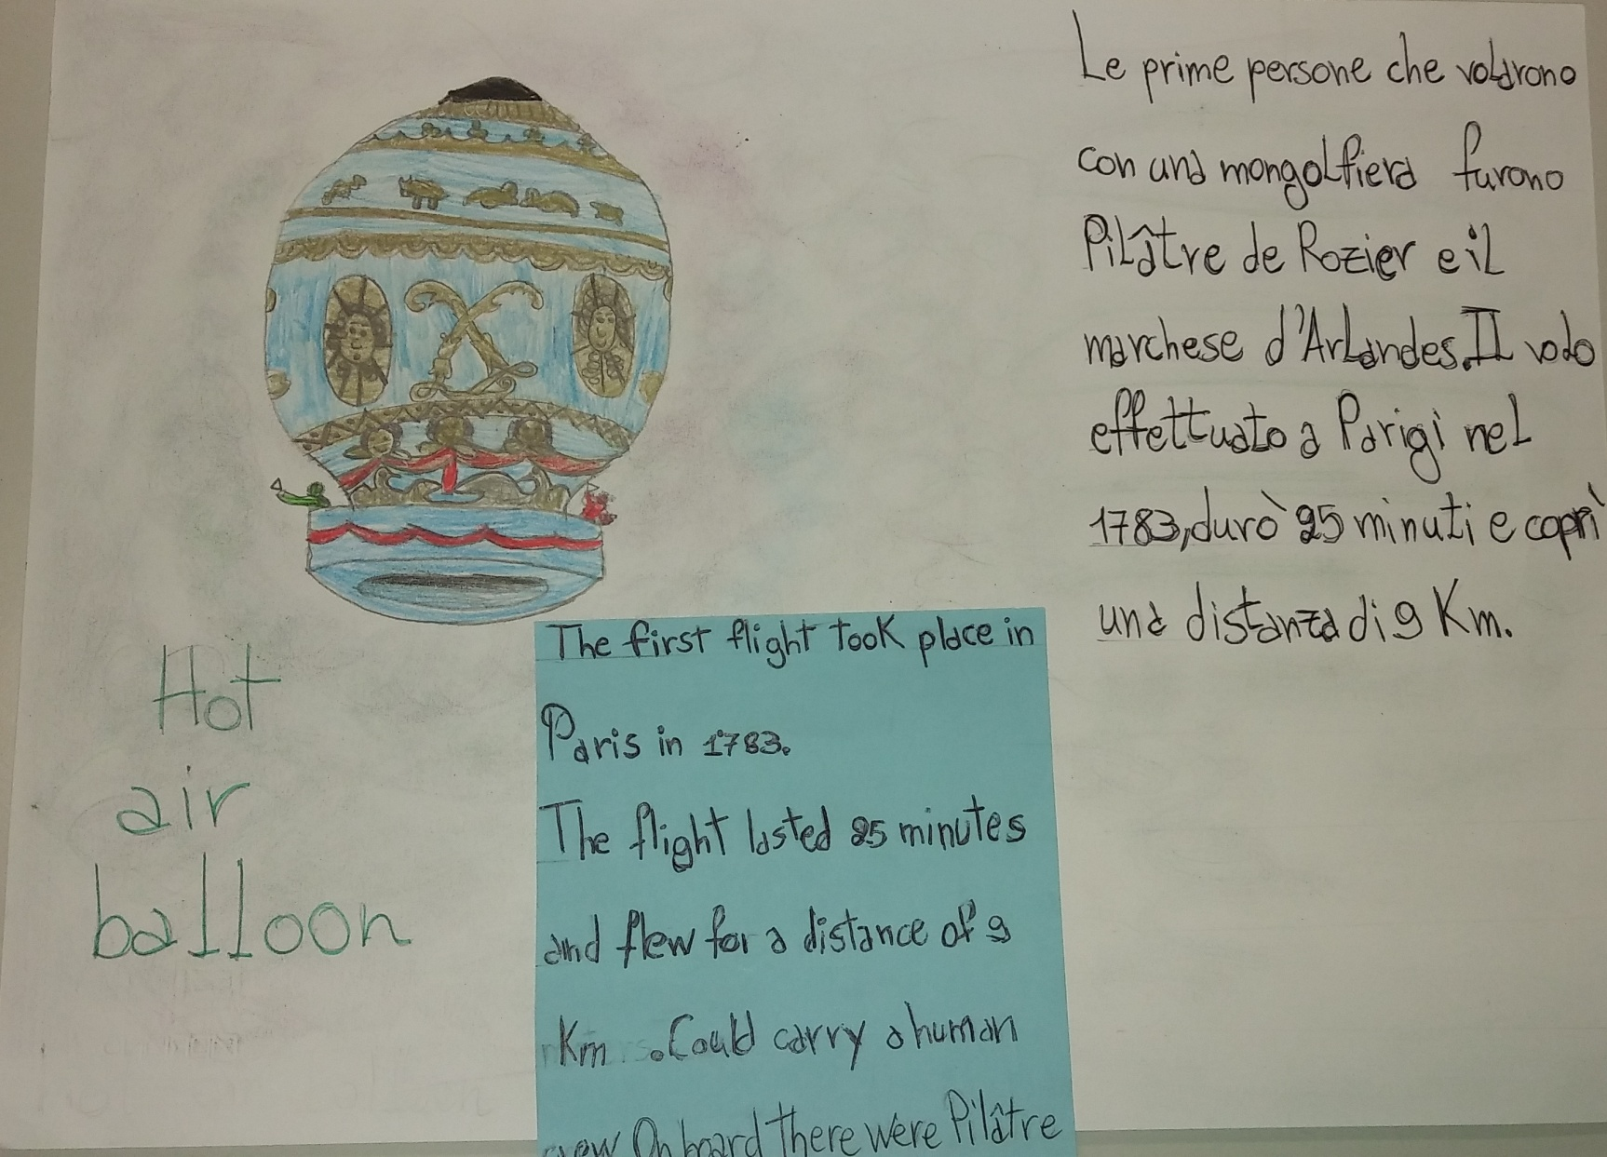
HOT AIR BALLON

Slide 4
DIFFERENTS IDEAS OF AIRPLANE
IN THE CLOSE PAST

Slide 5
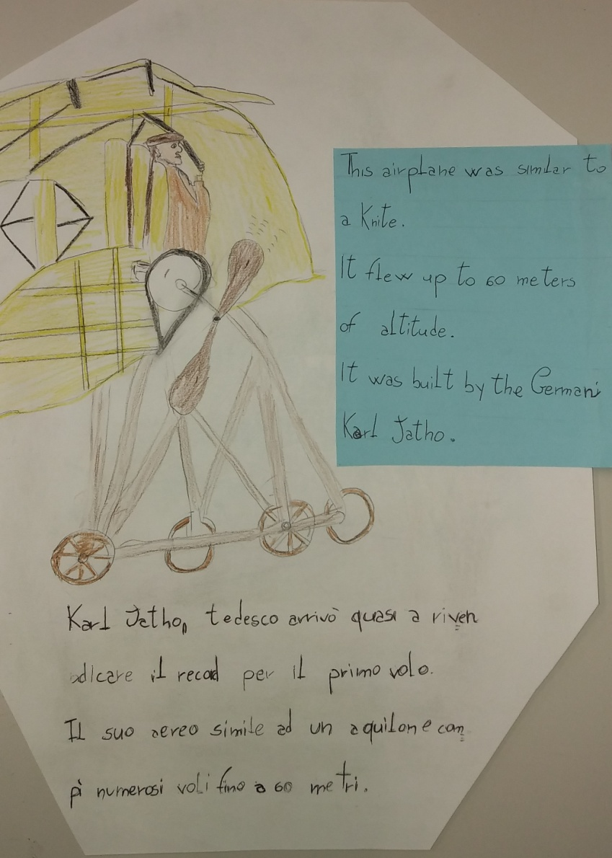

Slide 6
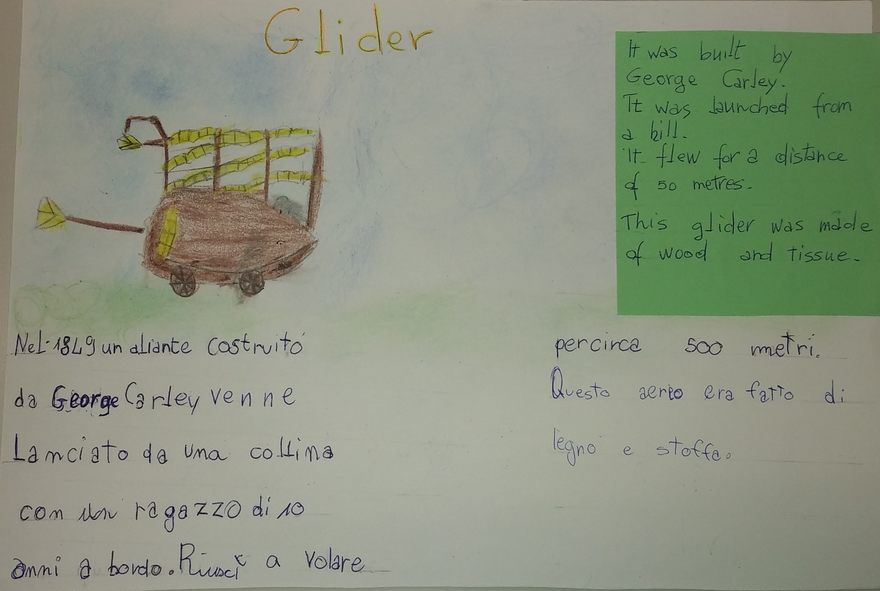

Slide 7
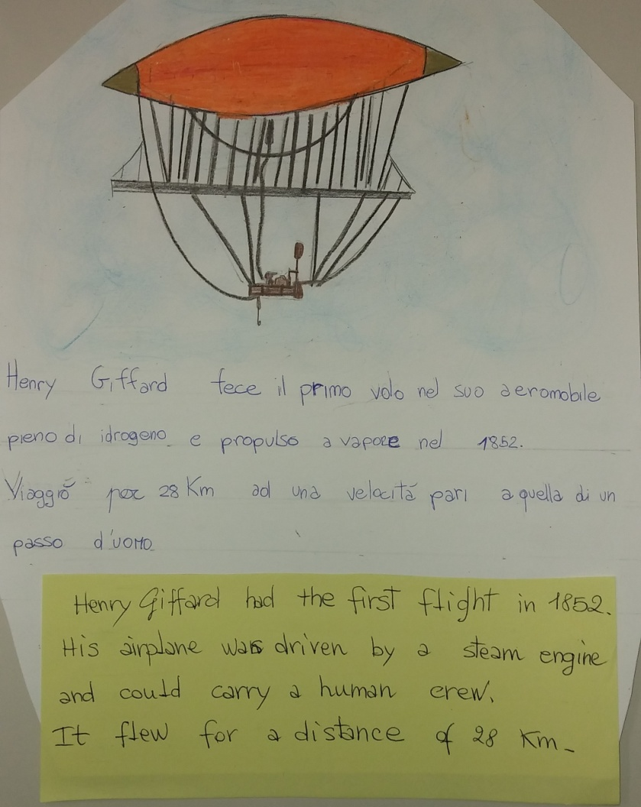

Slide 8
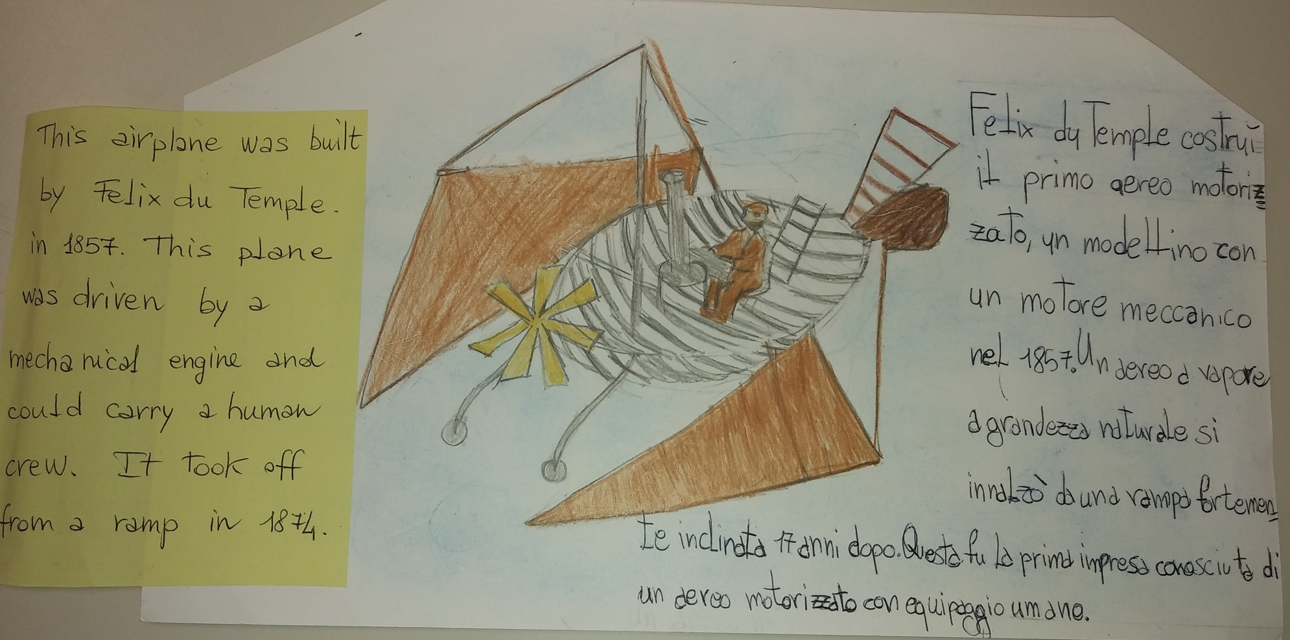

Slide 9
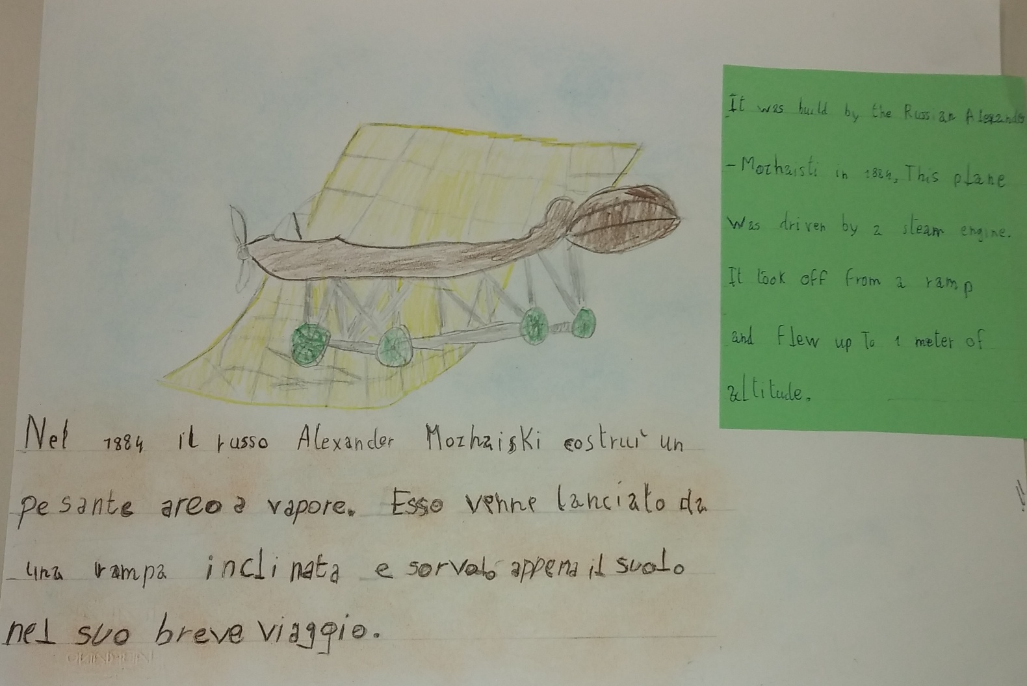

Slide 10
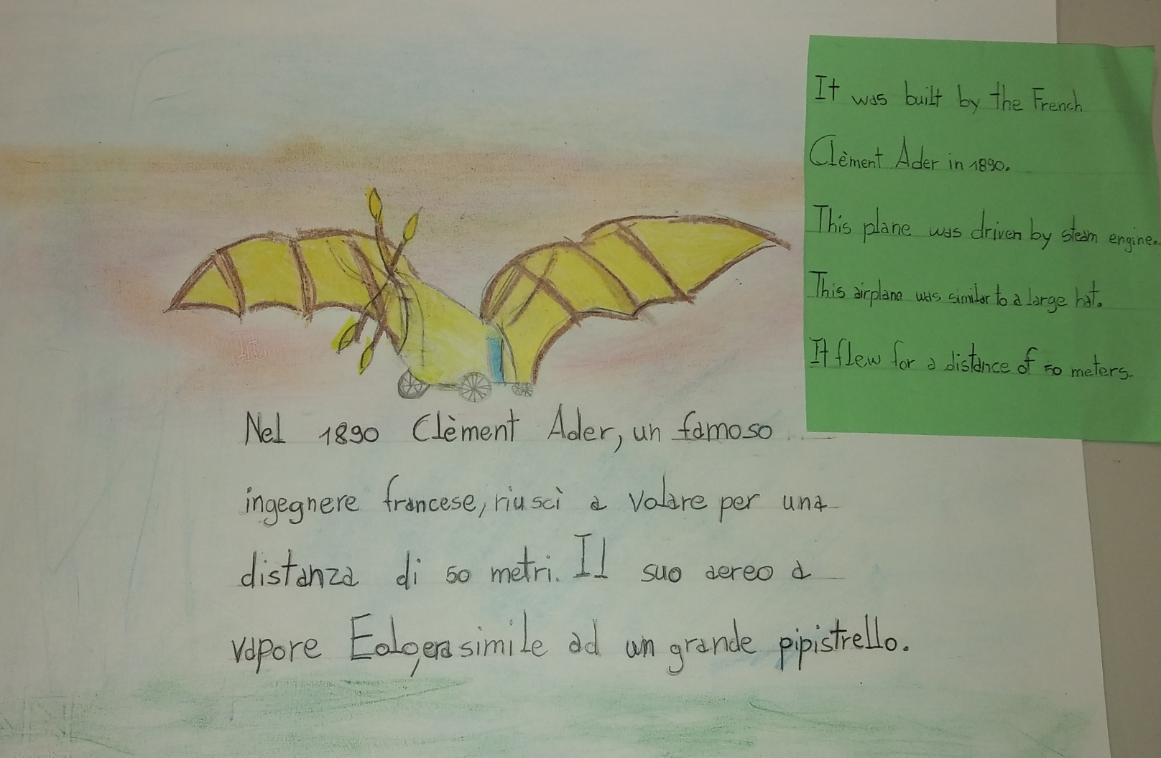

Slide 11
CLASSE IV A t.p.
SCUOLA PRIMARIA
“G.GINOBILI”
PETRIOLO a.s. 2017/18

