Slide 1
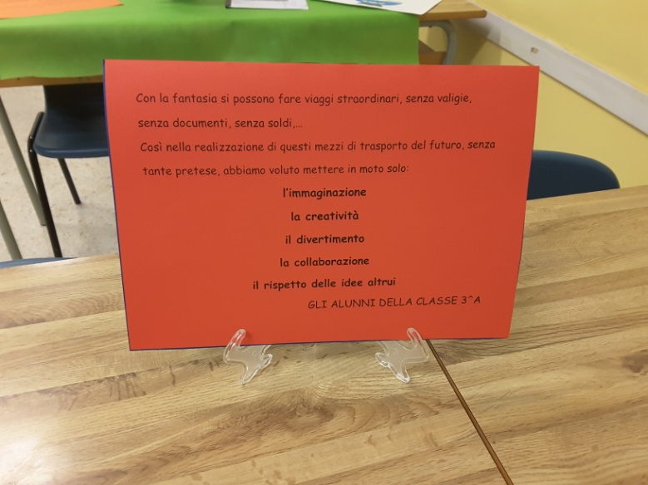
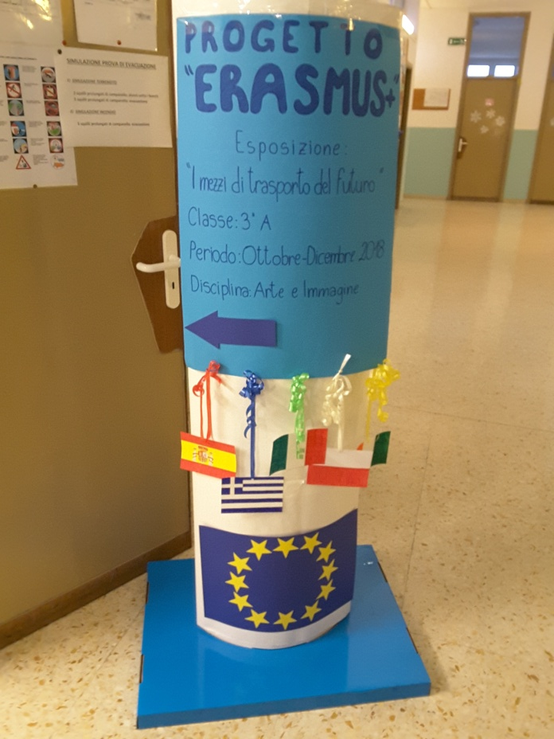
ou
Transport of the future
Our job about transport in the future.
Ingredients:
Recycled materials
Imagination
Creativity
Amusement
Cooperation
Respectfull of eachother’s opinion

Slide 2
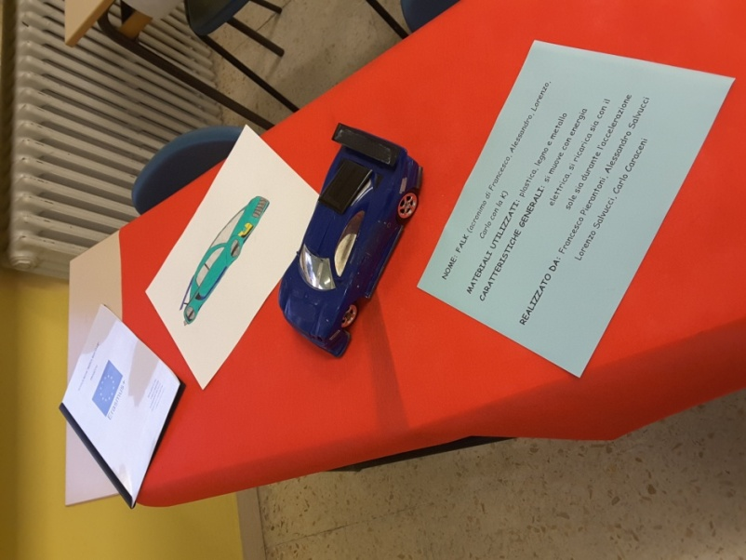
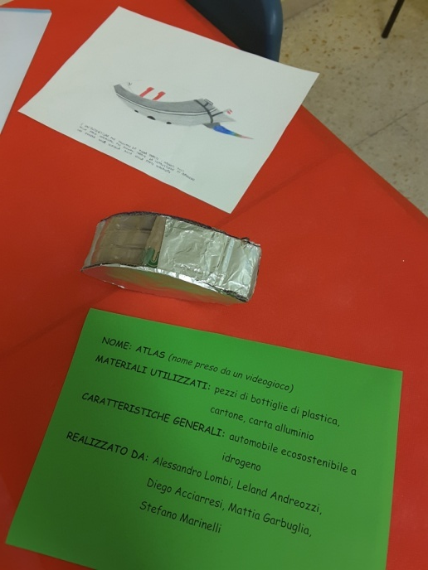
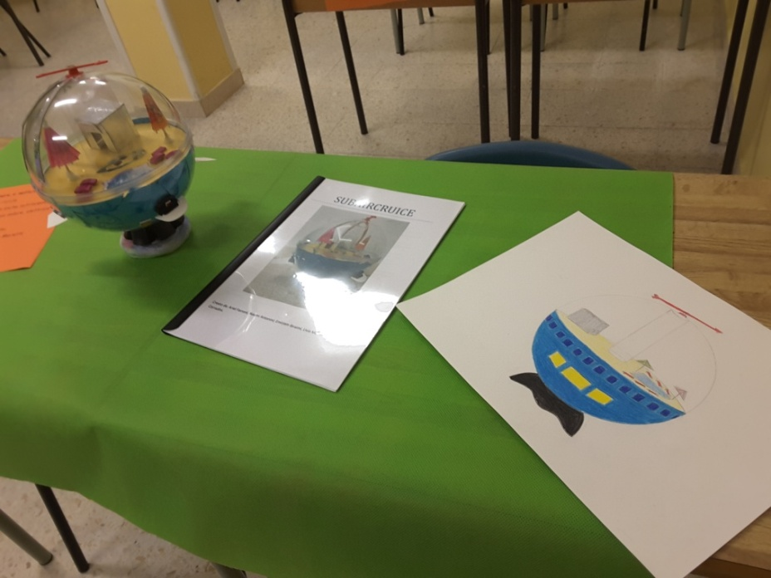
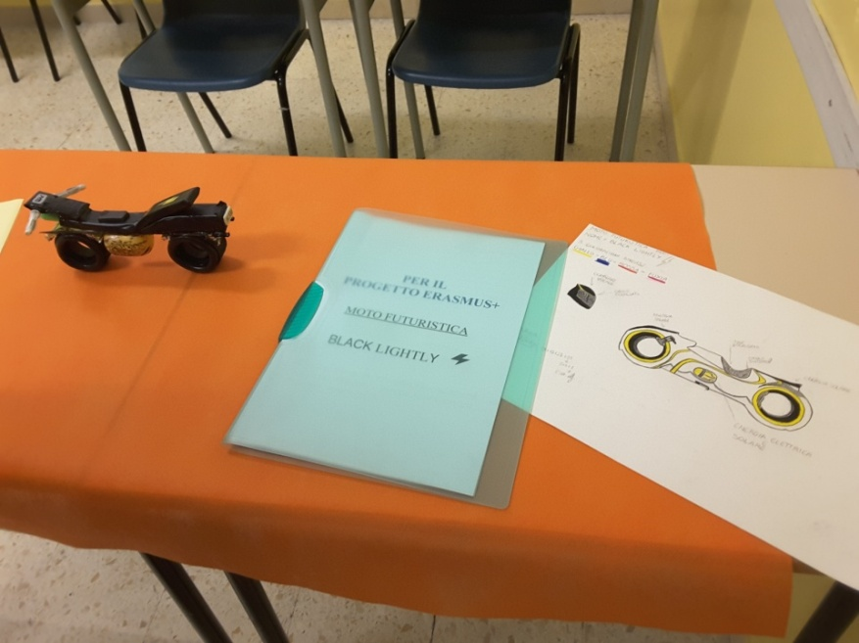
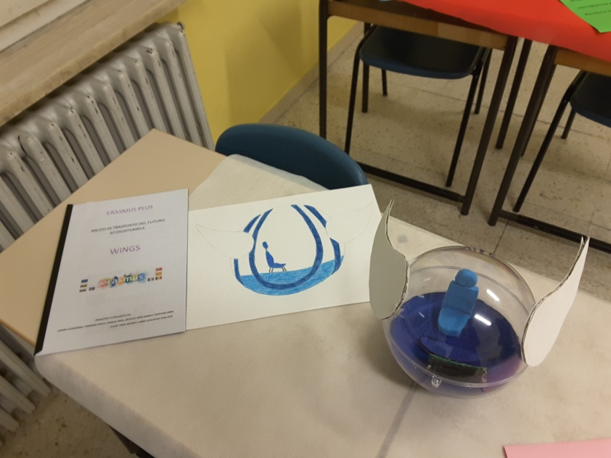
Subcruice
Falk
Atlas
Wings
Black
lightly

