Slide 1
Welcome to Mogliano

Slide 2
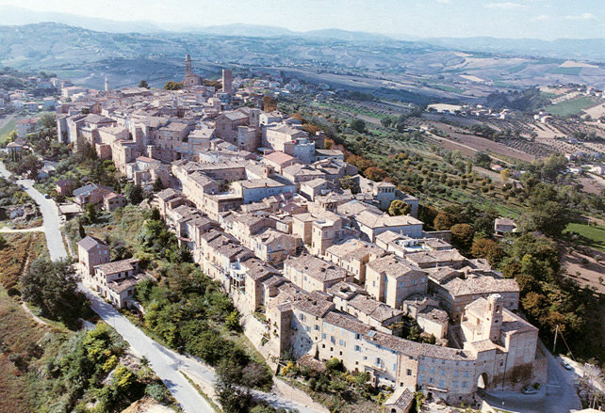
HISTORY OF MOGLIANO
Mogliano rises on a hill at 313 metres over the level of the sea, it’s at half way between the mountains and the sea.
It’s a little centre, in the area between Macerata and Fermo.
It’s a rich agricultural centre, with many artcrafts workers.

Slide 3
PIAZZA GARIBALDI

Slide 4
PIAZZA GARIBALDI
This square is a part of the historical centre, there are six entrances on every side of the squared place, in which there are S. Maria’s church and other buildings, such as the restaurant «Da Marina al teatro», the minimarket, the confectionery, the herbalist, the bakery and the launching residences.
An important part of this place is the historical monument in honor of the fallen people in the centre of the square, with an eagle emabalmed, from which the name «Monument of the eagle»

Slide 5
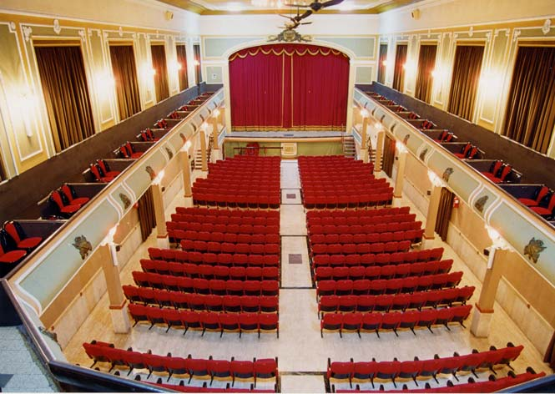
TEATRO APOLLO

Slide 6
TEATRO APOLLO
The façade was designed by Luciano Luciani.
In July 1880 the sculptor Luca Seri offered to equip the four pillars of the proscenium of his bas-reliefs and Luigi Fontana painted on the vault the scene of Apollo and the Graces, surrounded by medallions depicting famous musicians: the theater became Apollo Theater and two medallions depicting the two artists were placed above the entrance door to the audience.
In 1907 the roof collapsed, thus beginning a series of renovations that from time to time would change the appearance and destination of the theater deeply, until it became unusable and abandoned.
Only in 1984 began the long, complex and costly recovery project that will restore the Apollo Theater to its ancient eighteenth-century splendor in 2004, with the recovery even of the sketches of Milziade Miliozzi (1912) for the vòlto, depicting the Dancing Muses in circle with Apollo on the chariot to the spaces of the Olympus, in a decorative ring in which, within four medallions, the faces of Rossini, Verdi, Bellini and Donizetti stand out.

Slide 7
SANTA MARIA DA PIEDI

Slide 8
SANTA MARIA DA PIEDI
Set in the surrounders of the boundaries, on the side of the «Levante» door, it took its name from S. Maria «a pede castri».
The near gothic arc preserves, in the inner part, the fingers in iron of the doors that, at the sunset, after the Ave Maria, were closed.
On the old wall, over the arc, there still are five coats of arcs. They were removed from the soldiers of Napoleone after the battle of Tolentino.

Slide 9
SAN GREGORIO

Slide 10
SAN GREGORIO
In the past called «extra moenia» because it was built next to the moat castle.
it experienced a lot of changes and the last of them was in the 1700, when the presbitery was moved to the entrance and monumental stairs were added to join the hall to the new roads.
Inside, there are an altar piece of «Durante Nobili da Caldarola» and an interesting picture from G.B. Fagiani, showing Mogliano as it was in the 18th century.
After a recent restoration, the church was opened to the public again.

Slide 11
LA ROCCA

Slide 12
LA ROCCA
The fortress of Mogliano, of which only the bastions remain nowadays, is the best place to admire the panorama.
Inside of it there was S. Maria del Suffragio’s church, but today it is unholy.
It was built in 1698 and expanded in the end of 1700.
From the fortress it is possible to see S. Michele ancient hospital, built in 1782, and the autopalace, a complex in liberty style, the ancient pullman’s garage, today restored and reconverted in an exhibition place.

Slide 13
Abbadia di fiastra

Slide 14
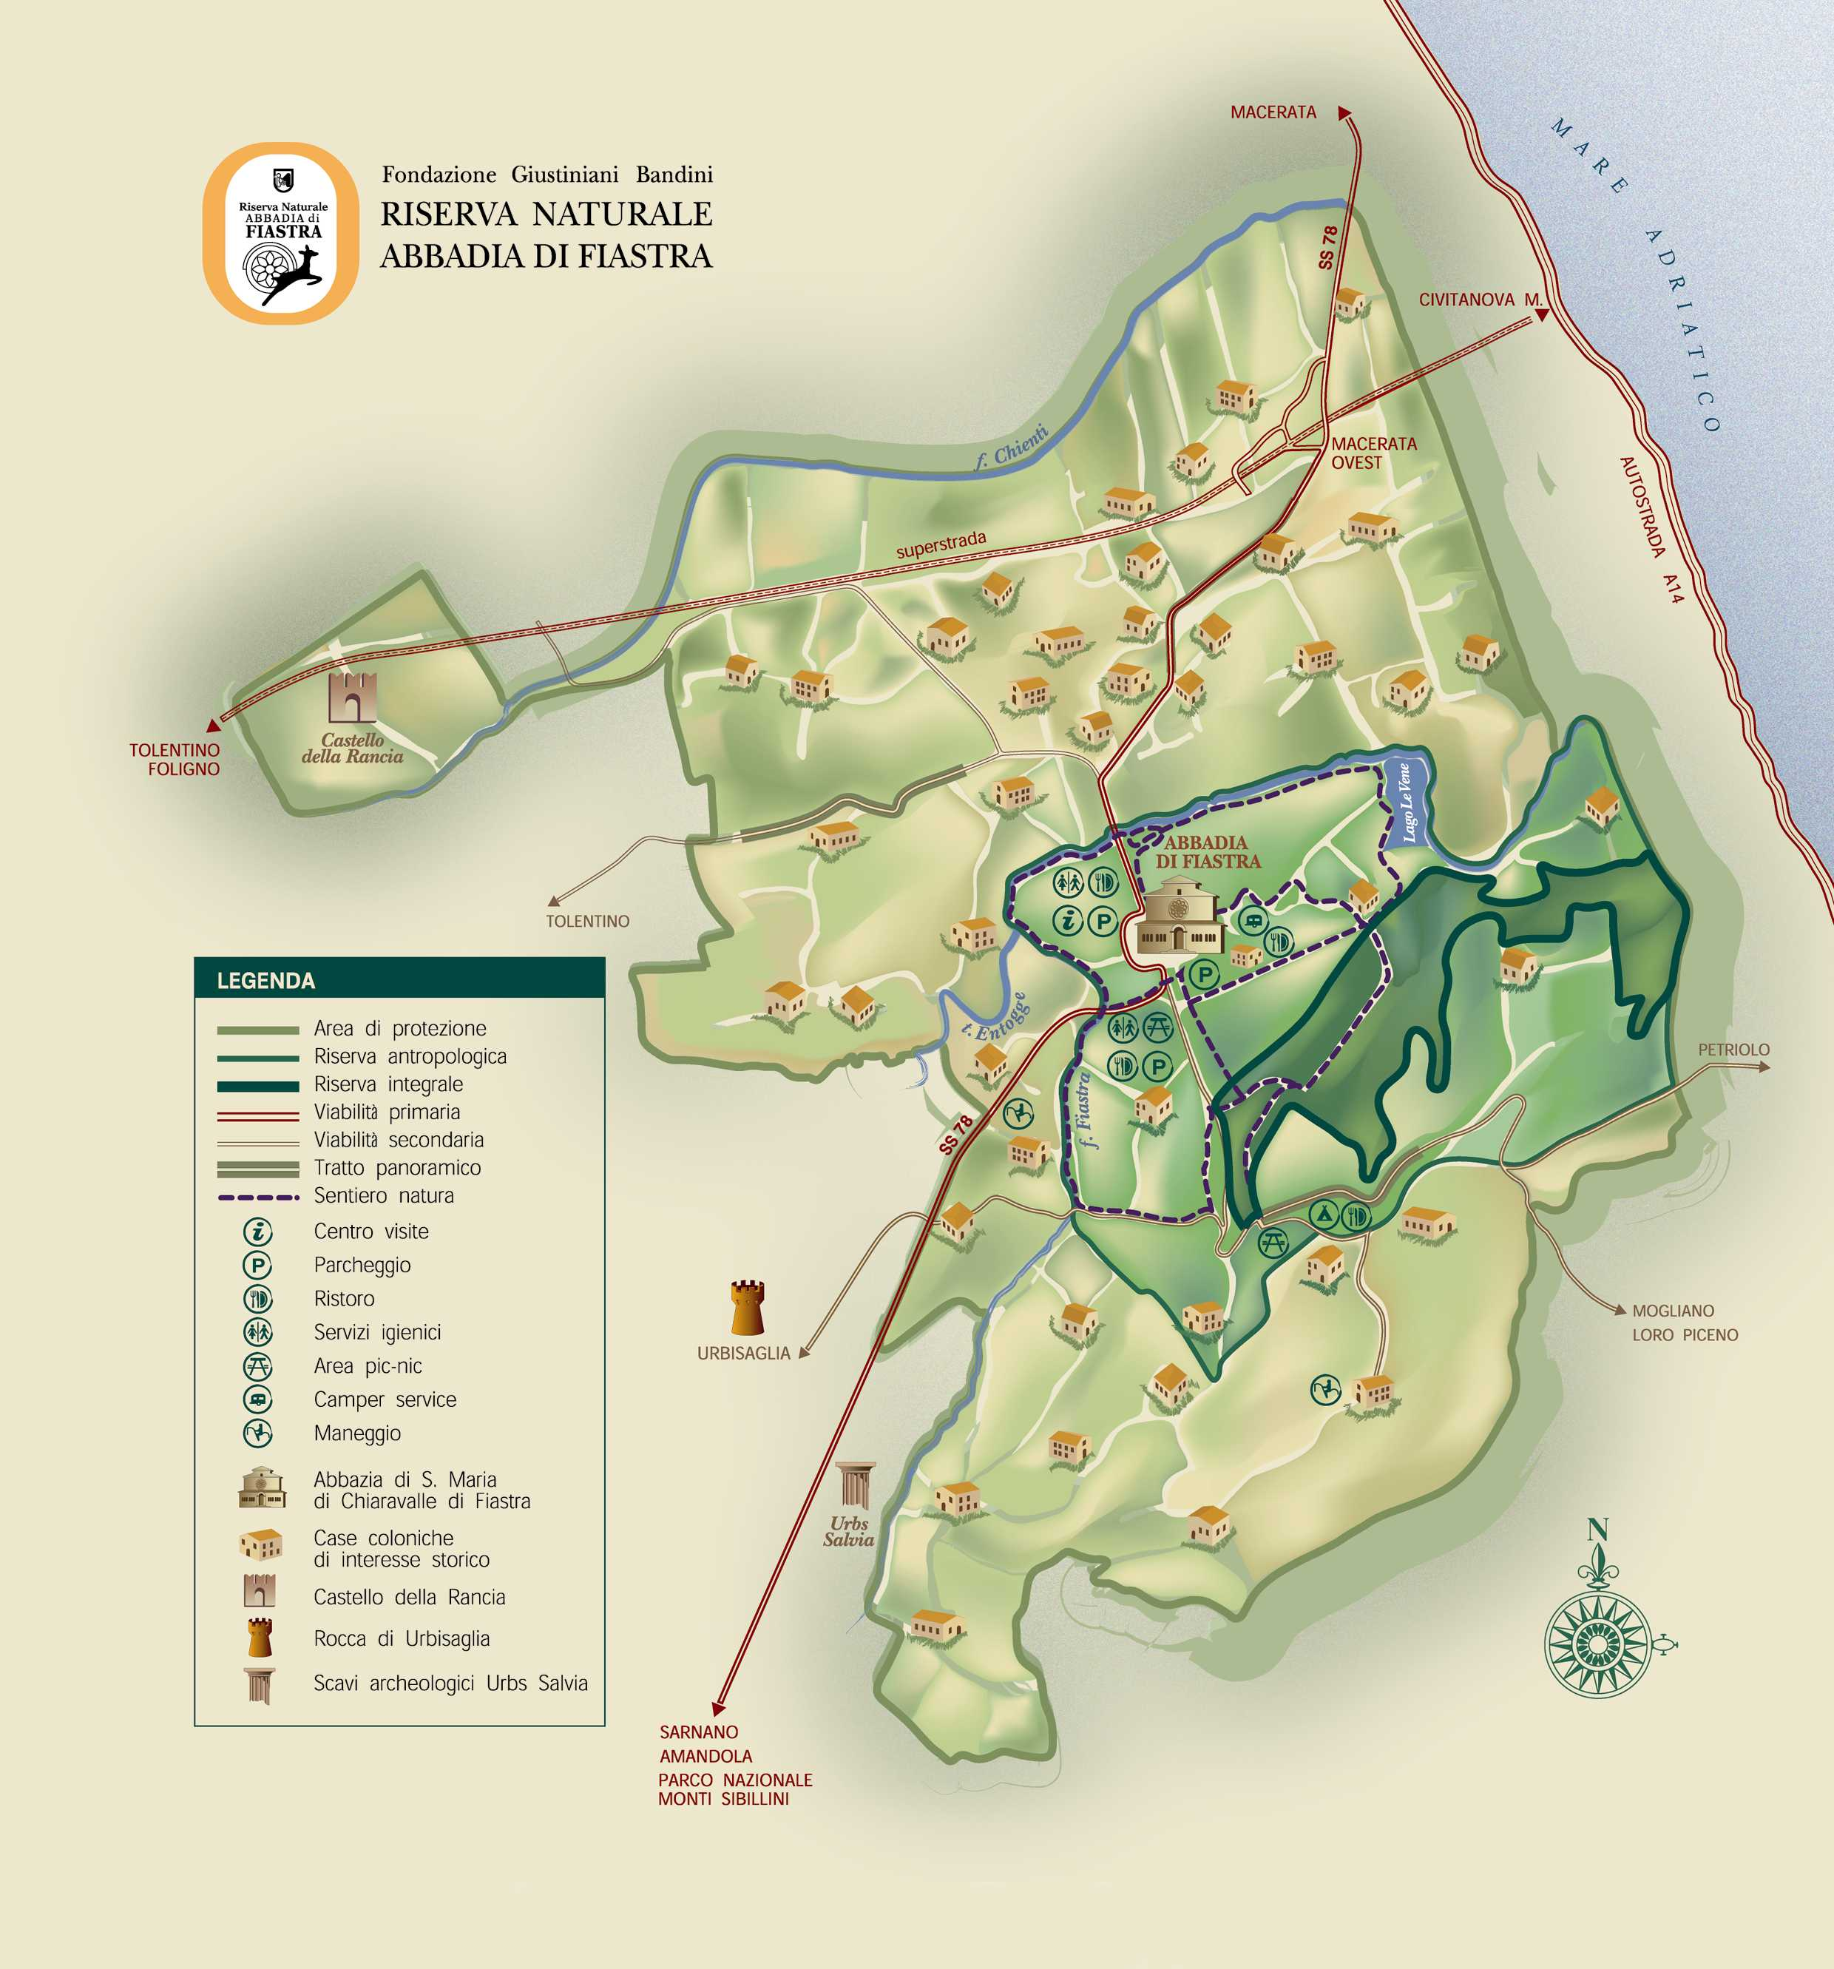
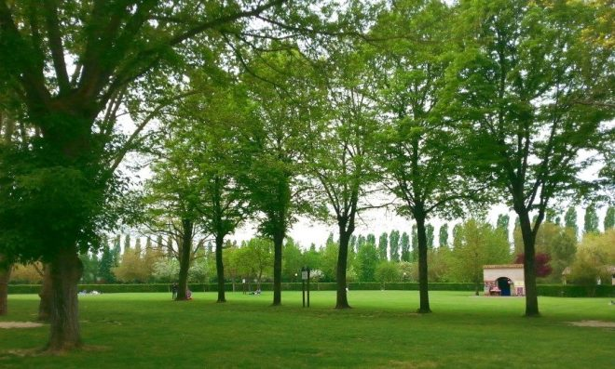
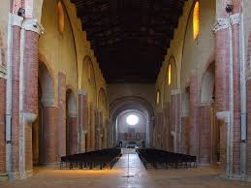
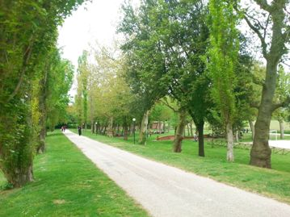
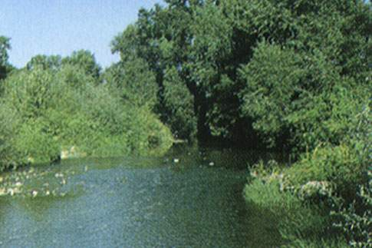
The abbey and its history The natural reserve an ecosystem
The monastery premises are still very similar to their medieval structure.
Fiastra Abbey Nature Reserve was established in 1984 and includes 4,448 acres of land surrounding the Abbey of Chiaravalle di Fiastra that were shaped over the centuries by the Cistercians.
The mission of the Nature Reserve is to safeguard the lands, to advance scientific research and environmental education activities, to promote the development of agriculture in accordance with the development of tourism, to safeguard the ancient Abbey.
The cloister, as we see it now, was restored by the cardinals in commendam. The well in the centre was used to draw water from a cistern that collected rain water from the roofs.

Slide 15
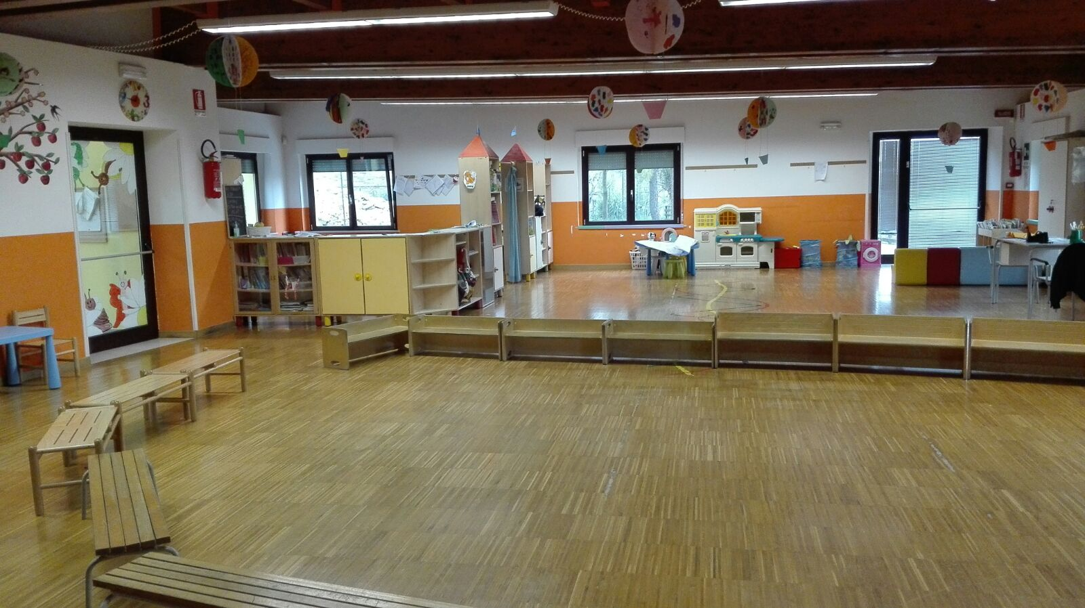
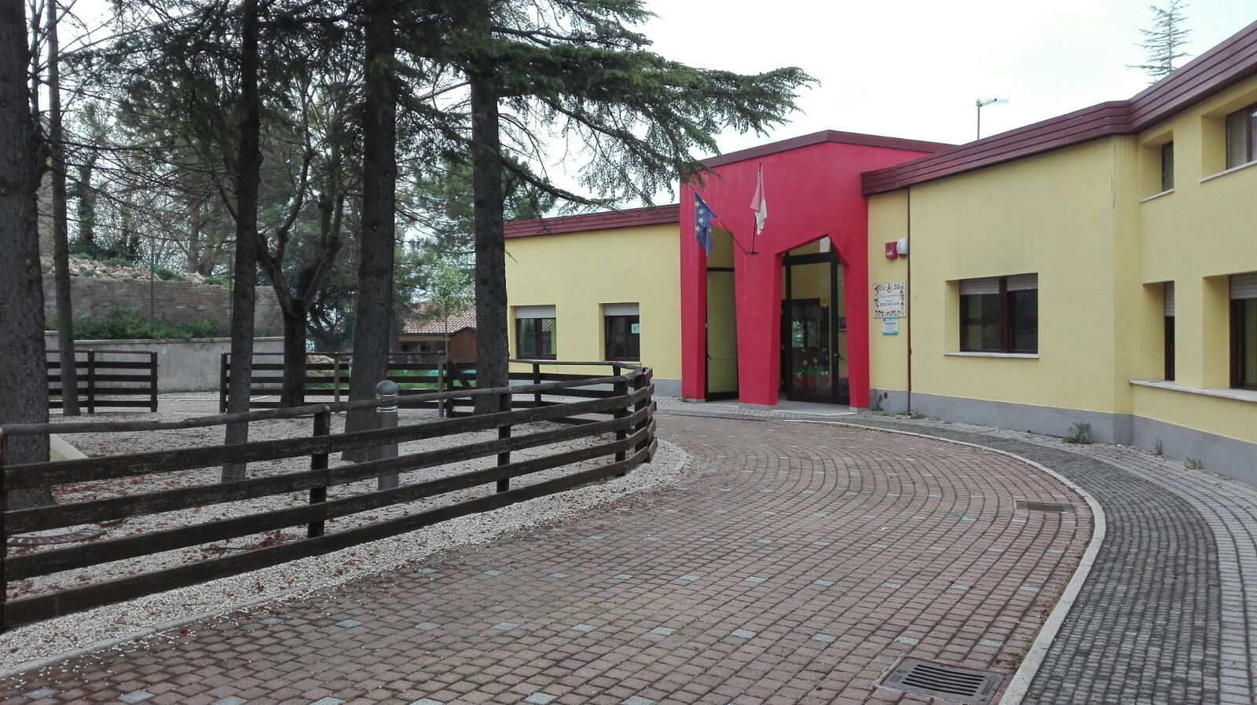
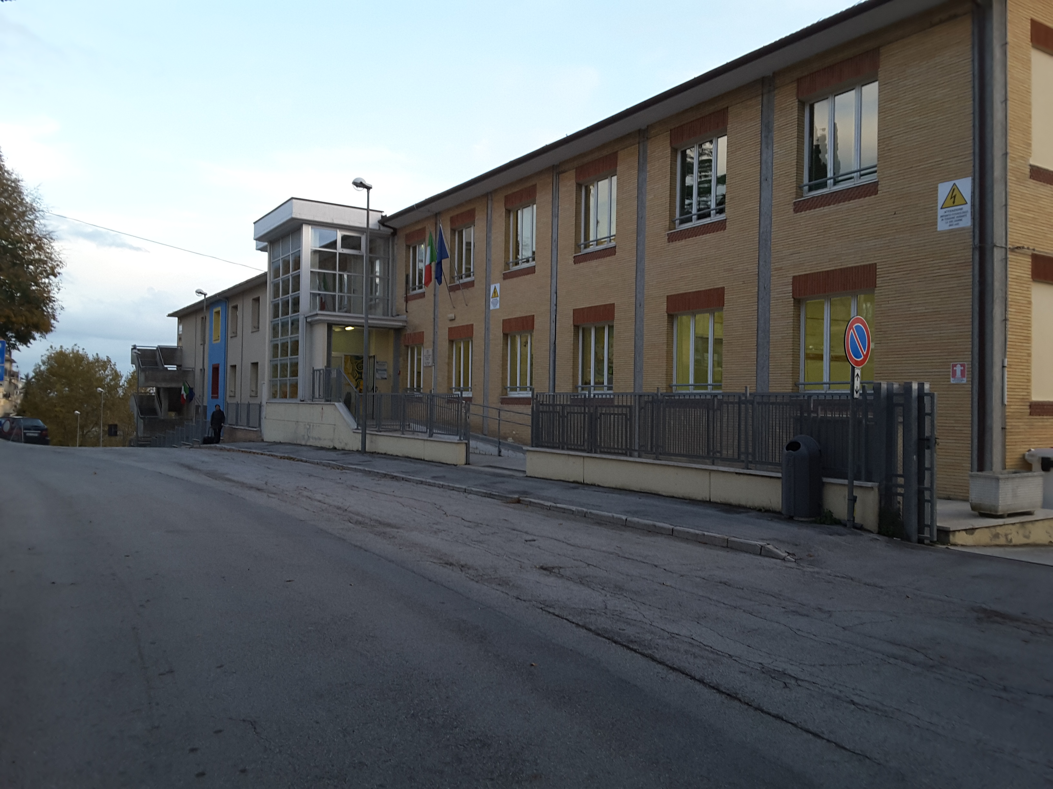
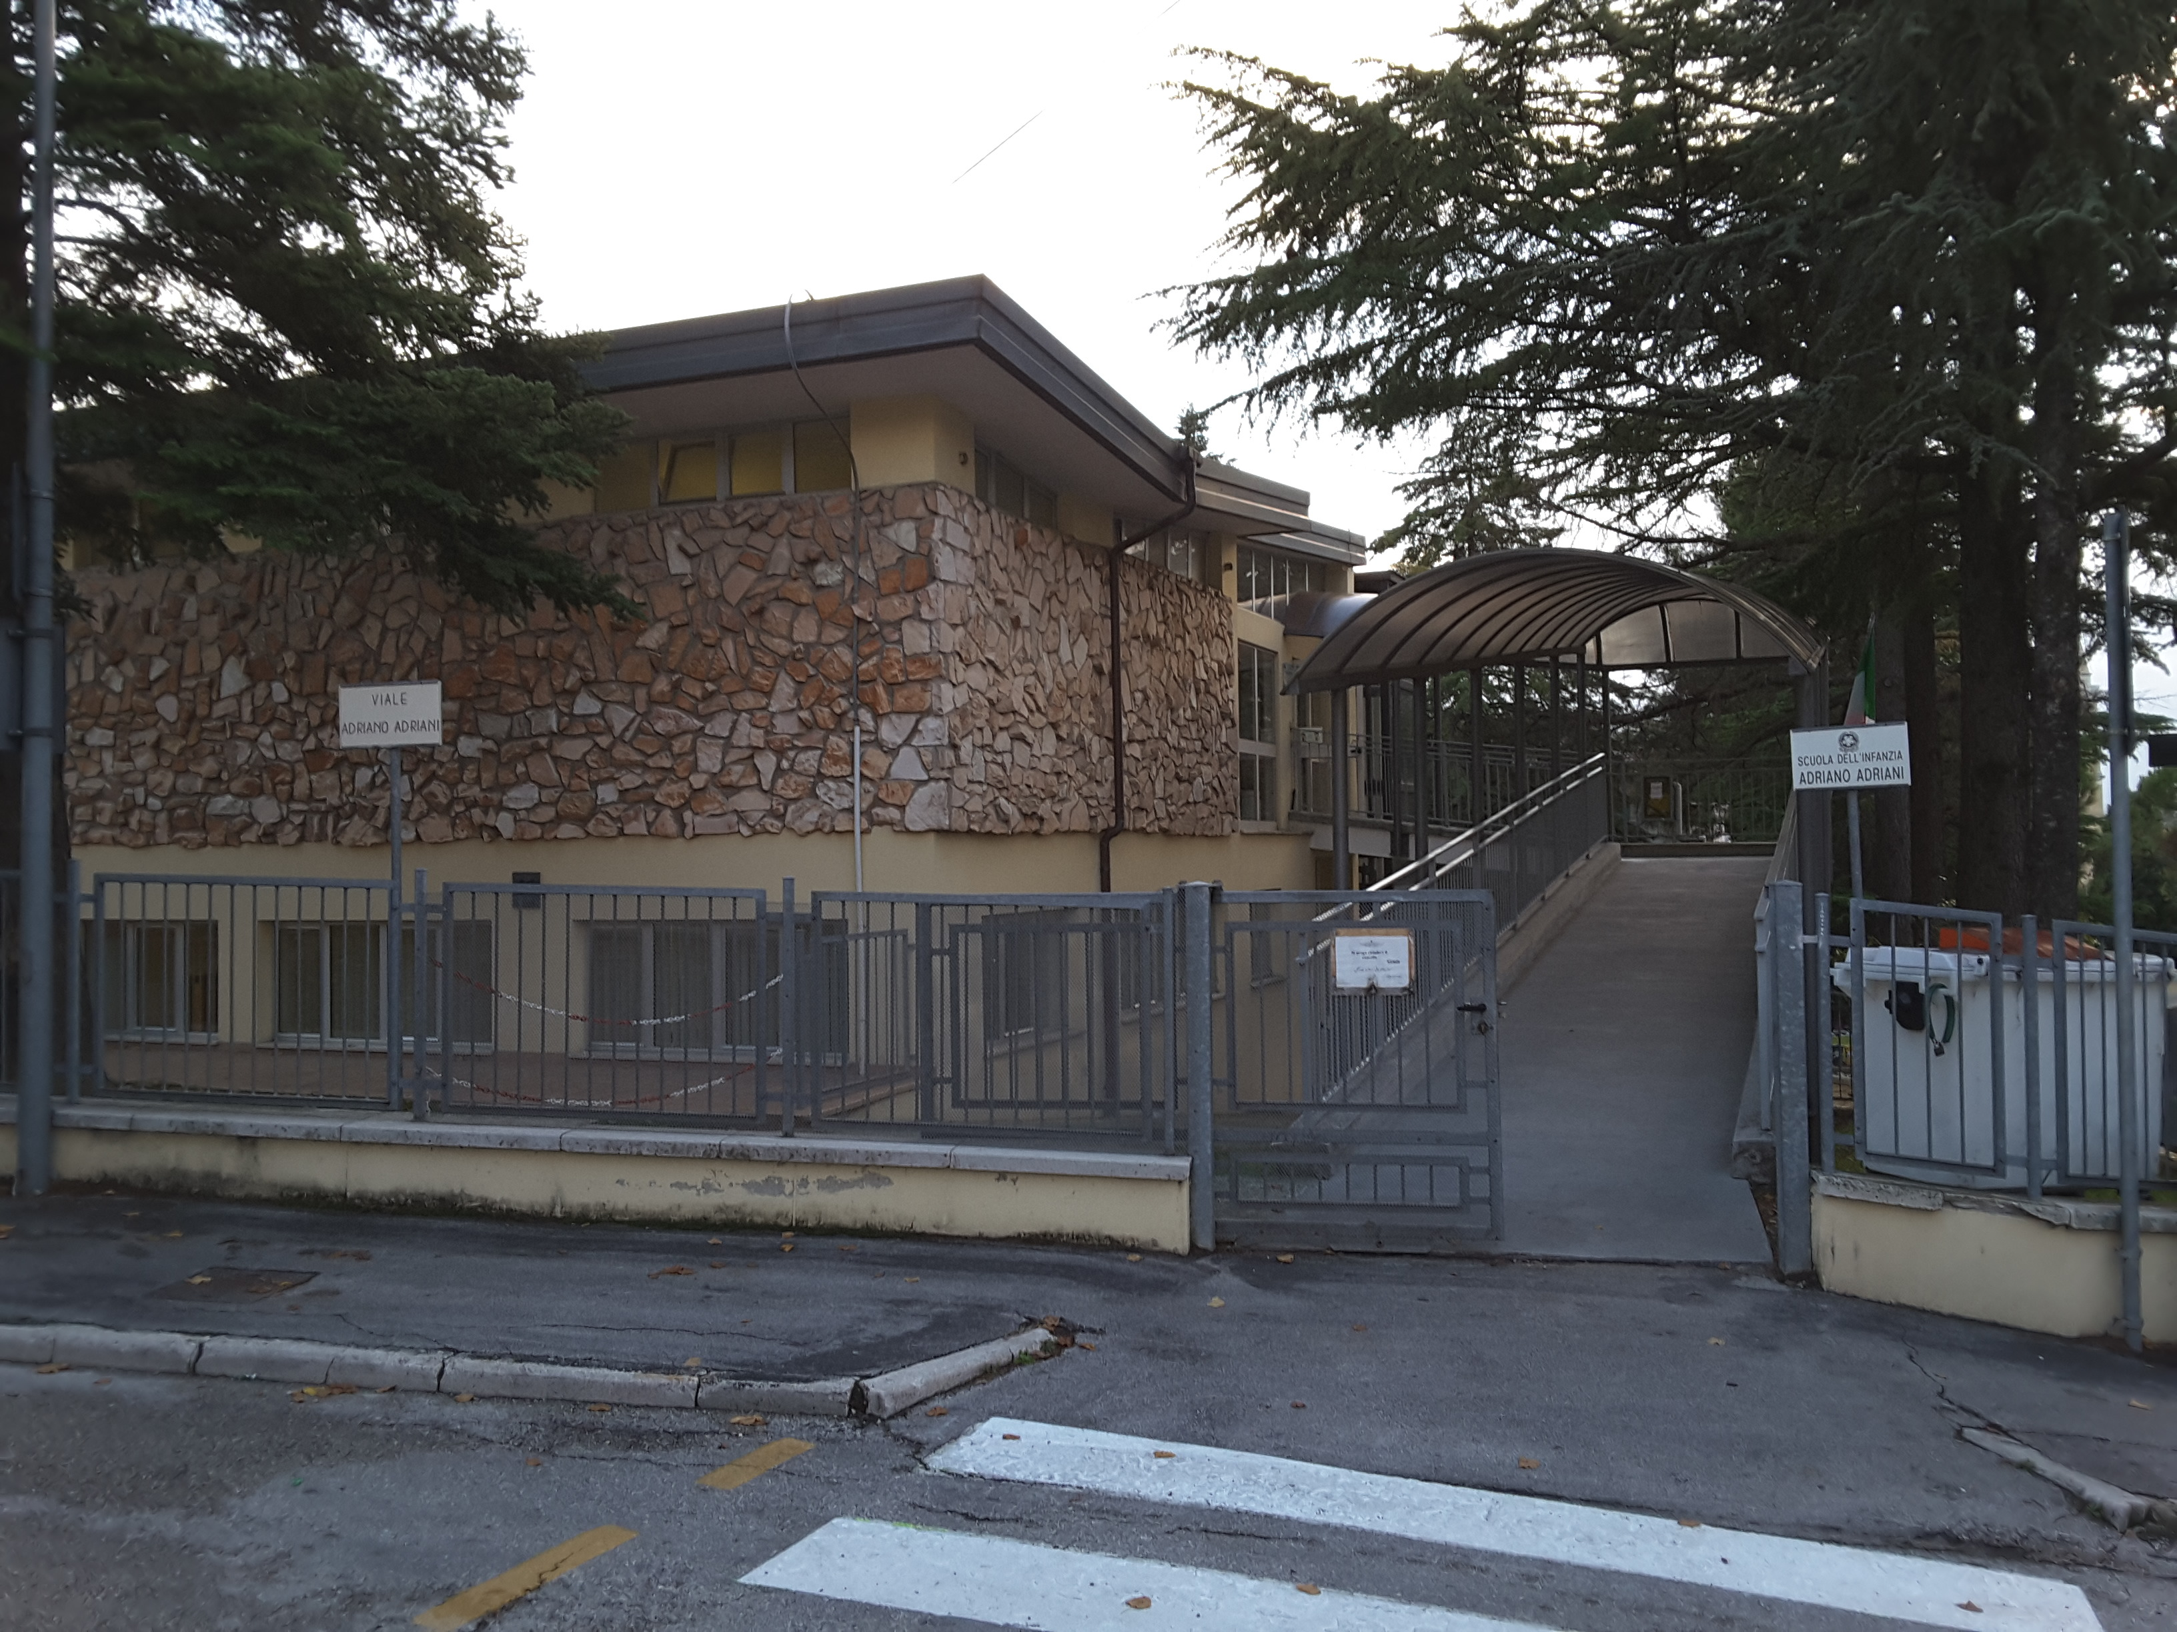
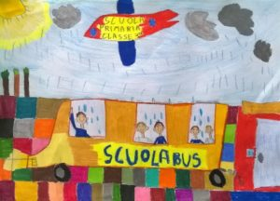
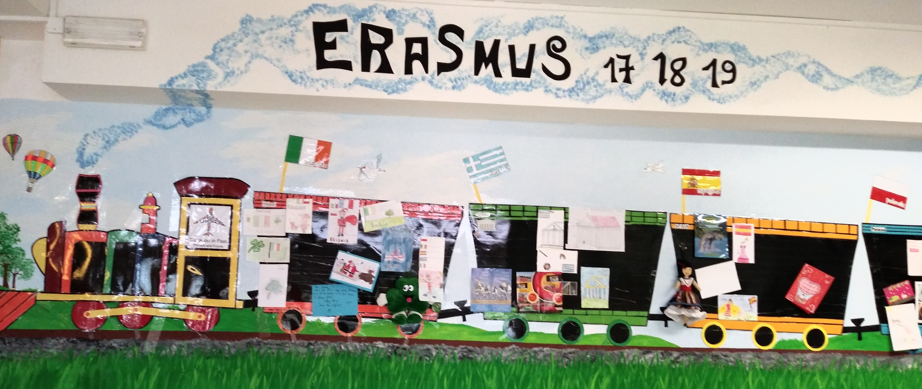
Istituto comprensivo Giovanni XXIII Our schools
We our school
We learn to learn…
… with joy

