Slide 1
Erasmus Project –(Transport in Past , Present and Future) –Second Year Cross curriculum
IV Class –Primary
I.C Berlinguer

Slide 2
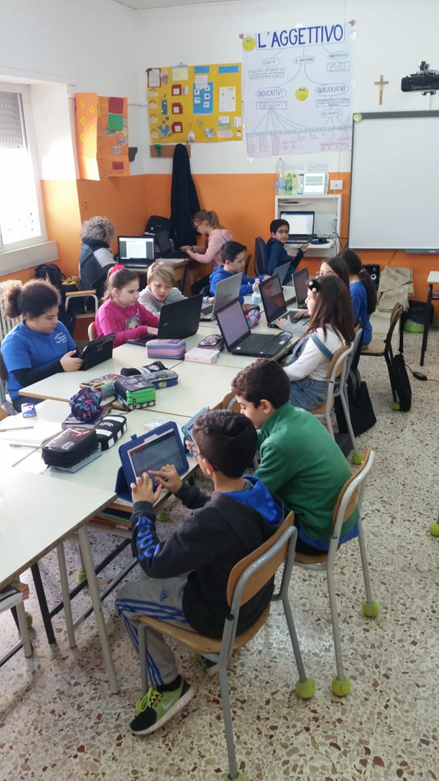
Work in progress
we try to have information about the global goals

Slide 3
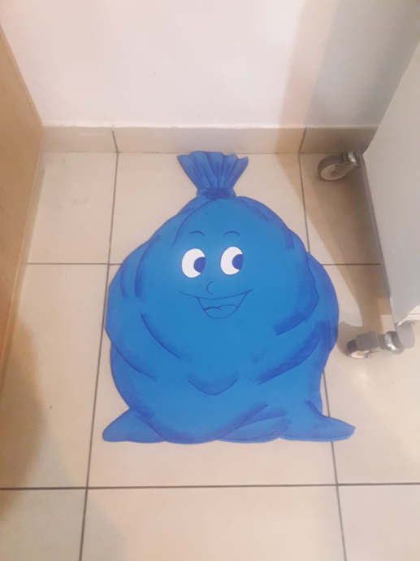
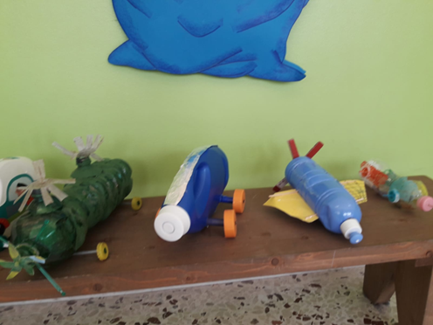
New friend!
New word
New toys!

Slide 4
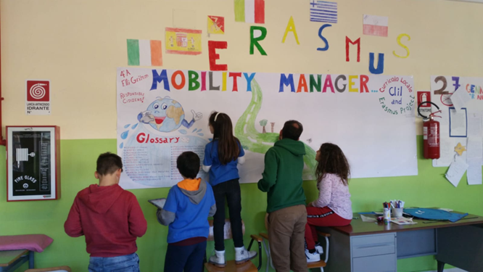
our work

Slide 5
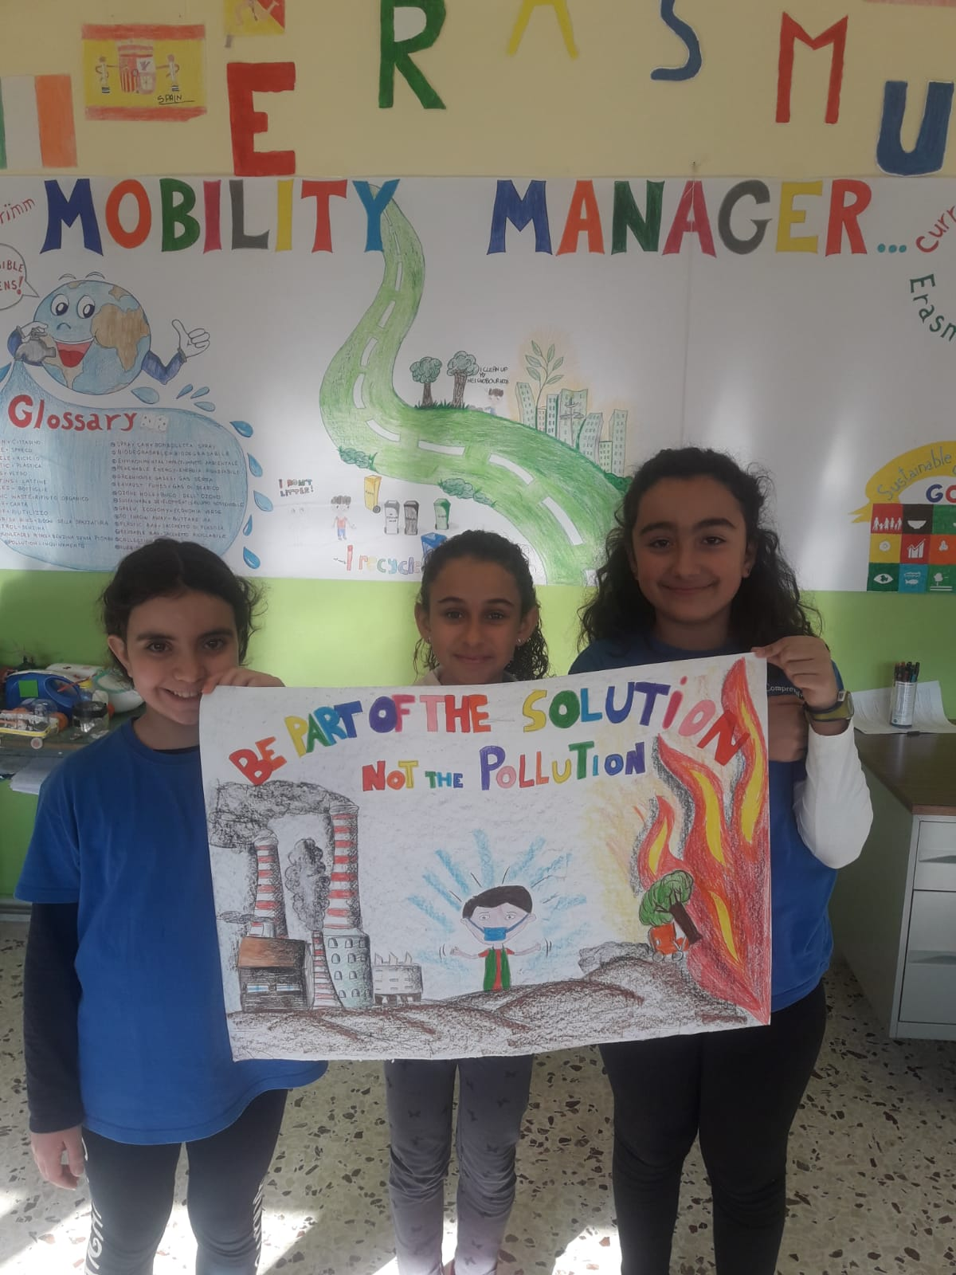
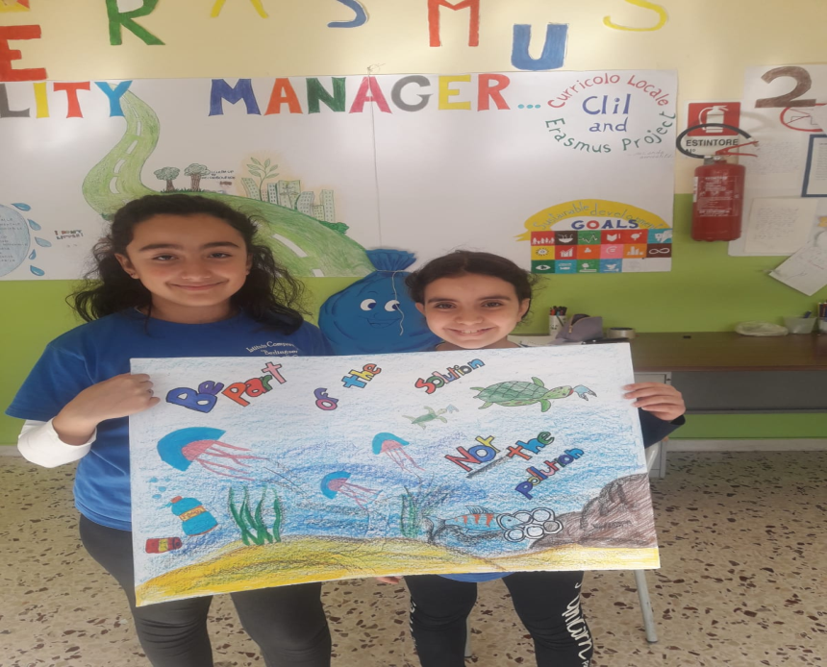

Slide 6
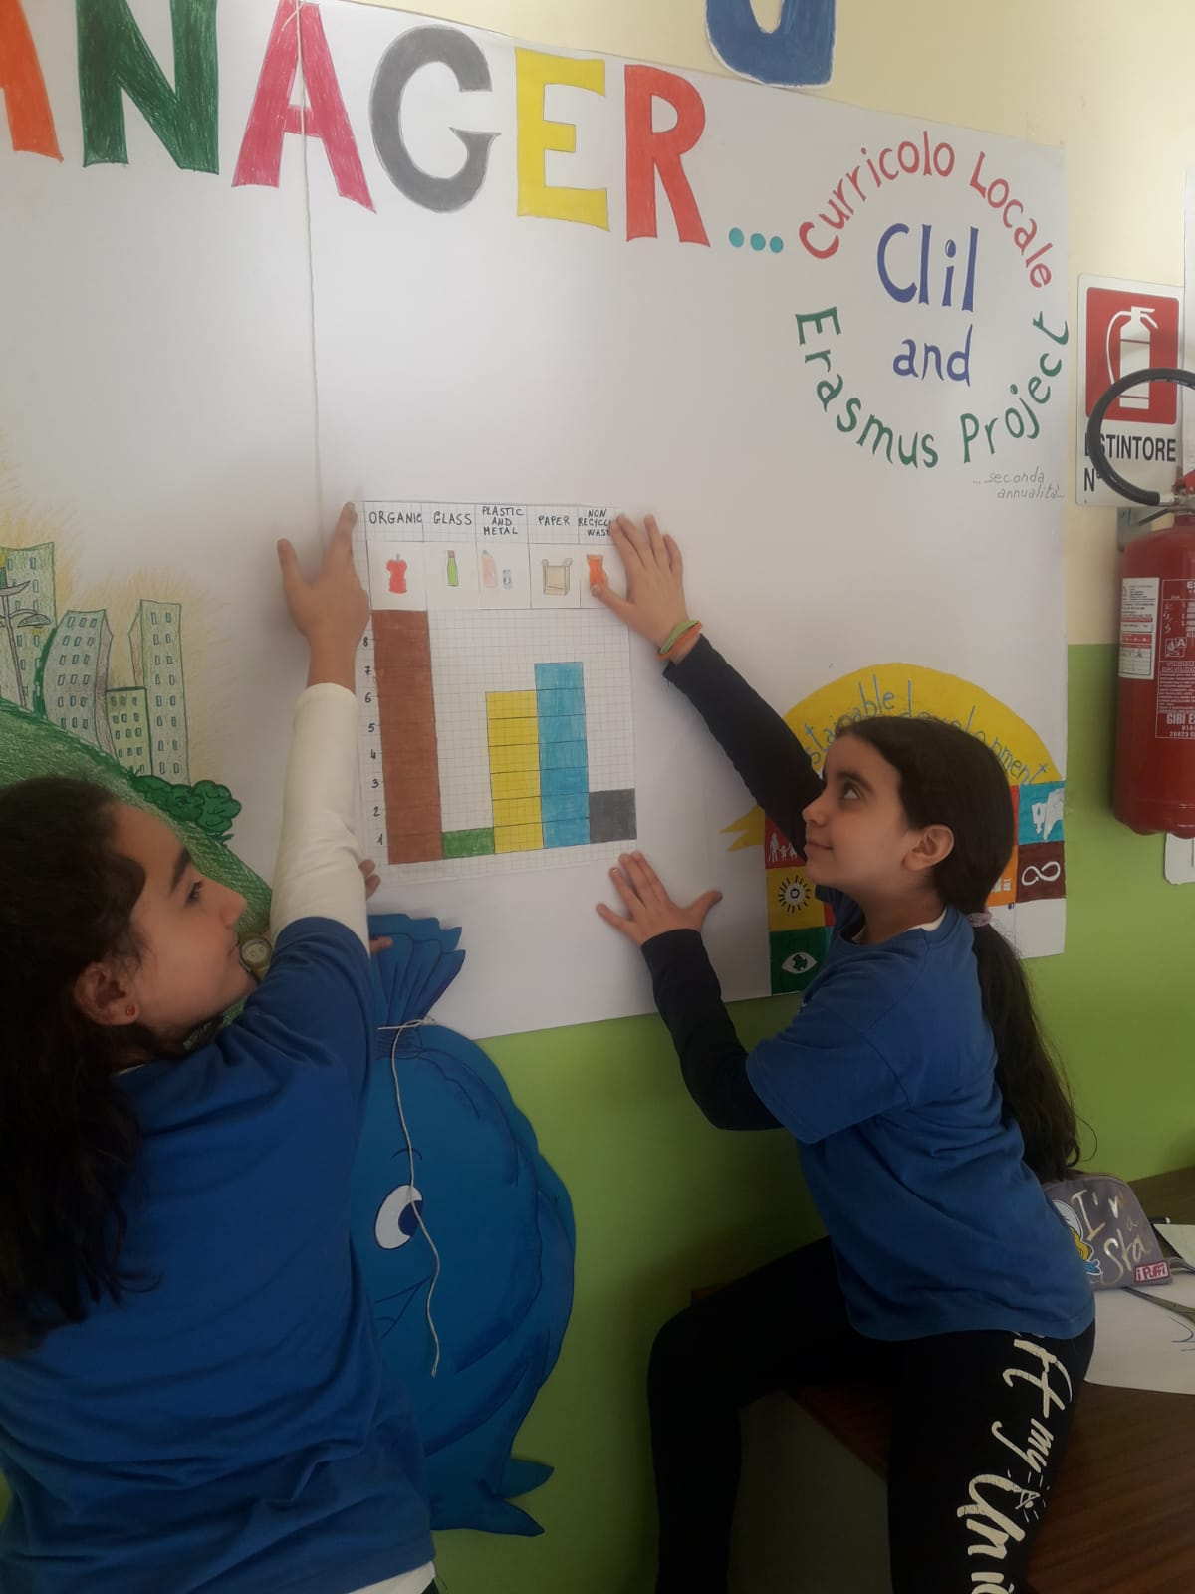
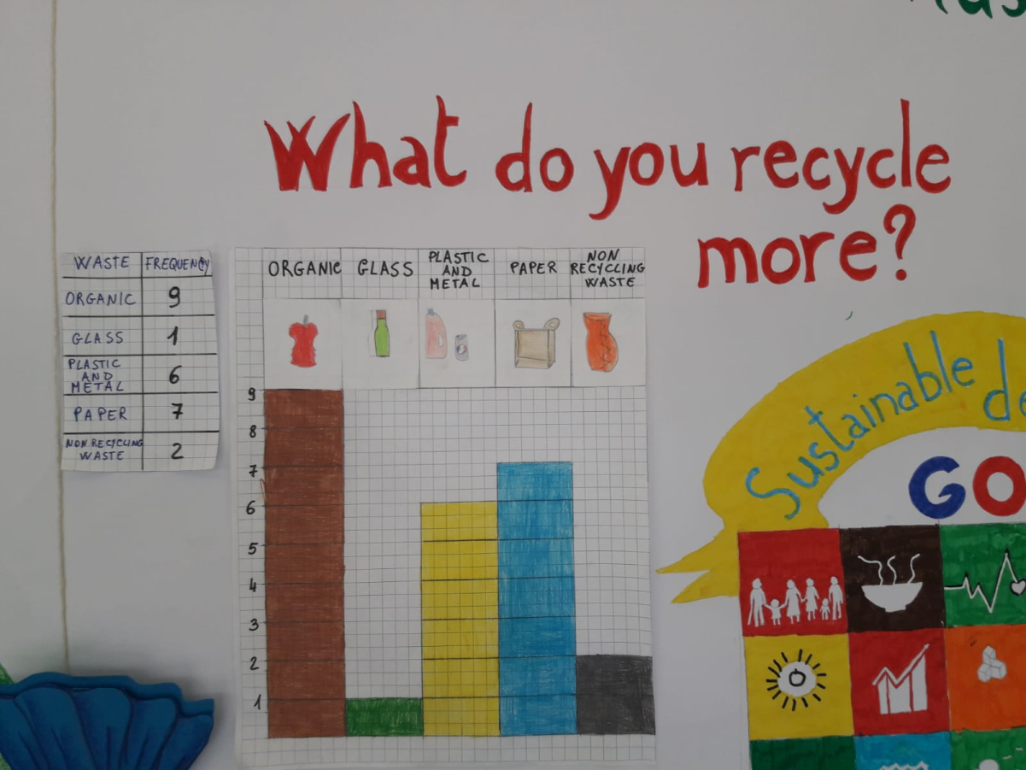
our interview
our interviews and our survey

Slide 7
