Slide 1
ZINICA MARIO
My name is Zinica Mario.I have 9 years and I
am in class II B,secondary school No.29,Galati.
My hobbys is to play quitar and swimming .I like to play whit dog puppies because they are cute and playful. Also i like school,where I can learn new things.
This is me.

Slide 2
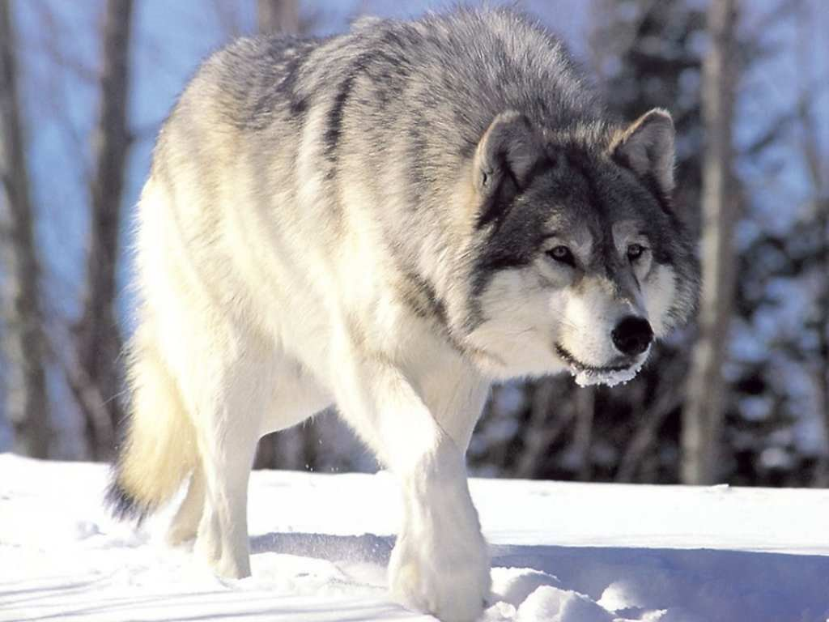
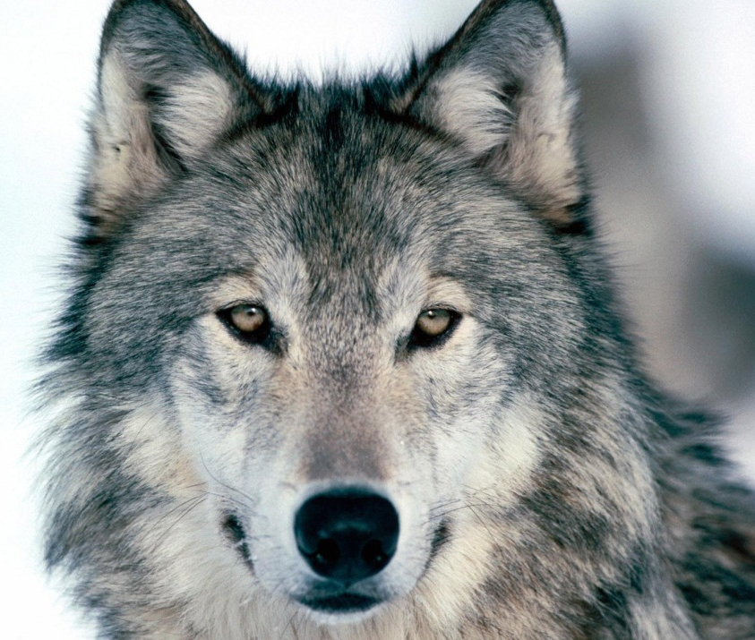
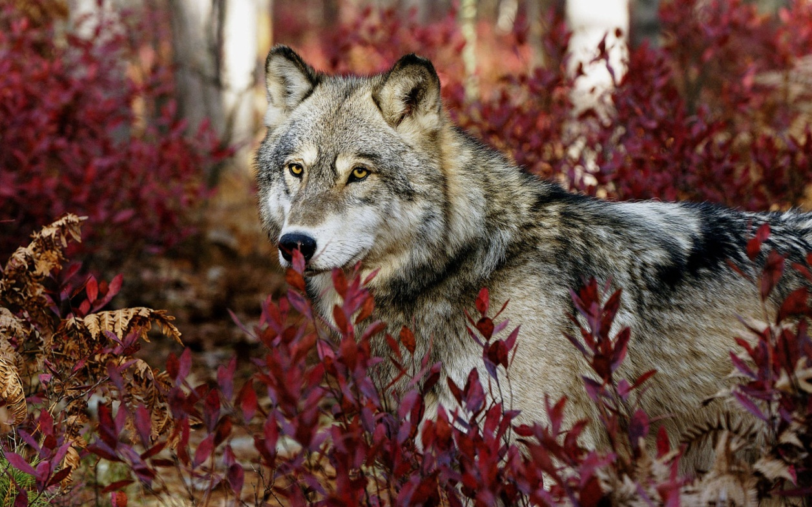
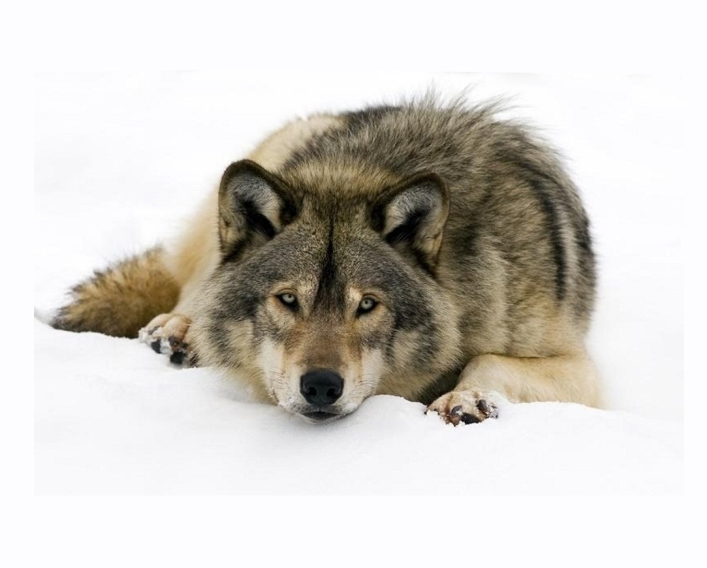

Slide 3
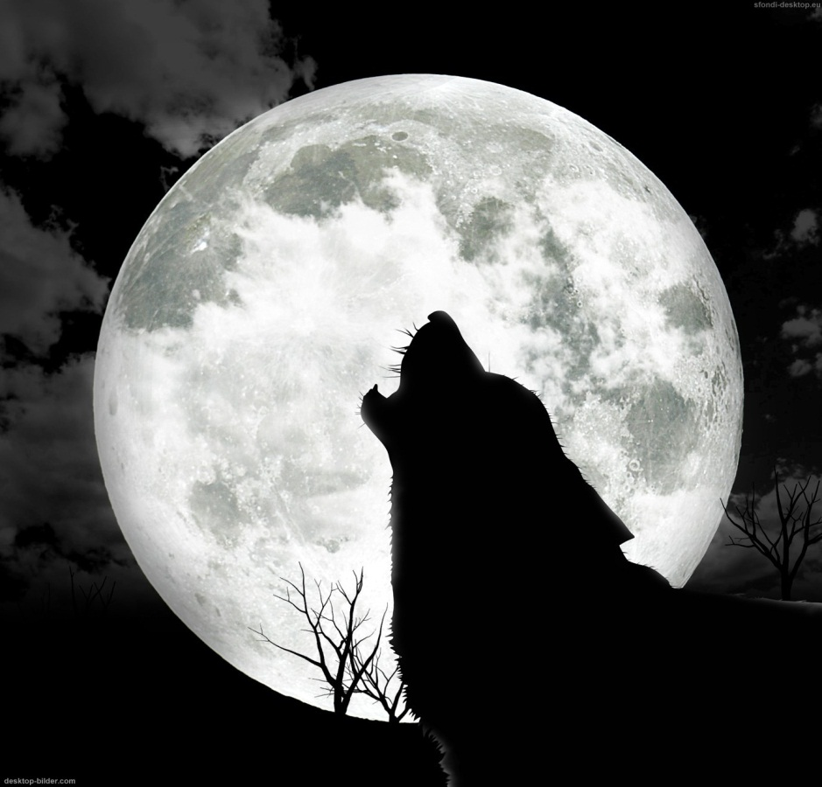
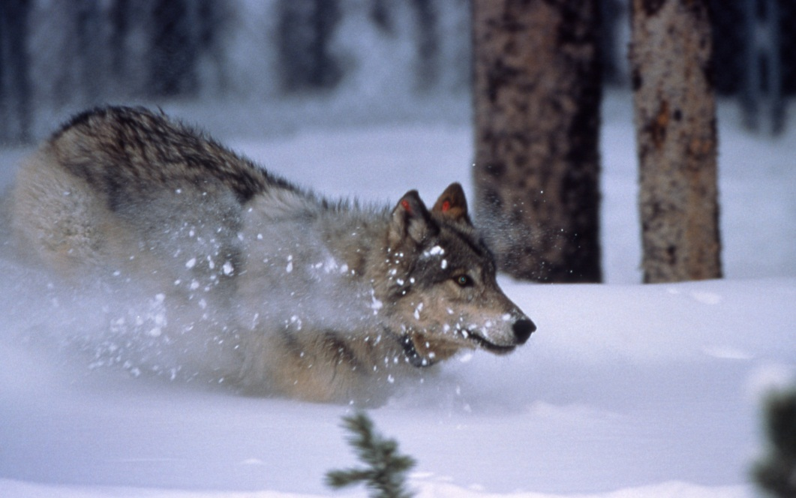
Scientific name: Canis lupus Rank: Species Gestation period: 62 – 75 d Tail length: 29 – 50 cm (Adult) Speed: 50 – 60 km/h (Running), 8 – 9 km/h (Loping pace)

Slide 4
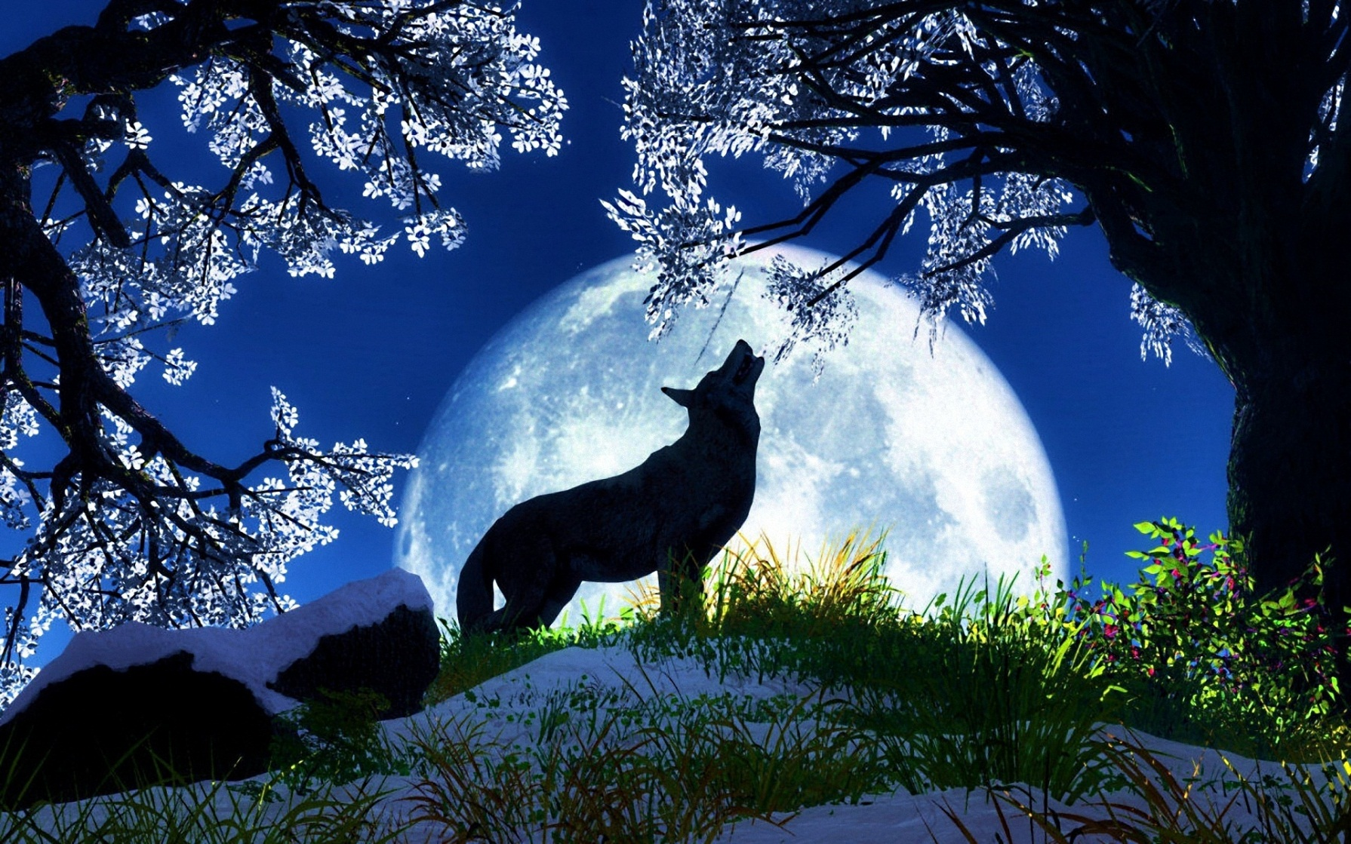
Gray wolf The gray wolf or grey wolf is a species of canid native to the wilderness. It is the largest member of its family, with males averaging 43–45 kg, and females 36–38.5 kg.

Slide 5
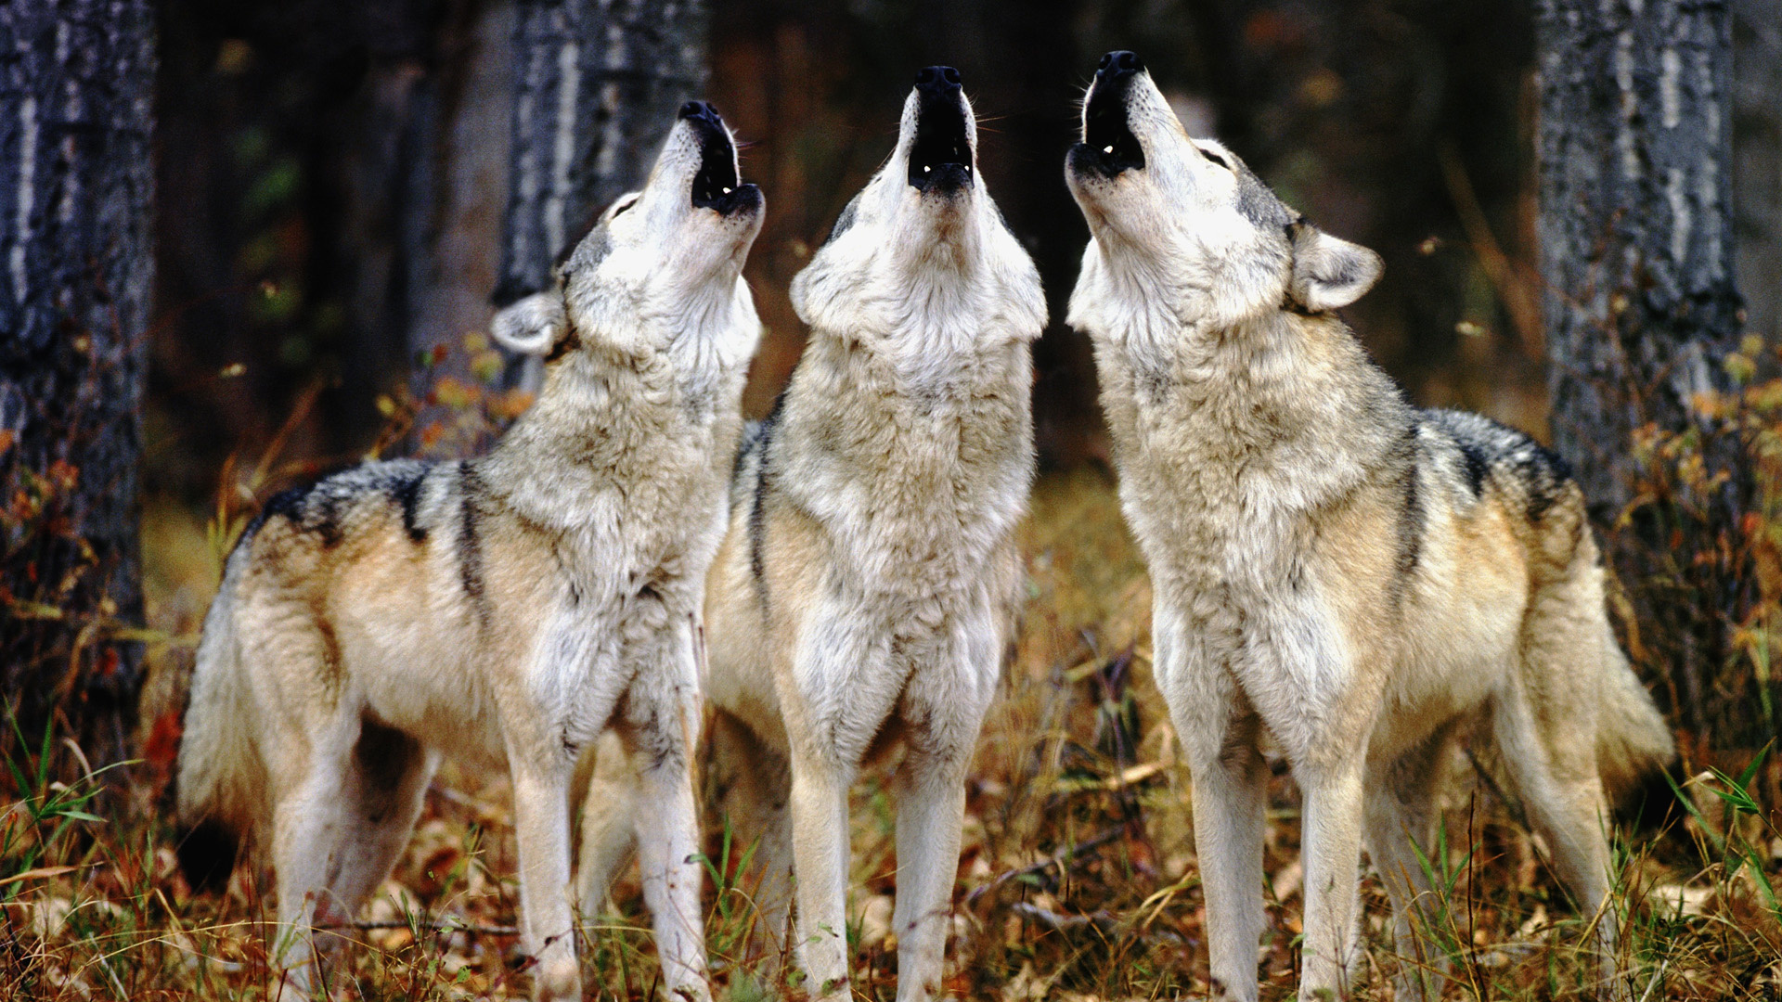
SCHOOL No.29 Galati

