Slide 1
STEM is… on fire Move the small fire to the large fire
Annie-Evi

Slide 2
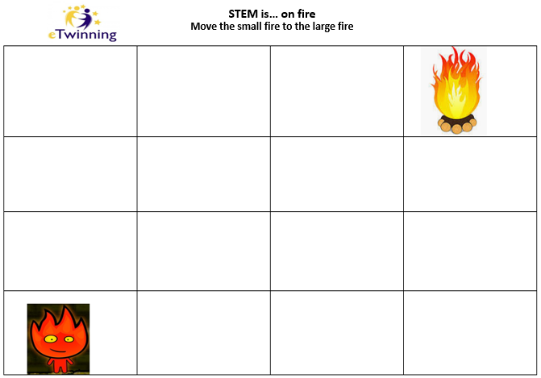
Eleni-Hatice Mutlu

Slide 3
Emine-Mioara Elena

Slide 4
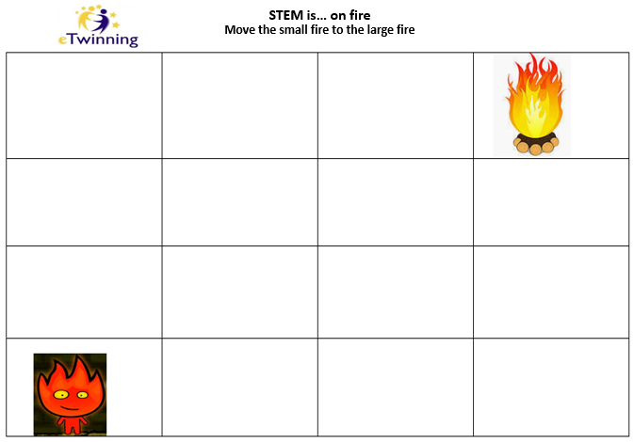
Varvara-Vasso

Slide 5
Spiridoula-Mariausillia

Slide 6
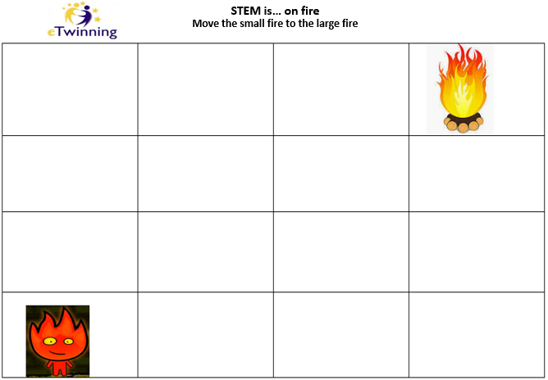
Georgiana-Hatice Guliz

Slide 7
Trial

