Slide 1
Math versus IT – The Easier Way
Made by: Tamás Czinkóczi
2016. (Hungarian mobility)

Slide 2
Development (screen division)

Slide 3
Useful keyboard shortcuts
CTRL + S Save the document (control)
ALT + TAB Change the screen (tabulator)
F5 Resfresh the webpage
CTRL +/- Make bigger/smaller the screen

Slide 4
JAVASCRIPT and MATH
Operator | Description
+ | Addition (x = y + 2;)
- | Subtraction (x = y - 2;)
* | Multiplication (x = y * 2;)
/ | Division (x = y / 2;)

Slide 5
JAVASCRIPT and MATH
Method | Description
abs(x) | Returns the absolute value of x
exp(x) | Returns the value of E^{x}
floor(x) | Returns the value of x rounded down to its nearest integer
pow(x,y) | Returns the value of x to the power of y
round(x) | Returns the value of x rounded to its nearest integer
sin(x) | Returns the sine of x (x is in radians)
sqrt(x) | Returns the square root of x

Slide 6
Let’s go! ;)

Slide 7
TASK basic

Slide 8
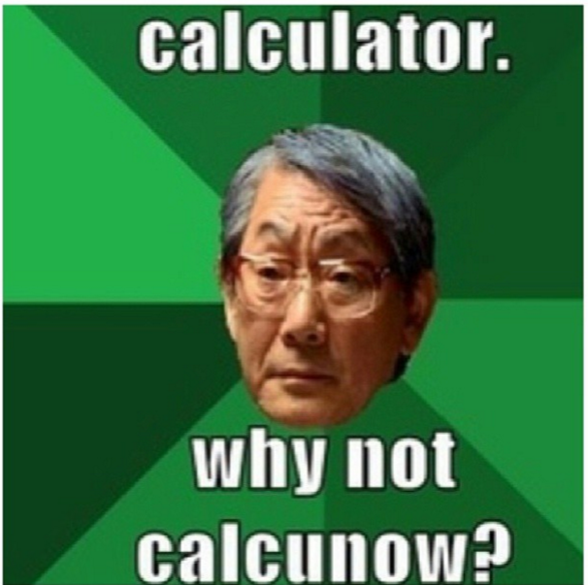

Slide 9
TASK 1. [name: double][in: a, out: ___ ]

Slide 10
TASK 2. [name: half][in: a, out: ___ ]

Slide 11
TASK 3. [name: ____][in: a, out: ___ ]

Slide 12
TASK 4. [name: ___ ][in: a,b out: ___ ]

Slide 13
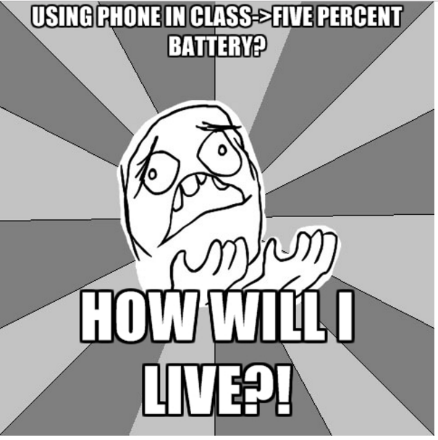
TASK 5. [name: ___ ][in: h time in our, p, out: ___ ]

Slide 14
TASK 6. [name: surface][in: a, out: ___ ]

Slide 15
TASK 7. [name: life expectancy][in: g, out: ___ ]

