Slide 1
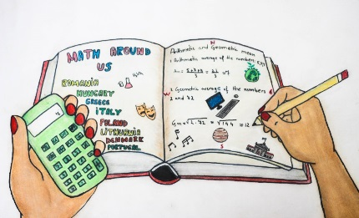
MATH AND THE ENVIRONMENT
ZESPÓŁ SZKÓŁ W GŁOGOWIE MAŁOPOLSKIM

Slide 2
It is time to think about our planet:
saving water and energy
reducing pollution
recycling
protecting animals, trees, plants
getting young people interested in the environment

Slide 3
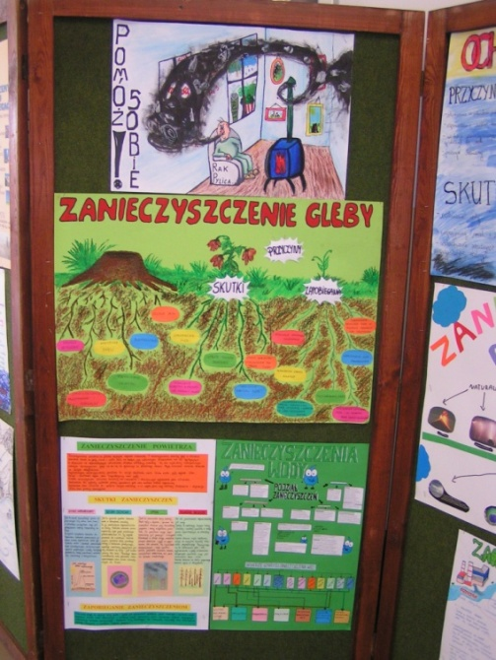
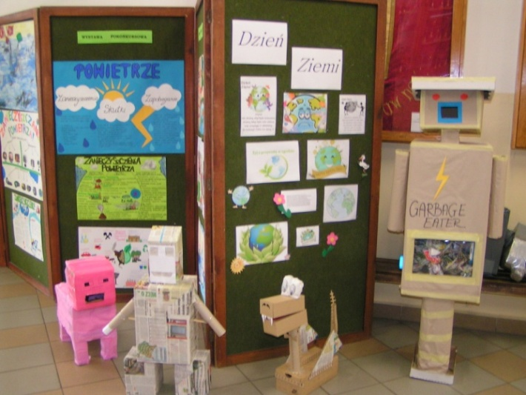
EARTH DAY AT OUR SCHOOL
We organize many events such as:
planting trees
picking up roadside trash
collecting recyclable materials
making educiational posters

Slide 4
We found the above quote very inspirational.
We got involved in three projects where math and the environment were connected.

Slide 5
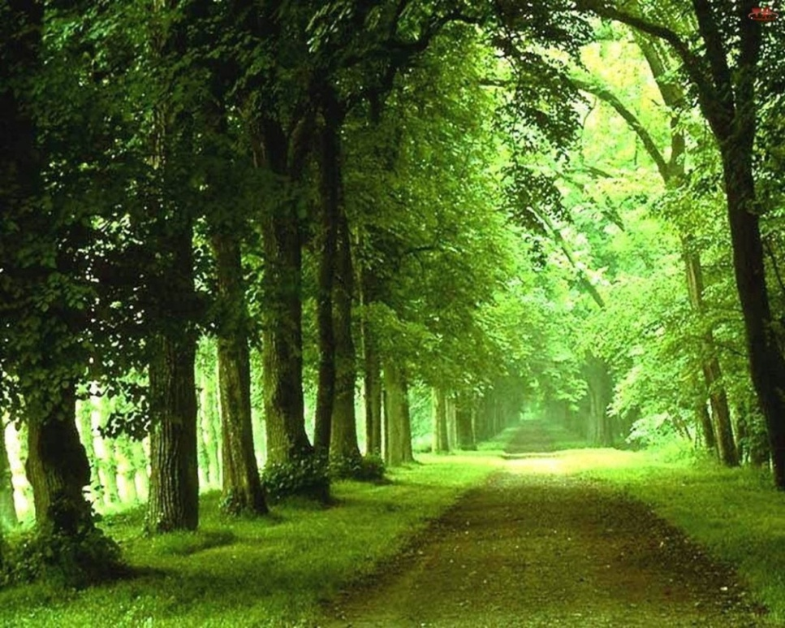
SAVING TREES
Trees are extremely important because they:
provide oxygen
deflect the sunlight
improve air quality
conserve water
preserve soil and
support wildlife
control the climate

Slide 6
USING WASTE PAPER
You need
100 tons of
waste paper
to produce
90 tons of paper.
17 trees need
to be cut down
in order to produce 1 ton of paper.
Our school collects approximately 7 tons of waste paper every year.

Slide 7
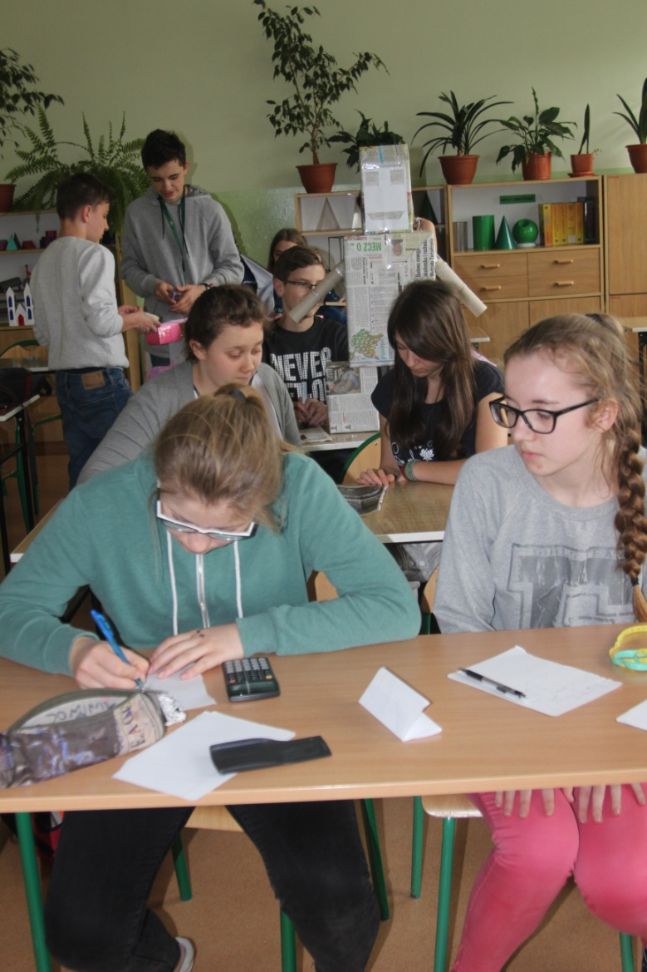
COUNTING THE PROPORTIONS

Slide 8
TOGETHER WE CAN MAKE A BIG DIFFERENCE!
In Poland there are
18596 primary schools
and junior high schools.
If they collected as
much waste paper
as our school we would
save 1991641,6 trees.

Slide 9
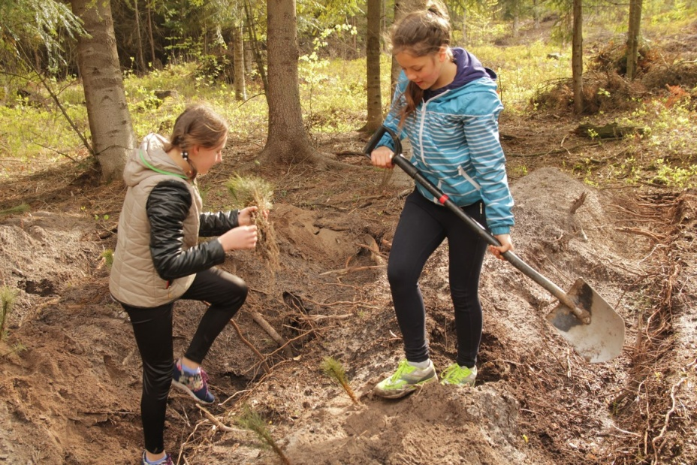
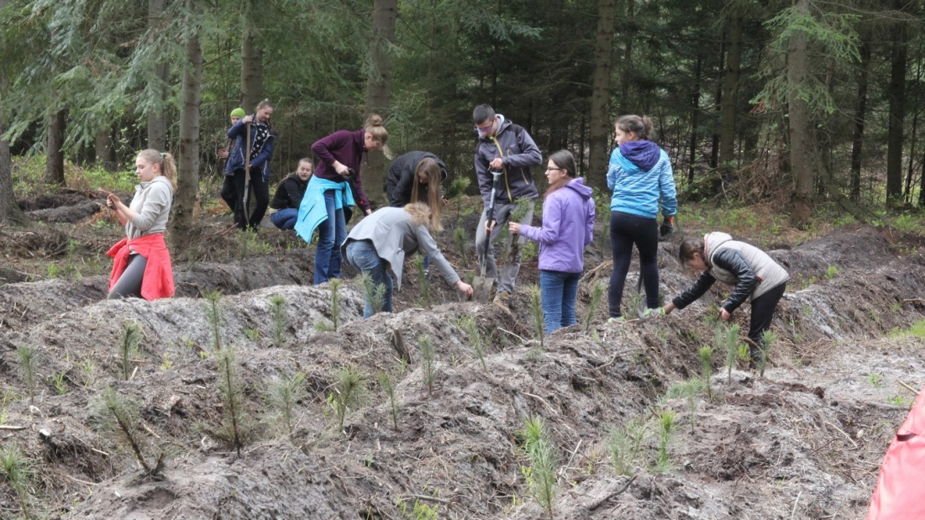
PLANTING PINE TREES
Having in mind the value of trees we went
one step further and planted some.
In April we planted 1,500 pine trees in the
area.

Slide 10
SAVINGS AT HOME
It is good to know how much your parents pay for bills
We chose six students
who collected data
from the last six months
The first task was to
compare and analyze
the results

Slide 11
The first family (4 members), living in a flat.
 | Family expenses for six months (zl) | Family expenses for one month (zl) | Expenses for one person
 |  |  | Per month (zl) | Per six months (zl)
GAS | 189 | 31 | 7,8 | 49
WATER | 1044 | 174 | 43,5 | 261
ELECTRICITY | 767 | 128 | 191 | 192
The second family (5 members), living in a detached house.
 | Family expenses for six months (zl) | Family expenses for one month (zl) | Expenses for one person
 |  |  | Per month (zl) | Per six months (zl)
GAS | 856 | 142 | 28 | 171
WATER | 559 | 93 | 18,6 | 112
ELECTRICITY | 586 | 98 | 19,6 | 117
The third family (4 members), living in a detached house.
 | Family expenses for six months (zl) | Family expenses for one month (zl) | Expenses for one person
 |  |  | Per month (zl) | Per six months (zl)
GAS | 680 | 113 | 28 | 170
WATER | 450 | 75 | 18 | 112
ELECTRICITY | 460 | 76 | 19 | 115

Slide 12
The forth family (3 members), living in a terraced house.
 | Family expenses for six months (zl) | Family expenses for one month (zl) | Expenses for one person
 |  |  | Per month (zl) | Per six months (zl)
GAS | 1244 | 207,33 | 69,11 | 414,67
WATER | 539 | 89,83 | 29,94 | 179,67
ELECTRICITY | 658 | 109,67 | 36,56 | 219,33
The fifth family (4 members), living in a detached house.
 | Family expenses for six months (zl) | Family expenses for one month (zl) | Expenses for one person
 |  |  | Per month (zl) | Per six months (zl)
GAS | 2799,86 | 466,64 | 116,66 | 699,97
WATER | 848 | 141,33 | 35,33 | 212
ELECTRICITY | 1715 | 285,83 | 71,46 | 428,75
The sixth family (5 members), living in a terraced house.
 | Family expenses for six months (zl) | Family expenses for one month (zl) | Expenses for one person
 |  |  | Per month (zl) | Per six months (zl)
GAS | 2513,66 | 418,94 | 83,79 | 502,73
WATER | 989,4 | 164,9 | 32,98 | 197,88
ELECTRICITY | 1234,24 | 205,71 | 41,14 | 246,85

Slide 13
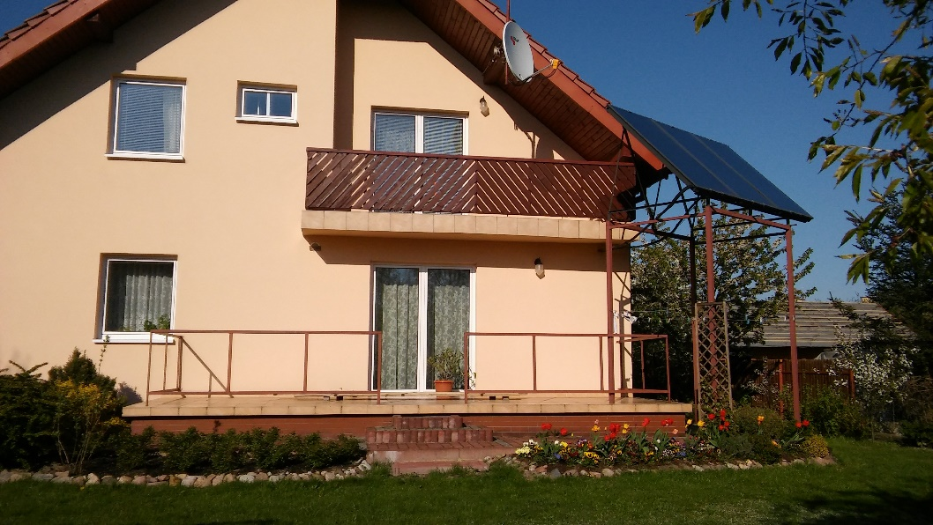
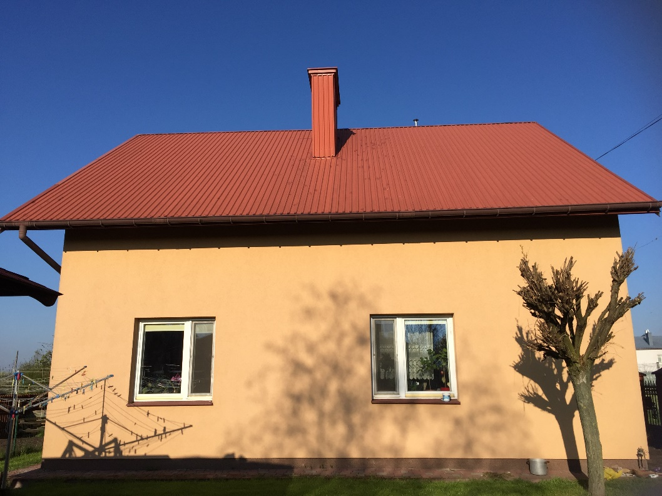
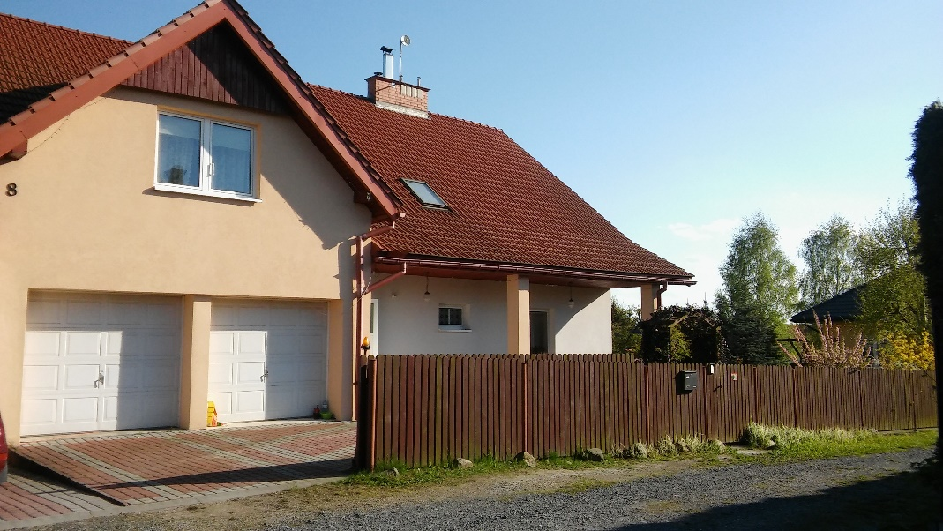

Slide 15
HOW TO BECOME ENVIRONMENTALLY FRIENDLY
The second task was to write an improvement plan for the family with the highest usage of media

Slide 16
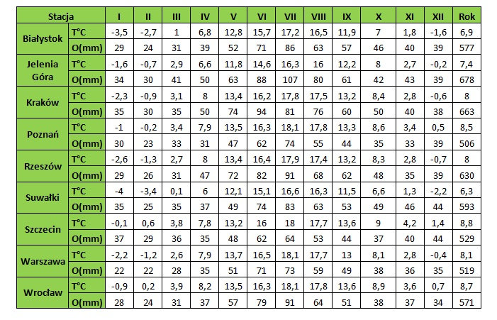
BLENDED LEARNING WITH THE PORTUGUESE TEAM
Climatic diversity in Poland

Slide 17
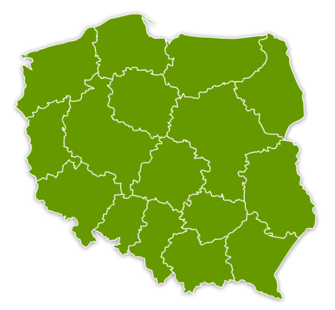
Szczecin is the hottest city
Suwałki is the coldest one

Slide 18
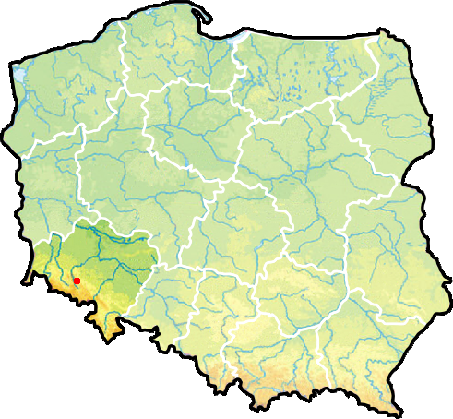
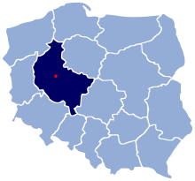
THE MOST HUMID AND THE DRIEST PLACES
Jelenia Góra is the most humid place
Poznań is the driest city

Slide 19
CLIMATE ZONES
We have two climate zones in Poland
The northern parts have temperate oceanic climate
The mountainous regions in the east and southeast have temperate continental climate

Slide 20
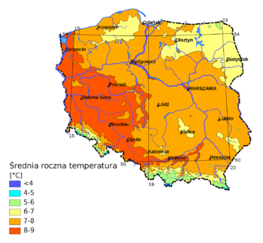
AVERAGE TEMPERATURES
In summer they are between 16.5 ° C and 20 ° C
In winter they are between -6 ° C
and 0 ° C

Slide 21
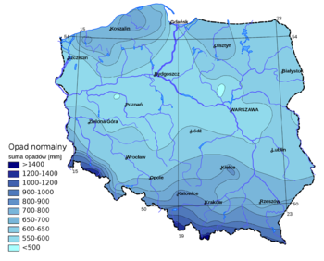
THE AVERAGE RAINFALL
The average rainfall is 600 mm in a year. But the distribution is uneven, 2/3 of annual rainfall occurs in the first 6 months.

