Slide 1
Math in Archaeology
Escola Básica e Secundária Anselmo de Andrade
Almada Portugal 2017
Strategic Partnership 2015-2017
Ref.No: 2015-1-RO01-KA219-015030
Short-Term Exchange
Portugal, 8th-12th May 2017
Math Around Us
Teachers:
Fernanda Martins
Carlos Almeida
Daniela Andrade
Dulce Pereira
Emília Costeira
Elisabete Garcia
Filomena Sousa
Dora Ponte
Sérgio Valente
Maria Cândida Ribeiro
Students: Adrian Burzacovshi; Inês Carreiro; Luana Silva

Slide 2
Dissemination

Slide 3
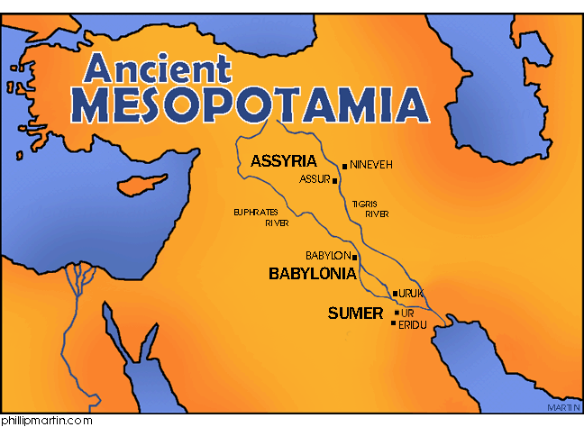
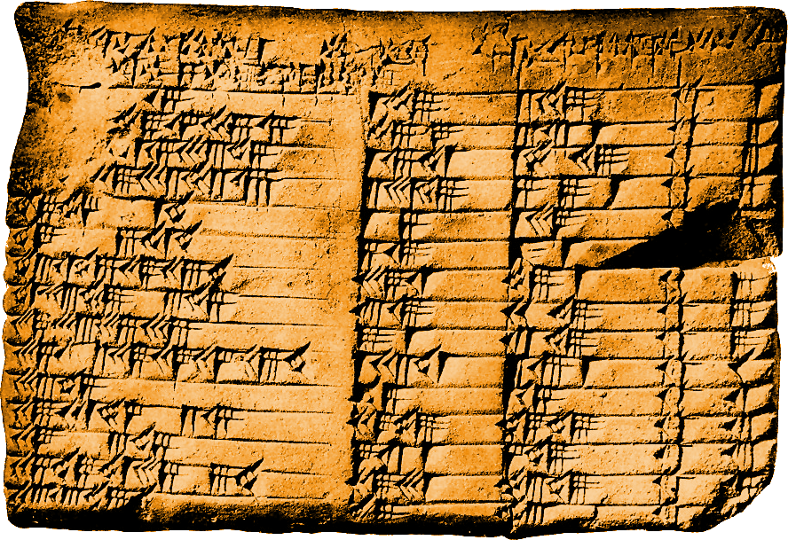
Plimpton 322

Slide 4
Problem 1 - Plimpton 322
A cane that measures 0,5 it’s placed against the wall. From the top it falls 0,1. How much does the cane move on the ground?
0,1
0,5
X

Slide 5
Resolution – Plimpton 322
A cane that measures 0,5 it’s placed against the wall. From the top it falls 0,1.
How much does the cane move on the ground?
$${0,5}^{2}={0,4}^{2}+x^{2} \left(=\right)$$
0,1
0,1
$$\left(=\right) x^{2}={0,5}^{2}−{0,4}^{2} (=)$$
0,5
0,5
$$\left(=\right) x^{2}=0,25−0,16 (=)$$
0,5- 0,1= =0,4
$$\left(=\right) x=\sqrt{0,09 }(=)$$
$$\left(=\right) x=0,3$$
X
X

Slide 6
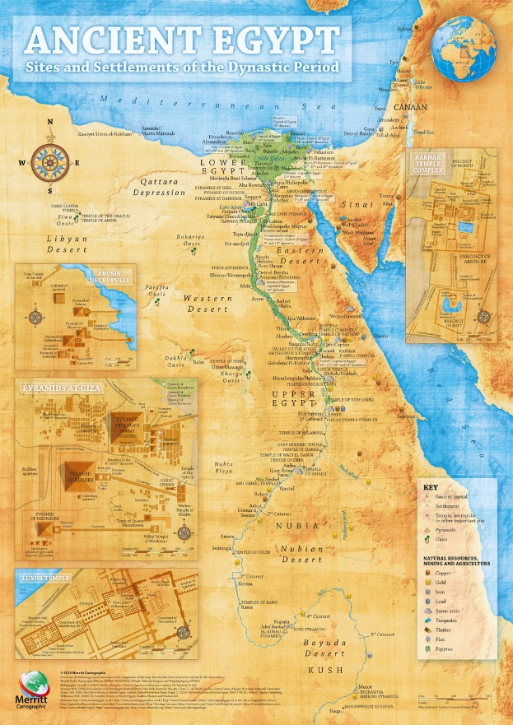
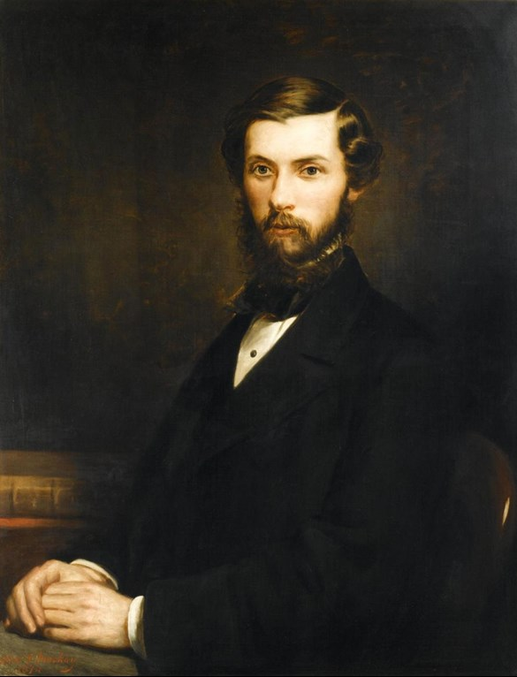
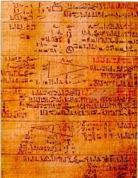
Rhind’s Papyrus
Rhind

Slide 7
Problem 2 – Rhind’s Papyrus
As payment a farmer receives 21 units of corn. From this quantity the farmer has to give the Pharaoh the fifth part of what the farmer keeps to himself. Hom much does the farmer keep?
X the quantity that the farmer keeps

Slide 8
Resolution – Rhind’s Papyrus
As payment a farmer receives 21 units of corn. From this quantity the farmer has to give to the Pharaoh the fifth part of what the farmer keeps to himself. How much does the farmer keep?
$$\frac{x}{5 }+x=21 \left(=\right)$$
X the quantity that the farmer keeps
21 is the total of corn
$\frac{x}{5}$ is the part that goes to the Pharoh
$$\left(=\right) \frac{x+5x}{5}=21 \left(=\right)$$
$$\left(=\right) 6x=21×5 \left(=\right)$$
$$\left(=\right) x=\frac{105}{6} \left(=\right)$$
$$(=) x=17,5$$

Slide 9
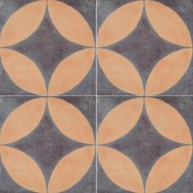
Problem 3 - Archaelogical Tiles
Four tiles are placed in a certain way. For this problem we are going to use only one. The side of the square measures 2. What is the area of the orange part?
2

Slide 10
Resolution - Archaeological Tiles
Four tiles are placed in a certain way. For this problem we are going to use only one. The side of the square measures 2. What is the area of the orange part?
If d=2, r=1
$$A=s^{2}$$
$$A=πr^{2}$$
$$A=2^{2} (=)$$
$$A=π×1^{2} (=)$$
2
$$\left(=\right) A=4$$
$$\left(=\right) A= π$$
$$A=4 −π$$
$$A=π−\left(4−π\right) (=)$$
$$\frac{π}{4}$$
$$\left(=\right) A=π−4+π (=)$$
$$\left(=\right) A=2π−4$$

