Slide 1
Math&Music
Hungary

Slide 2
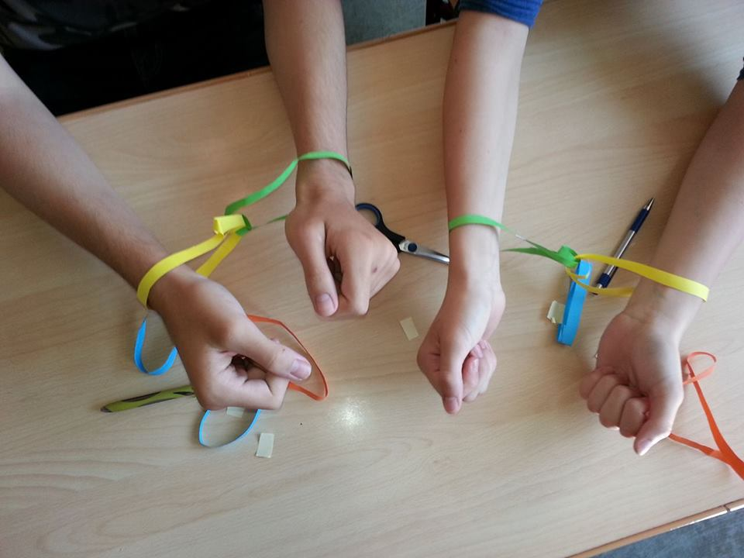
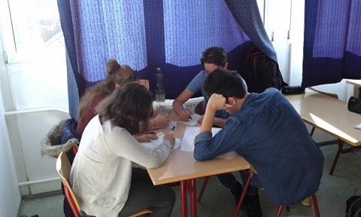
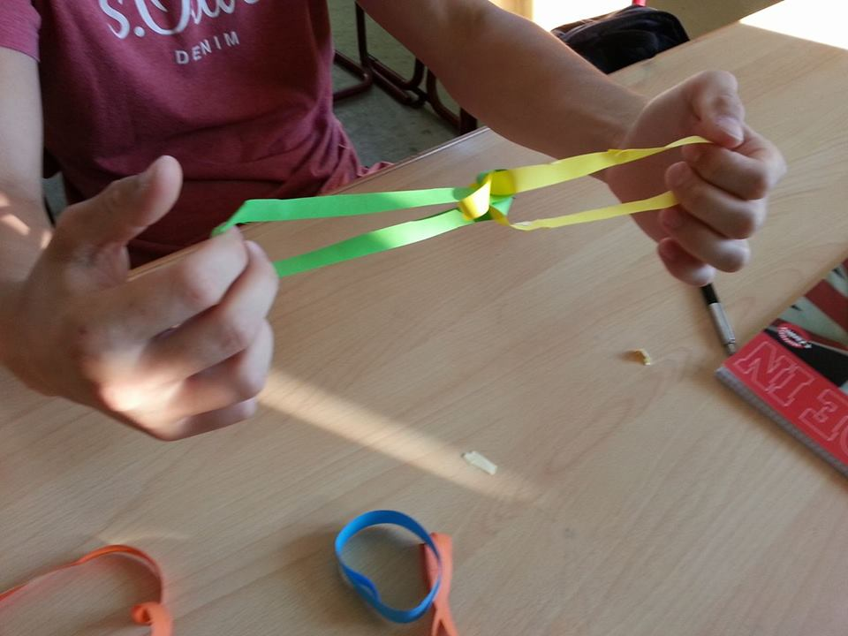
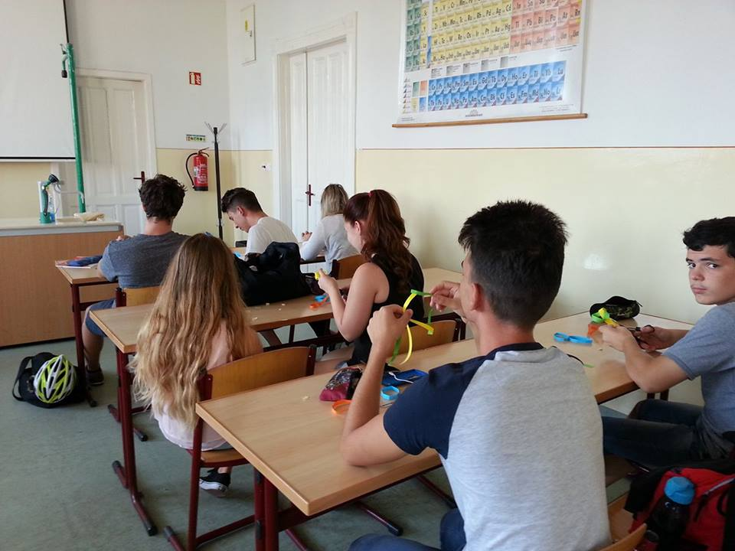
What did we do since the meeting?

Slide 3
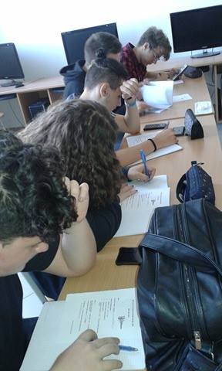
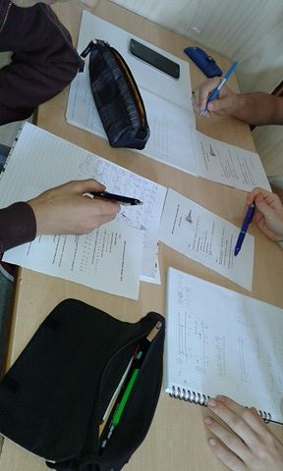
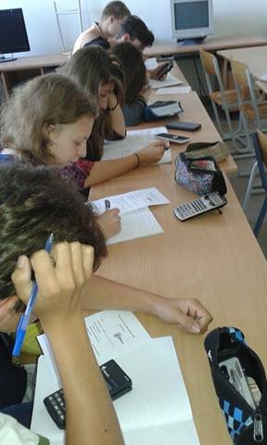
What did we do since the meeting?

Slide 4
Our new exercises

Slide 5
A young music teacher wrote a music consisting of 12 lines. Each line has its own pair: A-B, C-D,… , K-L, and the items in pairs are stated to be one after the other.
a) How many ways can we play this composition is othe orders in the pairs can not be changed?
6! = 720
b) How many ways can we play this composition
if there are the 6 pairs, but the order of A and B
can be changed?
6! Should be multiplied by 2

Slide 6
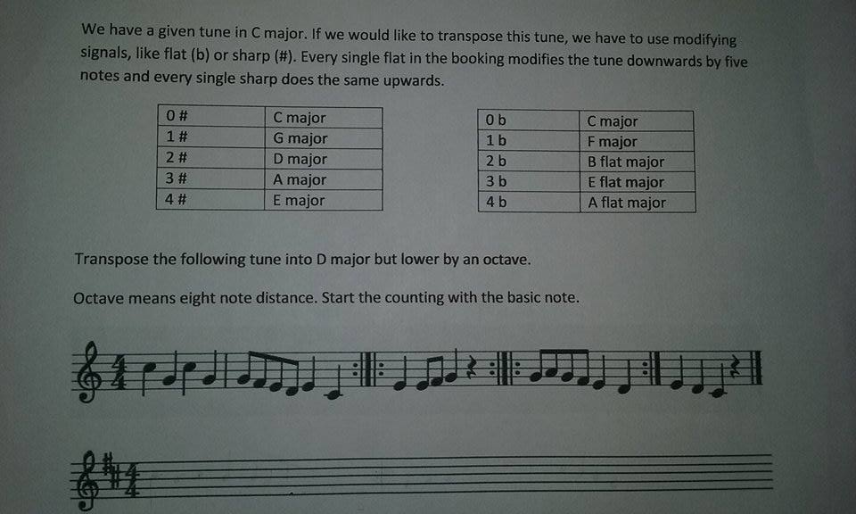
Our new exercises

Slide 7
Thank you for your attention! ☺

