Slide 1
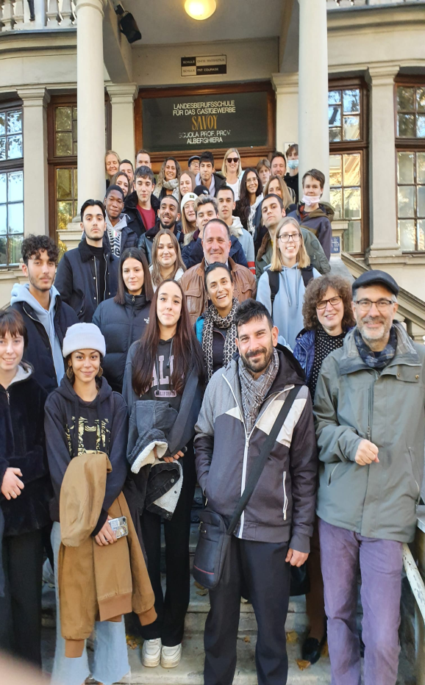
THE CULTURAL ACTIVITIES
MEETING THE OTHER STUDENTS

Slide 2
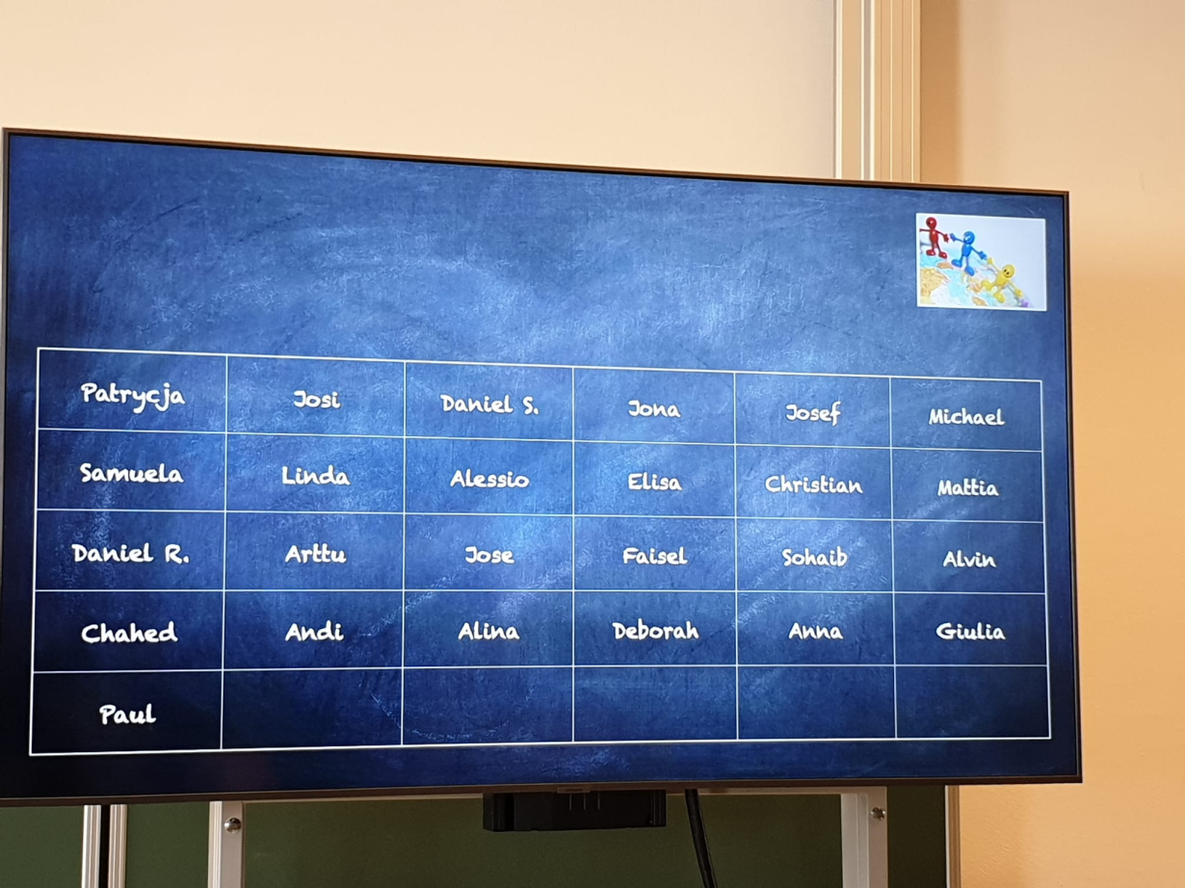
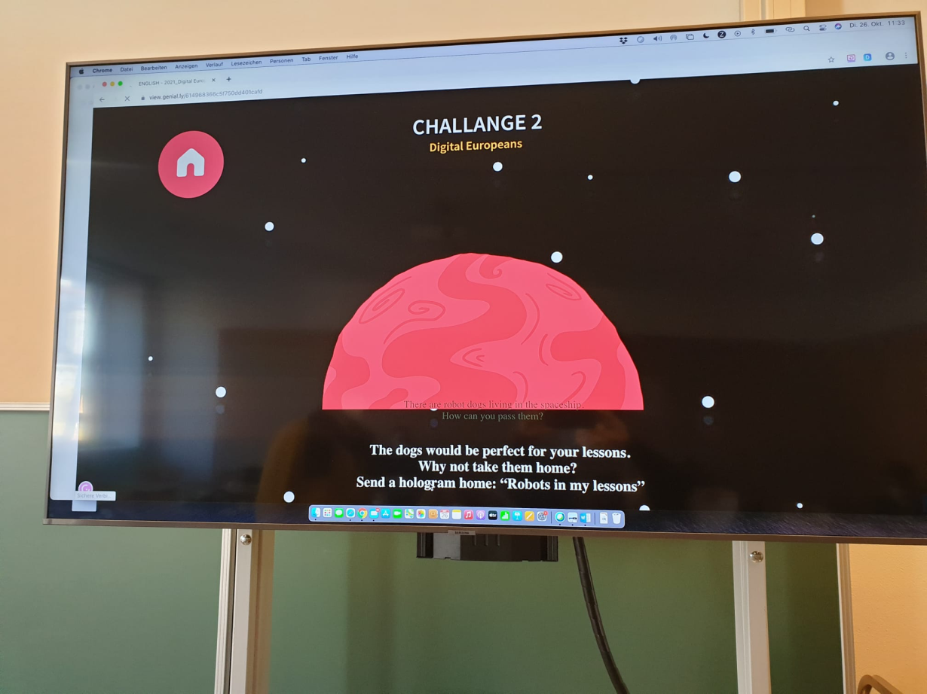
In Merano, when we went to school, we did a lot of challenges like quiz of our countries.
We were divided in 5 groups of work and in these we did the proposed activities.

Slide 3
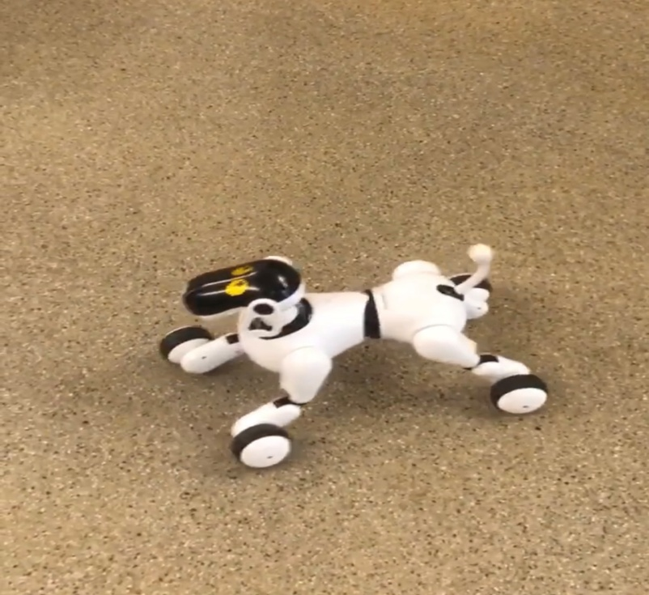
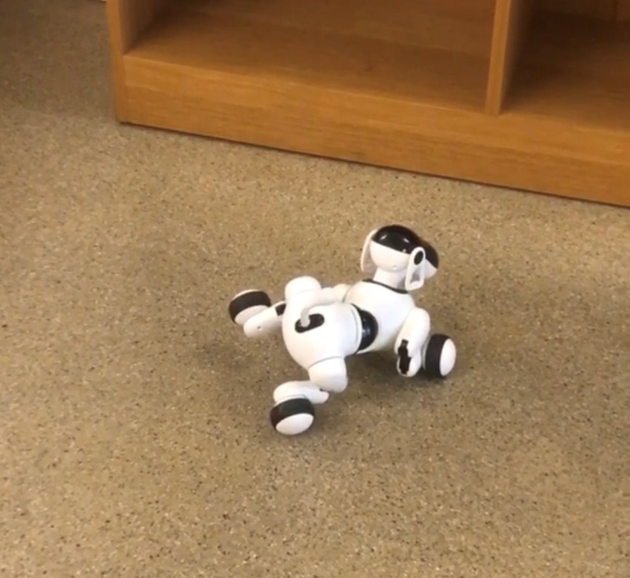
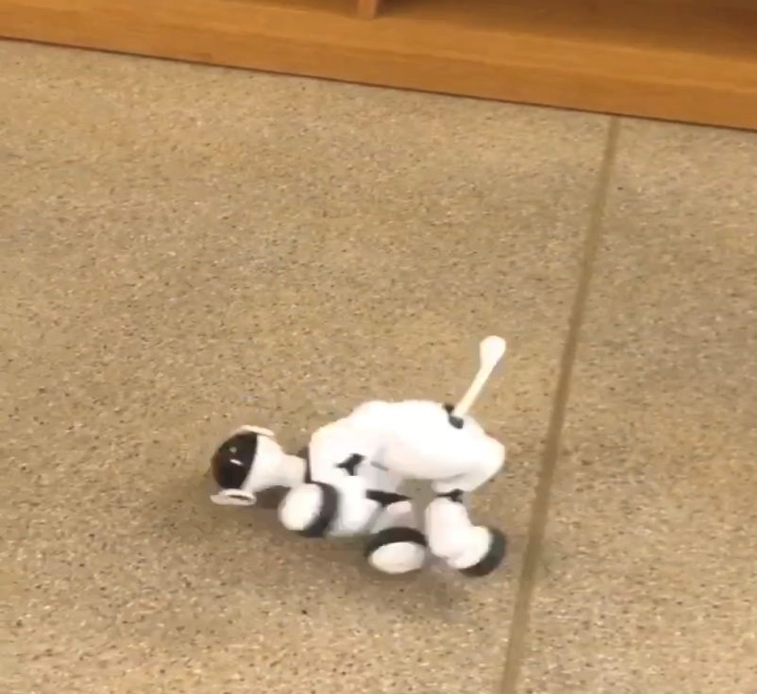
We also worked with robot dogs and tablets in one of this challenge.

Slide 4
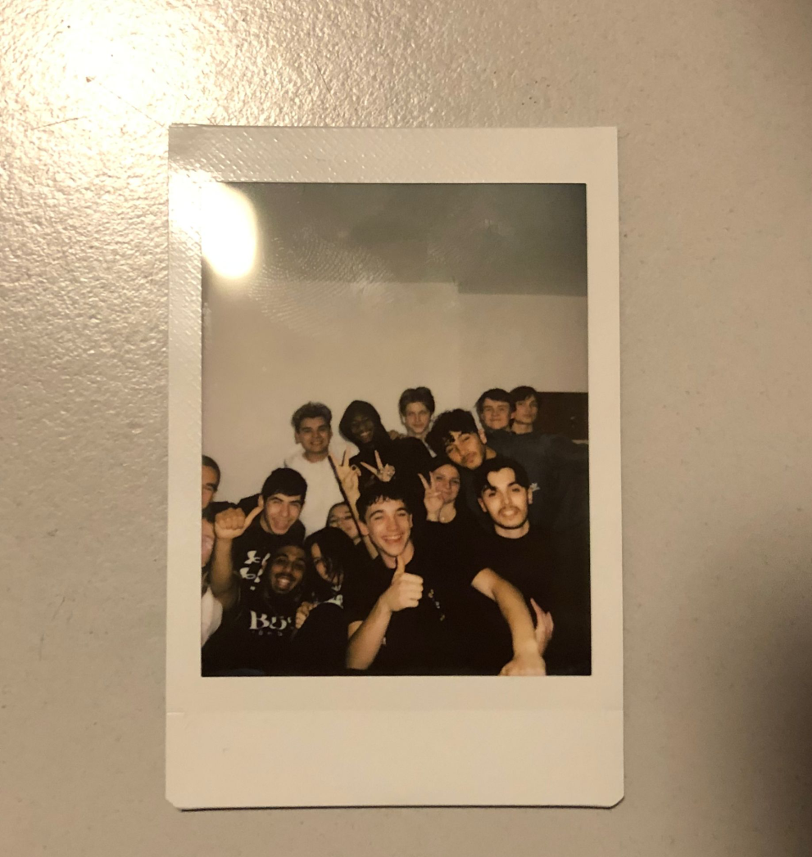
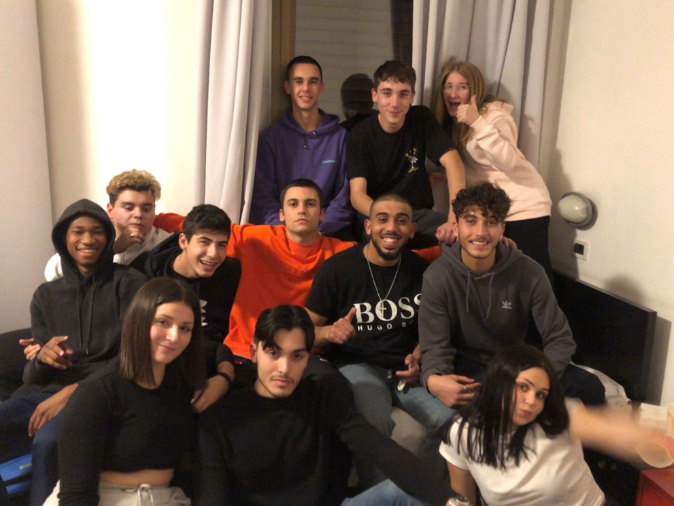
In the afternoon we had free-time so we went to the centre of Merano all together.
In the evening we stayed in one room always together and we did small parties with music and food.

Slide 5
THE BEST THIG ABOUT THIS EXPERIENCE
The best thing of this experience was met new people of other nationalities.
In fact, thanks to this project, in addition to making friends with the other students, we discovered the different way of life depending on the country where you live. For example the school, in Italy we have to buy and use books to study in Germany the school offers all children a tablet to study and they didn’t use books.

