Slide 1
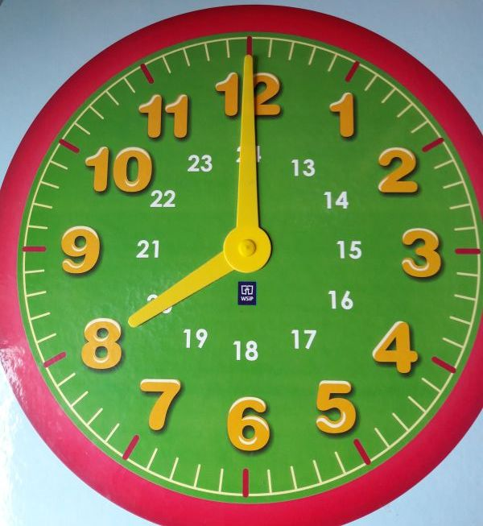
A school day
We start at 8 am.
Monday
Tuesday
Wednesday
Thursday
Friday

Slide 2
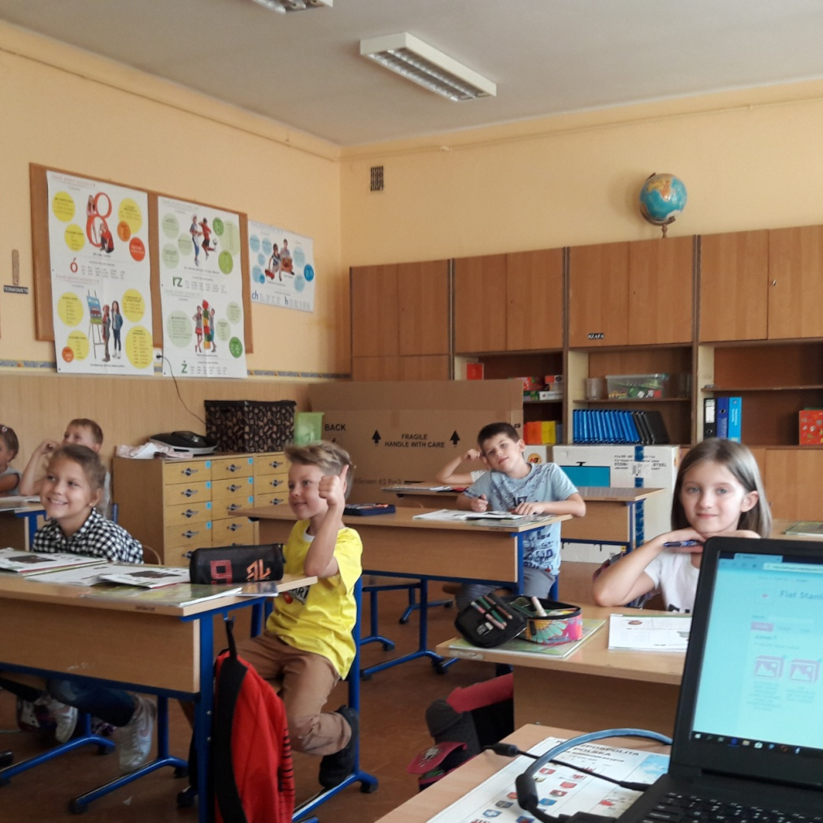
We learn

Slide 3
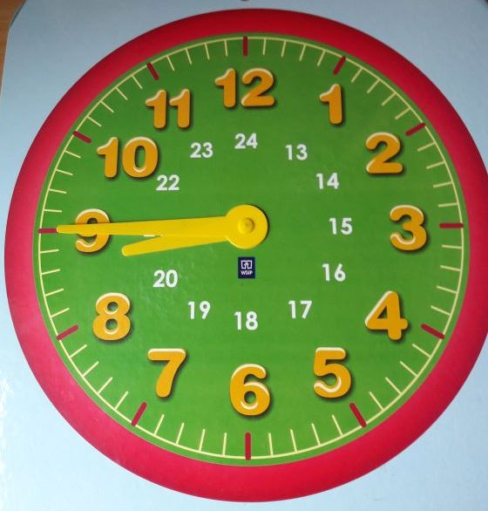
45 minutes
A lesson lasts 45 minutes

Slide 4
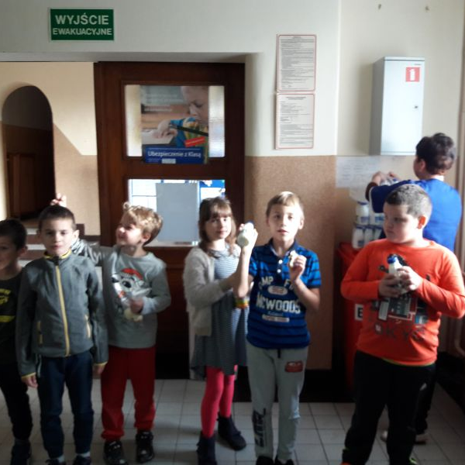
break
We drink milk

Slide 5
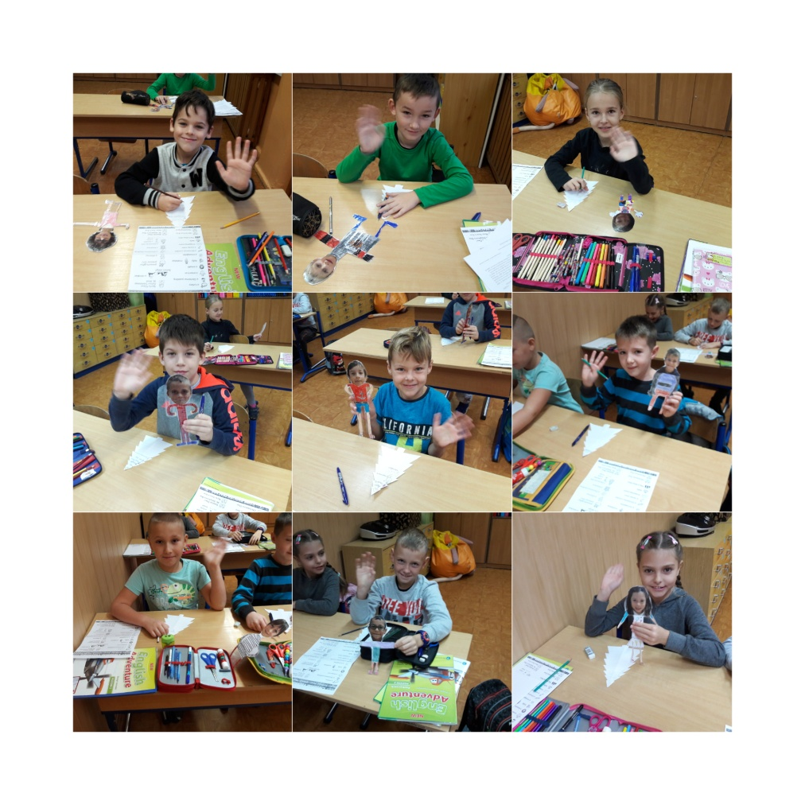
We work

Slide 6
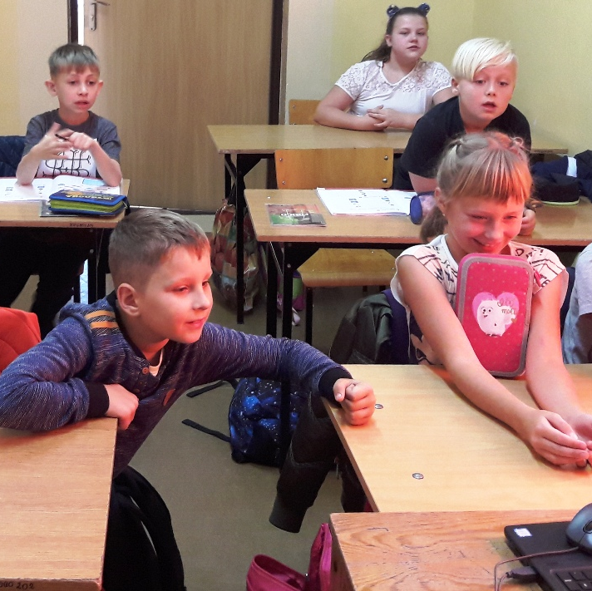
We discover

Slide 7
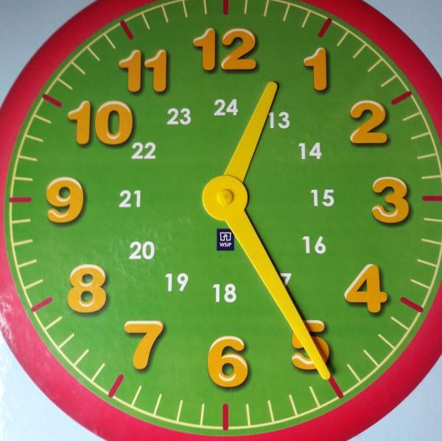
Finish
We usually finish lessons at 12.25

Slide 8
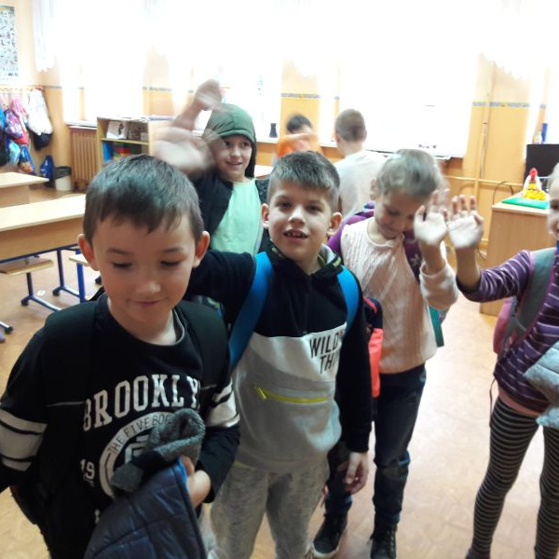
We Go home
or
stay
in the after lesson club
until 15.30

Slide 9
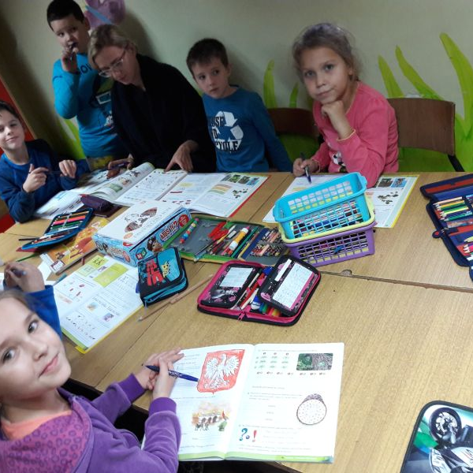
After lesson club
we do homework

Slide 10
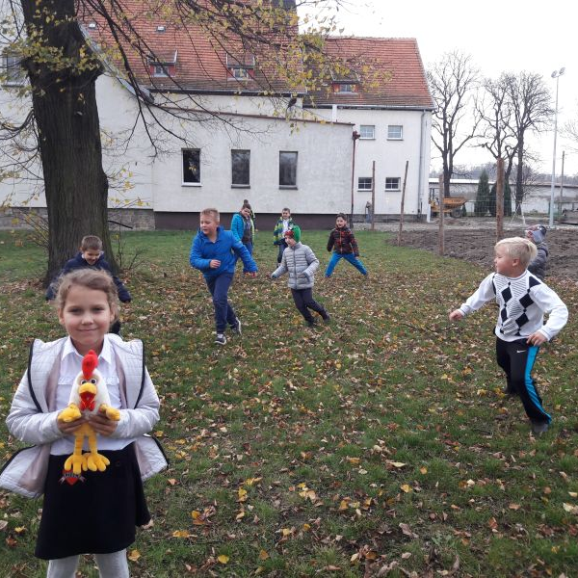
After lesson club
we play outside

