Slide 2
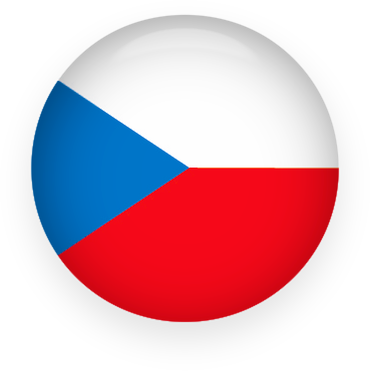
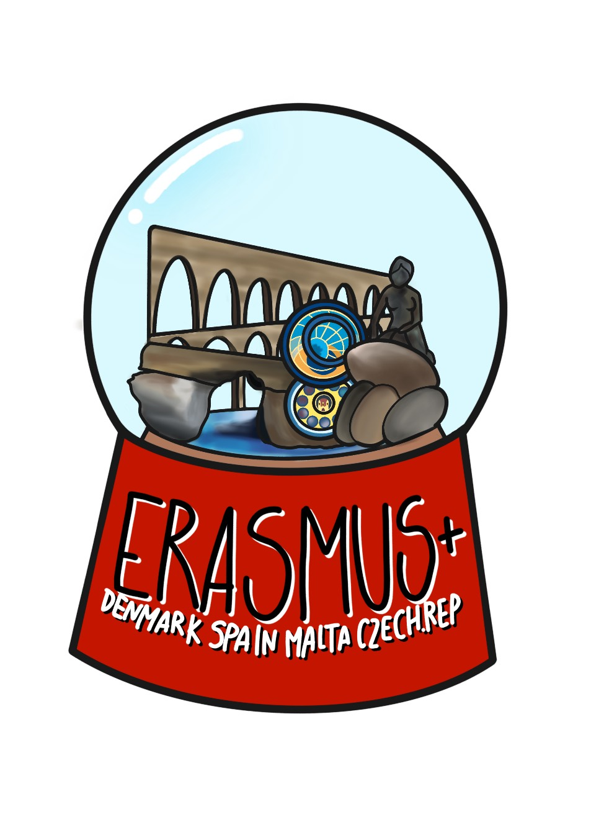
CZECH REPUBLIC
Pavlina tylšová, karolína kaválková and jan čermák

Slide 3
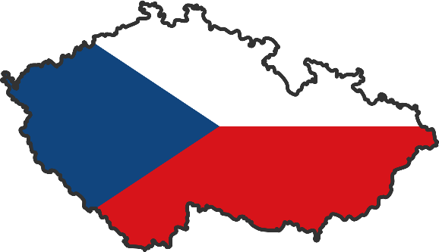

Slide 4
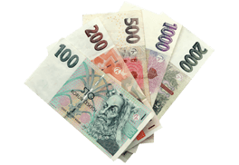
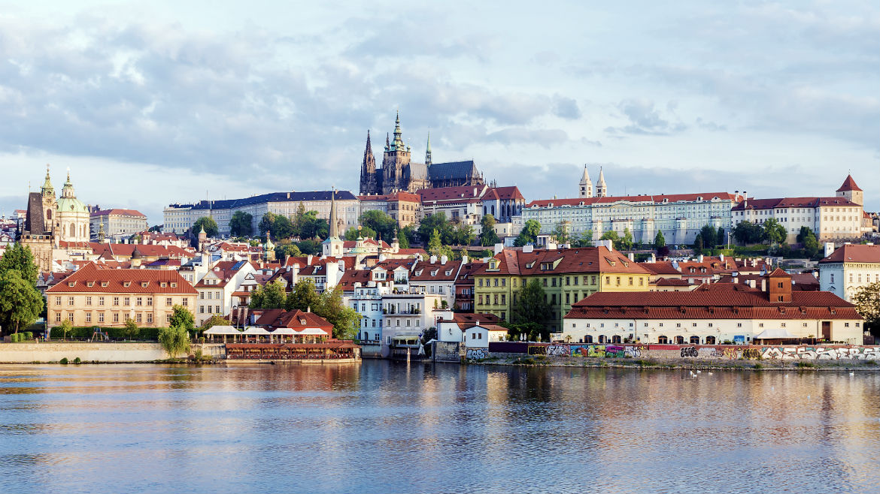
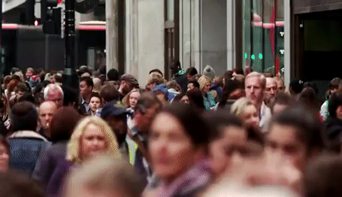
Information
President: Miloš Zeman
Total area: 78,867 square kilometers
Three historical territories: Bohemia, Moravia and Silesia
Capital city: Prague
Population: about 10 500 000
Czech language
Currency: Czech crown (koruna) – CZK

Slide 5
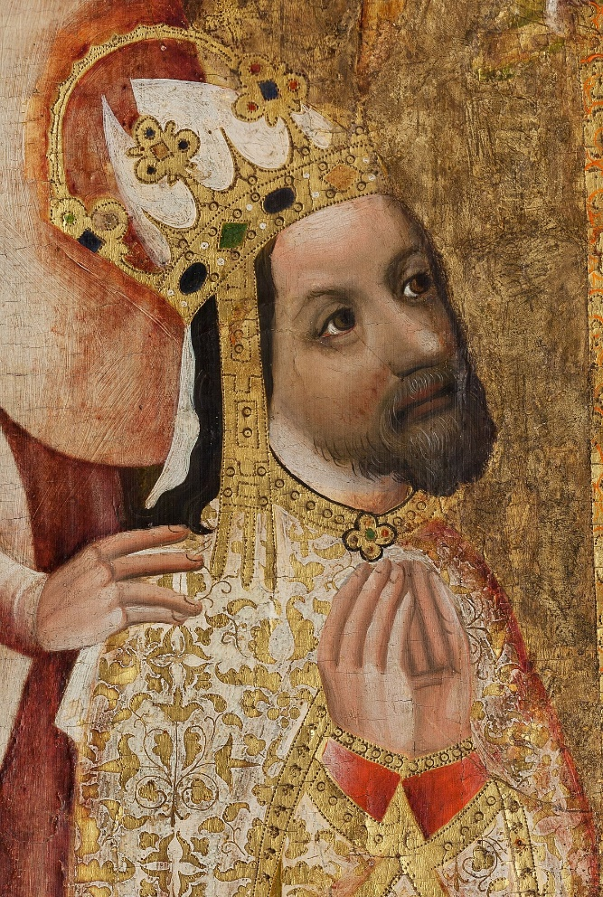
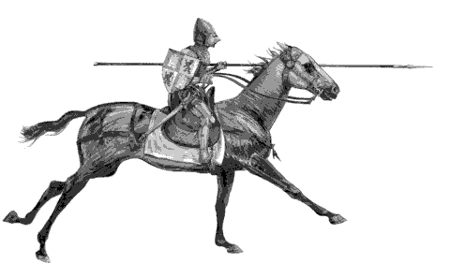
history
the 9th century - arrival of Christian missionaries
1346-1378 - the peak in the prestige and power of the kingdom of Bohemia during the reign of Charles IV
1918 - foundation of an independent state of Czechs and Slovaks
November 1989 - fall of the Communist regime
1993 Czech Republic founded after the split of Czechoslovakia

Slide 6
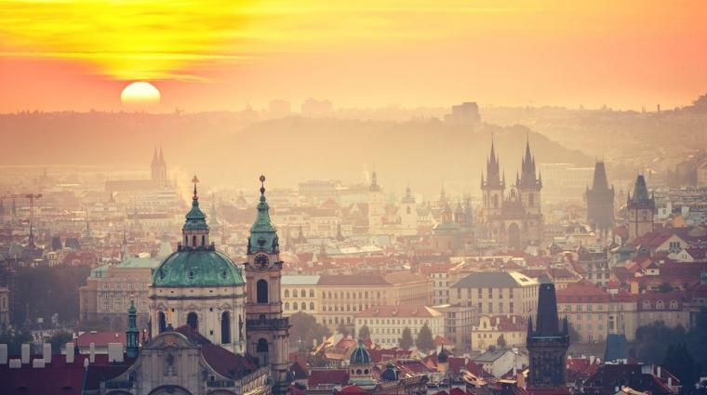
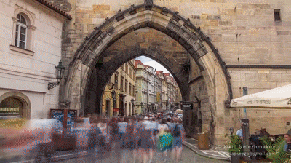
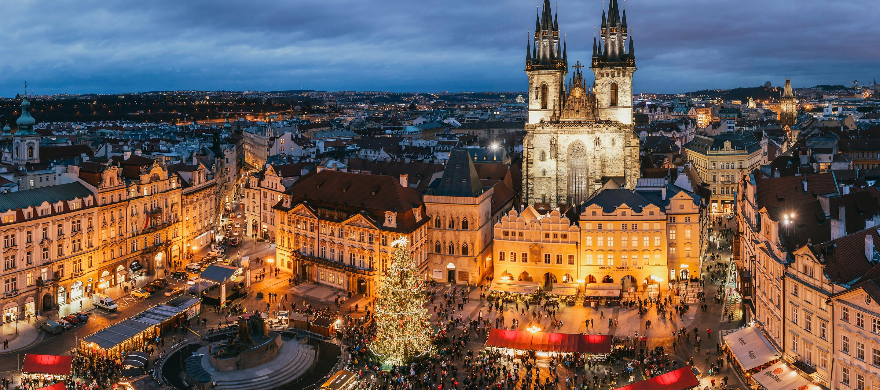
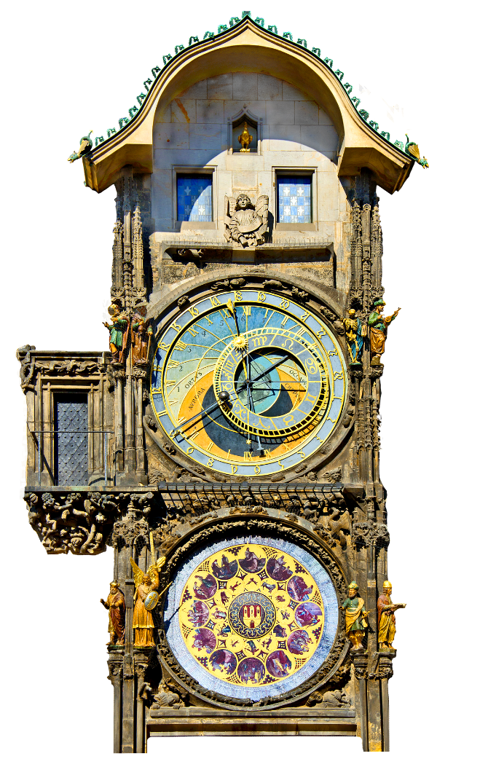
Monuments
1) Historic centre of Prague

Slide 7
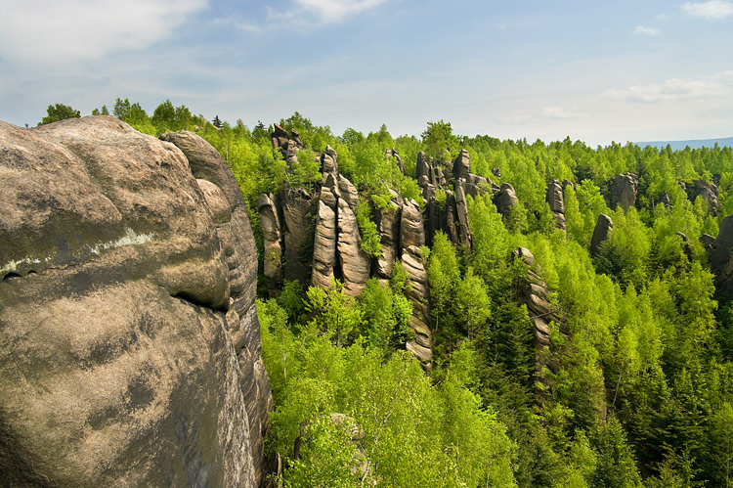
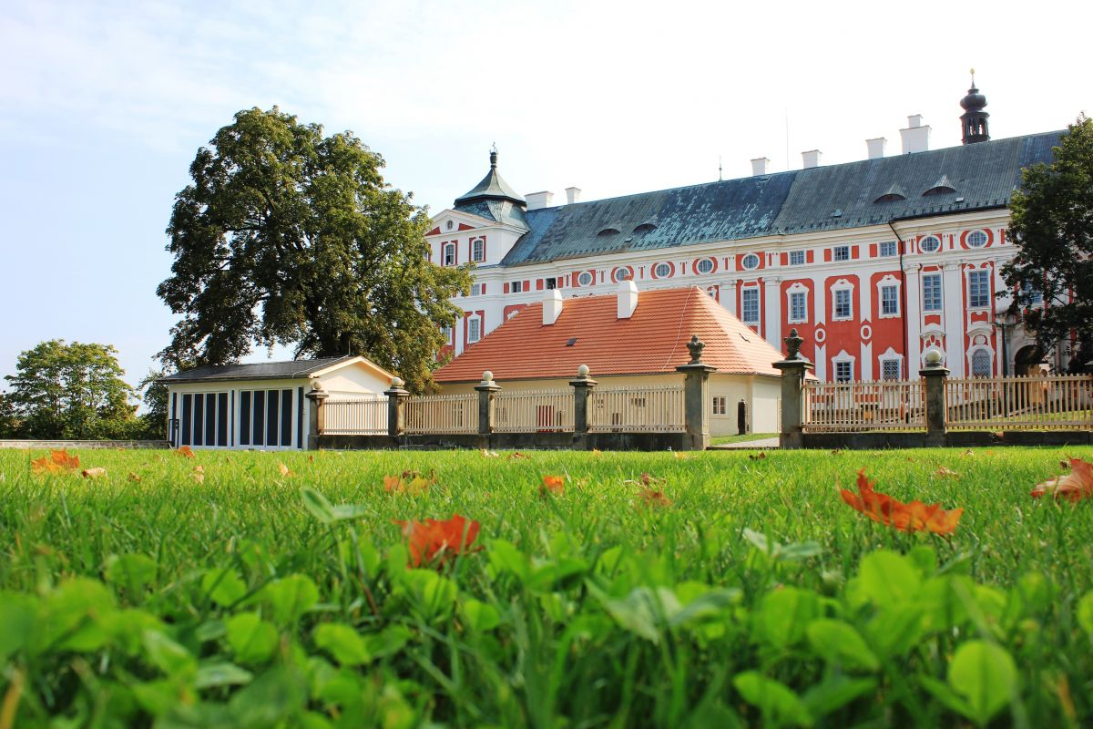
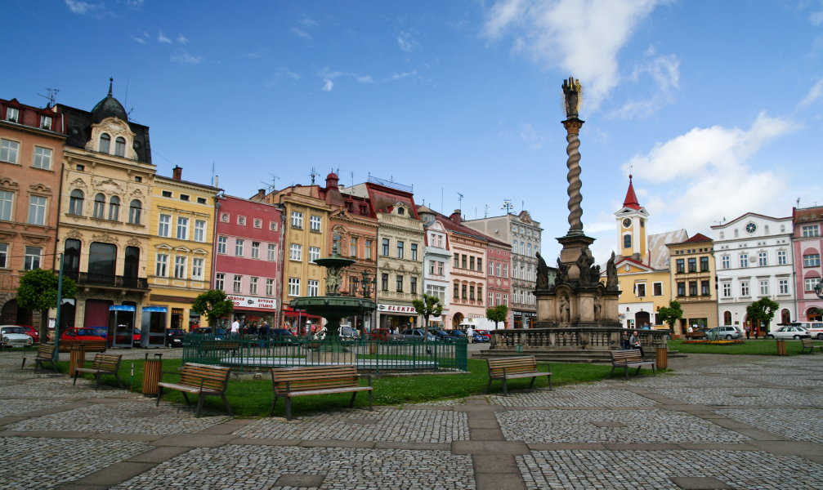
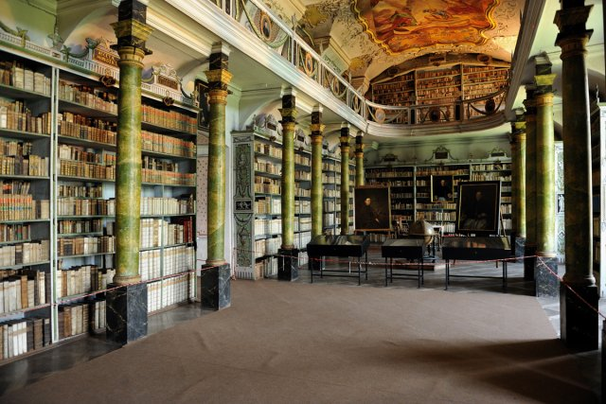
2) Broumov

Slide 8
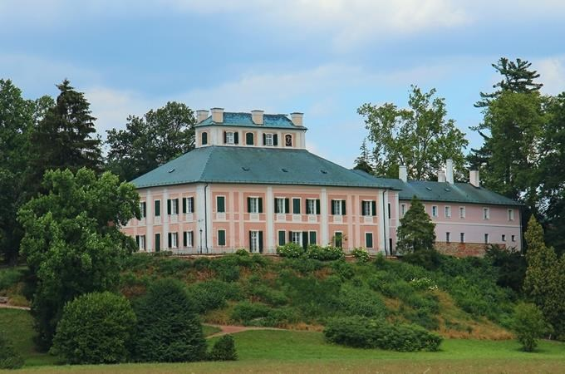
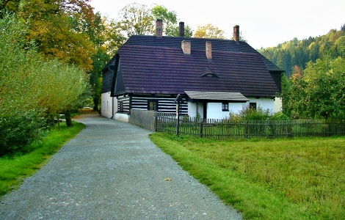
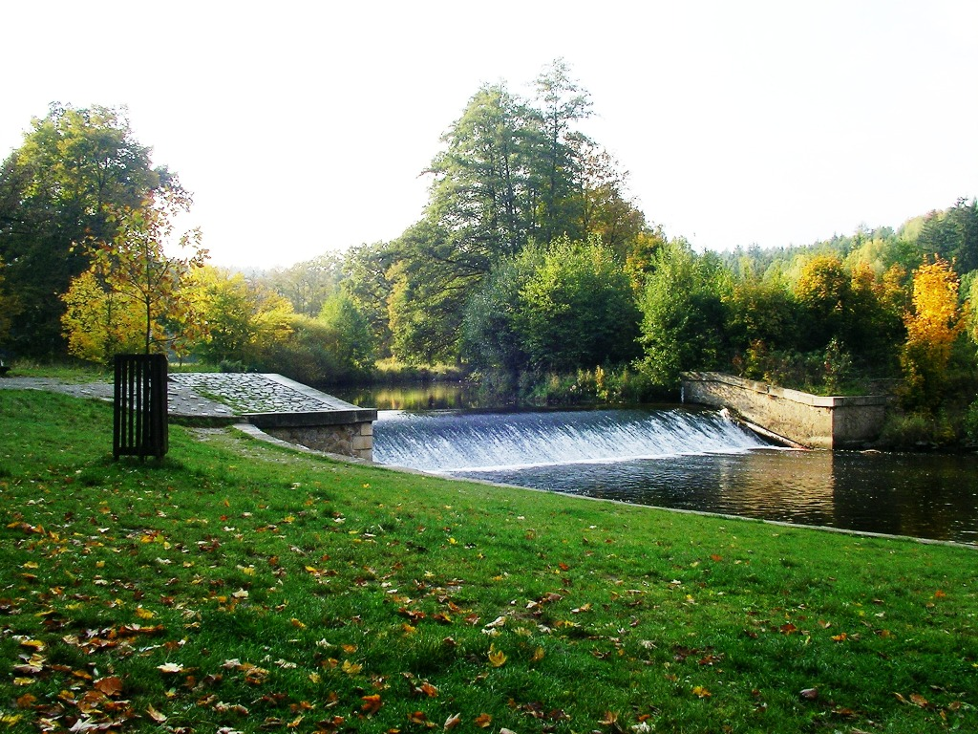
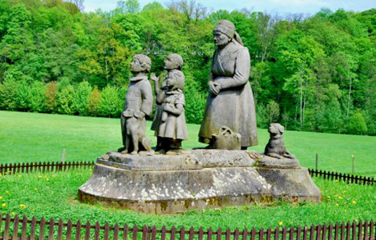
3) Ratibořice

Slide 9
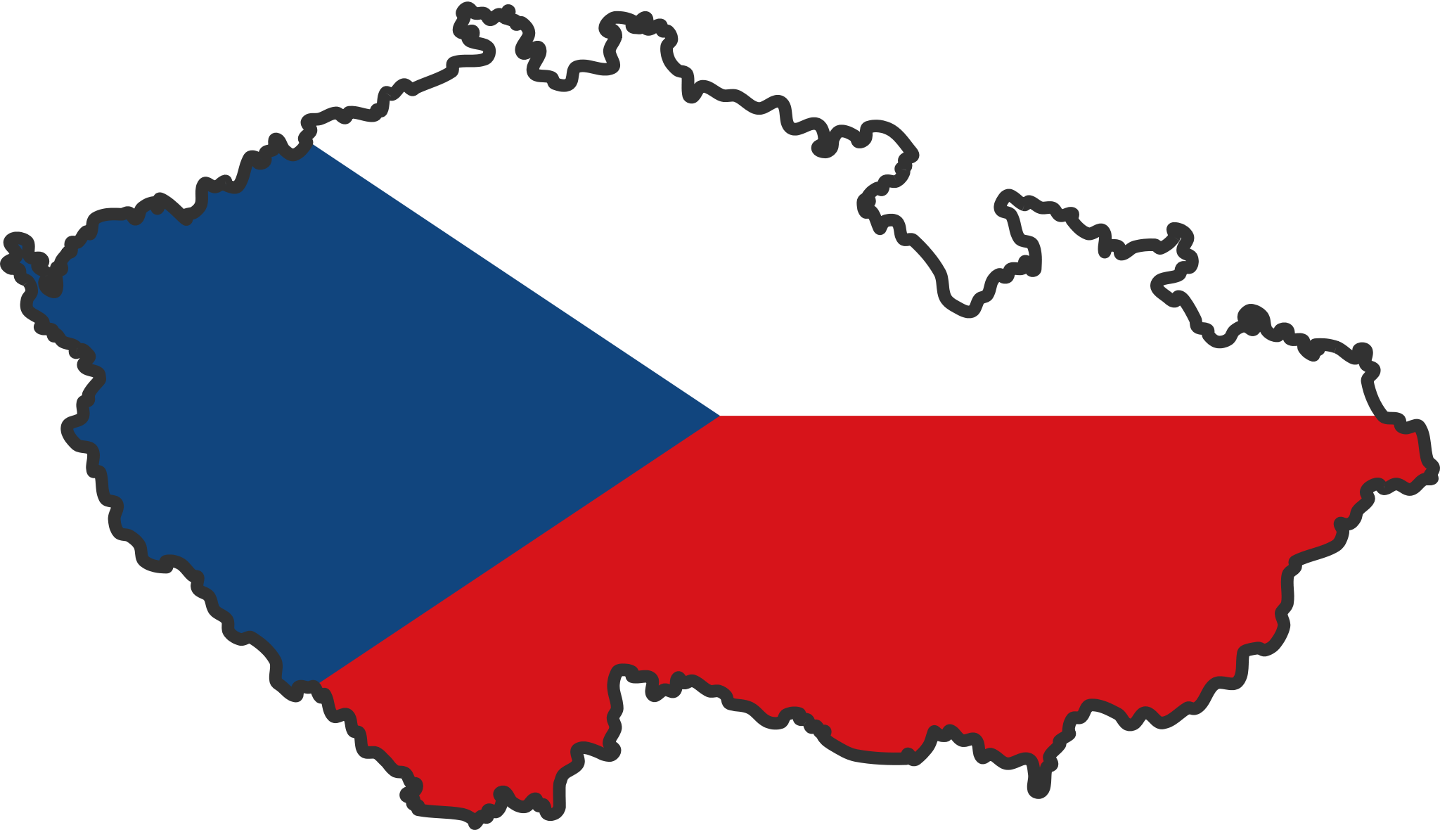
THANK YOU FOR ATTENTION

