Slide 1
Our school Academia Mercurii and Náchod

Slide 2
History
-Our school was founded in 1992.
-The first courses were:
Bussiness studies
managment and marketing

Slide 3
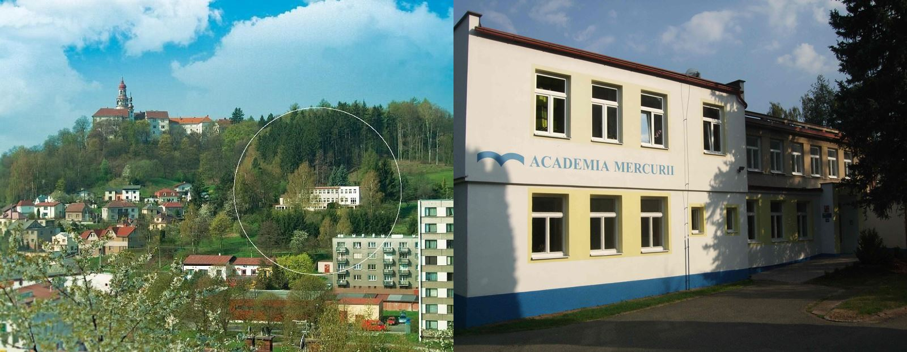
Basic information
- 3 study courses:
Managment of traveling and turism
Economic lyceum
language lyceum, replaced by sports lyceum.
-Our secondary school is private.
-Languages: English, German, French, Spanish, Russian.
- about 130 students.

Slide 4
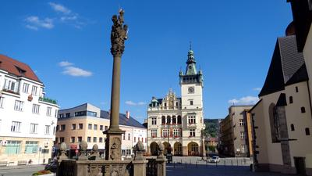
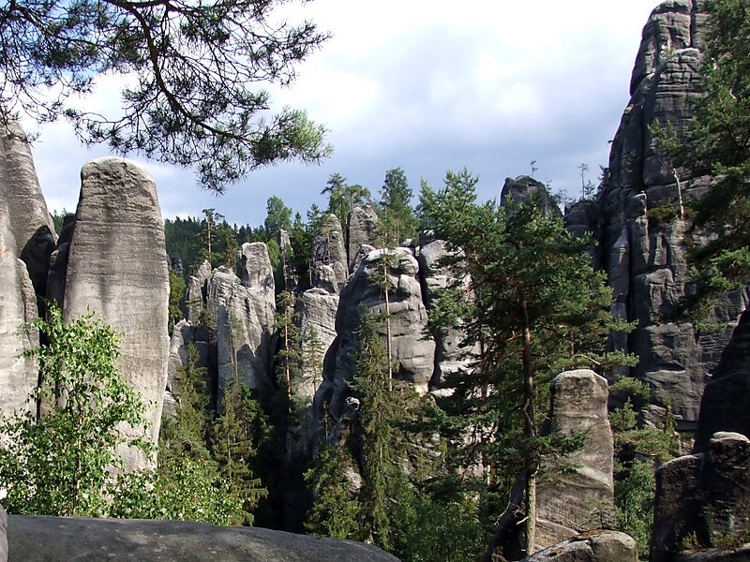
Náchod and nature around
-Town was founded in the 13th century.
-The town Náchod was formerly a spa town.
-Adršpach rocks are one of the biggest rocky towns in Europe.

Slide 5
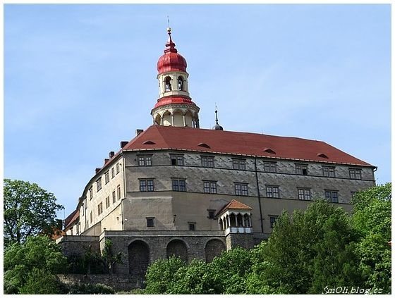
Castle Náchod
-Our school is located under the castle Náchod.
-There are 2 bears in the castle, called Ludvík and Dáša.
-Castle Náchod is also one of the locations, that you will visit at us.

Slide 6
Thanks for attention

