Slide 1
Typical Cuisine
By: Daniela, Tom and María

Slide 2
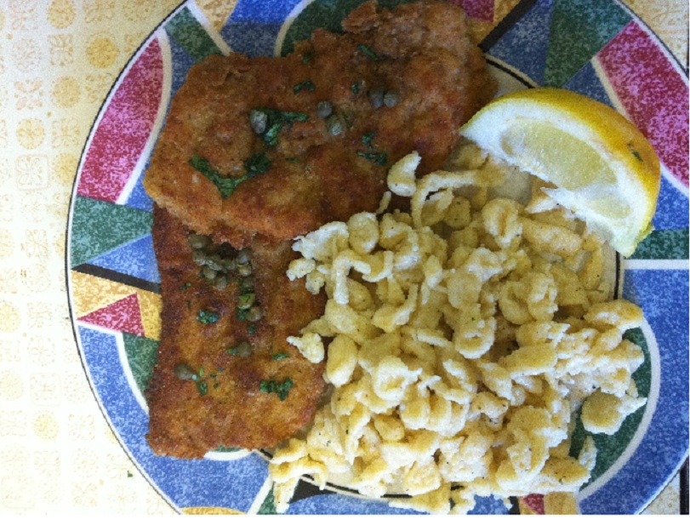
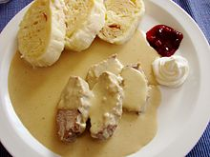
CZECH CUISINE
Svíčková
typical Czech dish and one of the most popular Czech meals
served with a cream topping and usually with cranberry sauce and slice of lemon in many restaurants around the Czech Republic.
Řízek
it is known as a smažený řízek or just řízek, and is made of pork, chicken, or veal
served with boiled or mashed potatoes or potato salad
used to be and to some degree still is a typical packed lunch for day trips

Slide 3
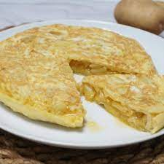
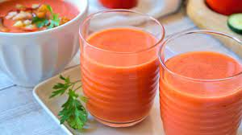
SPANISH CUISINE
Tortilla de patata
Is an omelette made with potatoes and sometimes with onion.
Gazpacho
Is a spanish typical food from Andalucía.
Is cold tomato soup.
We usually drink it in summer months.

Slide 4
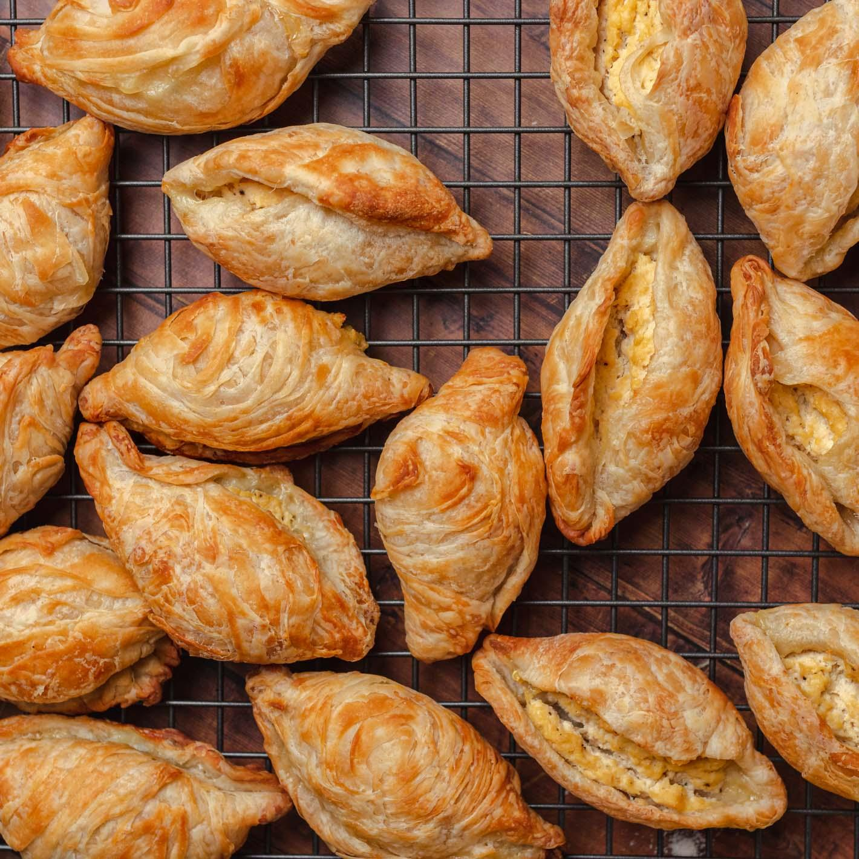
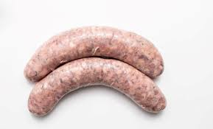
MALTEASE CUISINE
Pastizzi
Pastizzi are usually diamond-shaped or round-shaped and made with a pastry .
Maltese Sausage
the traditional fresh Maltese sausage, is made from ground pork, sea salt, crushed black peppercorns and coriander seeds.

