Slide 1
Traditional food of Malta, Spain and Czech Republic
made from Jerome Xiberras, Ludovico Di Gennaro

Slide 2
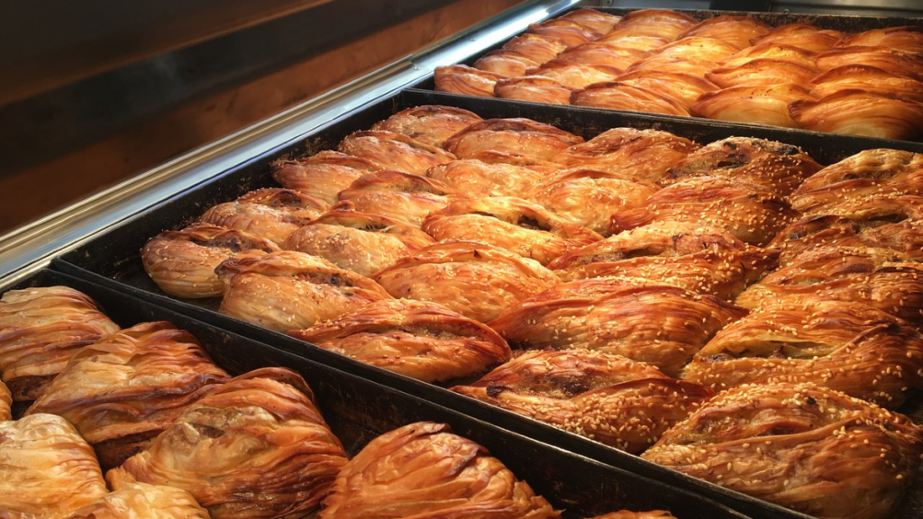
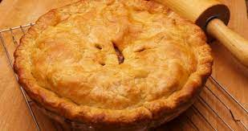
malta´s Traditional food
Pastizzi
Pastizzi (singular is pastizz) are a small pastry made with a crisp flaky dough and typically stuffed with fillings like ricotta cheese, mushy peas or chicken. While they are typically savoury they can also be filled with nutella.
Torta tal-lampuki
It's a pie stuffed with lampuki potatoes, capers and onions and is usually prepared in the months of August till September.

Slide 3
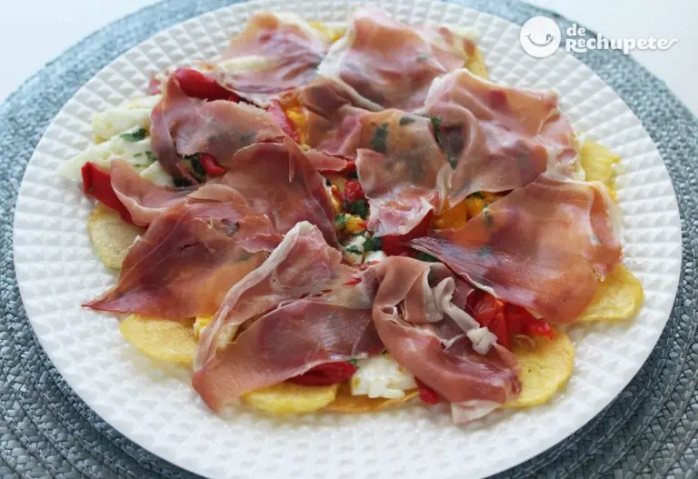
Spain’s Traditional food
Huevos rotos con Jamón: is a dish were scrambled eggs and potatoes are mixed with ham. You can add peppers if you want.
Ingredients:
1 kilo of potatoes for frying (6-7 potatoes)
6 large free-range eggs
2 large onions
Salt and freshly ground black pepper (to taste)
Extra virgin olive oil (for frying)
5 slices of Serrano ham
4 roasted piquillo peppers

Slide 4
Czech Republic’s traditional food
Vepřo Knedlo Zelo:
This Czech classic is widely recognized as the national dish, even though its origins can be traced to neighboring Bavaria. When translated, the name of the dish gives you a clear idea of what to expect on your plate—pork, dumplings, and sauerkraut.

