Slide 1
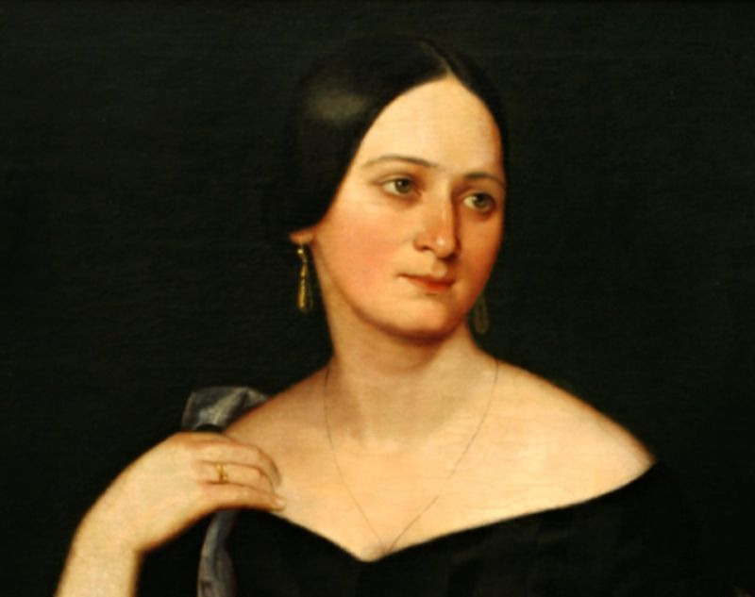
Božena Němcová

Slide 2
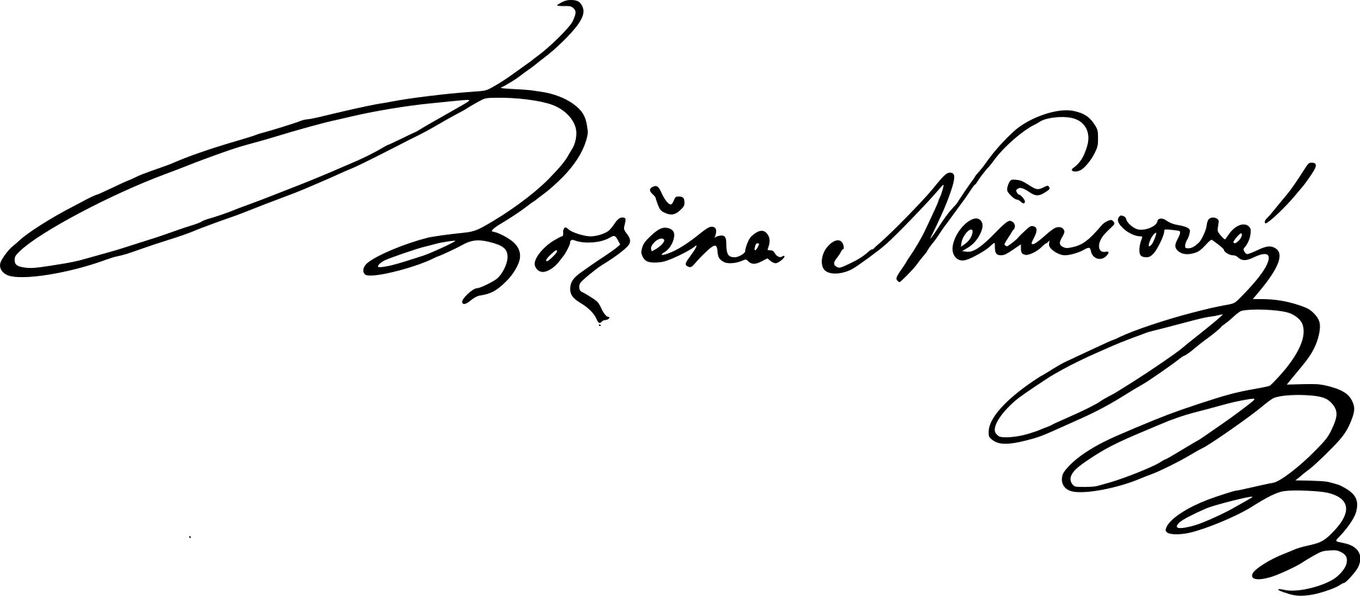
Božena Němcová
one of the first female writers in the Czech Republic – it was revolutional
Czech writer of the National revival
born in 1820 in Vienna as Barbara Pankel
lived near Ratibořice (Grandma´s valley) as a child, where her grandma lived
at the age of 17 she married Josef Němec, who was 15 years older
4 children
suffered from lack of money
died in 1862 (she was only 40 years old) in poverty

Slide 3
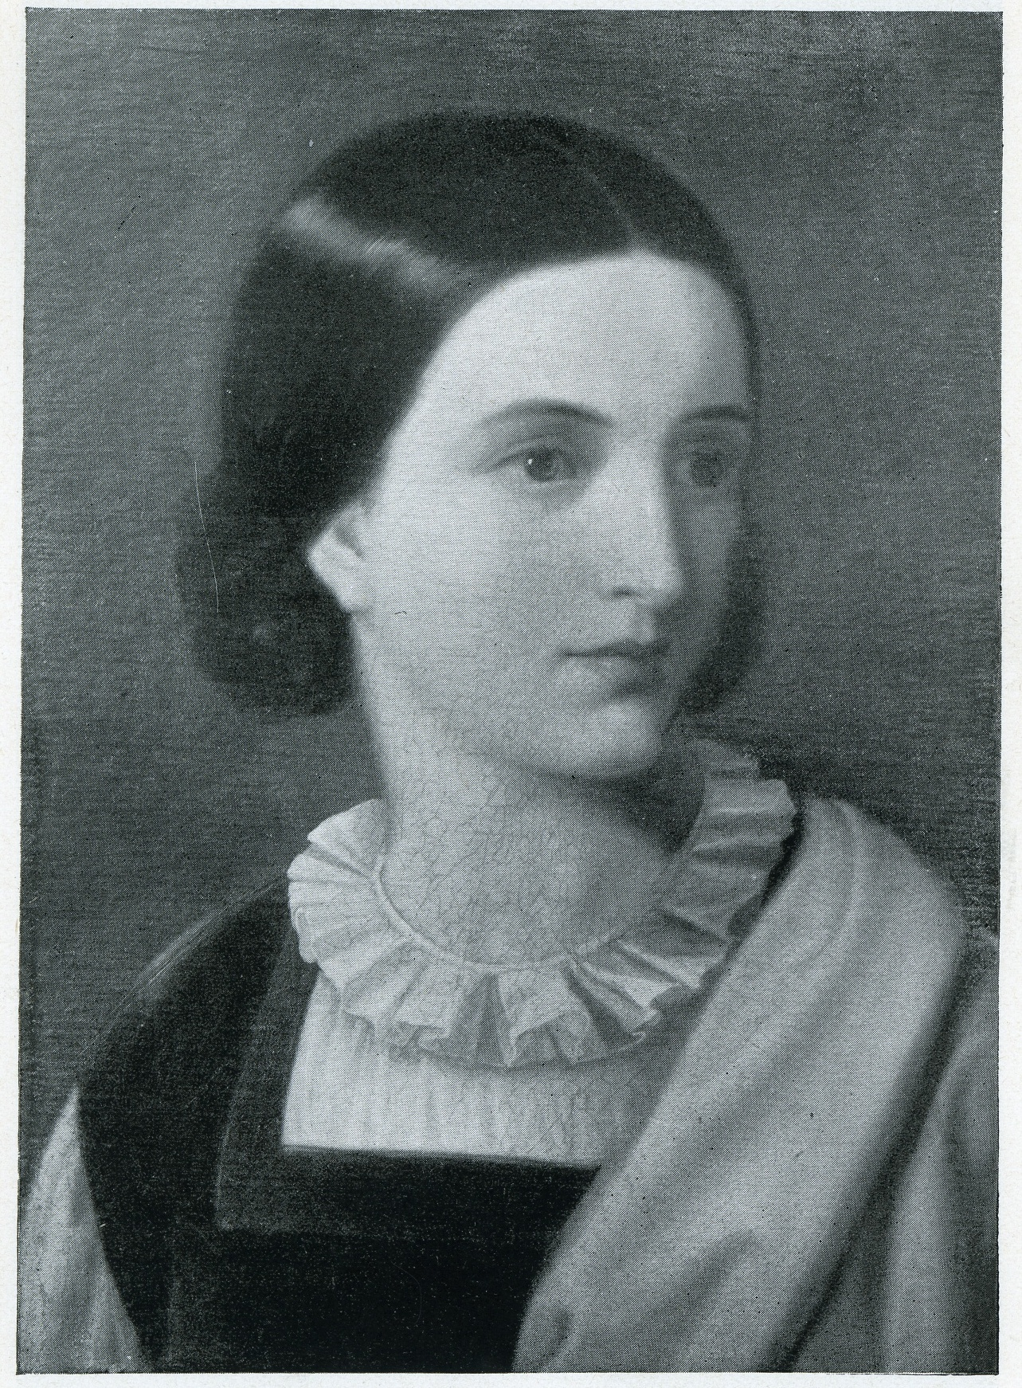
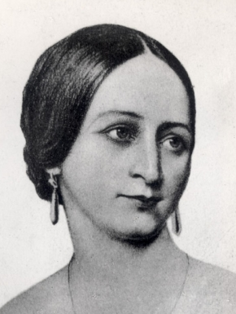

Slide 4
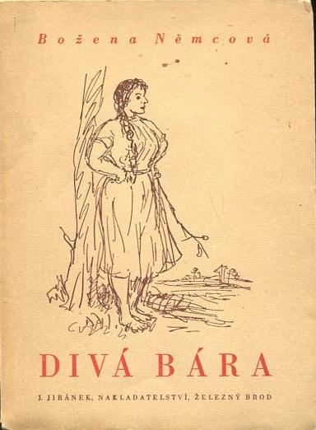
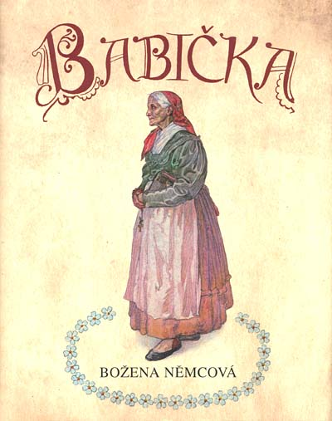
Some of her works
About life of a girl named Barbora.
Realistic description of life on a country side.

Slide 5
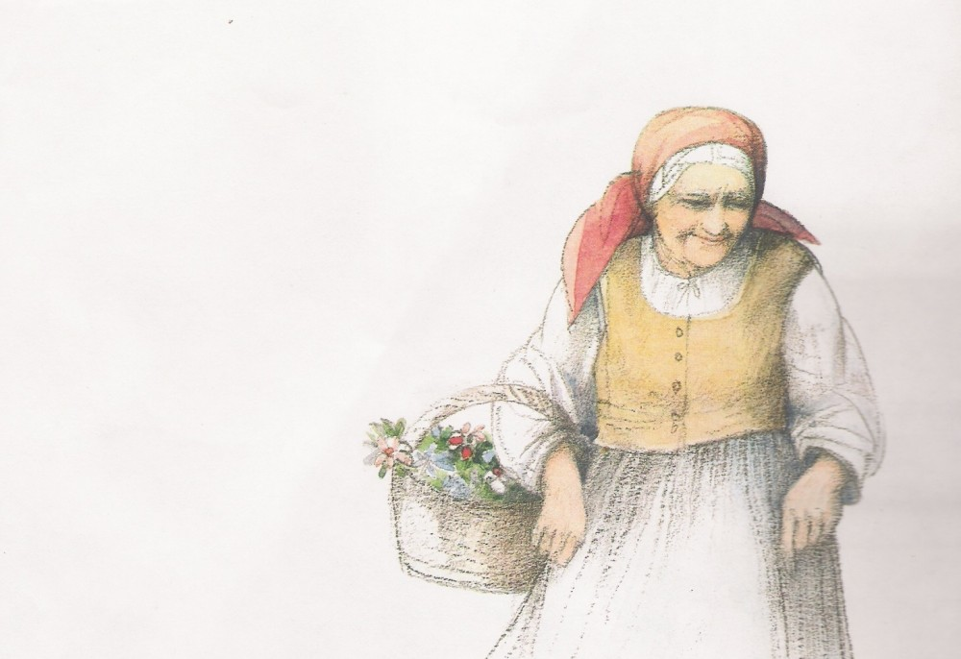
Babička - Grandma
most popular work
novela
from 1855
after the death of her son Hynek
describes her childhood in Ratibořice
(later called Grandma´s Valley)
folk customs, village way of life
individual episodes are connected by Grandmother
https://www.youtube.com/watch?v=3vZfGqCSIo8

Slide 6
Ratibořice – Grandma´s Valley

Slide 7
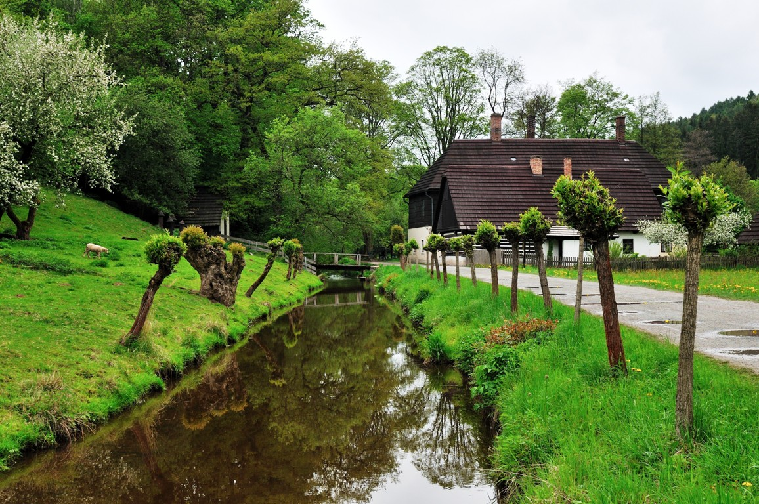
Ratibořice – Grandma´s Valley
known thanks to Božena Němcová
Božena Němcová spent her childhood here
they lived near the castle and greenhouse
she had many siblings and Grandmother who helped her mother

Slide 8
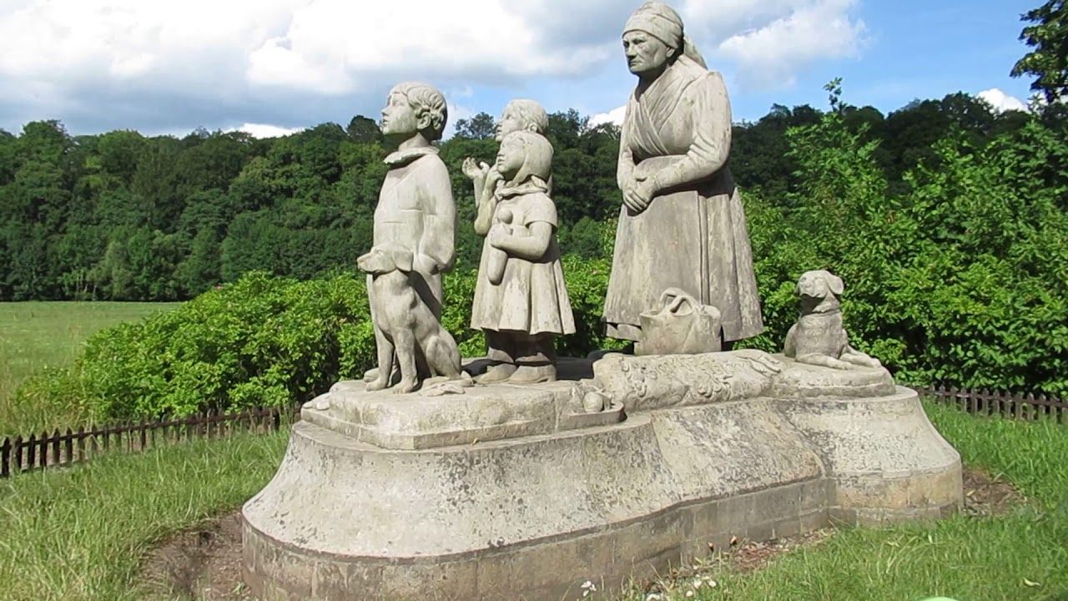
Grandmother´s monument
statue of Grandmother and children – one of them is young Božena Němcová

Slide 9
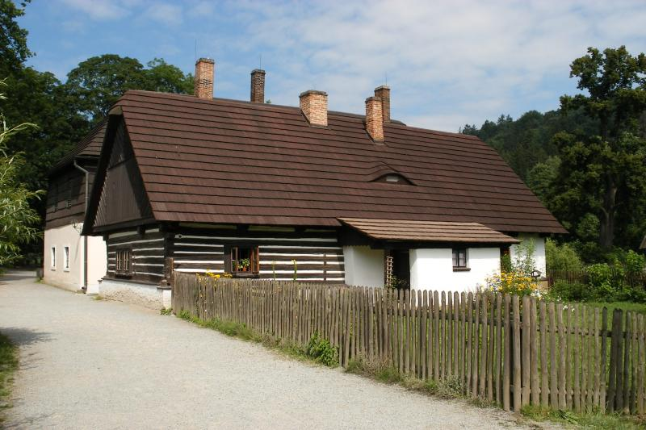
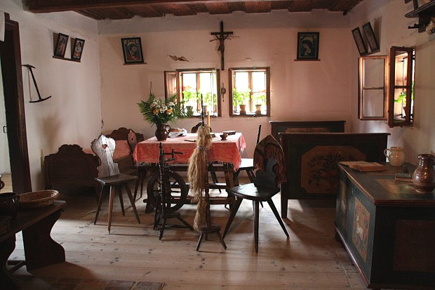
Old bleachery

Slide 10
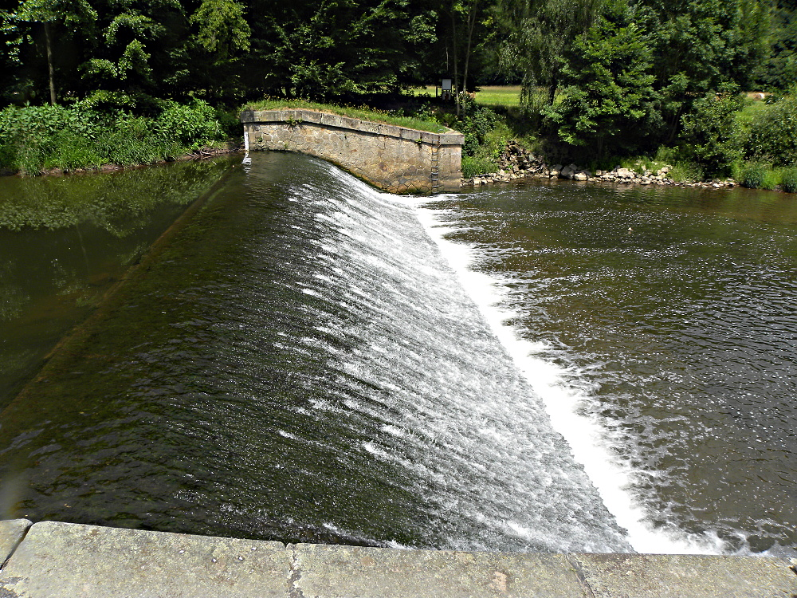
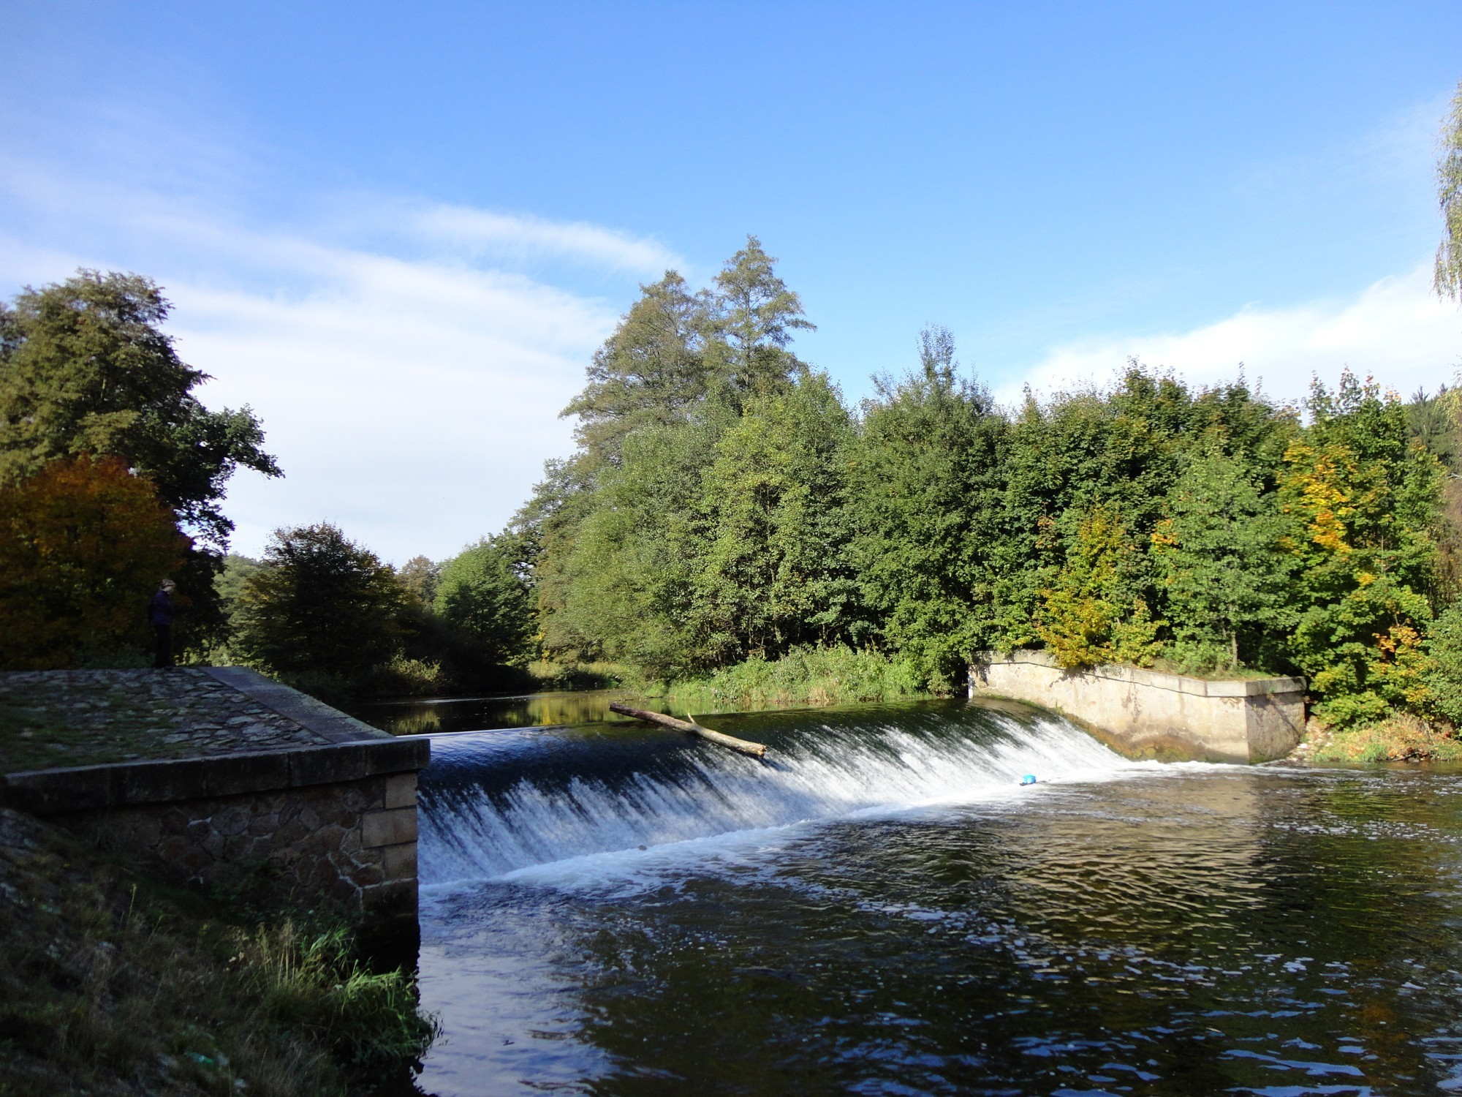
Weir of Viktorka (Viktorčin splav)

Slide 11
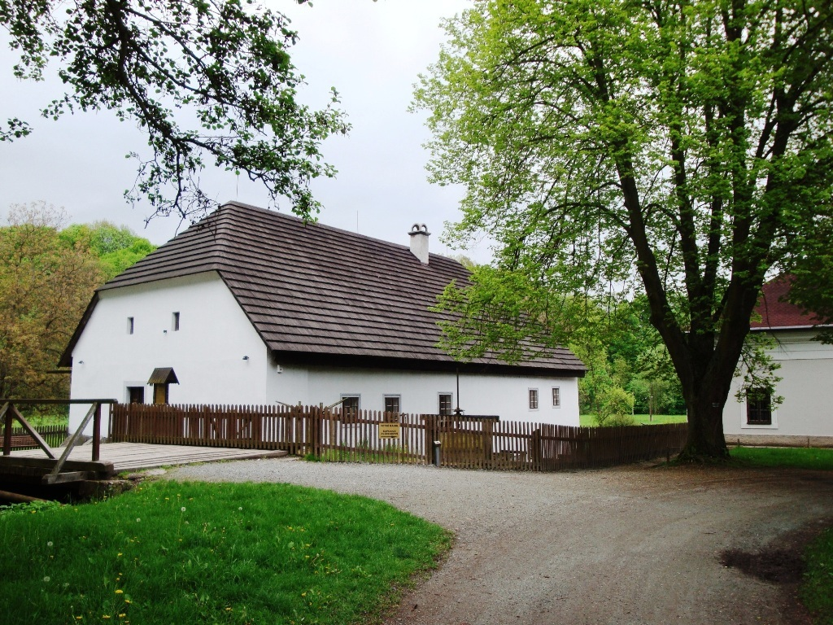
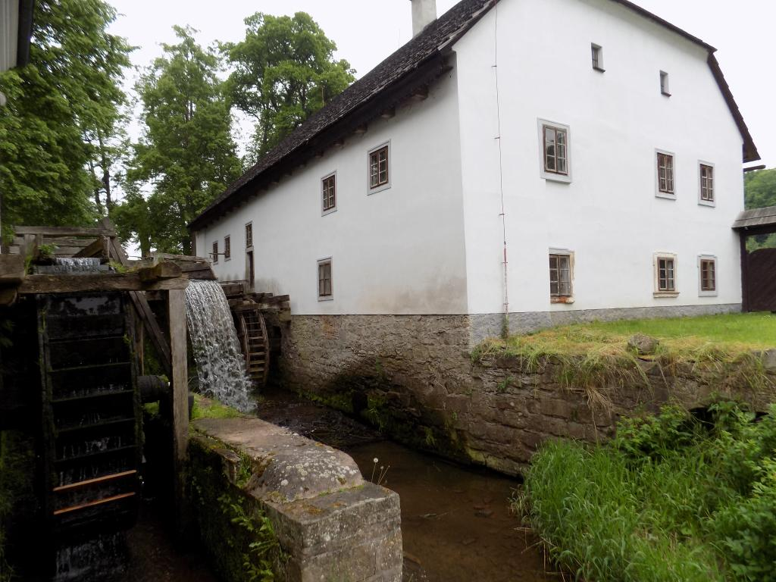
Mill of Rudr

Slide 12
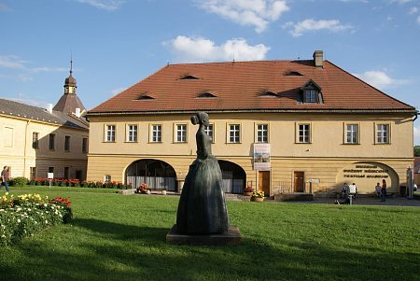
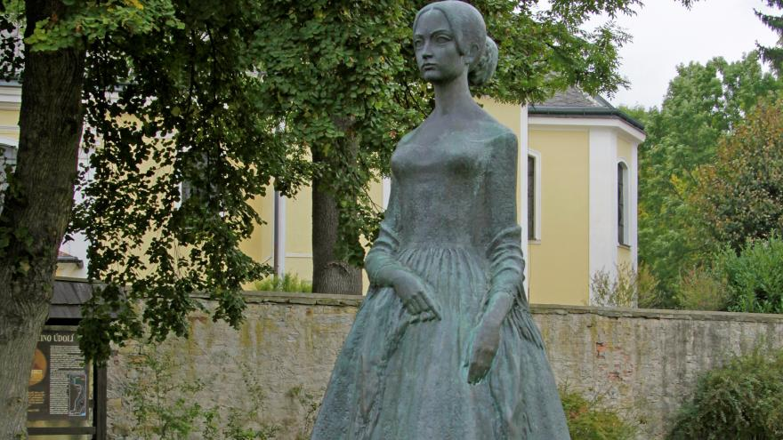
Museum
museum of her life and works
in Česká Skalice
previous school of Božena Němcová

Slide 13
And now let´s test you in a Kahoot! https://create.kahoot.it/share/bozena-nemcova-and-ratiborice/9ba53bbf-bc7a-4b3f-80e2-b8ac395106ad

Slide 14
Thank you for your atention!

