Slide 1
TRADITIONAL CUISINE IN CZECH REPUBLIC, SPAIN AND MALTA
Made by: Jone, Zoe, Anet and Lucía

Slide 2
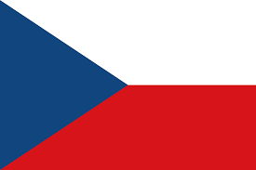
Typical Czech food

Slide 3
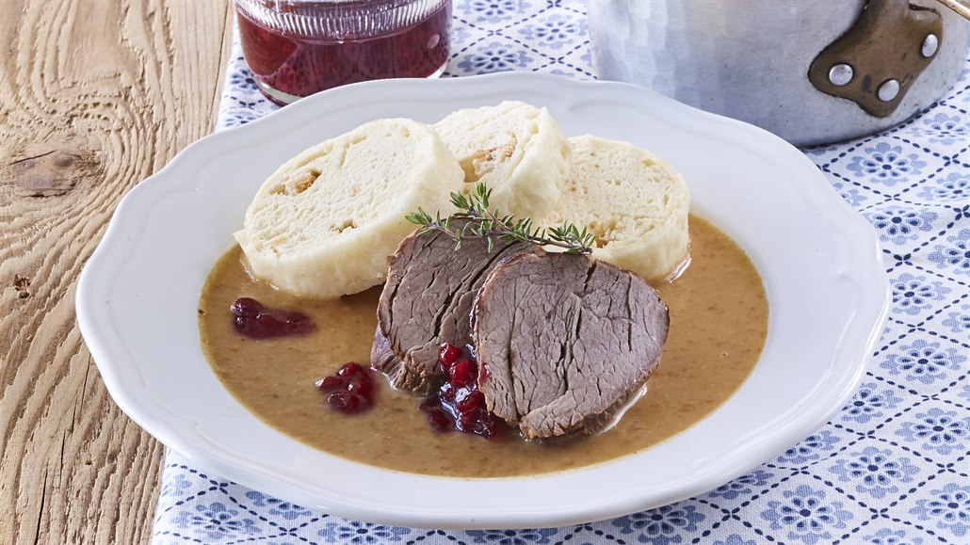
Svíčková
It is sirloin steak prepared with vegetables (carrots, parsley root, celeriac and onion), spiced with black pepper, allspice, bay leaf and thyme, and boiled with double cream. It is generally served with houskové knedlíky (bread dumplings).

Slide 4
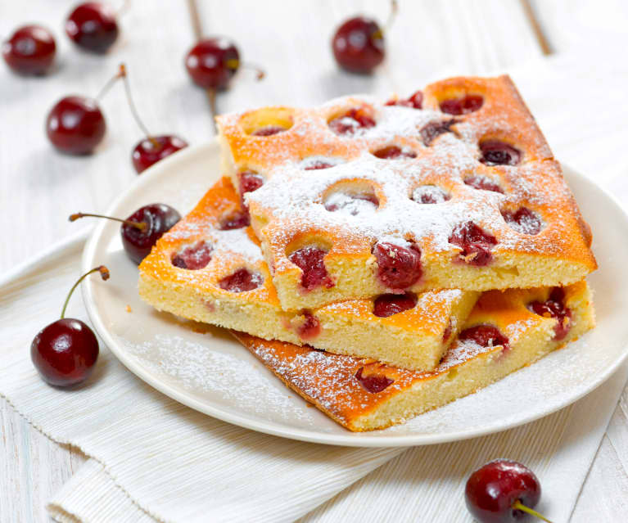
Bublanina
Typical Czech dessert which can also be found in Slovakia.
This simple dessert is prepared by mixing wheat flour, sugar, eggs, butter or oil, and baking powder into a batter, which can also contain vanilla sugar or vanilla extract, lemon zest, and milk.

Slide 5
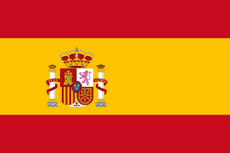
Typical Spanish food

Slide 6
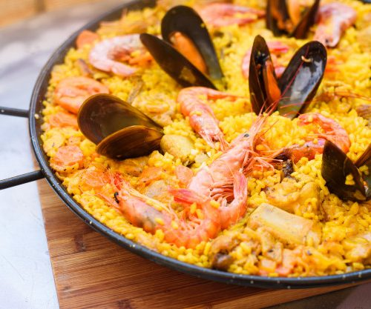
Paella
Paella is a dish originally from Valencia
It consists of round rice, some variety of green beans, chicken, olive oil and chicken broth.
There are more types like the paella de marisco and paella mixta ( combines meat from livestock, seafood and vegetables)
Paella means frying pan in Valencia’s regional language.
From the 19th century

Slide 7
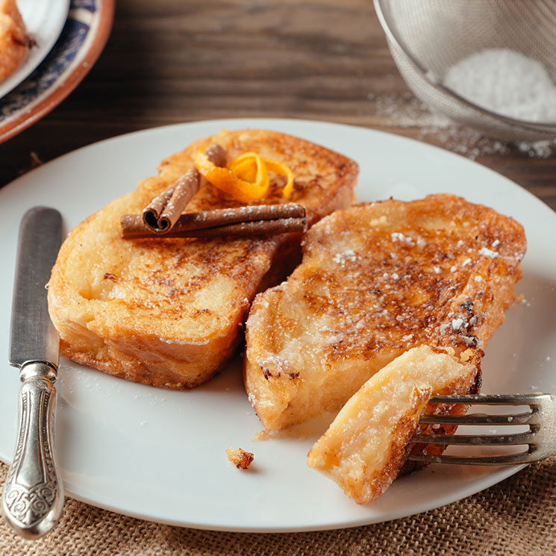
Torrijas
Torrijas are a typical Spanish dessert that they are made of bread, milk, cinnamon, eggs, sugar, vanilla, lemon and sometimes wine, that are fried in olive oil.
They are a typical easter dessert
It is also known in other countries like France (Pain Perdu), England (Poor knights of Windsor), in America (French Toast) and some more…

Slide 8
Typical Maltese food

Slide 9
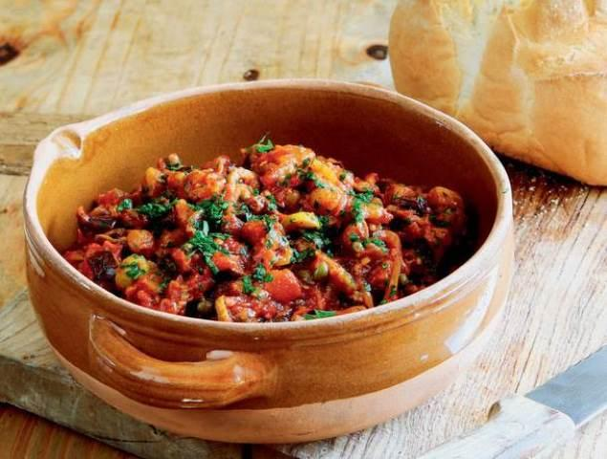
Kapunata
Kapunata is the Maltese version of the Sicilian caponata, which is similar to France’s famous ratatouille. The main ingredients are aubergines and bell peppers, cooked with fresh tomatoes and flavored with olives and capers. It is best enjoyed as a main dish accompanied by fresh, crusty Maltese bread, or as a side dish with tuna steak.

Slide 10
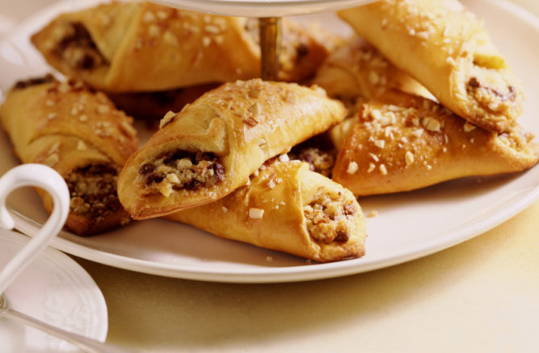
Imqaret
It’s a typical maltese dessert, made of a fried pastry filled with dates
It has a diamond shape
It name comes from the arabic (maqrut)

