Slide 1
CZECH TYPICAL FOOD

Slide 2
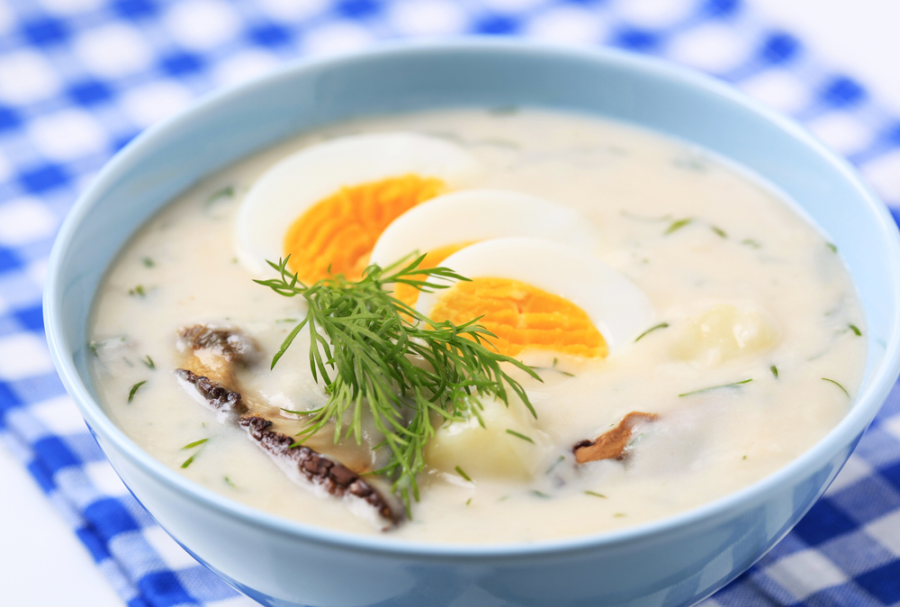
Kulajda (Dill soup)
Kulajda is a Czech mushroom soup containing dill and potatoes, softened with a cream
It's characterized by a typical sweet and sour taste

Slide 3
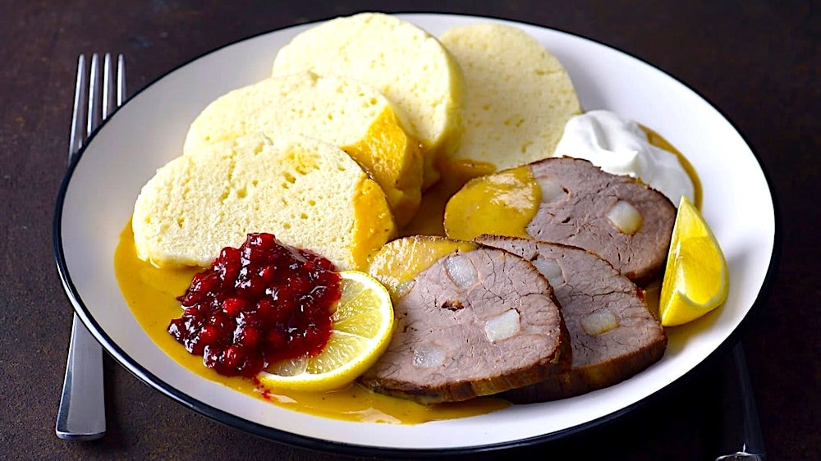
Svíčková na smetaně (Roast sirloin in sour cream sauce with dumplings)
roast sirloin
stewed carrot
celeriac
parsley root
onion cream boiled dumplings
cranberry compote

Slide 4
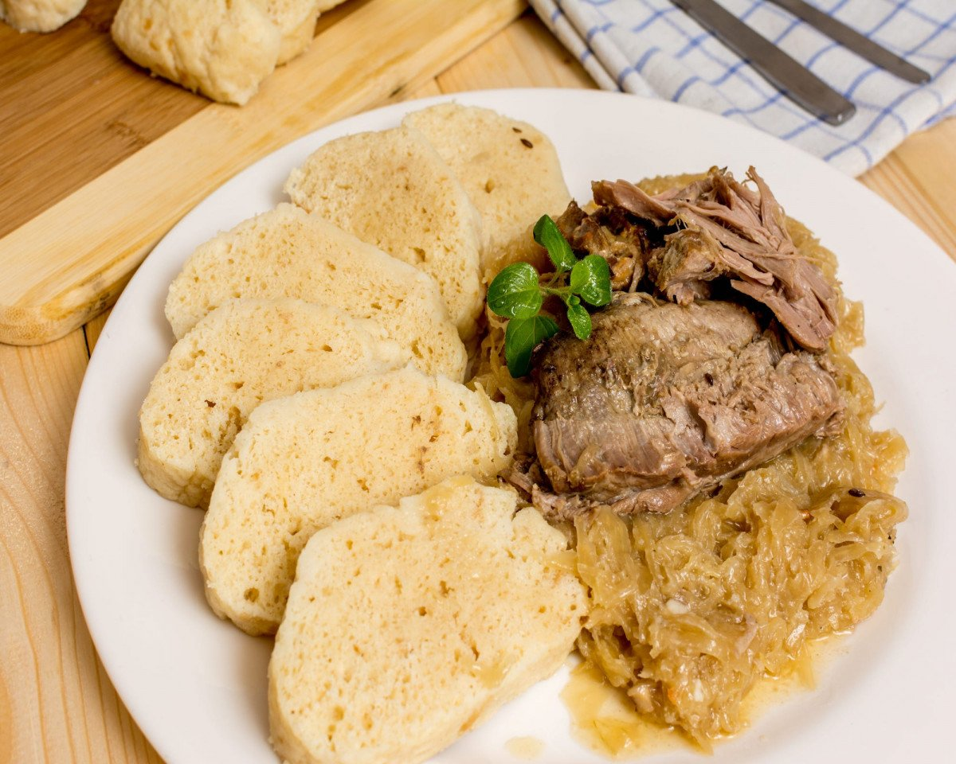
Vepřo knedlo zelo (Roast pork with dumplings and sauerkraut)
roast pork neck
sauerkraut
stewed cabbage
bread dumplings
potato dumplings

Slide 5
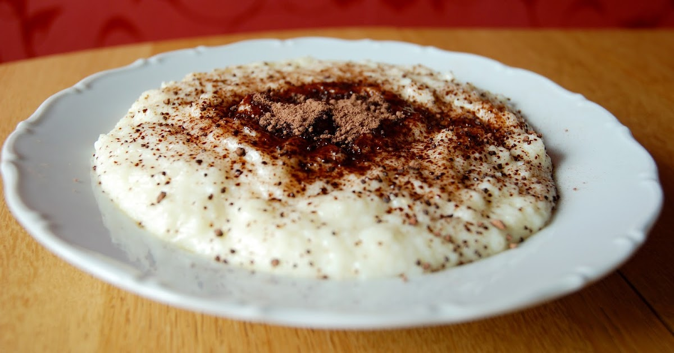
Krupicová kaše (Semolina porridge)
Is a hot breakfast cereal
Smooth in texture and mild in taste
It is made by combining semolina flour with warm water or milk

Slide 6
SPANISH TYPICAL FOOD

Slide 7
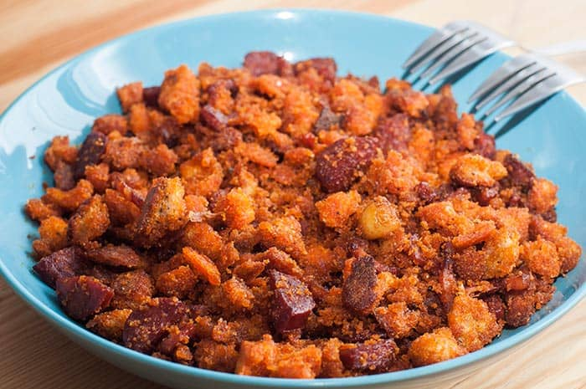
MIGAS

Slide 8
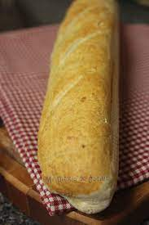
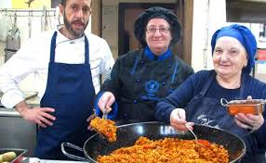
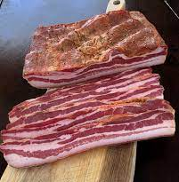
Recipe
500 gr of hard bread. 300 ml of water.
1 dessert spoon of salt.
2-3 fresh sausages.
2 green peppers.
3 strips (1 cm thick) of fresh bacon or pancetta.
6 cloves of dried garlic.
100 ml of olive oil.

Slide 9
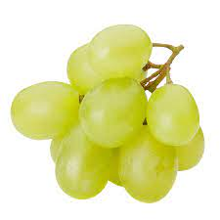
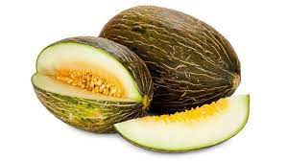
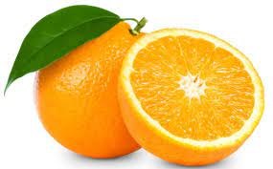
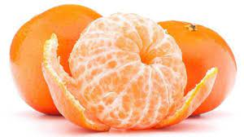
You can add

Slide 10
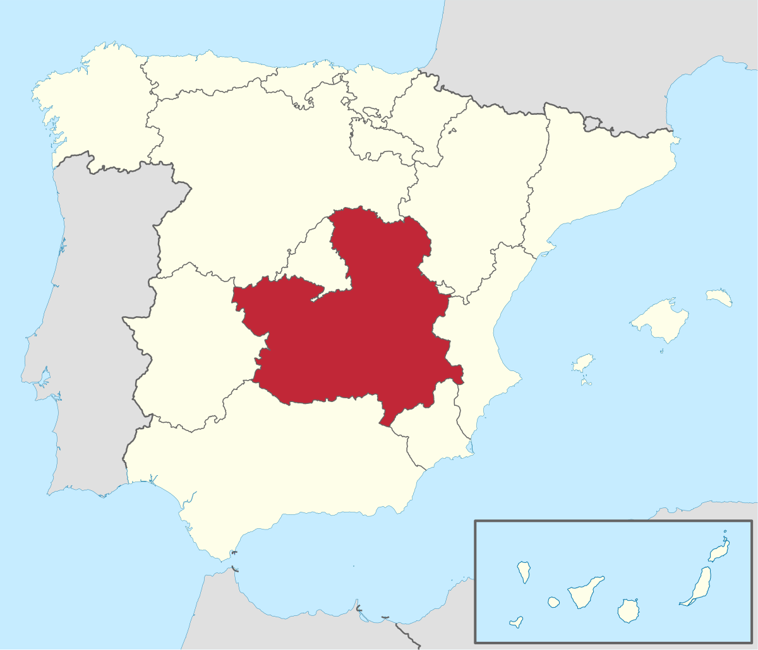

Slide 11
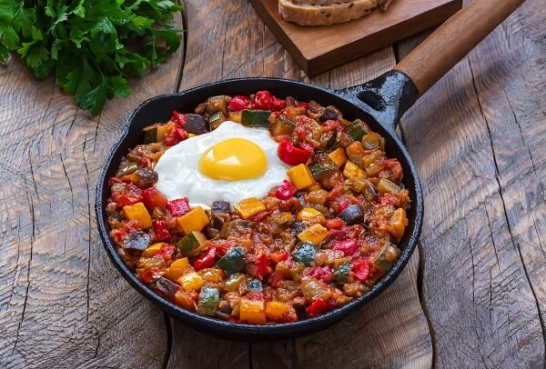
PISTO

Slide 12
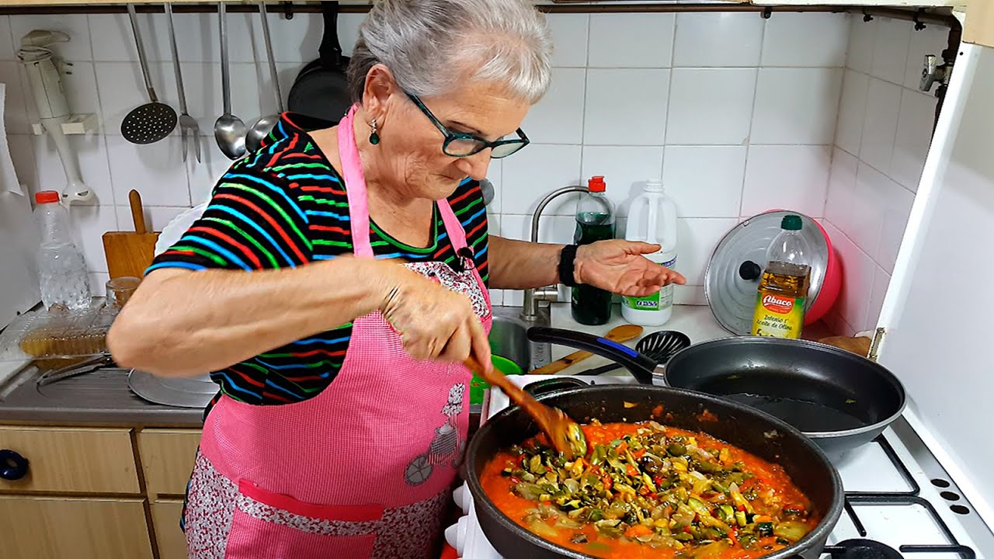
Recipe
400g of ripe tomatoes
1 large onion
1 red bell pepper
1 green bell pepper
1 zucchini
1 clove garlic
50 ml of white wine
Salt (to taste of each house)
Mild extra virgin olive oil

Slide 14
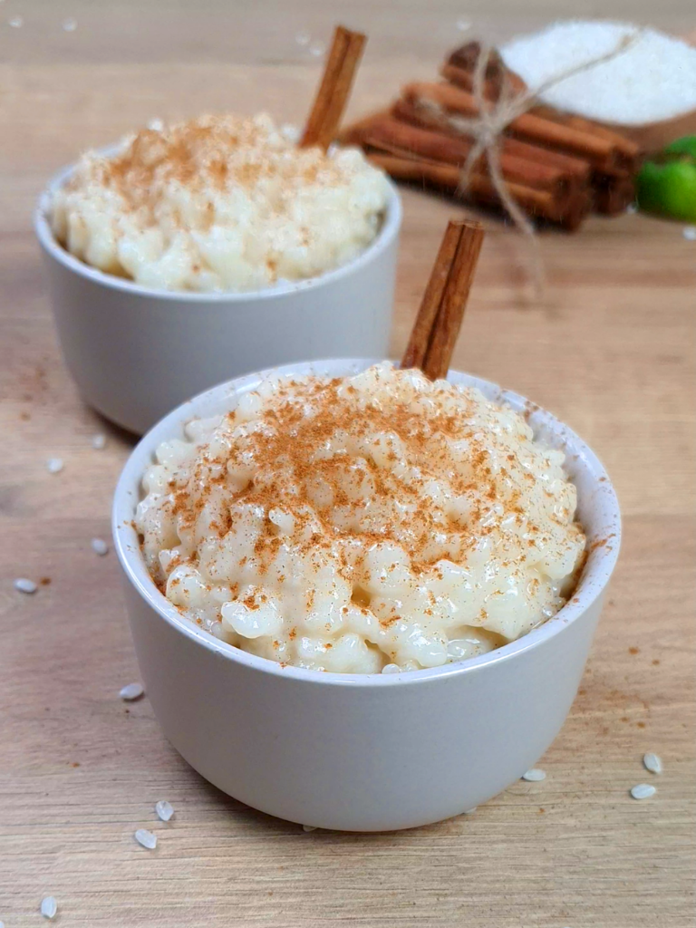
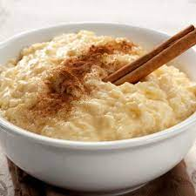
ARROZ CON LECHE

Slide 15
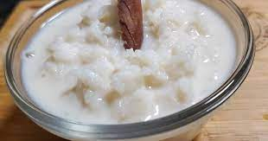
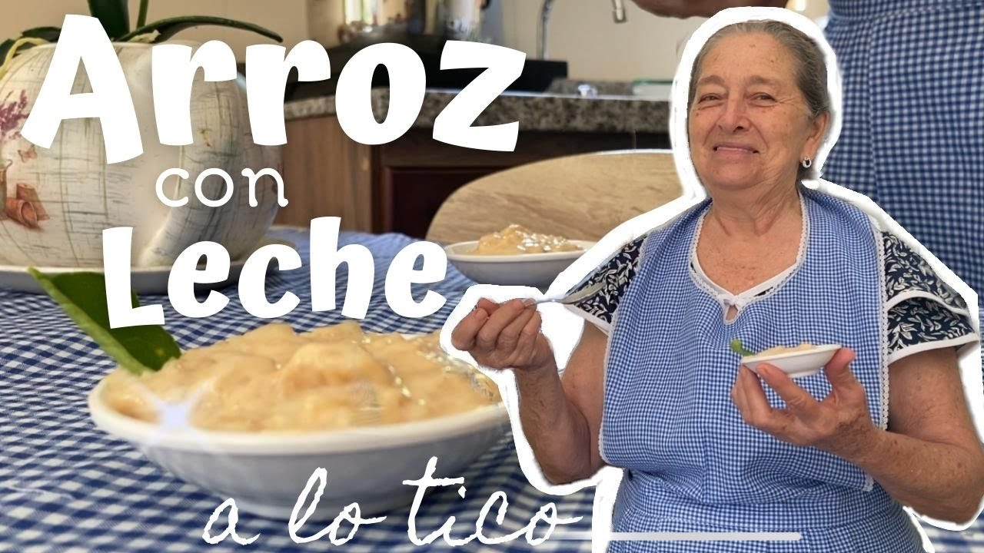
RECIPE
Whole milk 1.5L
Round rice 200g
Lemon peel (only the yellow part) 1/2
Orange peel (only the yellow part) 1/2
cinnamon stick
Salt
Sugar 180g
Unsalted butter 70g
ground cinnamon (to sprinkle)

Slide 16
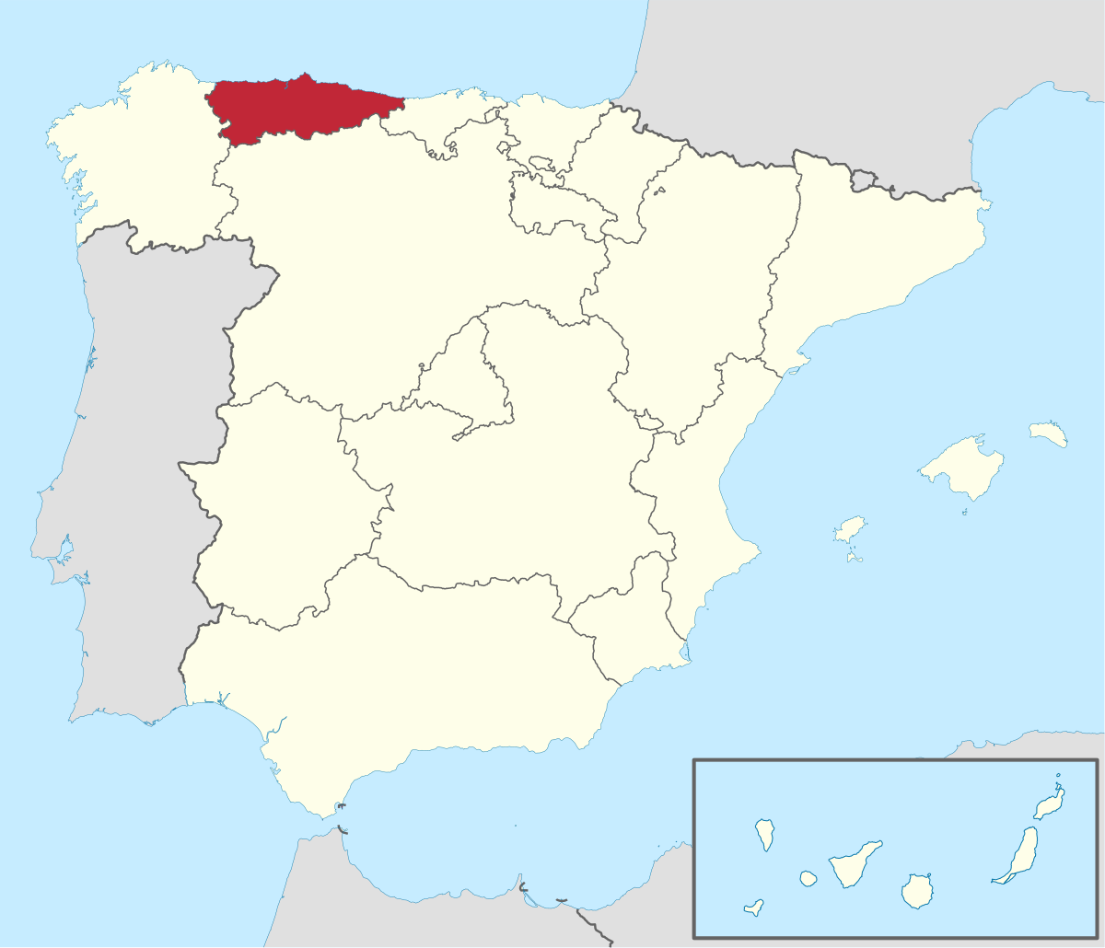

Slide 18
THANK YOU FOR YOUR ATTENTION!!!

