Slide 1
ERASMUS COUNTRIES FOOD
By: Alice, Stella, Francesco, Clara and Alejandra

Slide 2
MALTESE FOOD
Figoli
Figoli is pastry made in easter.It has almond filling and in any shape.It can be decorated in icing.

Slide 3
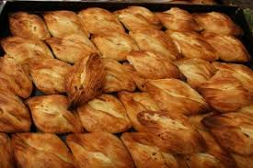
MALTESE FOOD
Pastizzi
Pastizzi are chese and peas filled pastre. They are are very popular in malta and tourists.

Slide 4
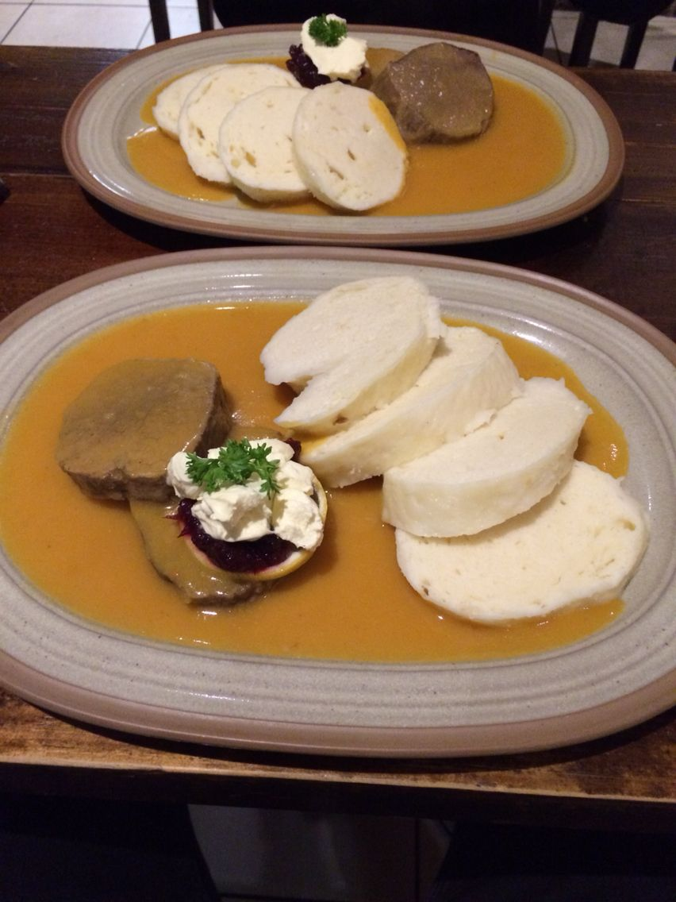
CZECH FOOD
Svíčková
sirloin steak prepared with vegetables
served with houskové knedlíky
(bread dumplings), cranberries, cream

Slide 5
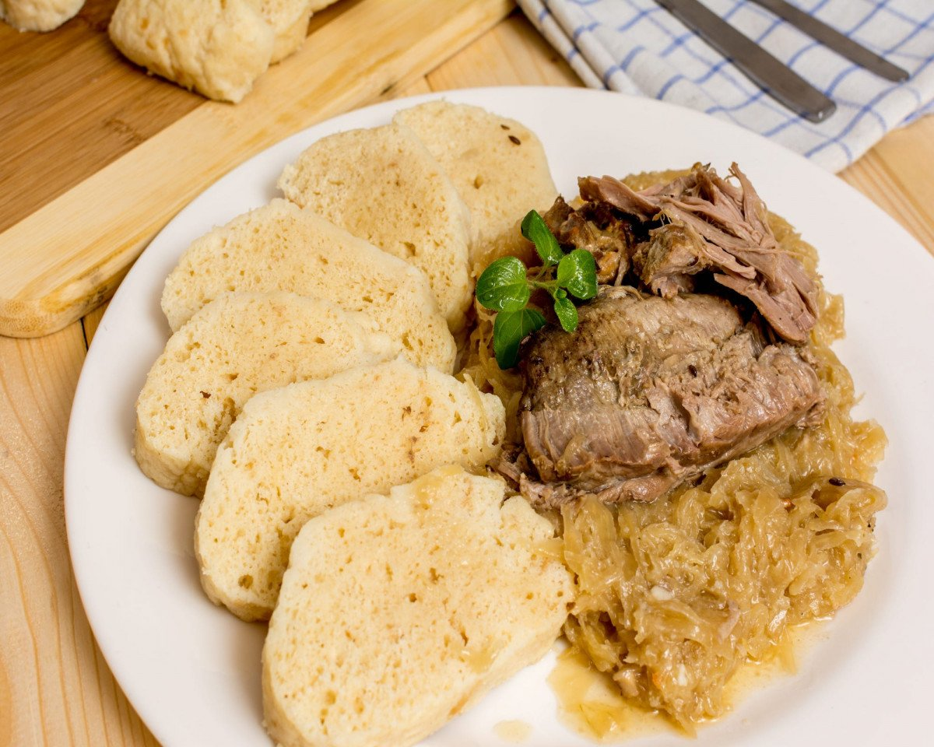
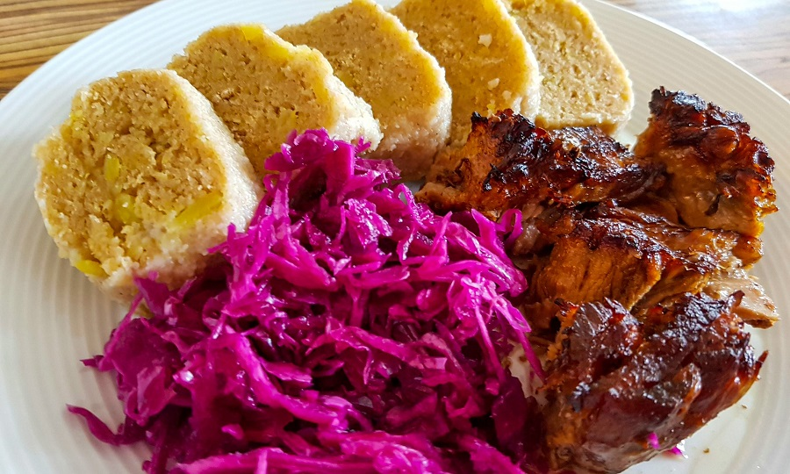
CZECH FOOD
Vepřo knedlo zelo (Pork, dumpling and cabbage)
roast pork with bread dumplings (houskové knedlíky) and stewed cabbage (white or red)
after loading these things on plate, pour the juice from baking

Slide 6
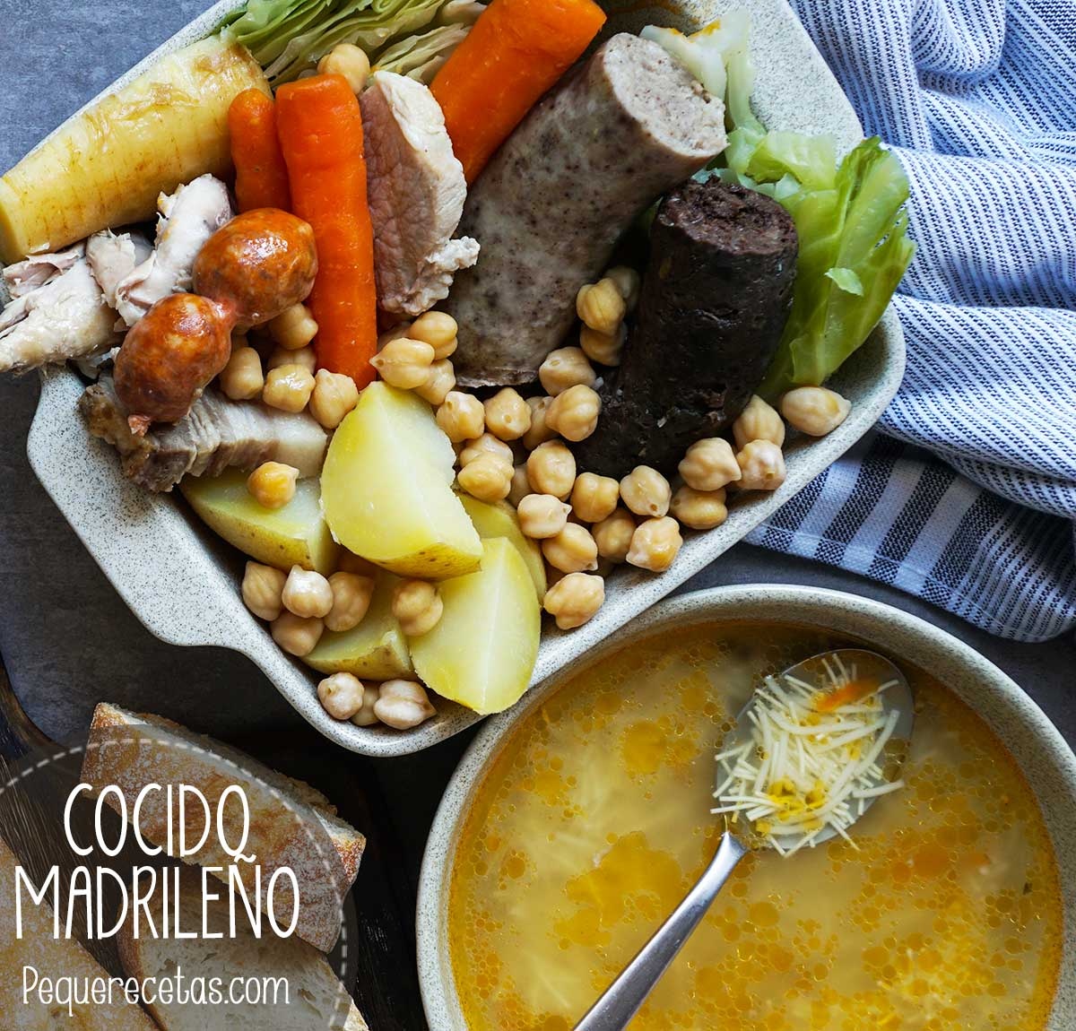
SPANISH FOOD
A stew with chickpeas, black pudding, chorizo ​​and other foods that complete its flavor.

Slide 7
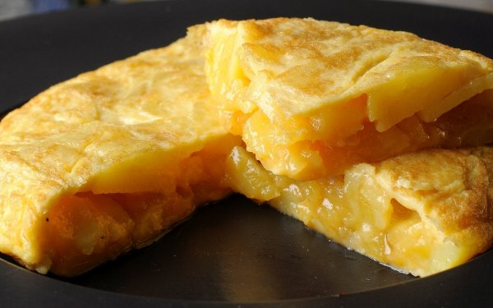
SPANISH FOOD
A mix of eggs and potatoes cooked.

Slide 8
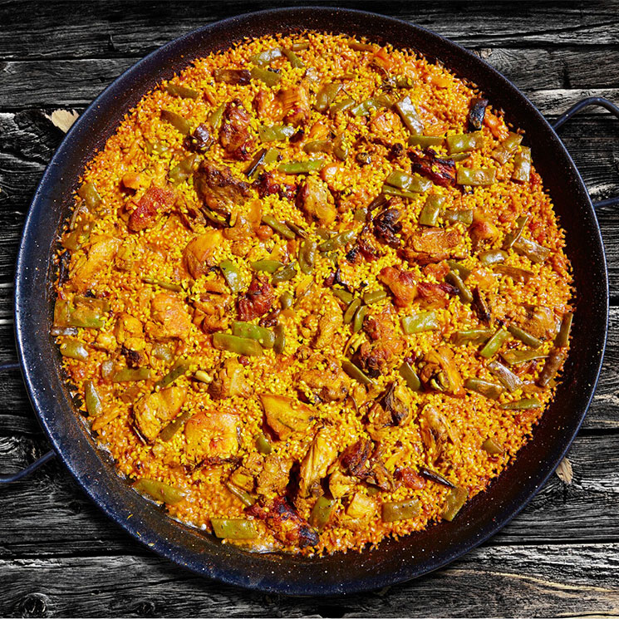
SPANISH FOOD
There are a lot of types but it usually contain chicken, vegetables, seafood… and all that make the rice have more flavour.

Slide 9
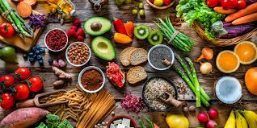
END

