Slide 1
Spanish Language
Tom, Joseph, Aitor

Slide 2
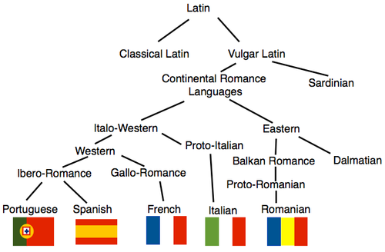
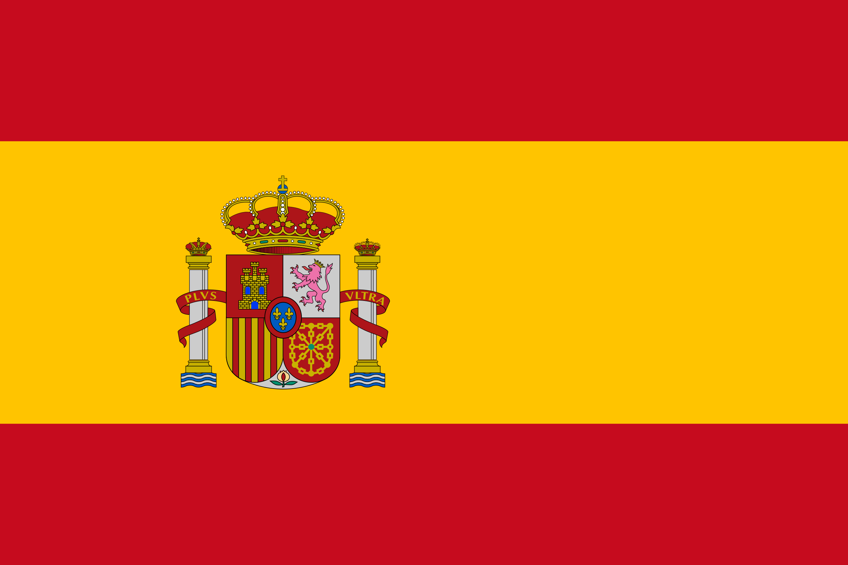
Origin of the Spanish Language
This is an Indo-European language that is an evolution of the “Vulgar Latin” which was spoken in the middle ages until the contemporary age in the most of Europe.
It was the official language of the Roman Empire, Africa and the near East apart from the Greek language.

Slide 3
¿Where is it spoken?
Spanish is Spoken in:
Argentina
Bolivia
Chile
Colombia
Costa Rica
Cuba
Dominican Republic
Ecuador
Equatorial Guinea,
El Salvador
Guatemala
Honduras
Mexico
Nicaragua
Panama
Paraguay
Peru
Puerto Rico,
Spain
Uruguay
Venezuela

Slide 4
¿How many people speak Spanish?
Around 543 million people speak Spanish and around 460 million are natives.
It is around 6% of the total population

Slide 5
Some Spanish words:
Spanish | English
Hola | Hello
Adiós | Goodbye
Buenos días | Good morning
Buenas noches | Goodnight
Buenas tardes | Good afternoon
Gracias | Thank You
Perdón | Sorry
Por Favor | Please
Si | Yes
No | No
¿Qué tal? | How are you?

