Slide 1
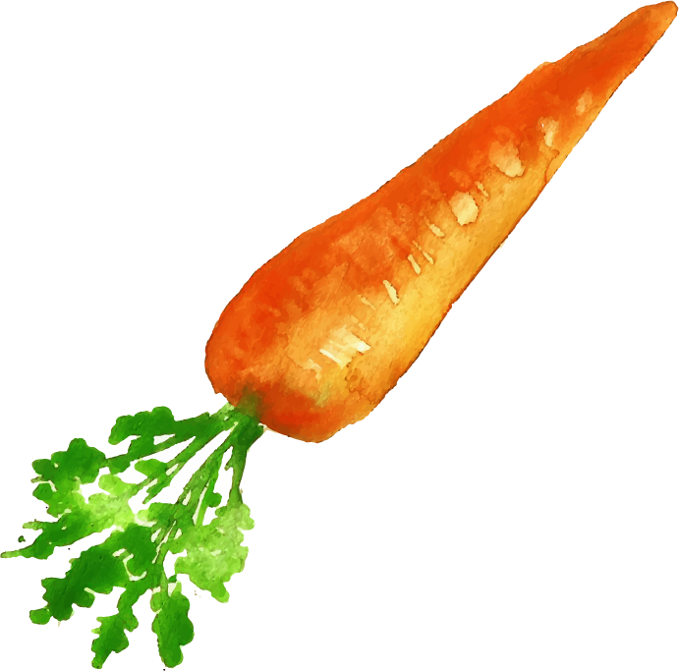
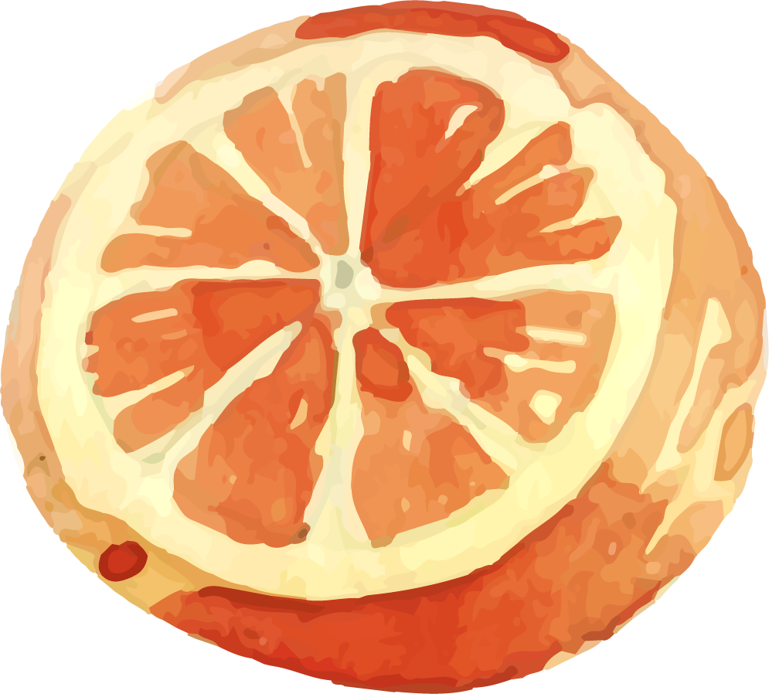
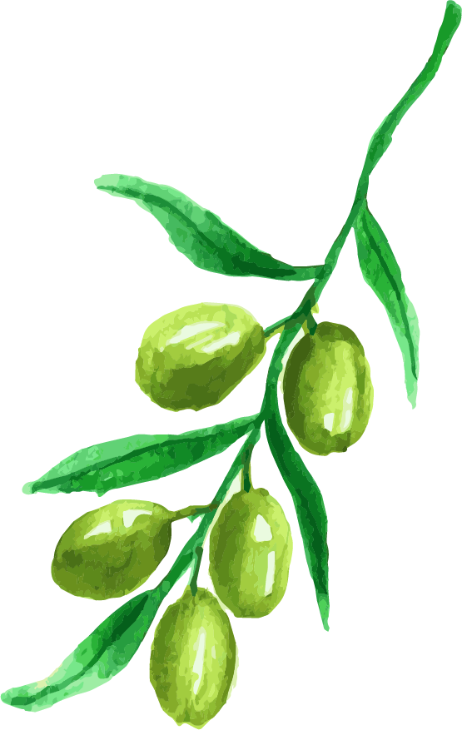
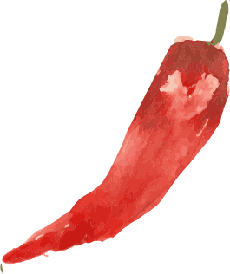
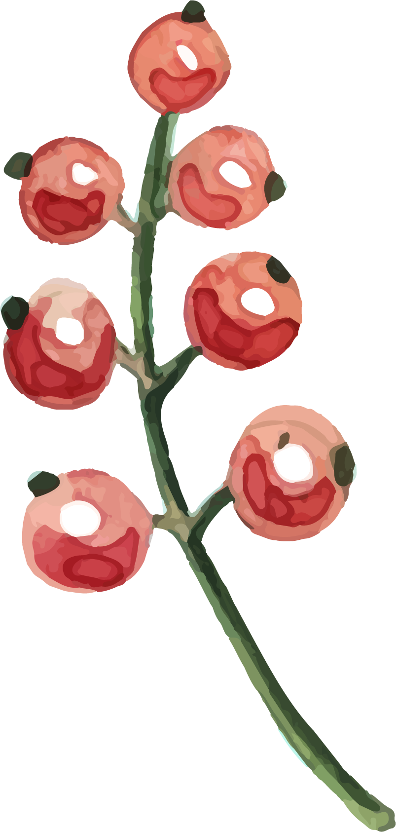
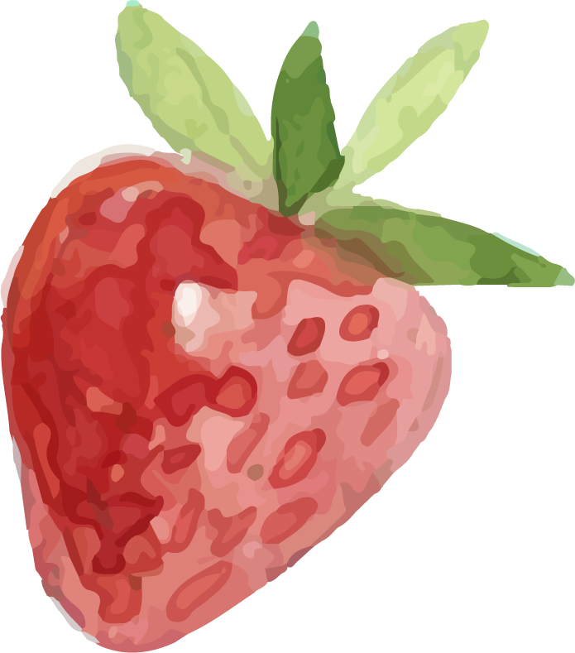
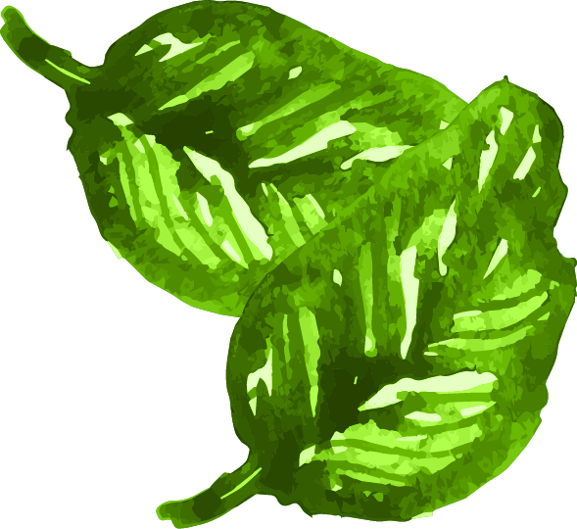
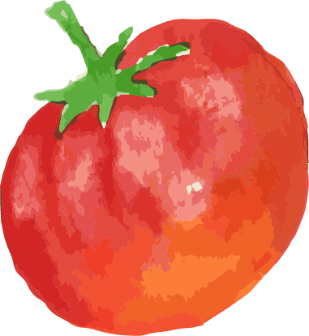
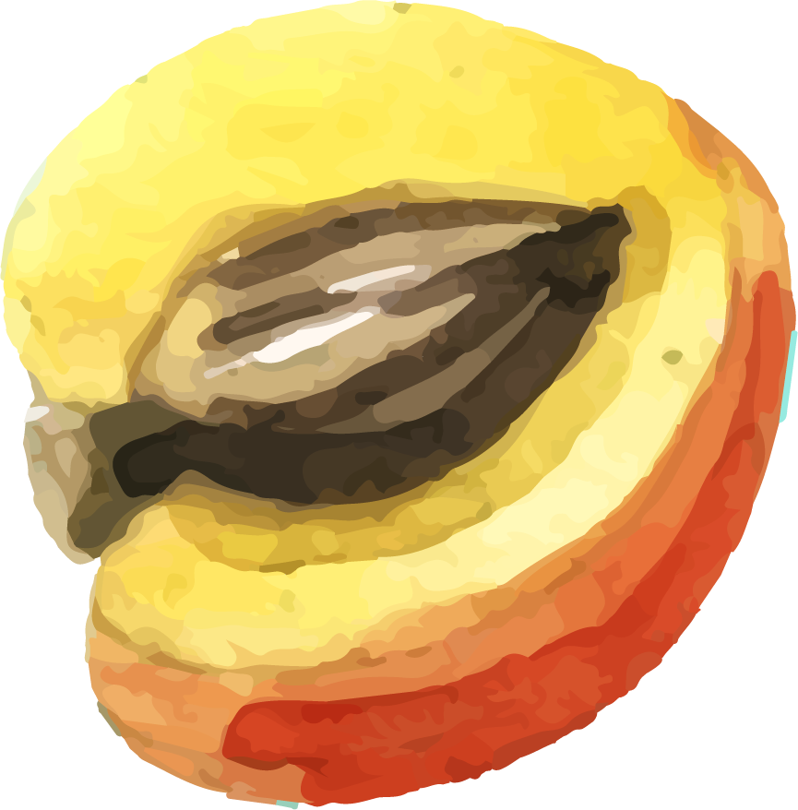
TRADITIONAL CUISINE

Slide 2
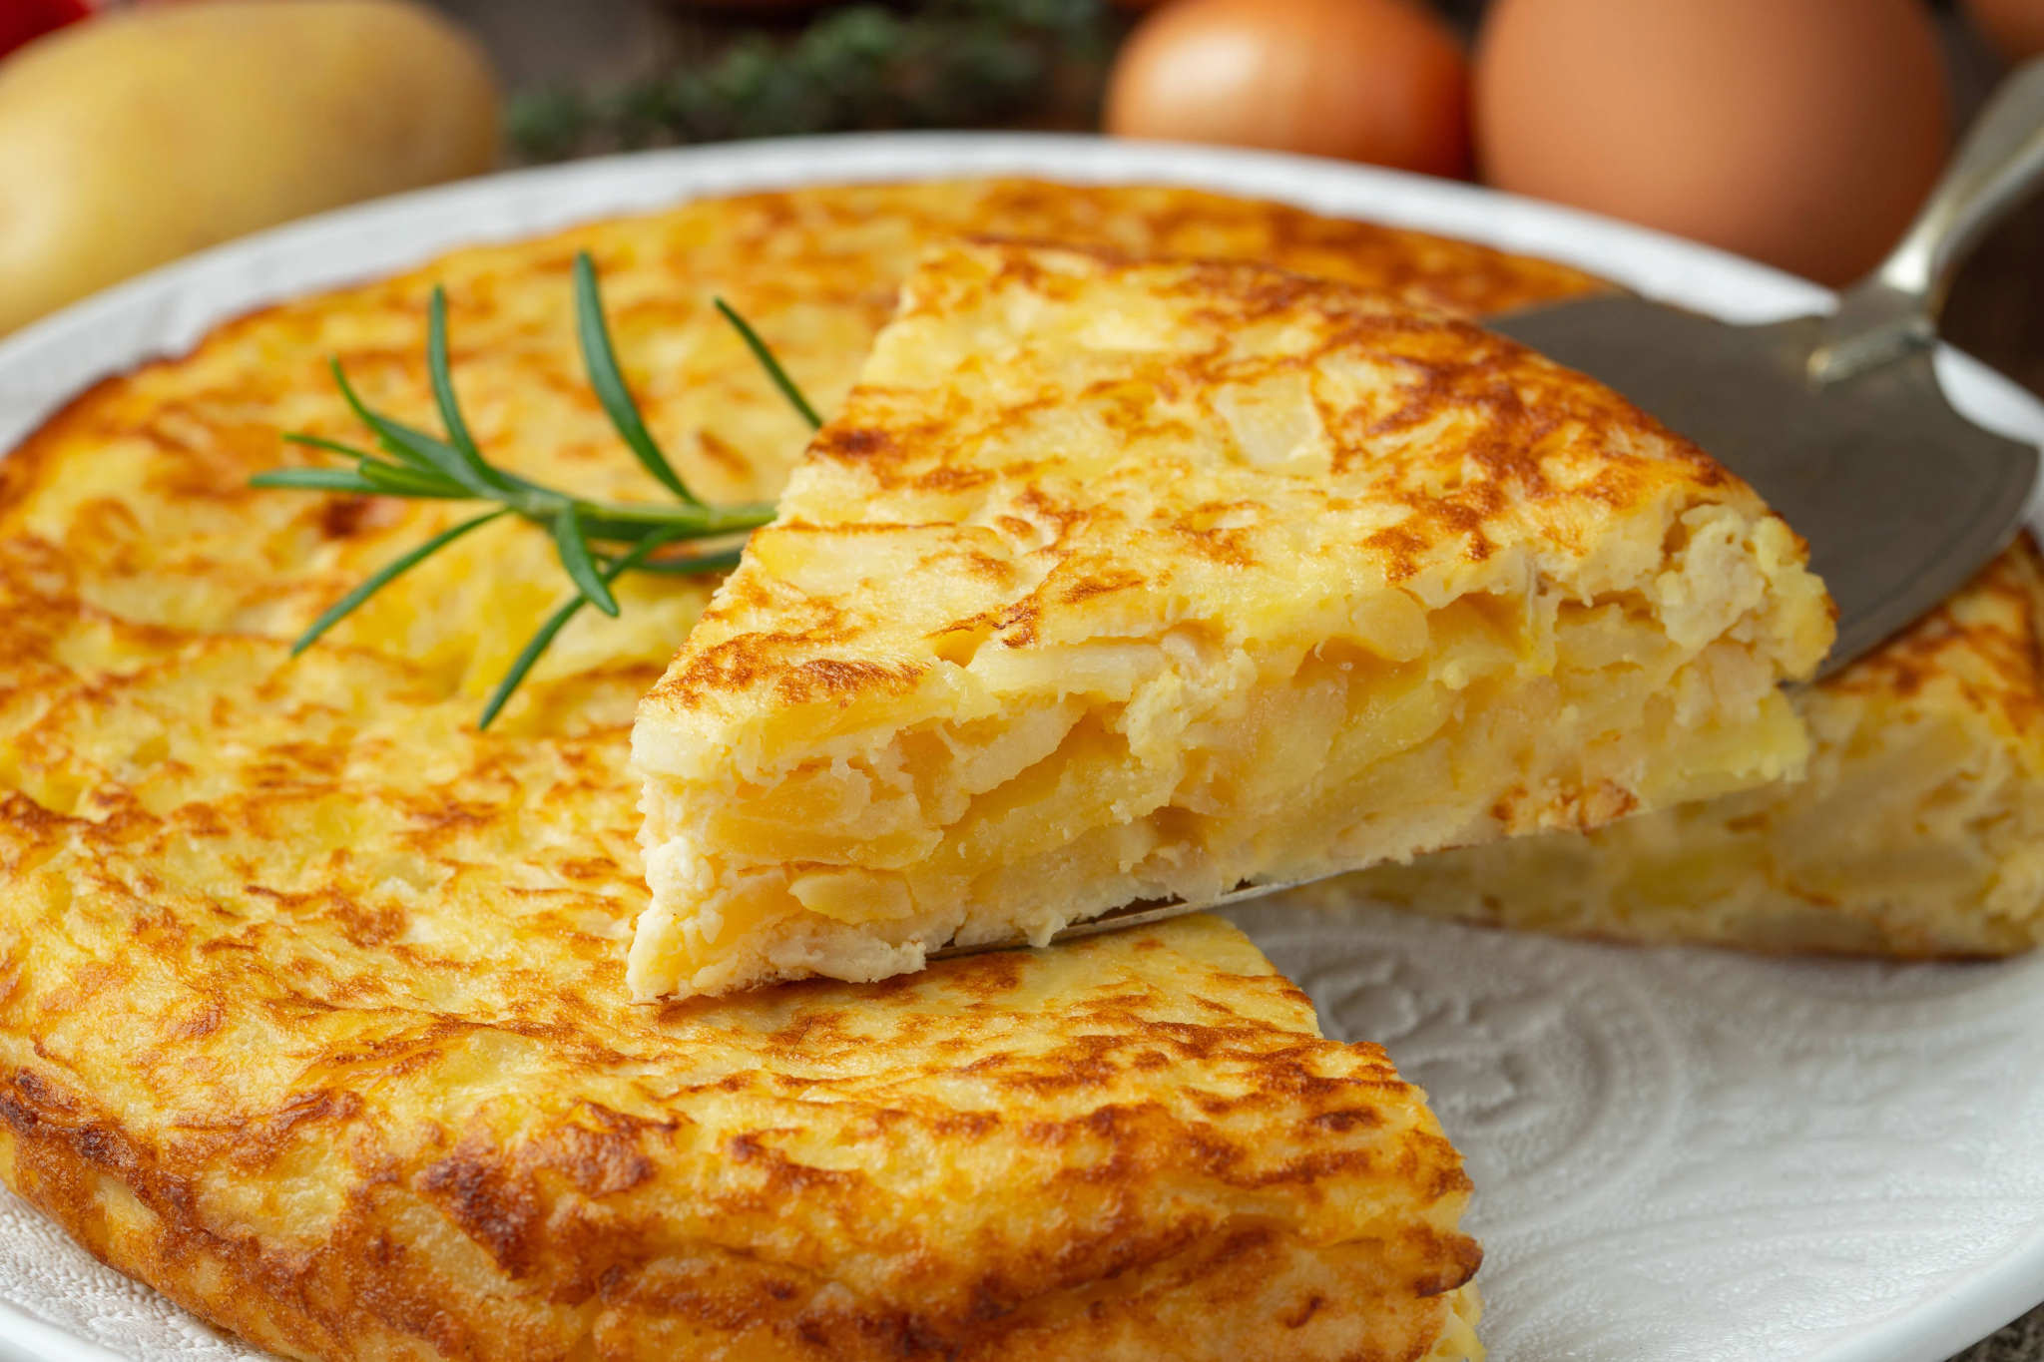
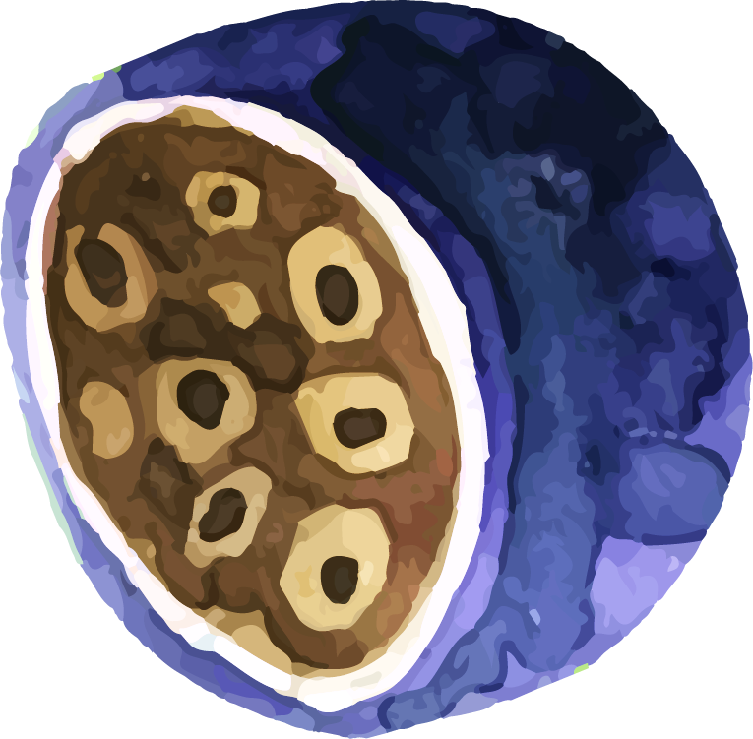
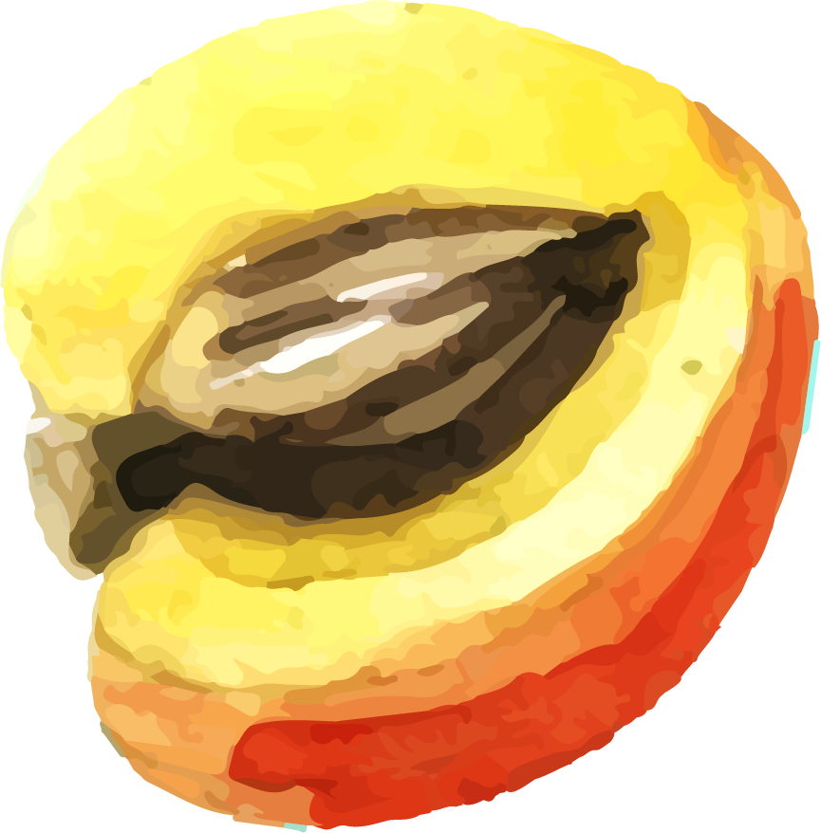
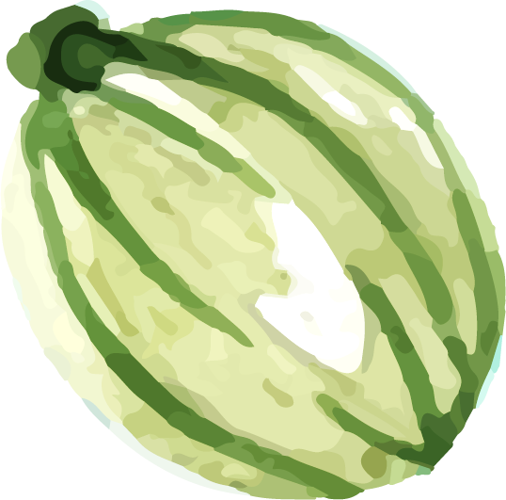
SPANISH TRADITIONAL CUISINE
TORTILLA DE PATATA
INGREDIENTS:
-5 Eggs, 5 potatoes, salt and oil.
HOW TO DO IT:
Peel the potatoes, cut the potatoes in thin slices. Fry them in hot oil. Then mix them in a bowl with the eggs and salt and put everything in a saucepan for 5 minutes in each side.
Serve and eat.

Slide 3
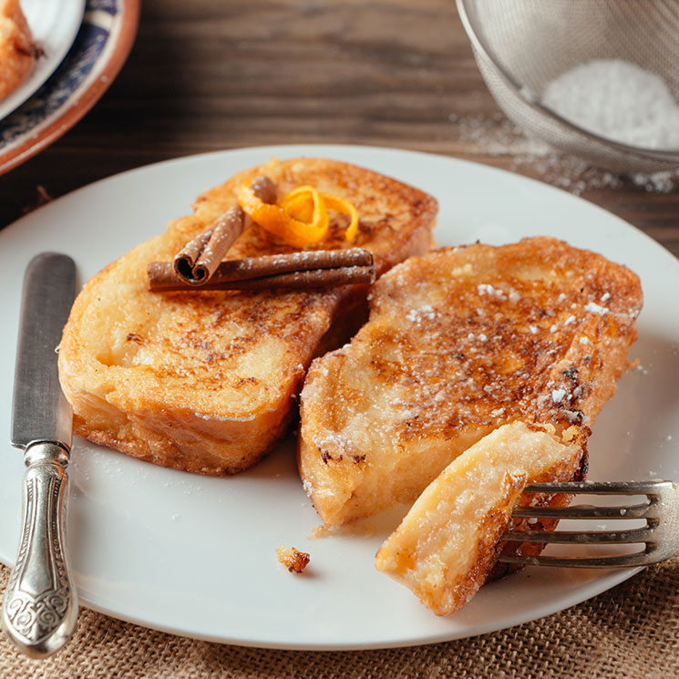
SPANISH TRADITIONAL CUISINE
TORRIJAS
INGREDIENTS:
-Bread, milk, sugar,lemon peel, and cinnamon.
HOW TO DO IT:
-Cut some bread into slices.
- Heat a litre of milk with some sugar, cinnamon in bar and lemon peel.
- Put the bread inside a plate with than mixture until it is soaked.
- Fried it till it´s golden brown.
-Soak it in cinnamon and sugar.
Serve and eat.

Slide 4
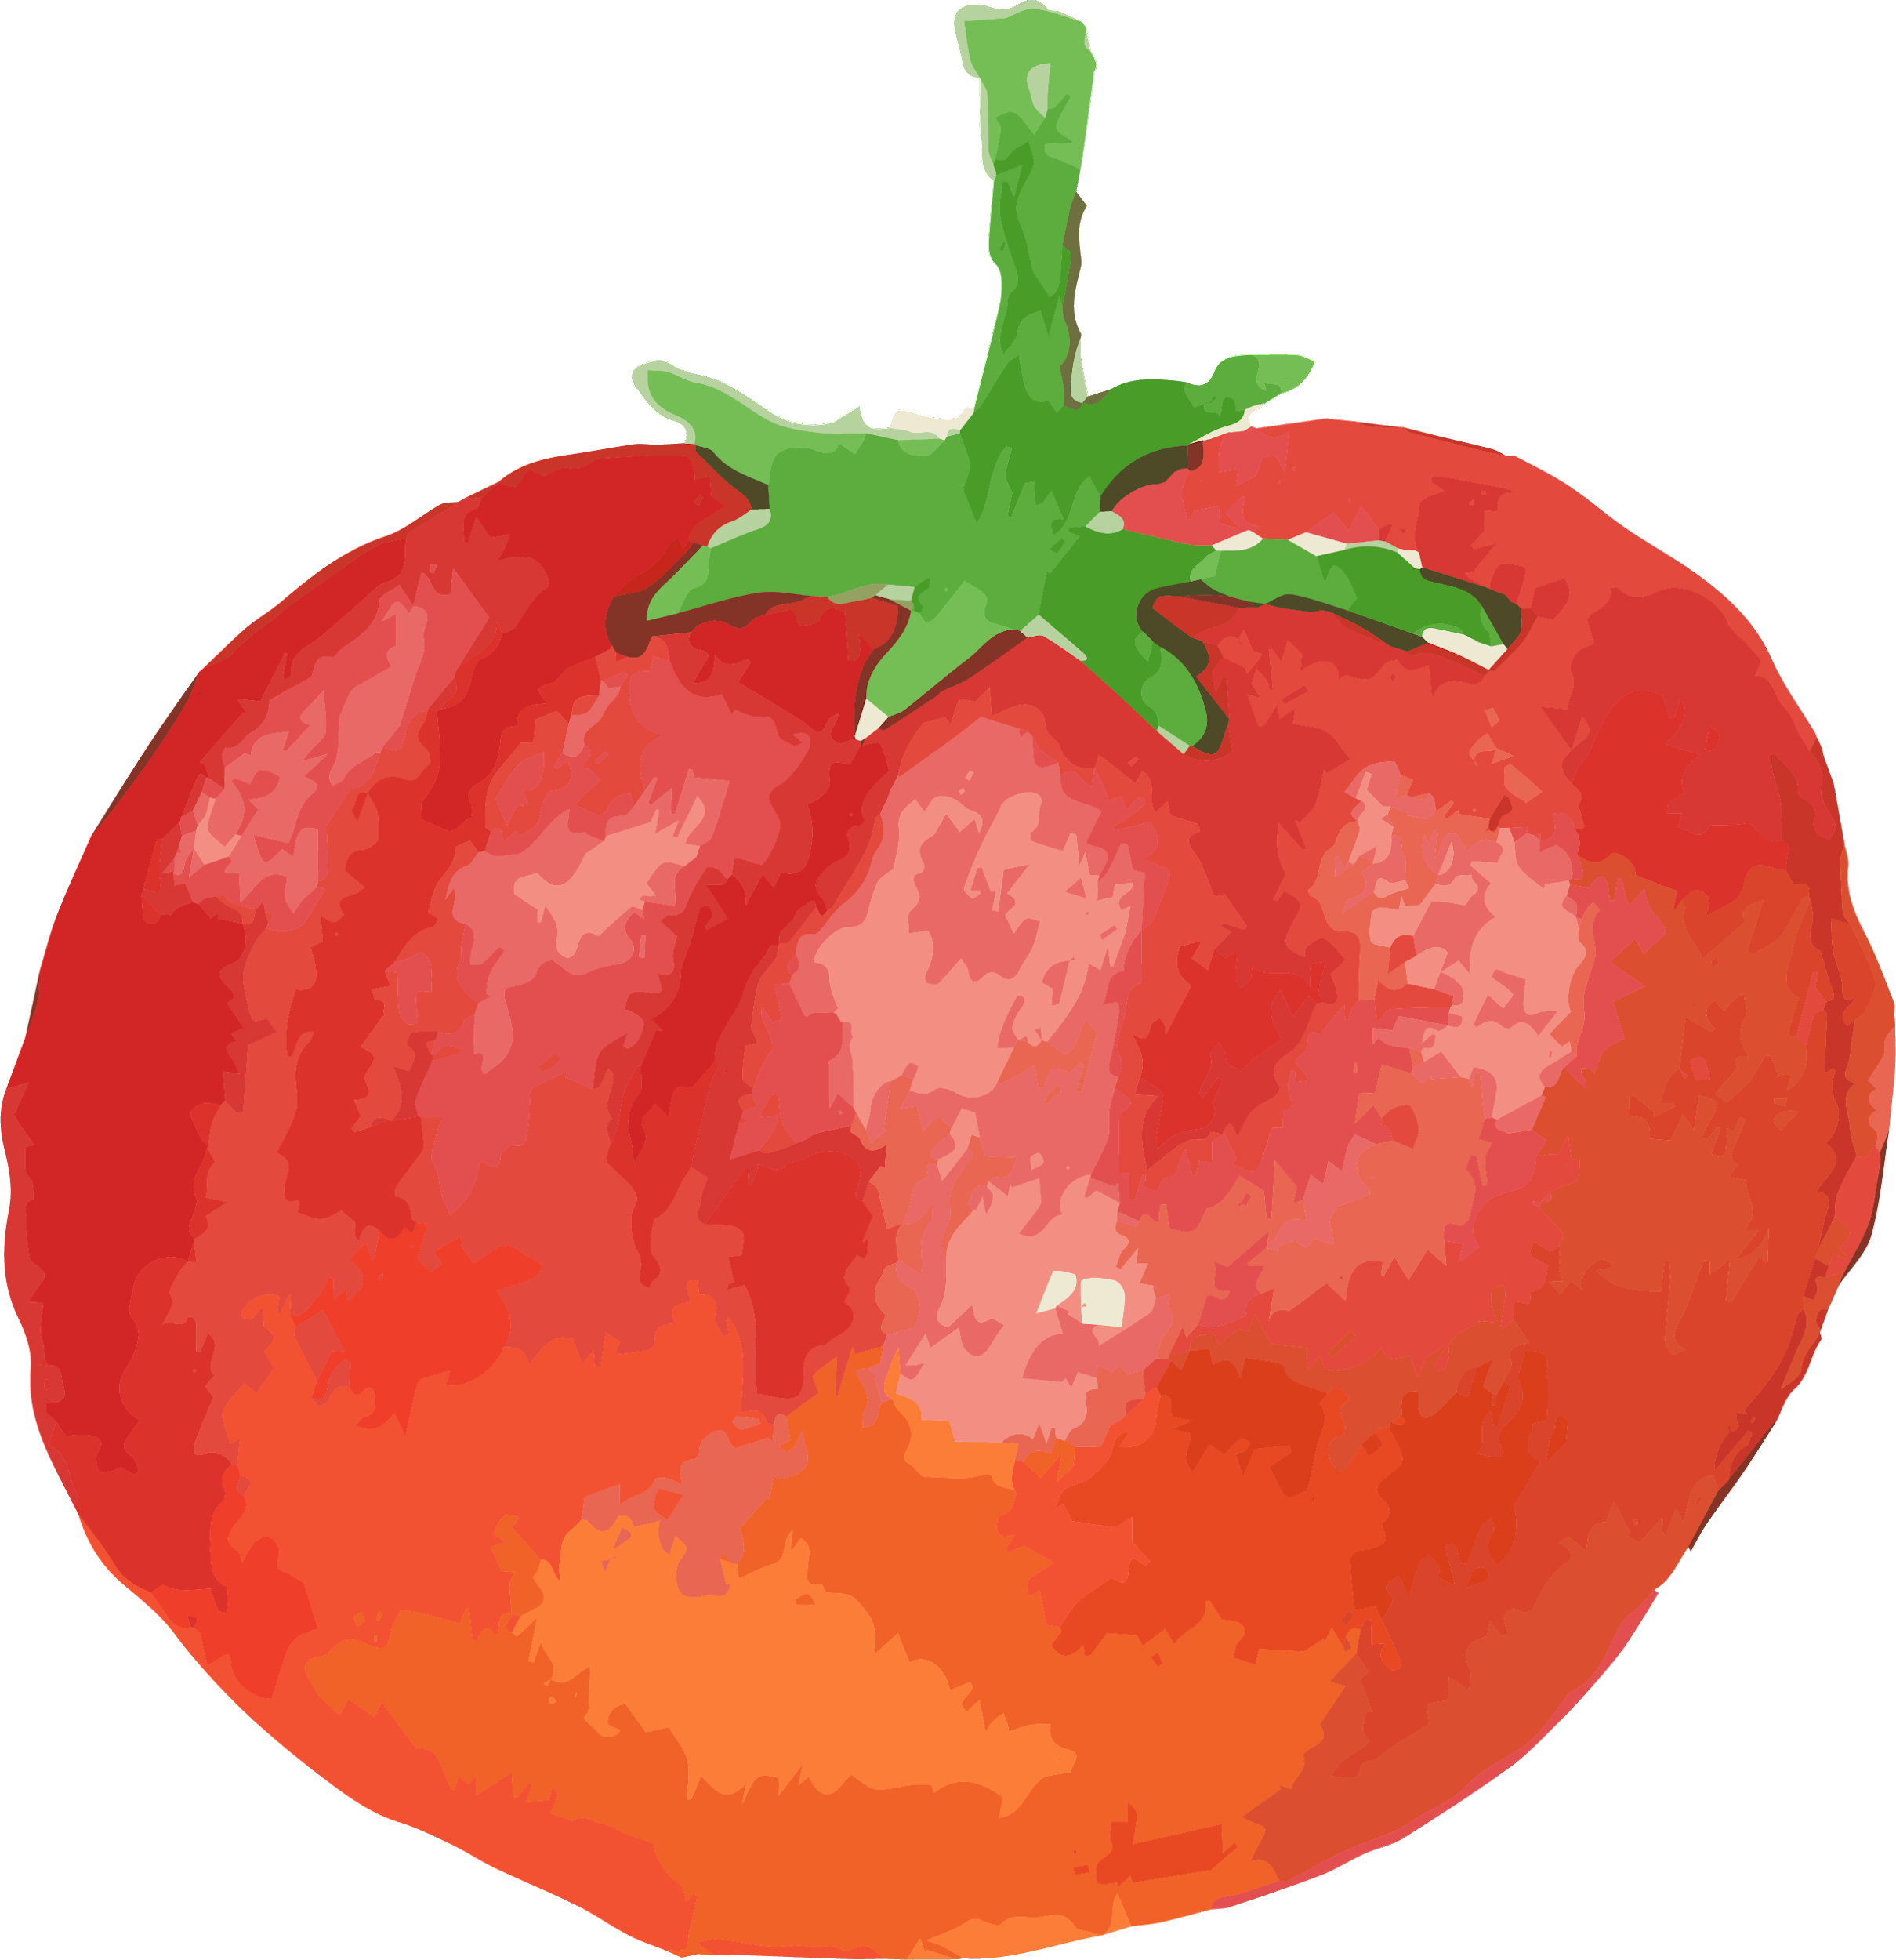
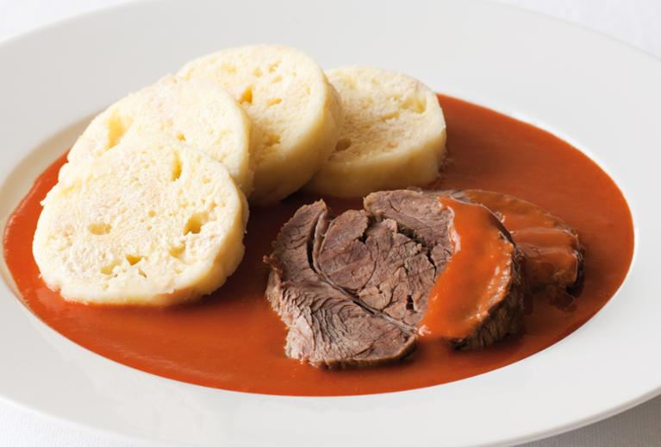
CZECH TRADITIONAL CUISINE
RAJSKÁ OMÁČKA
INGREDIENTS:
-Beef, root vegetables, and tomato paste, celery root, parsley root, onion, cloves of garlic, salt and
water.
HOW TO DO IT:
We will start with making a broth by cooking beef and root veggies. It takes about 3 hours, after all broth-related ingredients start simmering in the pot, remove the beef out of the broth, set it aside.
Strain the finished broth into a clean pot, discard the vegetables and spices.

Slide 5
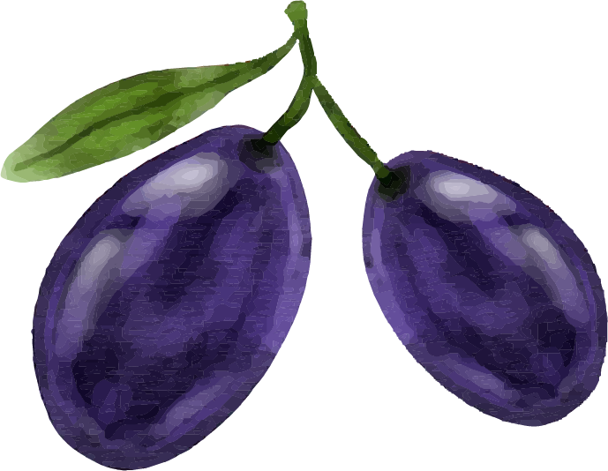
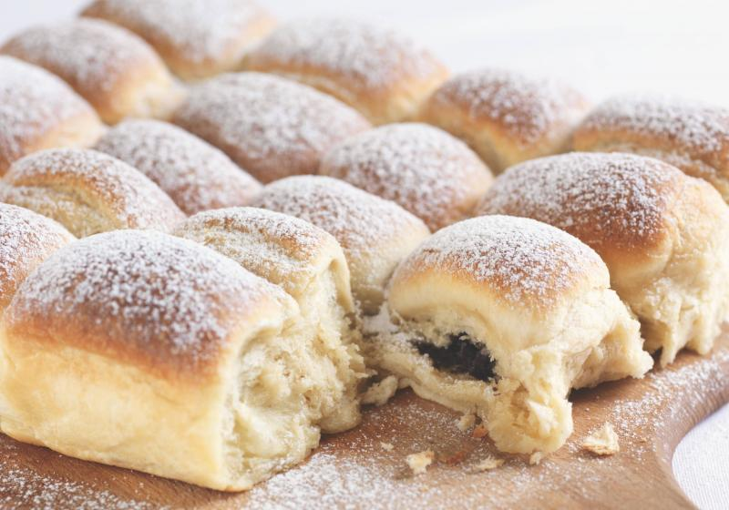
CZECH TRADITIONAL CUISINE
BUCHTY (CZECH SWEET FILLED BUNS)
INGREDIENTS:
-100 g margarine
-100 g icing sugar
-2 yolks
-500 g flour
-1/2 l milk
-30 g fresh yeast
-2 teaspoons of rum
-Lemon zest
HOW TO DO IT:
Make a dough, let the dough rise in a warm place for 1 hour..
Using a knife, divide the rolled-out dough into squares. Fold the edges of the dough over the filling and seal well.Place the prepared buns in the baking dish. Bake in a preheated oven at 320°F (160°C) for about 40-50 minutes, until golden brown.Let the buns cool, dust with icing sugar, and serve

Slide 6
THANKS FOR LISTENING!!!
By Michala Kopecká and Celia Ordeig

