Slide 2
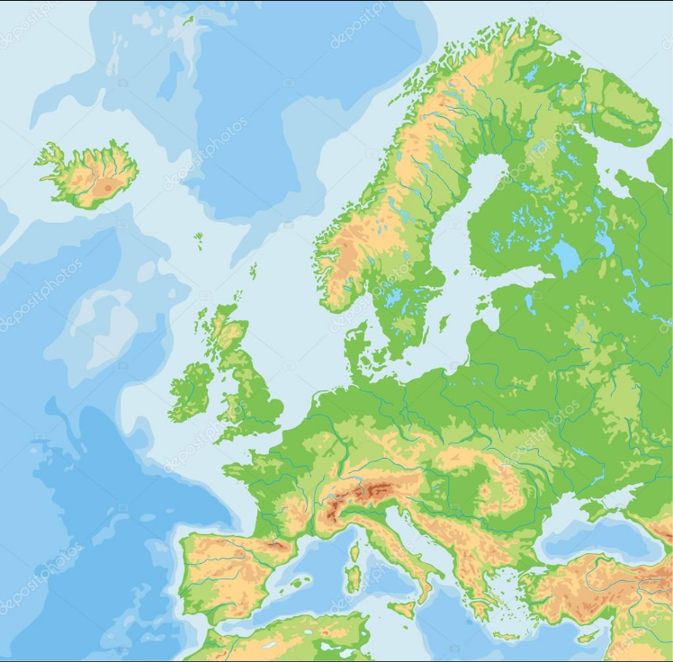

Slide 3
IES Joaquín Turina
SCHOOL DROP-OUT PREVENTION PROGRAMMES

Slide 4
SCHOOL LEVEL :
SPLIT CLASSES
CURRICULAR BACK-UP (Refuerza programme)
SCHOOL ABSENTEEISM PROTOCOL

Slide 5
SPLIT CLASSES
A class is broken down into small-ratio groups
Students with lower levels or insufficient performance are closely focused on
Boards of principals plan strategies

Slide 6
CURRICULAR BACK-UP (REFUERZA PROGRAMME)
On students’ and parental request
Students needing special reinforcement attend evening lessons on the school premises

Slide 7
SCHOOL ABSENTEEISM PROTOCOL
Teachers’ daily roll call detects absentees -- proof is required
Repeated unjustified absence is considered truancy
A file is opened on truancy records and sent up to the local authority

Slide 8
LOCAL-EDUCATIONAL- AUTHORITY LEVEL:
COVID-19 TUITION SUPPORT PERSONNEL
THERAPEUTIC PEDAGOGY PROGRAMME
S.A.E.D. (TUITION SUPPORT SERVICE)
ARRMI (Underage Offenders’ Rehabilitation and Reinsertion Agency)

Slide 9
COVID-19 TUITION SUPPORT PERSONNEL
A team of subject- specialized teachers is hired temporarily by the local authority
Reduced (bubble) groups are taken over and taught in different subjects
Secondary school classes sharing shifts are broken into smaller groups
Secondary education classes are split into shifts and require no temporary specialized teachers.

Slide 10
S.A.E.D (TUITION SUPPORT SERVICE)
Students taken sick and undergoing medical treatment at home are eligible for this programme
Sick students are taught at home by specialized educational personnel
S.A.E.D teachers work in full coordination with the schools regularly attended by sick students
Subject syllabuses are complied with and school assessment carried out

Slide 11
THERAPEUTIC PEDAGOGY PROGRAMME
Students under long-term medical surveillance at hospitals are eligible for the programme
A specialized educational team is sent to hospitals to teach young patients
Regular attendance and assessment is guaranteed through the convalescence spell
A smooth reinstatement into regular tuition is aimed at

Slide 12
A.R.R.M.I. (TUITION FOR UNDER 18-YEAR-OLD OFFENDERS)
A specialized educational team is sent to rehabilitation institutions for young offenders
Regular attendance and assessment is guaranteed through the rehabilitation period
Young offenders undergoing rehabilitation are expected to be open to new educational prospects when ripe for a socially acceptable comeback

Slide 13
NATIONWIDE LEVEL:
BASIC VOCATIONAL TRAINING PROGRAMME (F.P.B)
COMPENSATORY EDUCATION PROGRAMME
TRAINING AND LABOUR INSERTION (UFILs)
PMAR (LEARNING IMPROVEMENT PROGRAMMES)

Slide 14
BASIC VOCATIONAL TRAINING PROGRAMME
Abandonment and truancy are prevented by means of a professional basic training programme
Secondary school or junior secondary education students with low assessment grades and likely to repeat years are elligible for this programme
Remotivation and new educational prospects are established through educational strategies
Procedures are set up and assessed by school counselling teams

Slide 15
COMPENSATORY EDUCATION PROGRAMME
With similar objectives to the previous programme
Aimed at students with poor academic prospects but reluctant to basic vocational training
Procedures are set up and assessed by school counselling teams

Slide 16
TRAINING AND LABOUR INSERTION UNITS (UFILs)
With similar goals to the previous programmes
Conflictive or misbehaving students with poor academic performance and in risk of social exclusion are targeted
Unlike other special programmes’ approach, the low number of students involved in each UFIL makes the whole difference
Procedures are set up and assessed by school counselling teams in agreement with social assistants

Slide 17
PMAR (LEARNING IMPROVEMENT PROGRAMMES)
PMAR eligible students are free from any misconduct or discipline problems
Foreseeable absenteeism and low assessment levels due to a lack of motivation are frequently observed
A new adapted curriculum is programmed between years 2 and 3 (secondary school to secondary education)
Subjects are grouped together in realms (science and humanities) taught by specialized teachers
The educational goal is to come back to a regular syllabus in year 4 (15 and 16 years old).

