Slide 1
The Czech language
By tom Nývlt, Maxim mIZZI and Nathan pACE

Slide 2
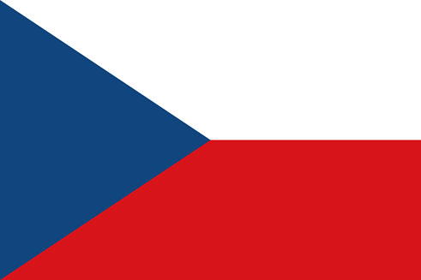
Origin of the language
The Czech language developed at the close of the 1st millennium from common West Slavic. Until the early 20th century, it was known as Bohemian.

Slide 3
Where it is spoken?
It is spoken in the historical regions of Bohemia, Moravia, and southwestern Silesia in the Czech Republic, where it is the official language.
Slovakian language is very similar to Czech language

Slide 4
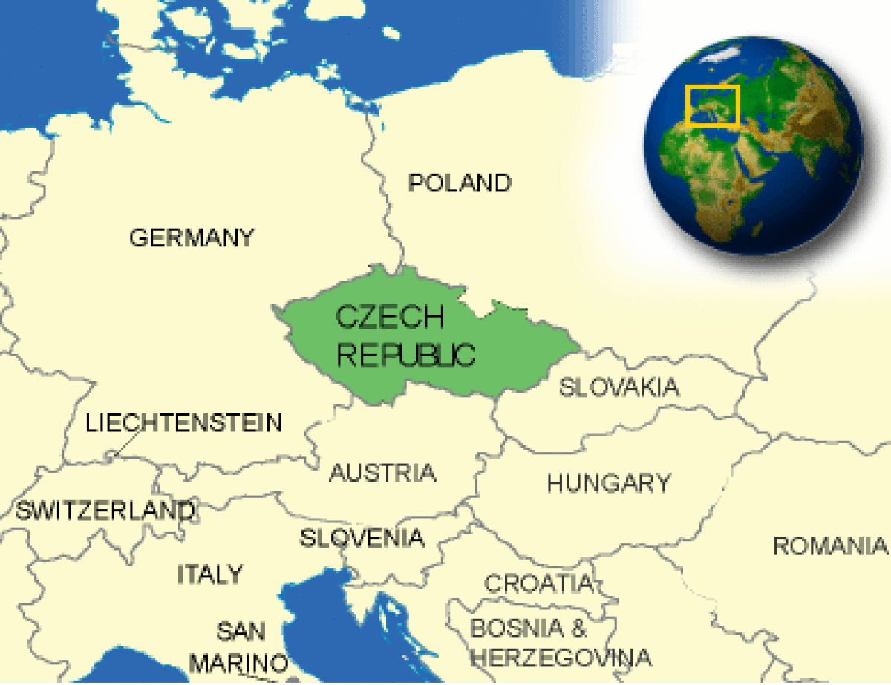
The map of CZECH

Slide 5
How many people SPEAK THE LANGUAGE
the czech language has over 10 million native speakers around the world.

Slide 6
Some examples
Hello: Ahoj
Good bye: Nashledanou
Thank you: Děkuji
Please:prosím
What’s your name?: Jak se jmenuješ?
Czech republic: česko
Spain: Španělsko
Malta: Malta

Slide 7
Thankyou for your attention
The end

