Slide 1
Composers of Classical music from Spain, Malta and Czech Republic

Slide 2
Czech classical music

Slide 3
Bedřich Smetana

Slide 4
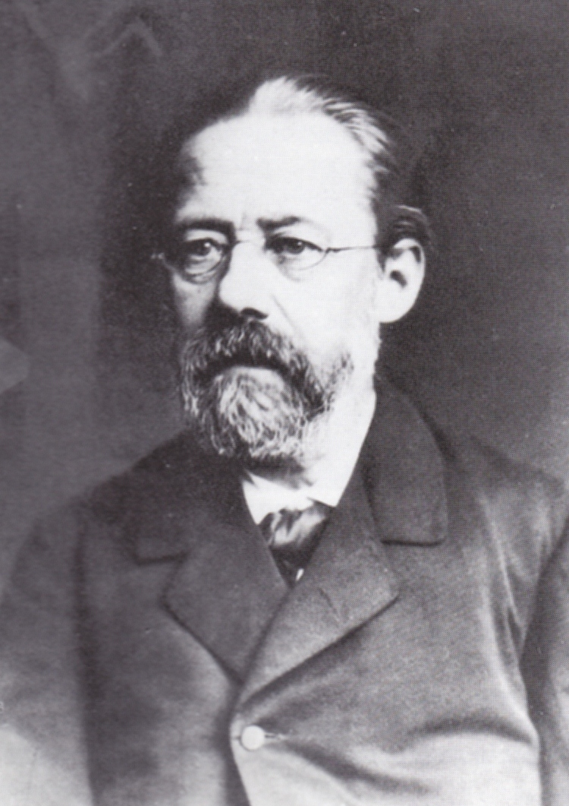
Basic information
Born – 2.3.1824 (Litomyšl)
Died – 12.5. 1884 (Prague)
He has been regarded in his homeland as the father of Czech music

Slide 5
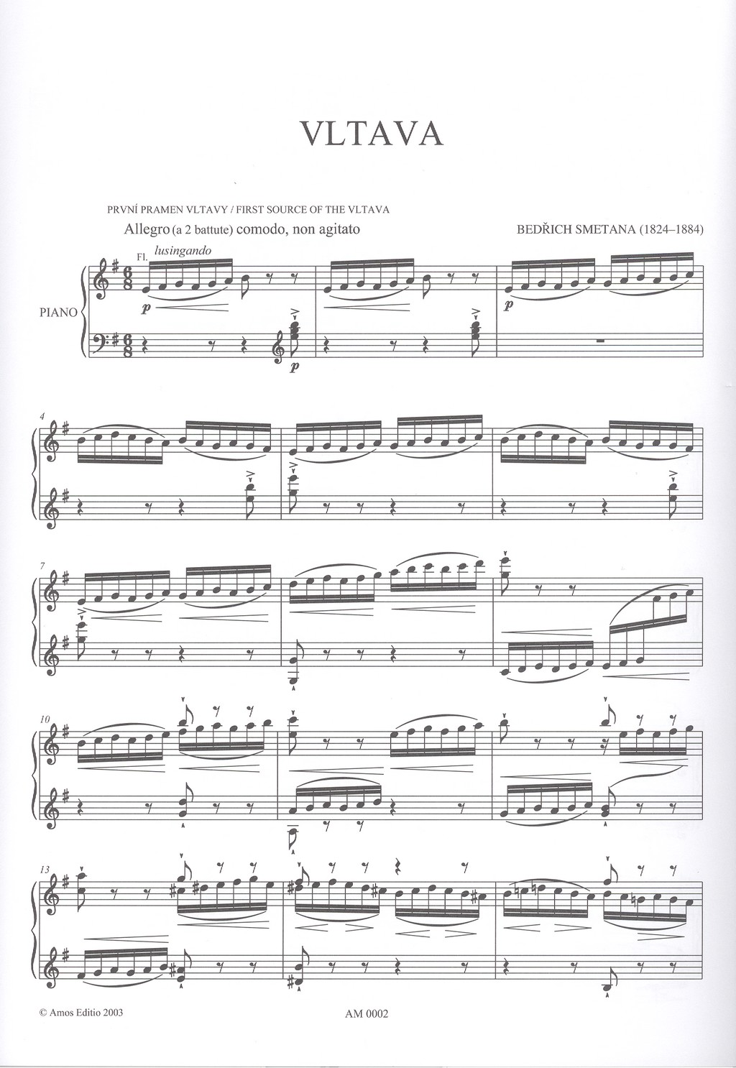
Works
Braniboři v Čechách (1862)
Prodaná nevěsta (1864)
Dalibor (1866)
Libuše (1869)
Dvě vdovy (1873)
Hubička (1875)
Tajemství (1877)
Čertova stěna (1880)
Viola (1872)

Slide 6
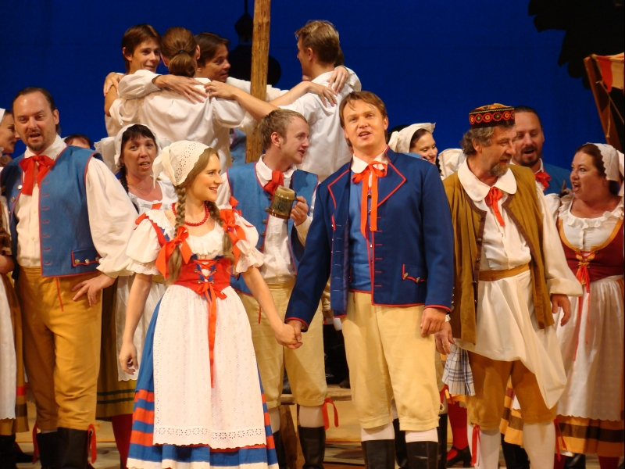
Sample
Prodaná nevěsta/ Bartered Bride - Duett "Znám jednu dívku, ta má dukáty" Dvorský & Novák - YouTube

Slide 7
Antonín Dvořák

Slide 8
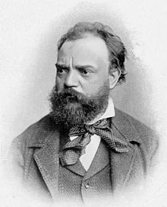
Basic information
Born - 8.8. 1841 (Nelahozeves)
Died - 1.5. 1904 (Prague)
Along with Smetana and Janáček, Dvořák is one of three most famous composers who wrote nationalist Czech music
He wrote chamber music including several string quartets, piano music, songs, operas, oratorios and nine symphonies.
The last of his symphonies is known as the New World Symphony because he wrote it in the United States.

Slide 9
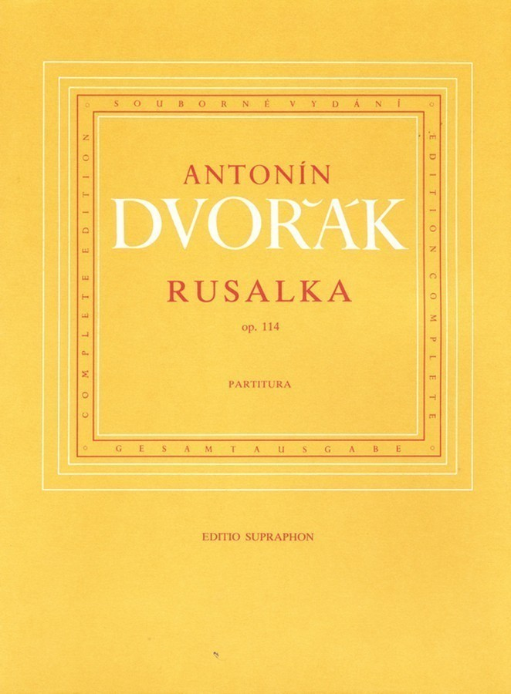
Works
Symphony no. 1 Zvonické zvony (Zvonické bells) (1865)
Symphony no. 9 Novosvětská (New world) (1893)
Čert a Káča (The Devil and Kate) (1899)
Rusalka (1900)
Slovanské tance (Slavic dances) (1878)

Slide 10
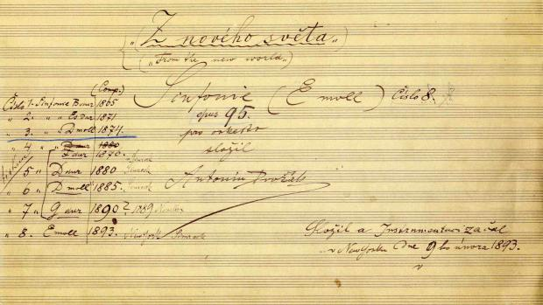
Sample
Antonín Dvořák - Z Nového světa (From the New World) Largo - YouTube

Slide 11
Spanish classical music

Slide 12
Tomás Luis De Victoria

Slide 13
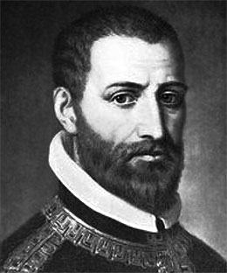
Basic information
Born - 1548 (Sanchidrián)
Died - 20.8. 1611 (Madrid)
He played two main instruments: organ and voice.
Victoria is the most significant composer of the Counter-Reformation in Spain, and one of the best-regarded composers of sacred music in the late Renaissance.

Slide 14
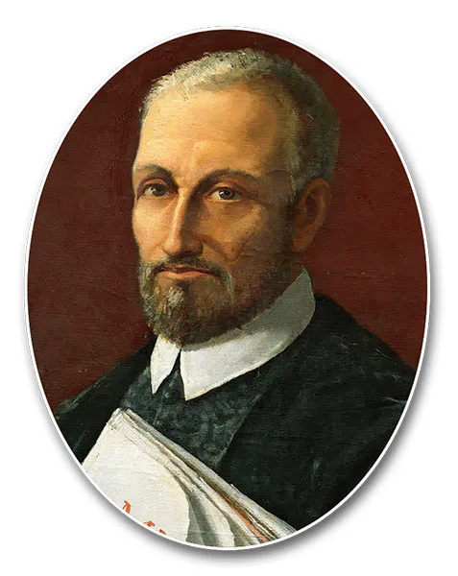
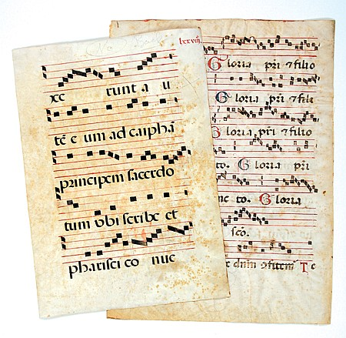
Works
Ave Maris Stella (1576)
O Magnum mysterium (1592)
Laetatus sum (1600)
Los motetes: O vos omnes (1572)
Vidi speciosam (1572)
Officium hebdomadae (1585)

Slide 15
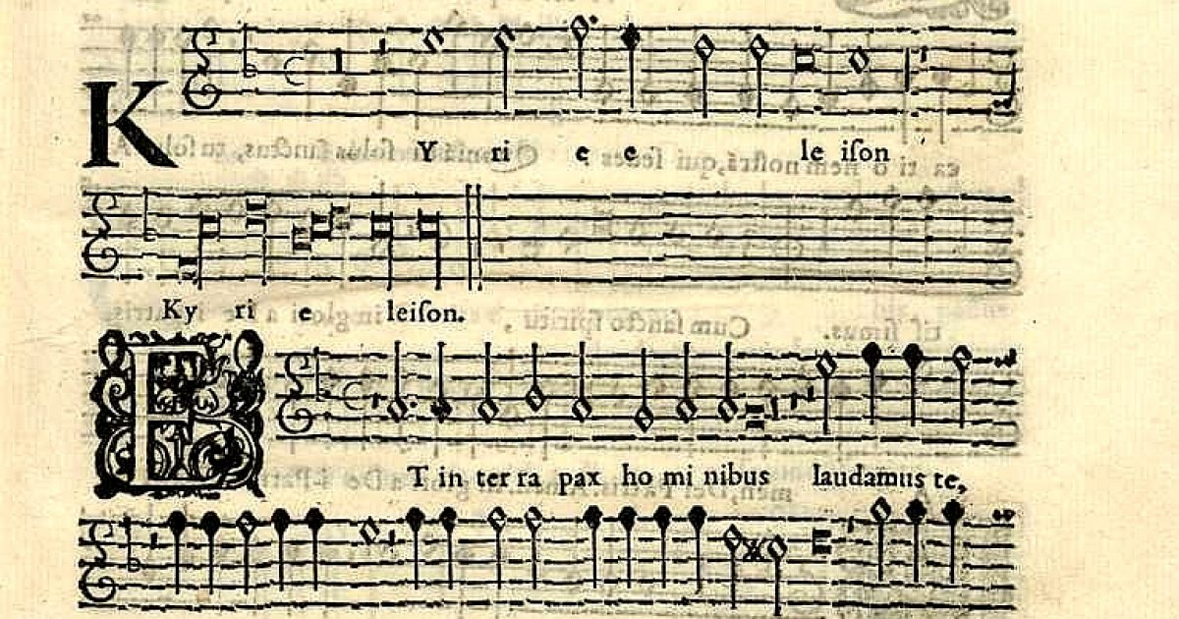
Sample
https://youtu.be/ahgfA1CKWR4

Slide 16
Manuel de Falla

Slide 17
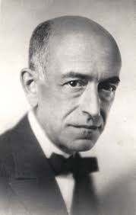
Basic information
Born- 23 November 1876
Died- 14 November 1946)
He was one of Spain's most important musicians of the first half of the 20th century.
Manuel de Falla y Matheu was a Spanish composer and pianist.

Slide 18
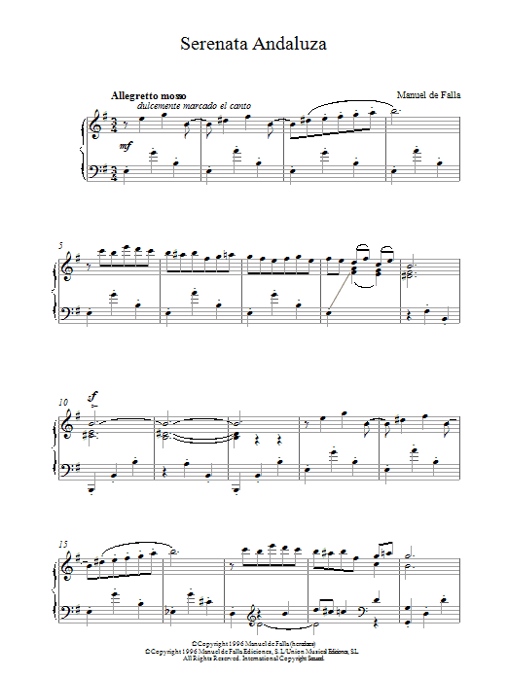
Works
Noche en los jardines de España (1916)
El amor brujo (1915)
El Sombrero de tres Picos (1919)

Slide 19
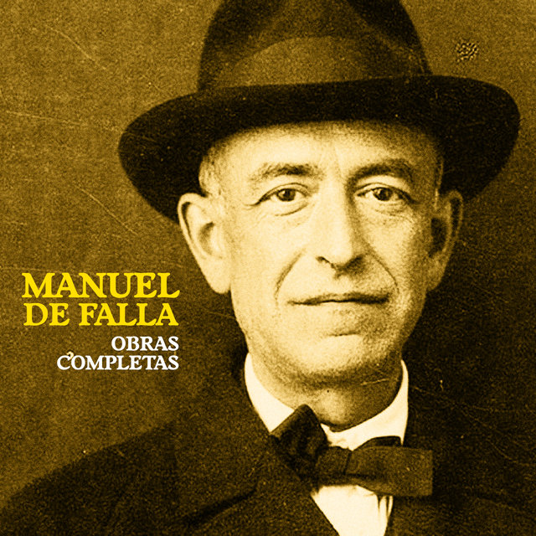
Sample
Manuel de Falla ‒ Noches en los jardines de España - YouTube

Slide 20
Joaquín Turina

Slide 21
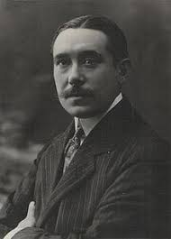
Basic information
Born - 9.12.1882 (Sevilla)
Died - 14.1.1949 (Madrid)
He played the piano
Since childhood he was known as a child prodigy
When he was only four years old, he improvised virtuously on the accordion that one of his maids had given him
He had the opportunity to receive his first music lessons at the Colegio del Santo Ángel and was in charge of accompanying the girls' choir.

Slide 22
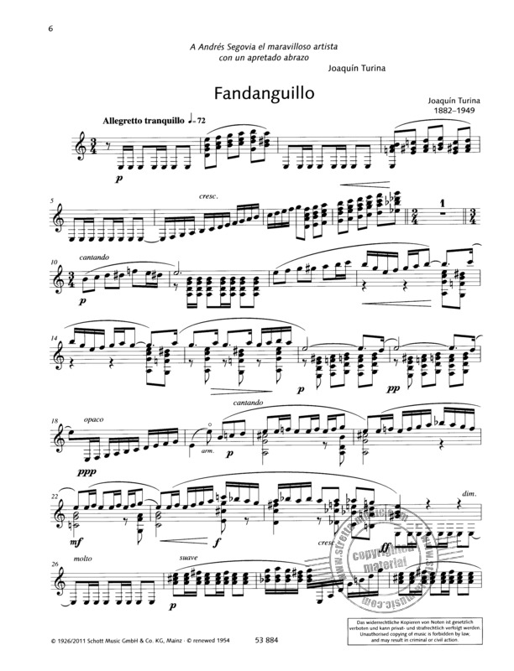
Works
Danzas fantásticas (1919)
Sinfonía sevillana (1920)
La procesión del Rocío(1913)

Slide 23
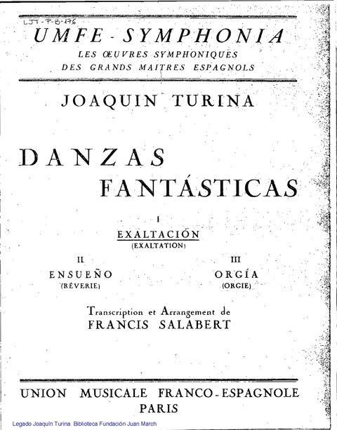
Sample
Joaquín Turina: Danzas fantásticas Op. 22 (1919) - YouTube

Slide 24
Maltese classical music

Slide 25
Nicolas Isouard

Slide 26
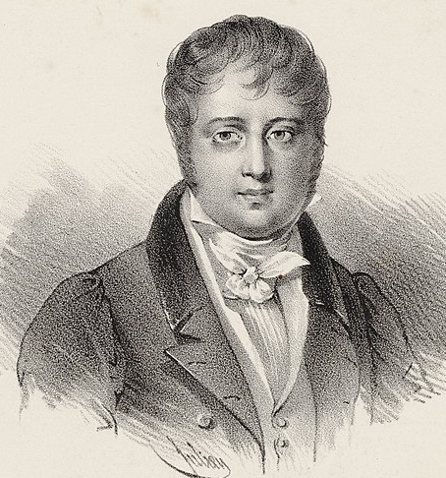
Basic information
Born- 18 May 1773 (Valletta)
Died- 23 March 1818 (Paris)
He composed for the Théâtre de l'Opéra-Comique, writing 30 works for it.
He composed masses, motets, cantatas, romances and duos, along with over 45 operas.

Slide 27
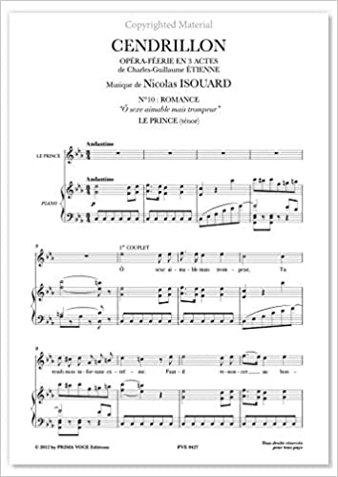
Works
Les confidences (1803)
Aladin, ou La Lampe merveilleuse (1822)
Un Jour à Paris, ou Leçon singulière (1808)
Le victime des arts, ou La Fête de famille (1811)
Le Billet de loterie (1811)
Le Prince de Catane (1813)
L'Une pour l'autre, ou L'Enlèvement (1816)

Slide 28
Sample
NICOLO ISOUARD: "Cendrillon" (1810)- Overture and Duet from Act II - YouTube

Slide 29
Antonio Nani

Slide 30
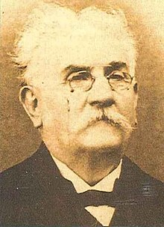
Basic information
Born - 6 October 1842 (Valletta)
Died - 25 February 1929 (Valletta)
Maltese composer and a member of a prominent family of Maltese musicians and composers
He composed both sacred music and operas

Slide 31
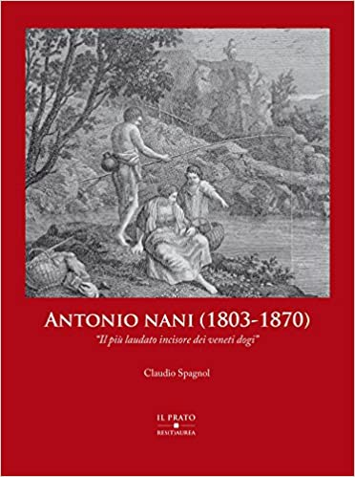
Works
Zorilla (1872)
I cavalieri di Malta (1880)
Agnese Visconti (1889)

Slide 32
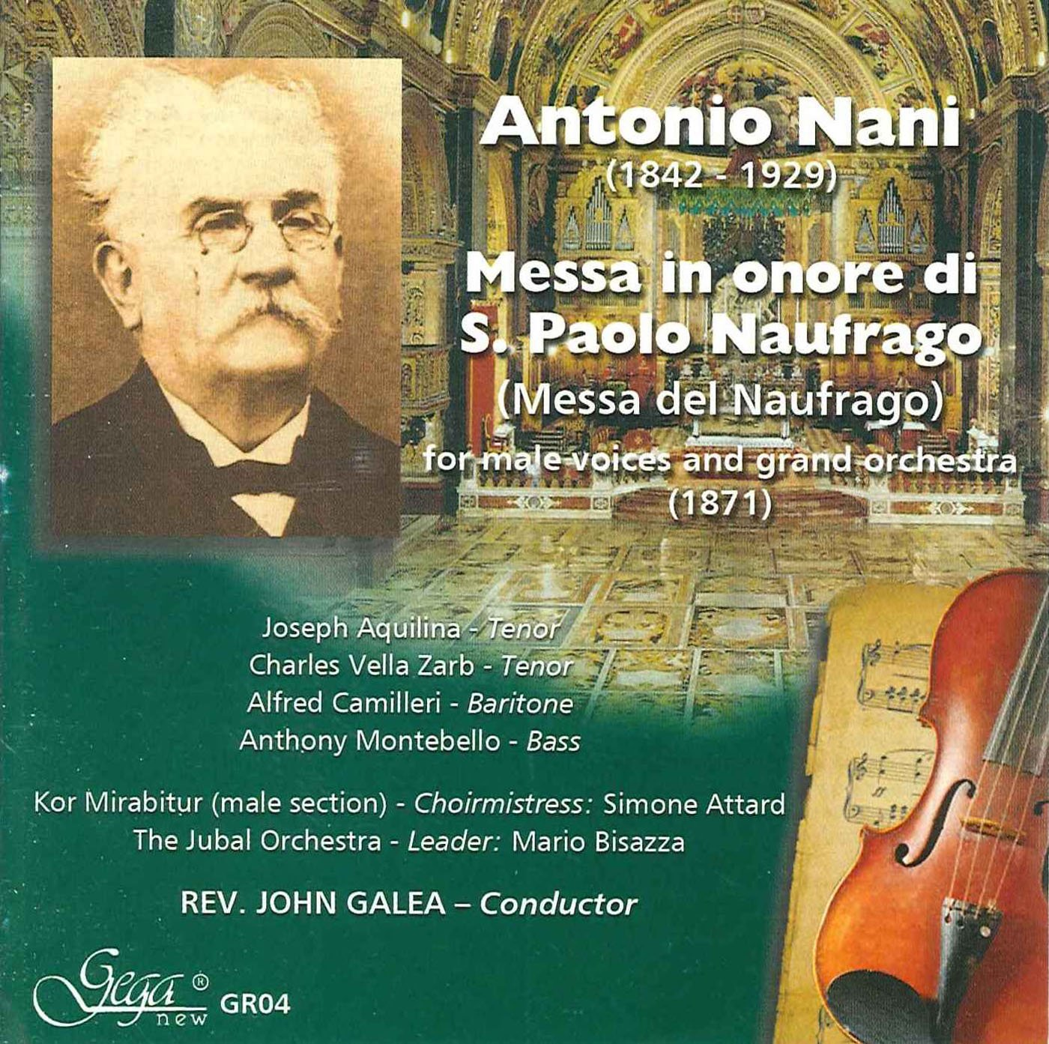
Sample
Antonio Nani - Messa in onore di S. Paolo Naufrago (1871) - YouTube

Slide 33
Thank you for your attention ♥

