Slide 1
Classical music
Of czech republic, spain and malta

Slide 2
Classical music
Classical music generally refers to the formal musical tradition of the Western world, considered to be distinct from Western folk music or popular music traditions
In addition to formality, classical music is often characterized by complexity in its musical form and harmonic organization
The earliest extant music manuscripts date from the Carolingian Empire (800–888)
By the mid-12th century France became the major European musical center: the religious Notre-Dame school first fully explored organized rhythms
The Baroque period (1580–1750) increased importance of musical instruments – most famous composer of this period - Johann Sebastian Bach
Italy remained dominant, being the birthplace of opera, the soloist centered concerto genre, the organized sonata form
Classical period (1730–1820) composers such as Wolfgang Amadeus Mozart, Joseph Haydn, and Ludwig van Beethoven created widely admired representatives of absolute music, including symphonies, string quartets and concertos
Romantic music (1800–1910) focused instead on programmatic music, for which the art song, symphonic poem and various piano genres
By the 20th-century many composers actively avoided past techniques and genres in the lens of modernism

Slide 3
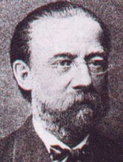
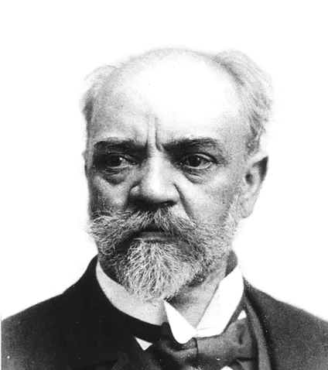
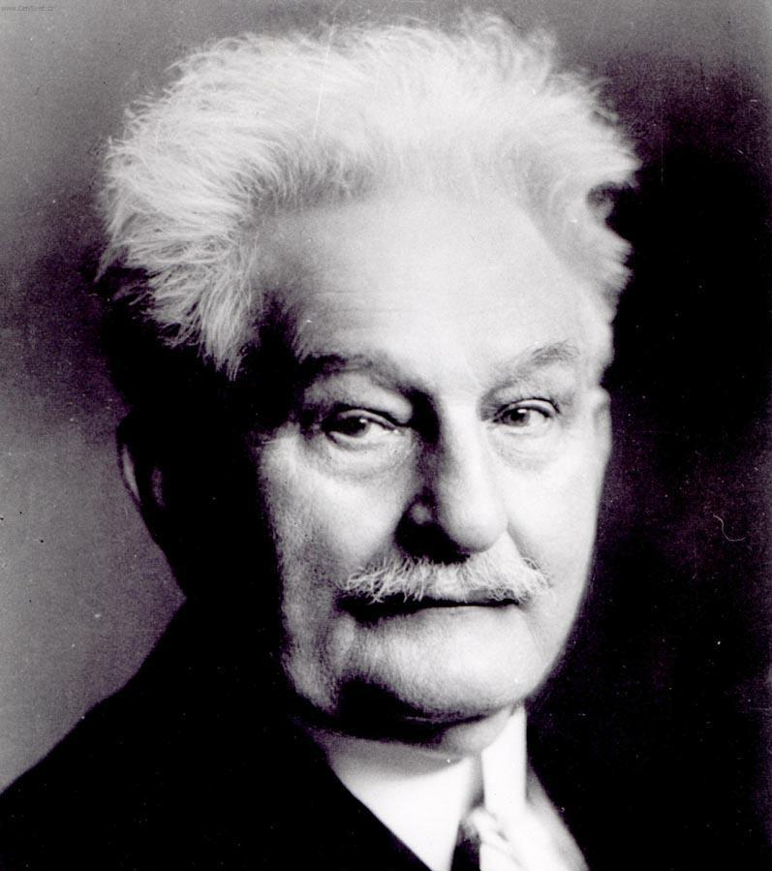
Classical music of czech republic
Early evidence of music in Czech Republic is documented in manuscripts from the library of the Cistercian monastery in Vyšší Brod (founded in 1259)
One of the most important is manuscript No. 42, from 1410 - it contains a hymn called Jezu Kriste, ščedrý kněže ("Jesus Christ Bountiful Prince"), that people would sing during the preaching of John Huss
The Czech classicism period is exemplified by František Xaver Brixi, Johann Baptist Wanhal, and Augustin Šenkýř
The founder of Czech national music Bedřich Smetana was inspired by the Bohemian Forest while creating his symphonic poem Vltava
Bedřich Smetana (1824-1884) - Vltava
Antonín Dvořák (1841-1904) – Rusalka, Čert a Káča
Leoš Janáček (1854-1928) – Šárka, Osud

Slide 4
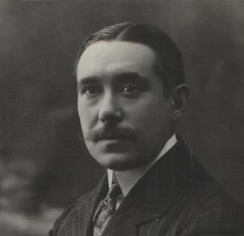
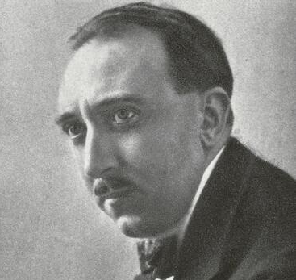
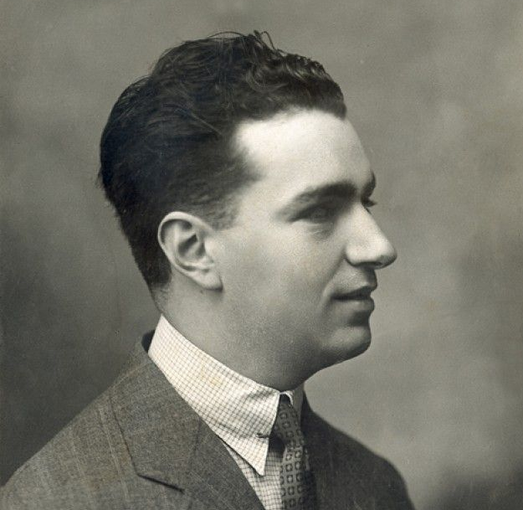
Classical music of spain
The Iberian peninsula has had a history of receiving different musical influences from around the Mediterranean Sea and across Europe
By the end of the 17th century the "classical" musical culture of Spain was in decline, and was to remain that way until the 19th century
Classicism in Spain, when it arrived, was inspired by Italian models
Joaquin Turina (+1882-1949) – Danzas Fantasticas , Sinfonia sevillana, La procesion del Rocio
Jesus Guridi (+1886-1961) – Diez melodias vascas, el caserio
Joaquin Rodrigo (+1901-1999) – Concierto de Aranjuez, Fantasia para un Gentilhombre

Slide 5
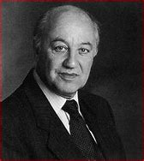
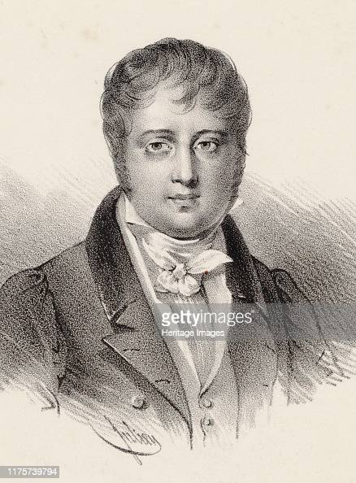
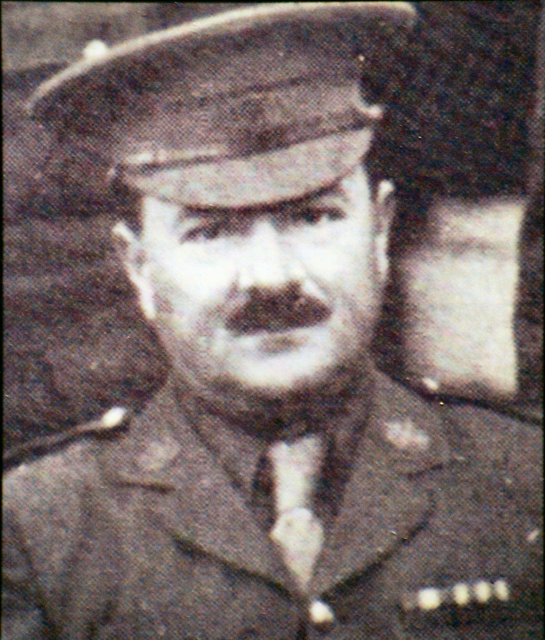
Classical music of malta
Charles Camilleri (1931 – 2009)
as a teenager, he composed many works based on folk music and legends of his native Malta
composed over 100 works for orchestra, chamber ensemble, voice and solo instruments
his most famous piece of music is the Maltese Suite, The Maltese Dances and the Mediterranean Dances
Nicolo Isouard (1775-1818)
he moved to Paris, where he worked as a free composer and became friends with Rodolphe Kreutzer
he composed masses, motets, cantatas, romances, and duos, along with over 45 operas
he was very famous in france and his operas were performed all over Europe with his most famous one being Cendrillon
Robert Sammut (1869-1934)
he studied medicine at the Royal University of Malta and the University of Edinburgh
While studying in Edinburgh he had once been asked to sing the Maltese Anthem - Malta did not have one, induced him to do something about it
he wrote some simple notes, however the pressure of his work made him forget about them
his most famous piece of music Innu Malti – the national anthem

Slide 6
Thank you for your attention!

