Slide 1
Maltese Language
Jan Cermak -Charlon Azzopardi
Leon Ruiz -Wayne Curmi

Slide 2
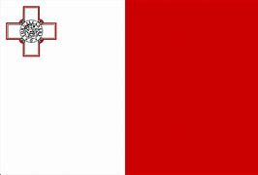
Origin of Maltese
-It’s a Semitic language as Arabic but it’s written in Latin alphabet.
-It’s influenced by the Italian and English language

Slide 3
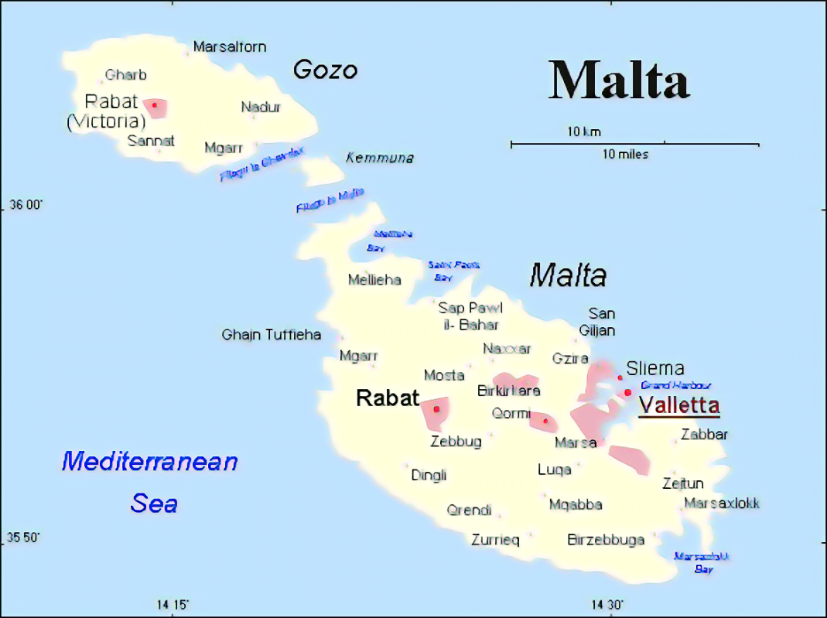
Spoken language
Native speakers 520 000
Spoken in three islands of Malta

Slide 4
Common words
Bongu = good morning
Bonswa = good night
Caw= bye
Wara l nofsinar it tajjeb = good evening
Kif int? = how are you?
Skola = school
Knisja = church
Kelb = dog
Qattusa = cat
Sugget = subject
Lesti = finished

