Slide 1
Æsthetic Essence’s final presentation

Slide 2
About us
Founded by students of Academia Mercurii from the 3rd grade
We produce natural, eco-friendly cosmetic products
Sortiment of products: soap, hand cream, bath bombs or lip balm

Slide 3
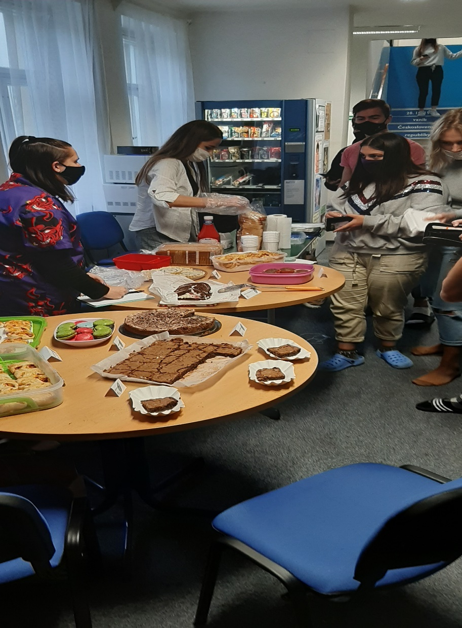
Start
We started in October 2020
Our team consists of 12 members
Each member had to give 150 Kč as share capital
Our share capital: 1 800 Kč
Snack day as another form of earnings
Snack day: 1 515 Kč
In total: 3 315 Kč

Slide 4
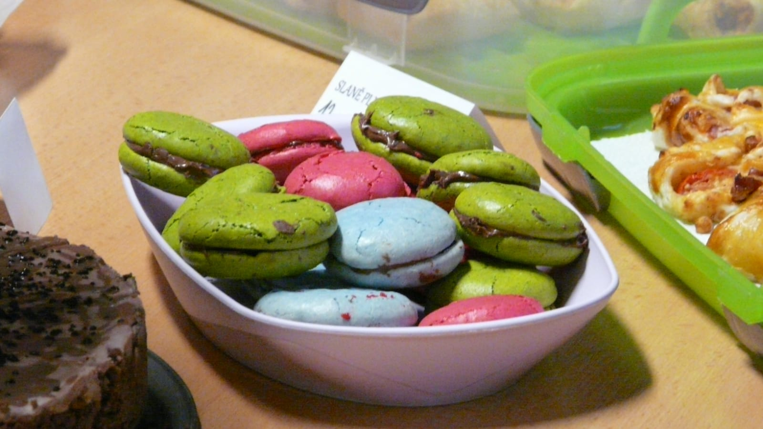
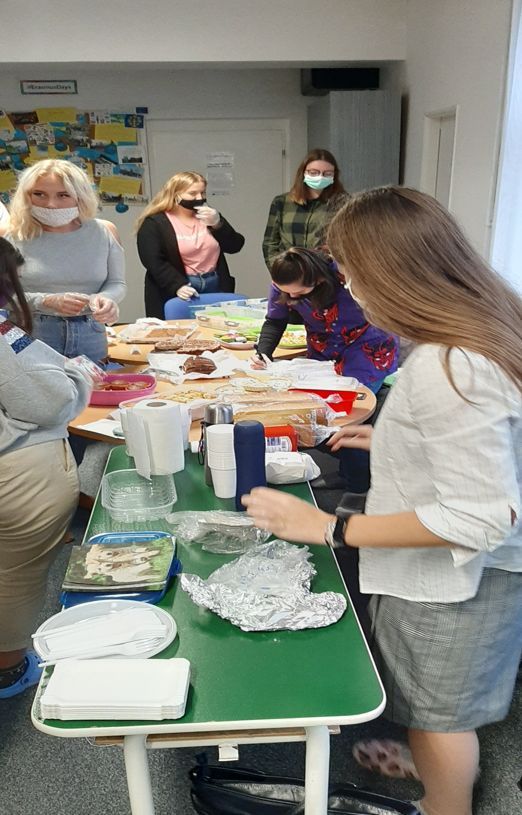
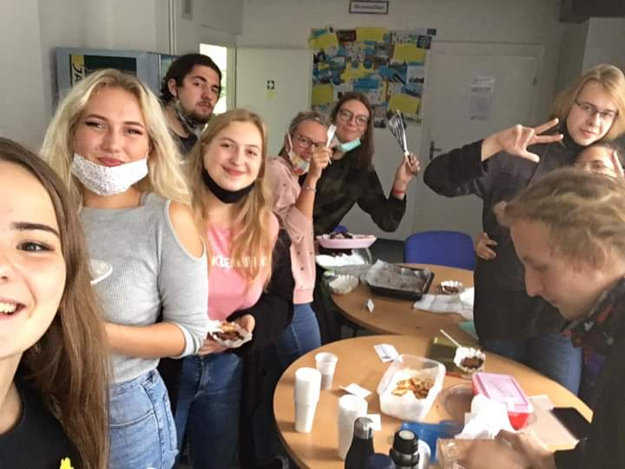
Snack Day

Slide 5
Infrastructure
Our personnel was sorted into 4 fields
Marketing, production, finances and human resources
Each field had it’s own function and manager

Slide 6
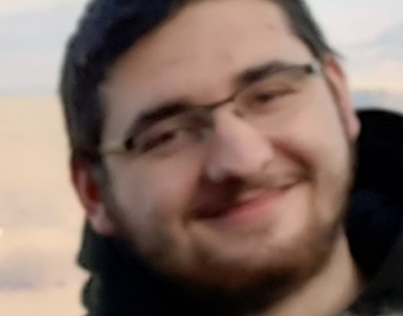
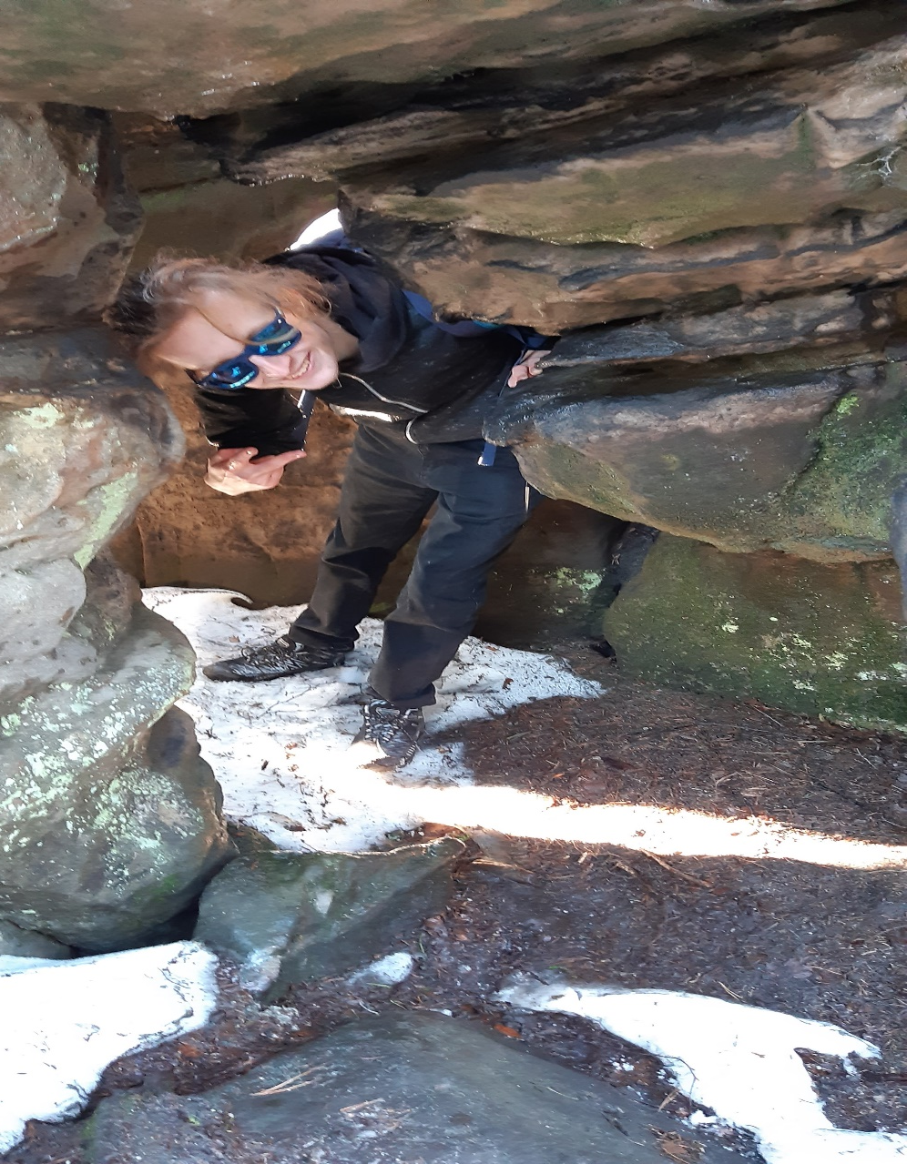
Marketing
Logo and motto
Social media
Communication with customers
Advertisement
Manager: Filip Ducháč
Employees: Filip Vaněk

Slide 7
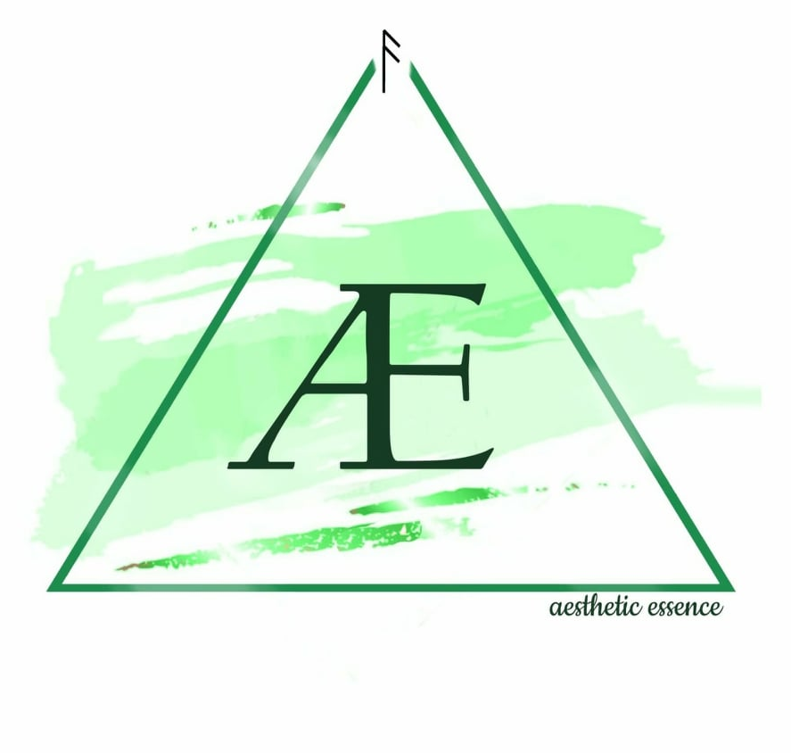
Company’s logo

Slide 8
Motto
Feel nature on your own skin

Slide 9
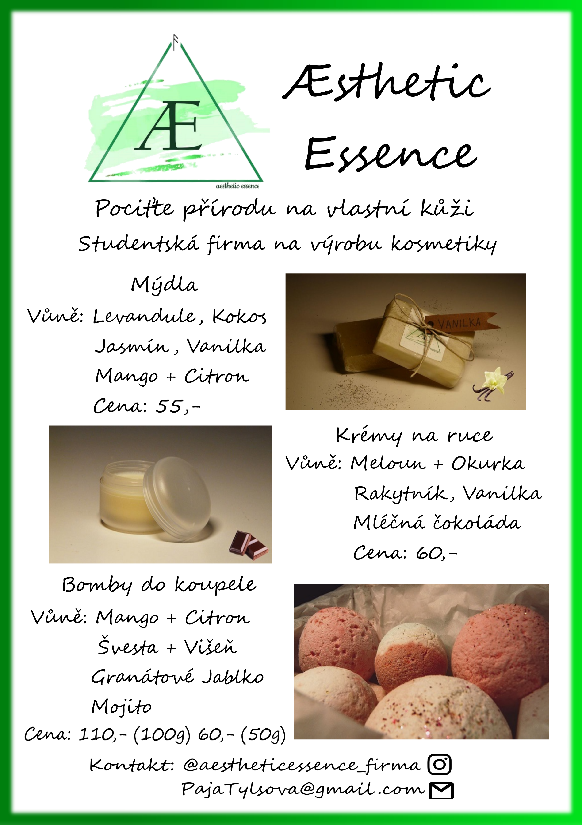
;
Showcase of advertising

Slide 10
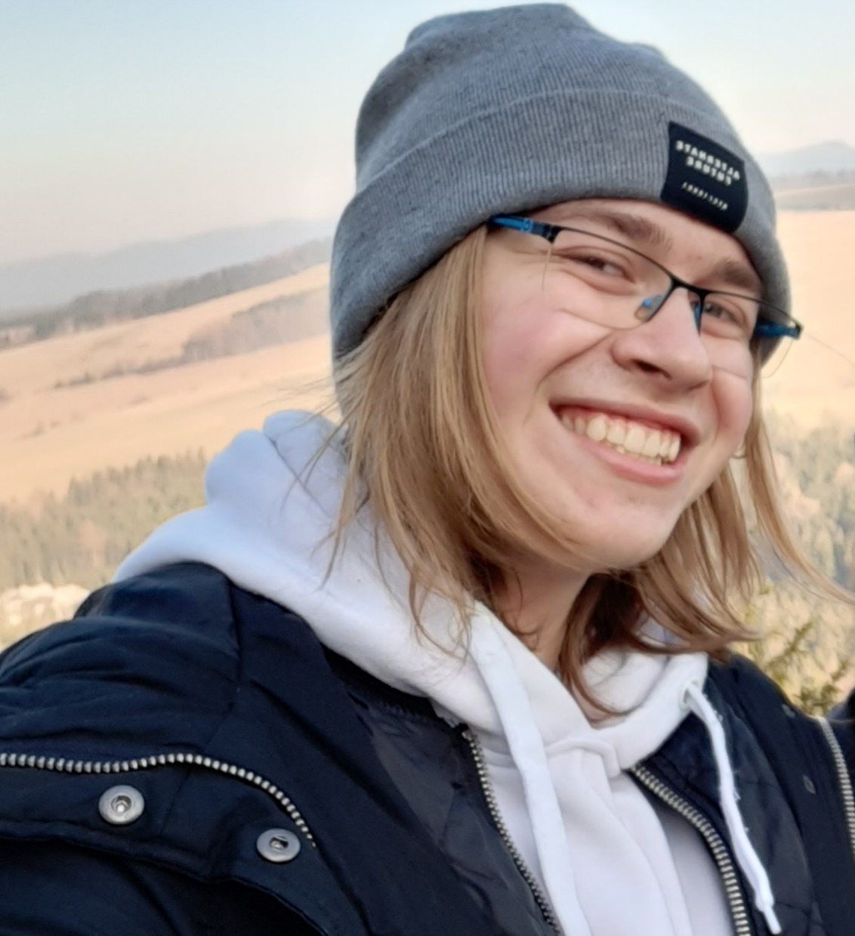
Human Resources
Keeping an eye on employees
Commucation
Manager: Filip Šindelář

Slide 11
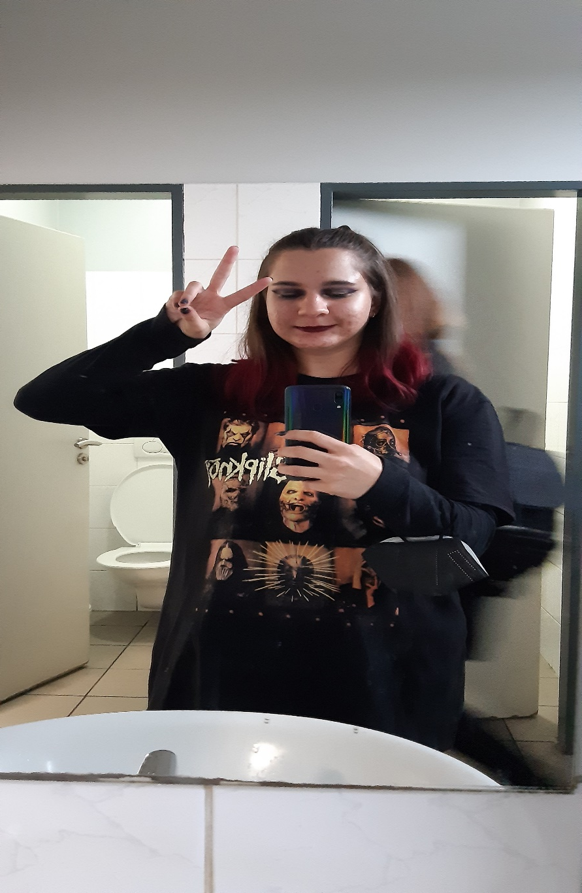
Finances
Finance control
Accounting
Base capital: 1800 Kč (after few kickstarter sales it grew to 3 315 Kč)
2020 gain: 3 890 Kč
2021 gain: 4 015 Kč
Final results: 4 248 Kč
Costs of running the company: 6 975 Kč
Manager: Adéla Síposová

Slide 12
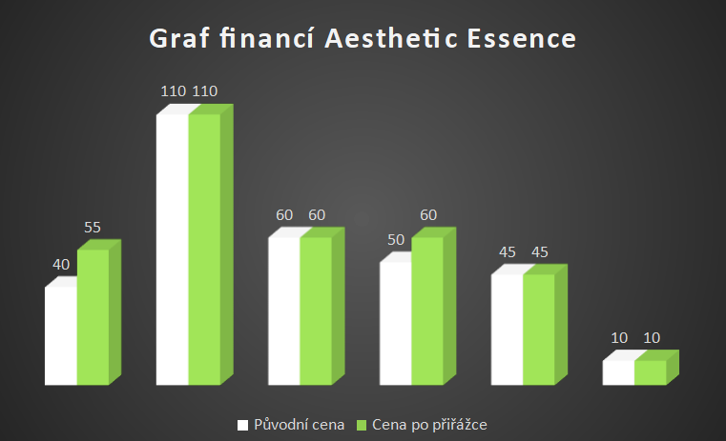
Graph of finances

Slide 13
Management
Keeping eye on the production
Pitching new ideas
Boss: Pavlína Tylšová
Assistant: Karolína Kaválková

Slide 14
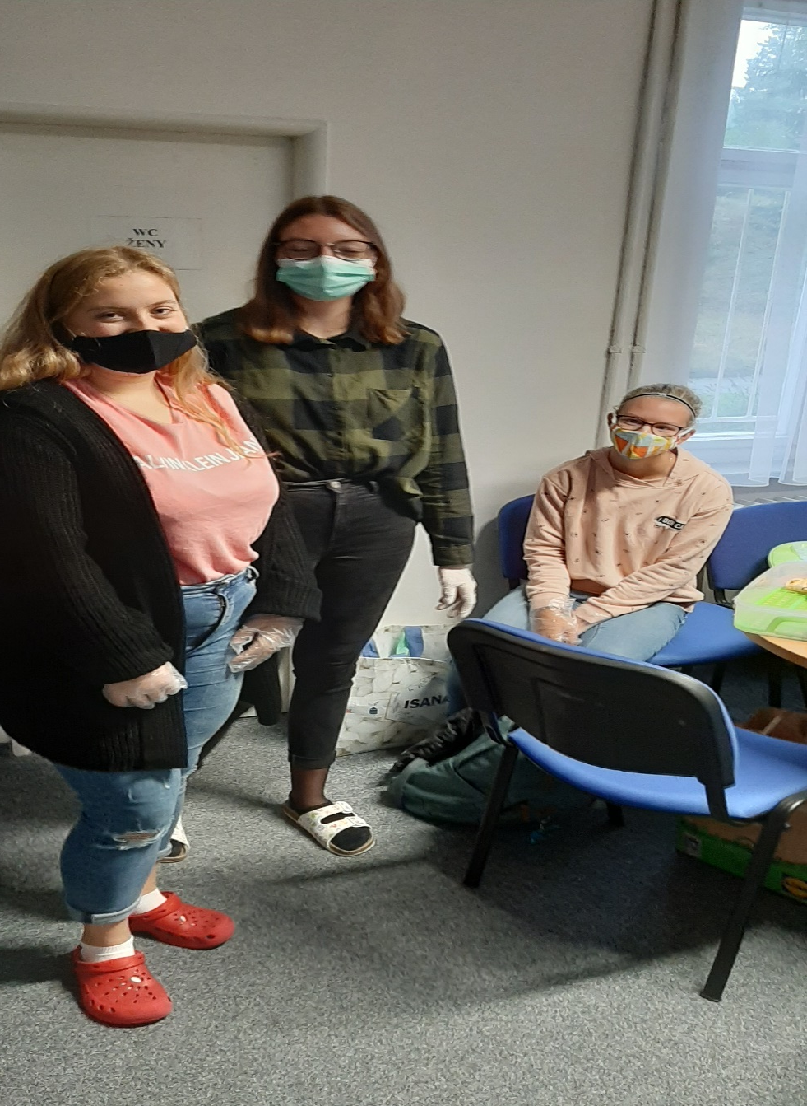
Production
Mainline production
The most important field in the company
Manager: Sabina Mrázková
Employees: Klára Kylarová, Eliška Nyklíčková, Matěj Sedláček, Darina Kratochvílová, Denisa Šolínová

Slide 15
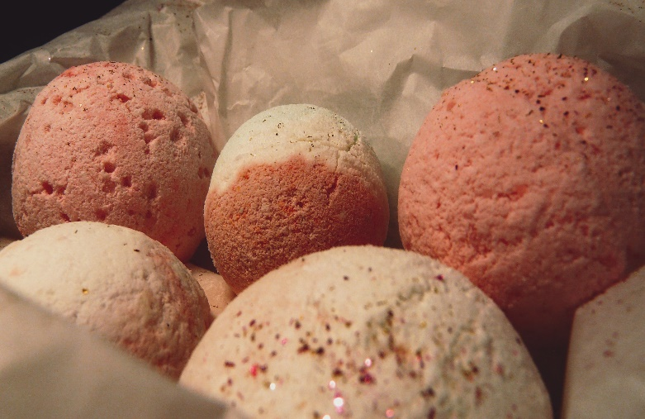
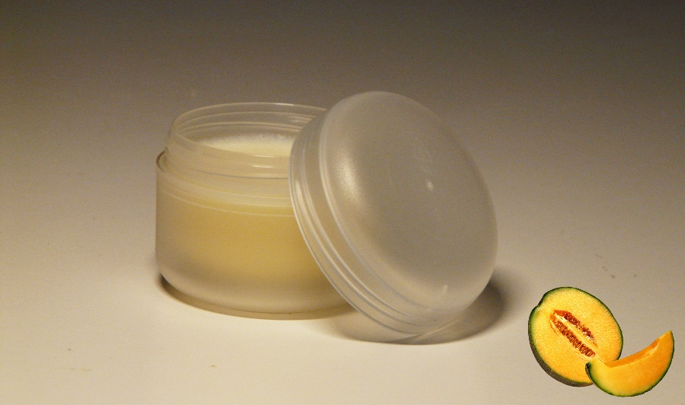
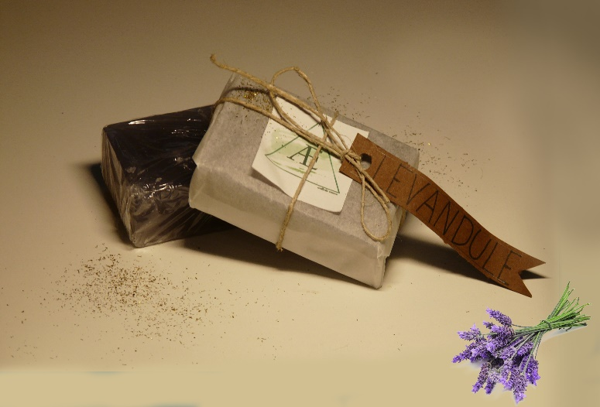
Showcase of products

Slide 16
product | scents | products sold
soap | vanilla | 15
 | jasmine | 15
 | levander | 22
 | coconut | 2
 | Mango and lemon | 12
Soap sold |  | 66
Skin cream | vanilla | 6
 | Milk chocolate | 6
 | Sea buckthorn | 8
 | Melon and cucumber | 8
Skin cream sold |  | 28
Bath bombs | Mango and lemon | 13
 | Pomegranate | 12
 | Bubble gum | 3
 | mojito | 0
 | Plums and cherries | 11
 | Blueberry and blackberry | 3
Bath bombs sold |  | 42
Lip balm | Blueberry and blackberry | 3
 | Milk chocolate | 3
Lip balm sold |  | 6
Graph of sold products

Slide 17
Products

Slide 18
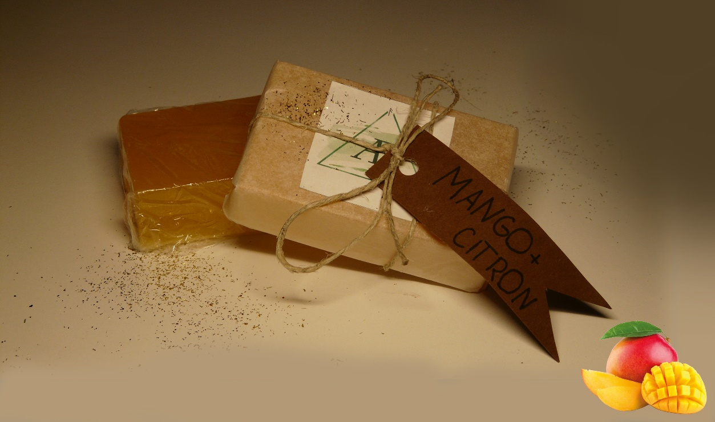
Soap
Vegan
Scents
vanilla, jasmine, levander, coconut, Mango and citrus

Slide 19
Bath Bomb
Vegan
Scents:
Pomegranate, Bubble gum, Mojito, Plums and cherries, Blueberry and blackberry

Slide 20
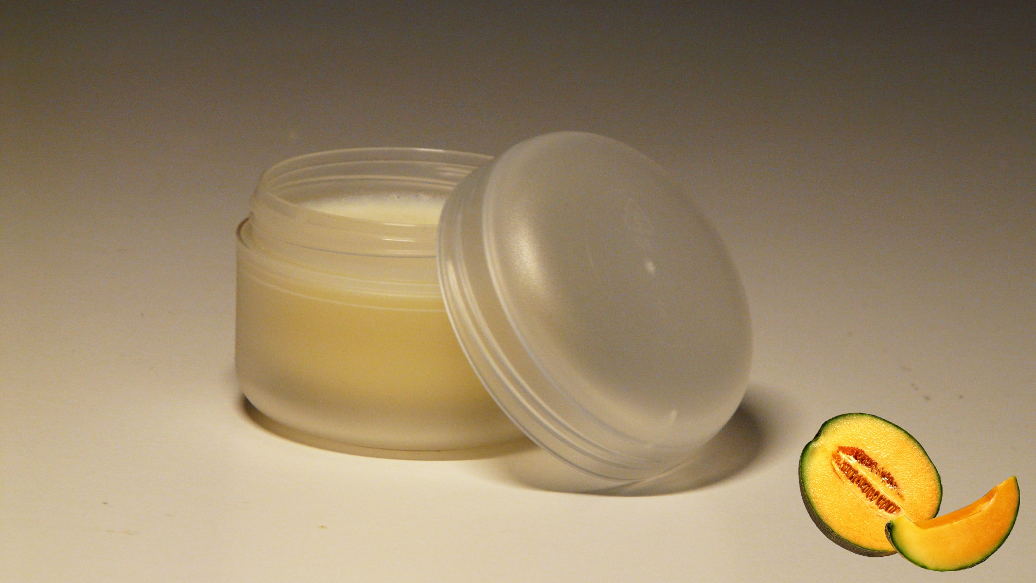
Hand cream
Vegan
Moisturizing
Scents:
Vanilla, Watermelon and cucumber, Milk chocolate, Sea buckthorn

Slide 21
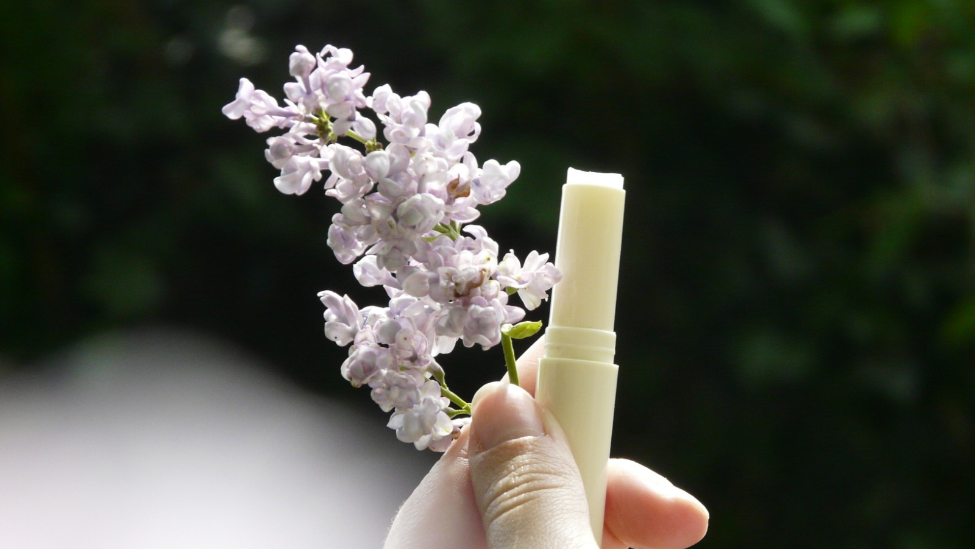
Lip balm
Moisturaizing
Scents:
Blueberry and blackberry, Milk chocolate

Slide 22
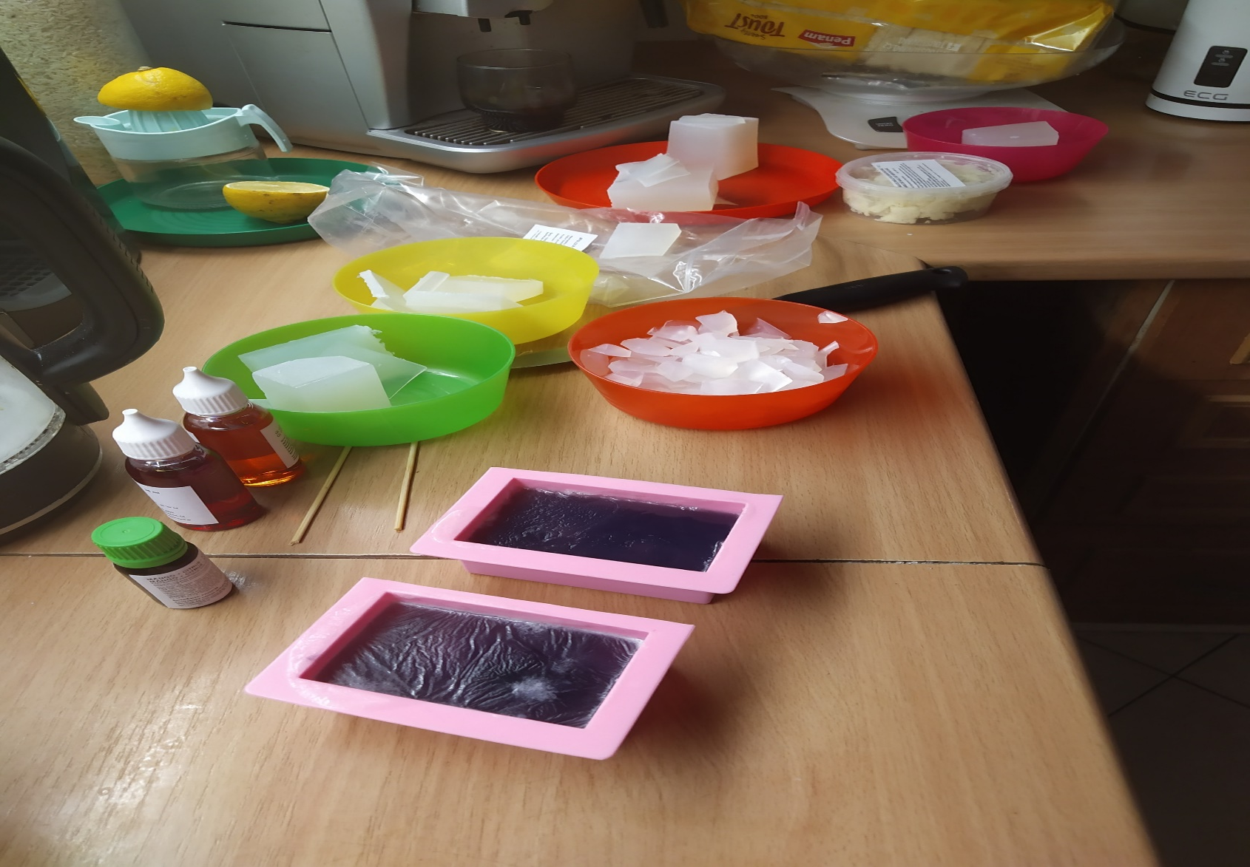
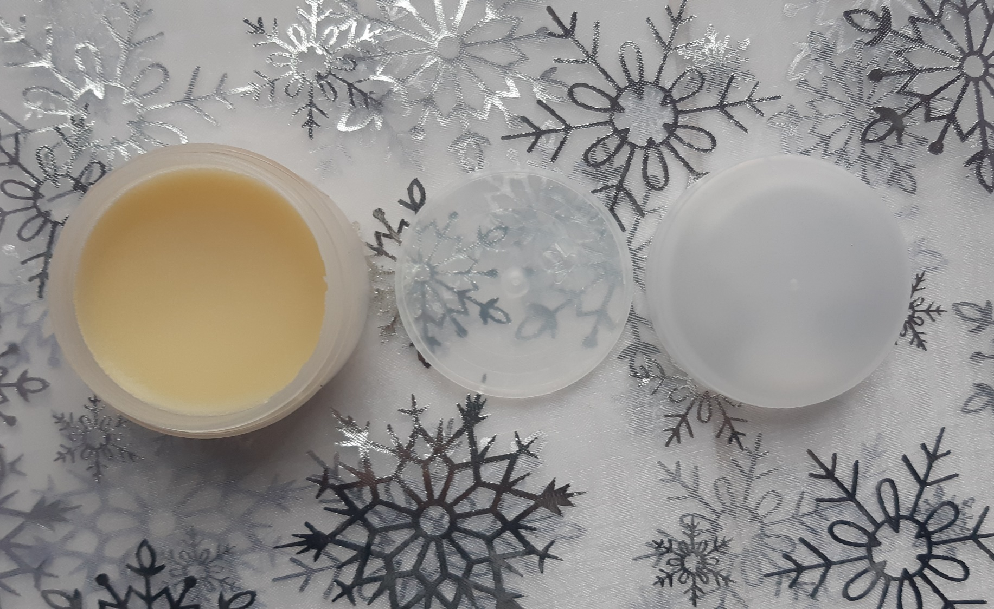
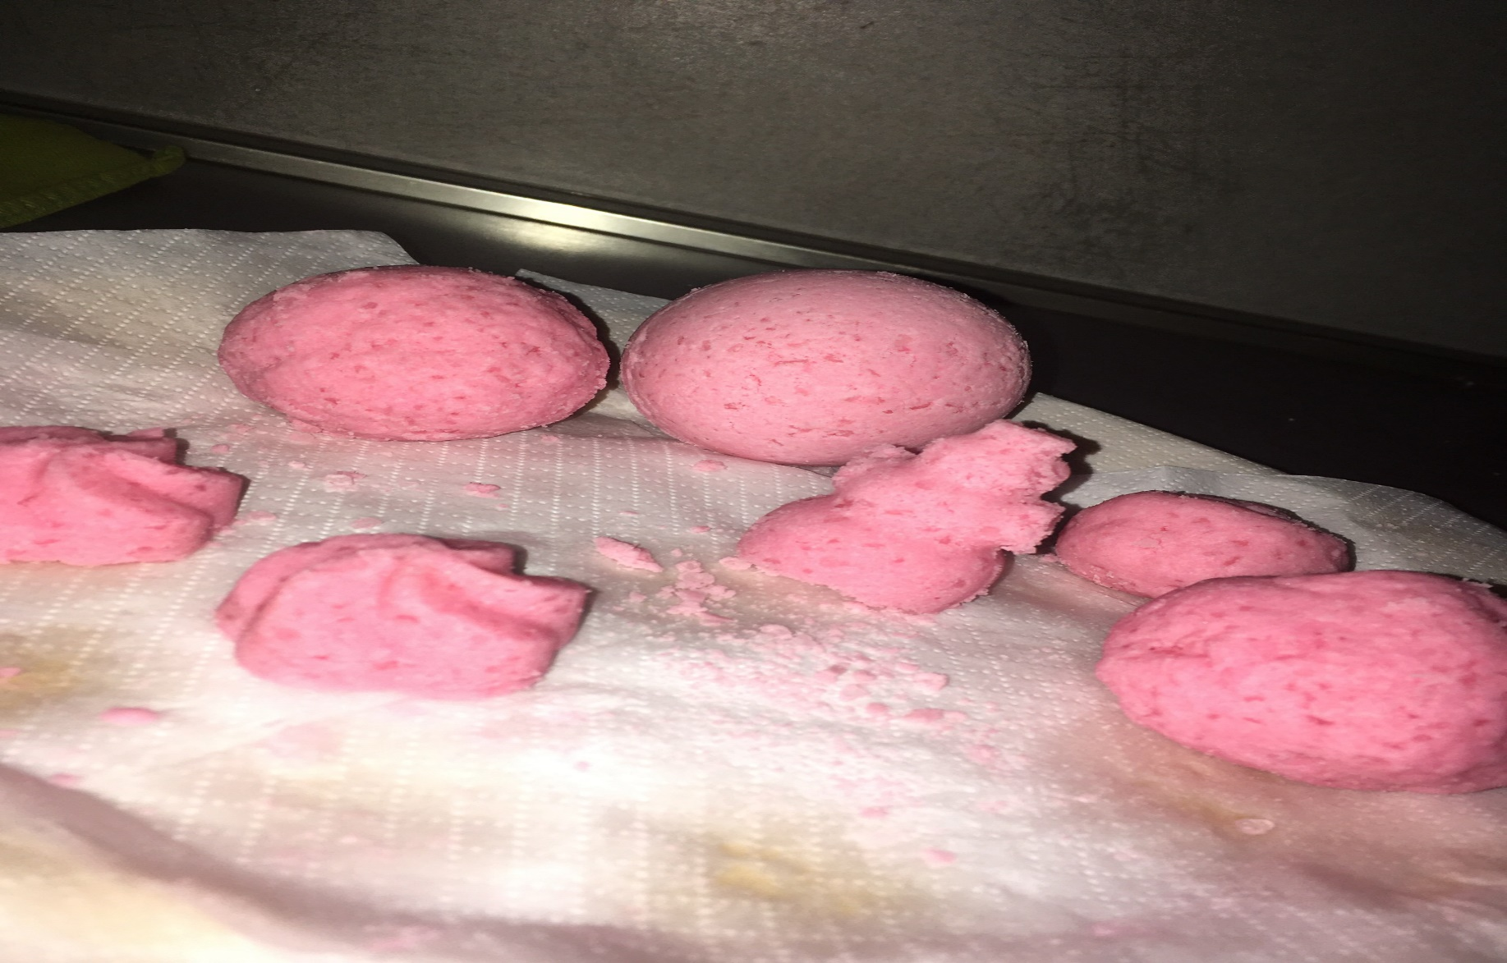
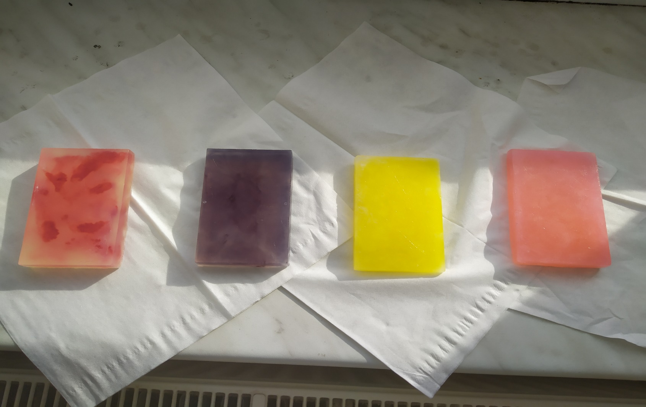

Slide 23
Closing
End: 25th of July 2021
Profit: 4 248 Kč
We really enjoyed our experience

Slide 24
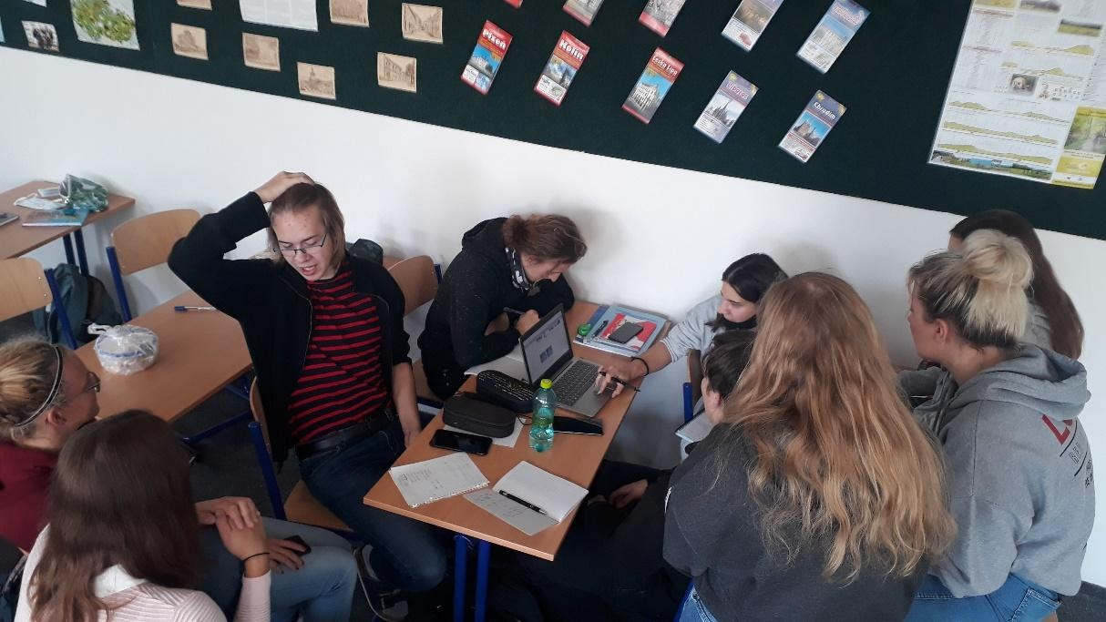
Our Team

Slide 25
Thank you for your attention

