Slide 1
TRADITIONAL MUSIC
Dominica Tomanova, Bruno Alonso Esteban and Salvio Galea

Slide 2
SPAIN

Slide 3
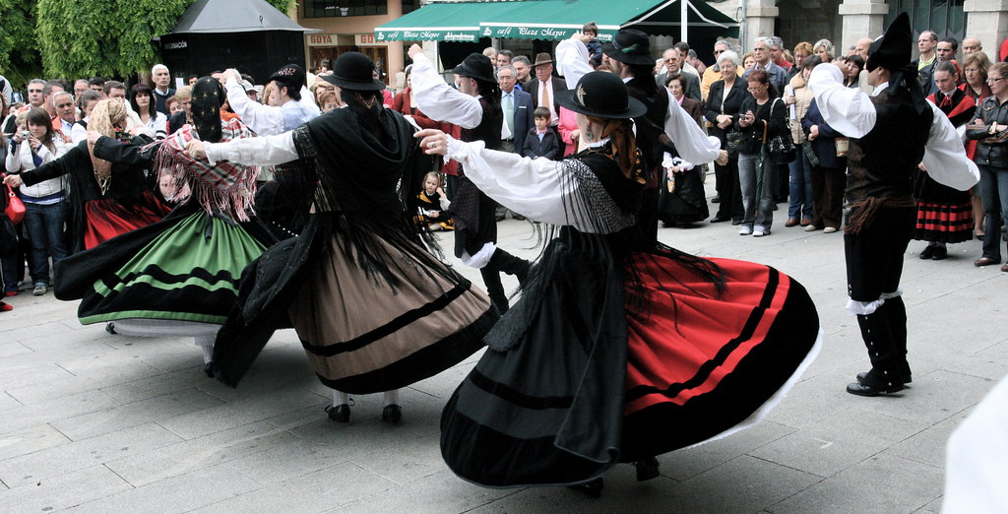
Muñeira

Slide 4
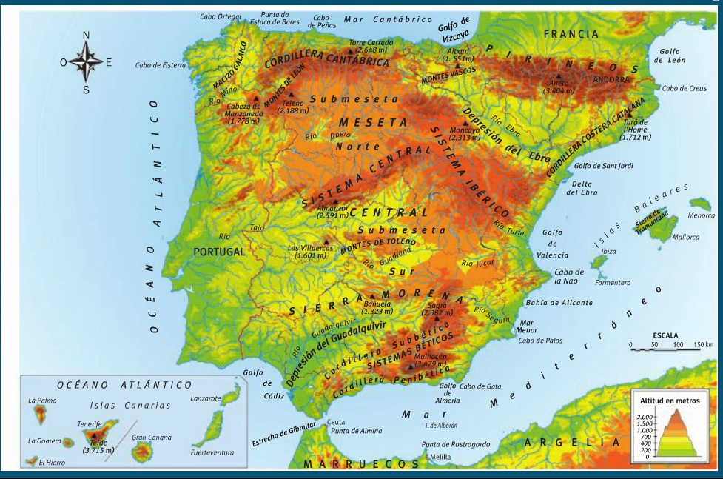
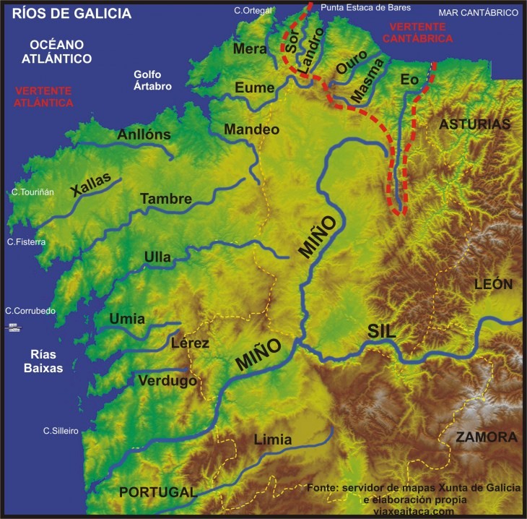
WHERE?

Slide 5
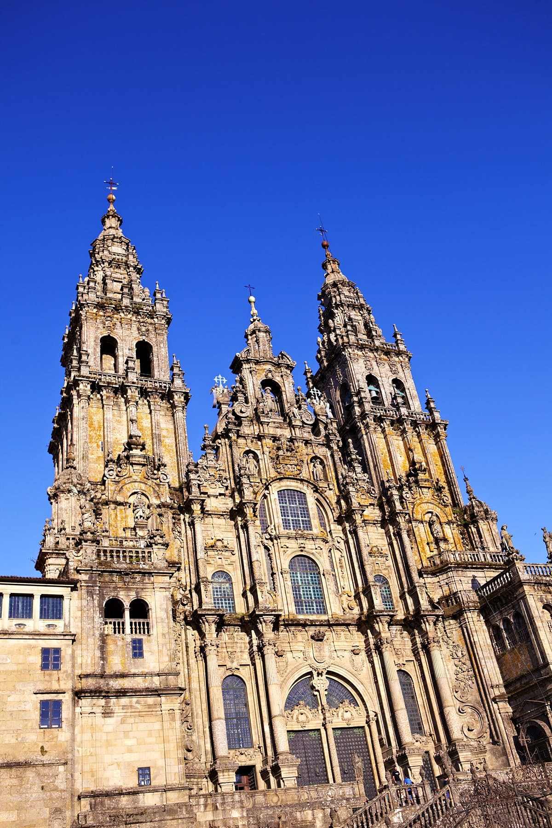
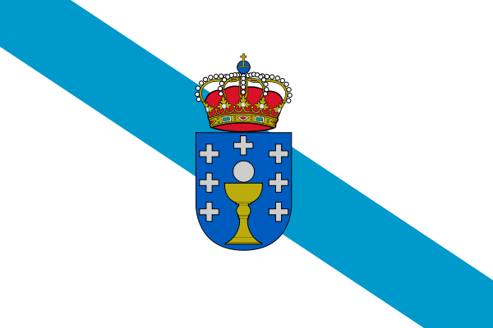
galicia

Slide 6
https://youtu.be/RnVmQgXHrMo

Slide 7
Czech Republic

Slide 8
Traditional music in Czech Republic
In Bohemian traditional music bagpipes are common.
Moravian traditional music is known for the cimbalom
played in ensembles that also include double bass clarinet and violins
The traditional music of Moravia displays regional influences

Slide 9
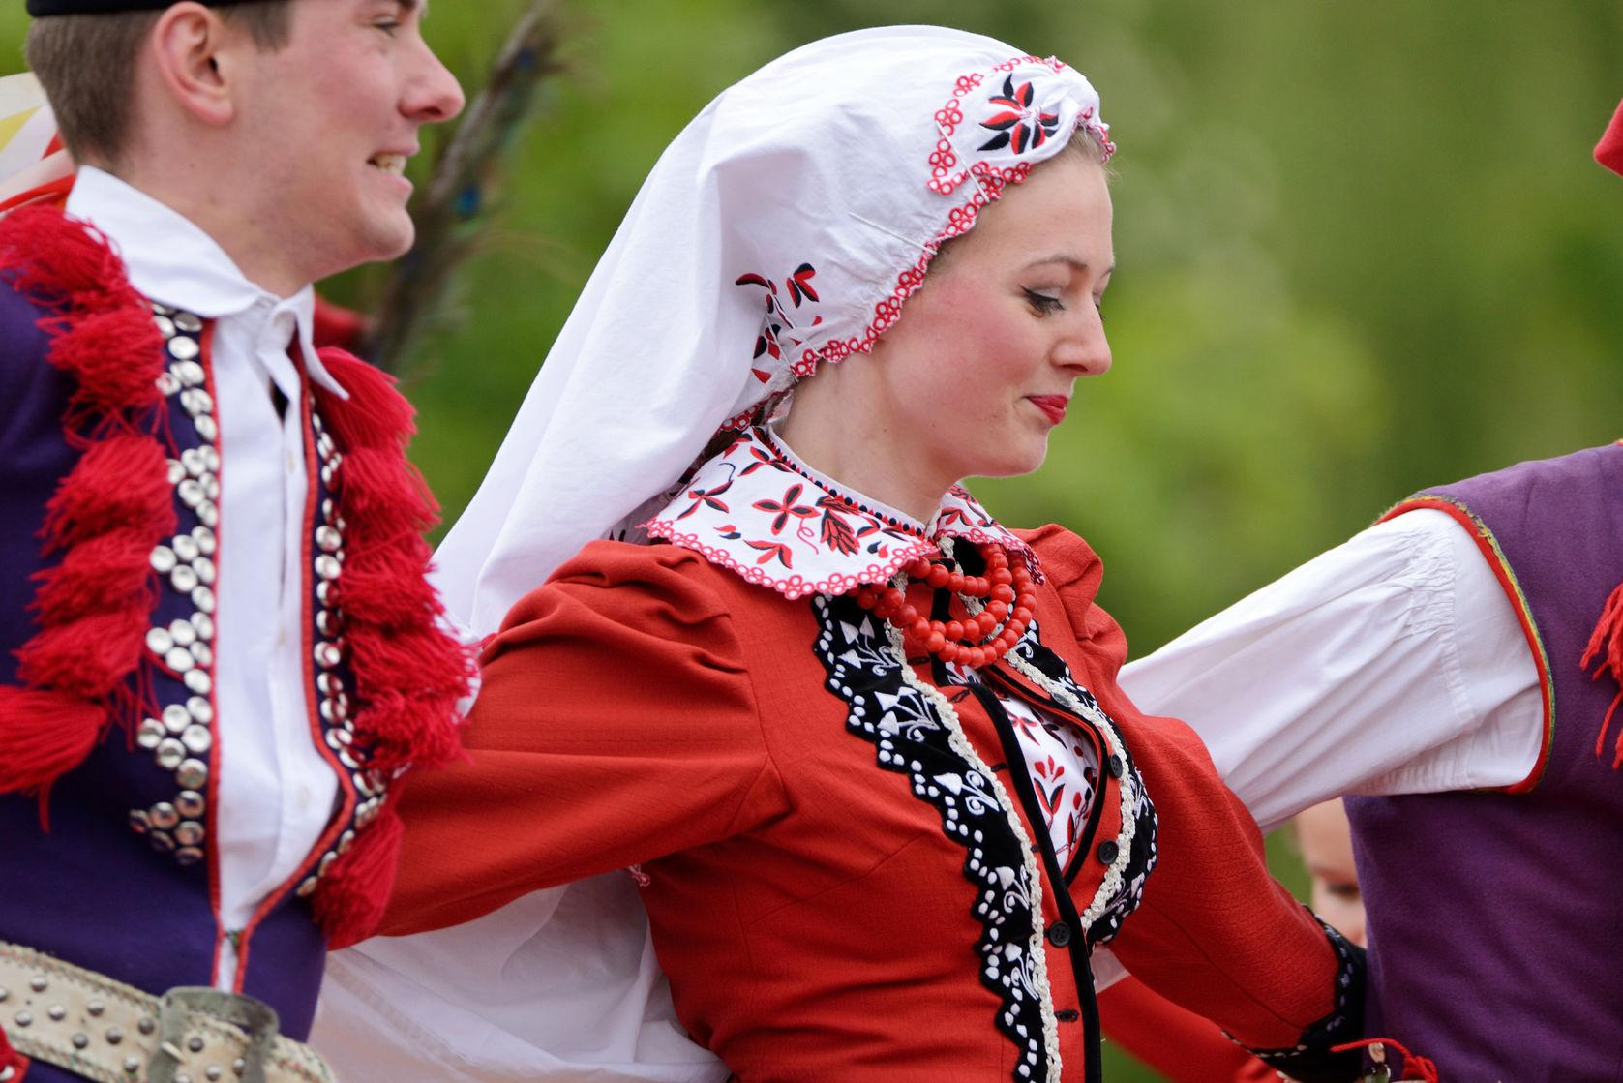
Polka
Familiar throughout all of Europe and the Americas
Originated in the middle of the nineteenth century in Bohemia
traditionally accompanied by folklore and costumes

Slide 10
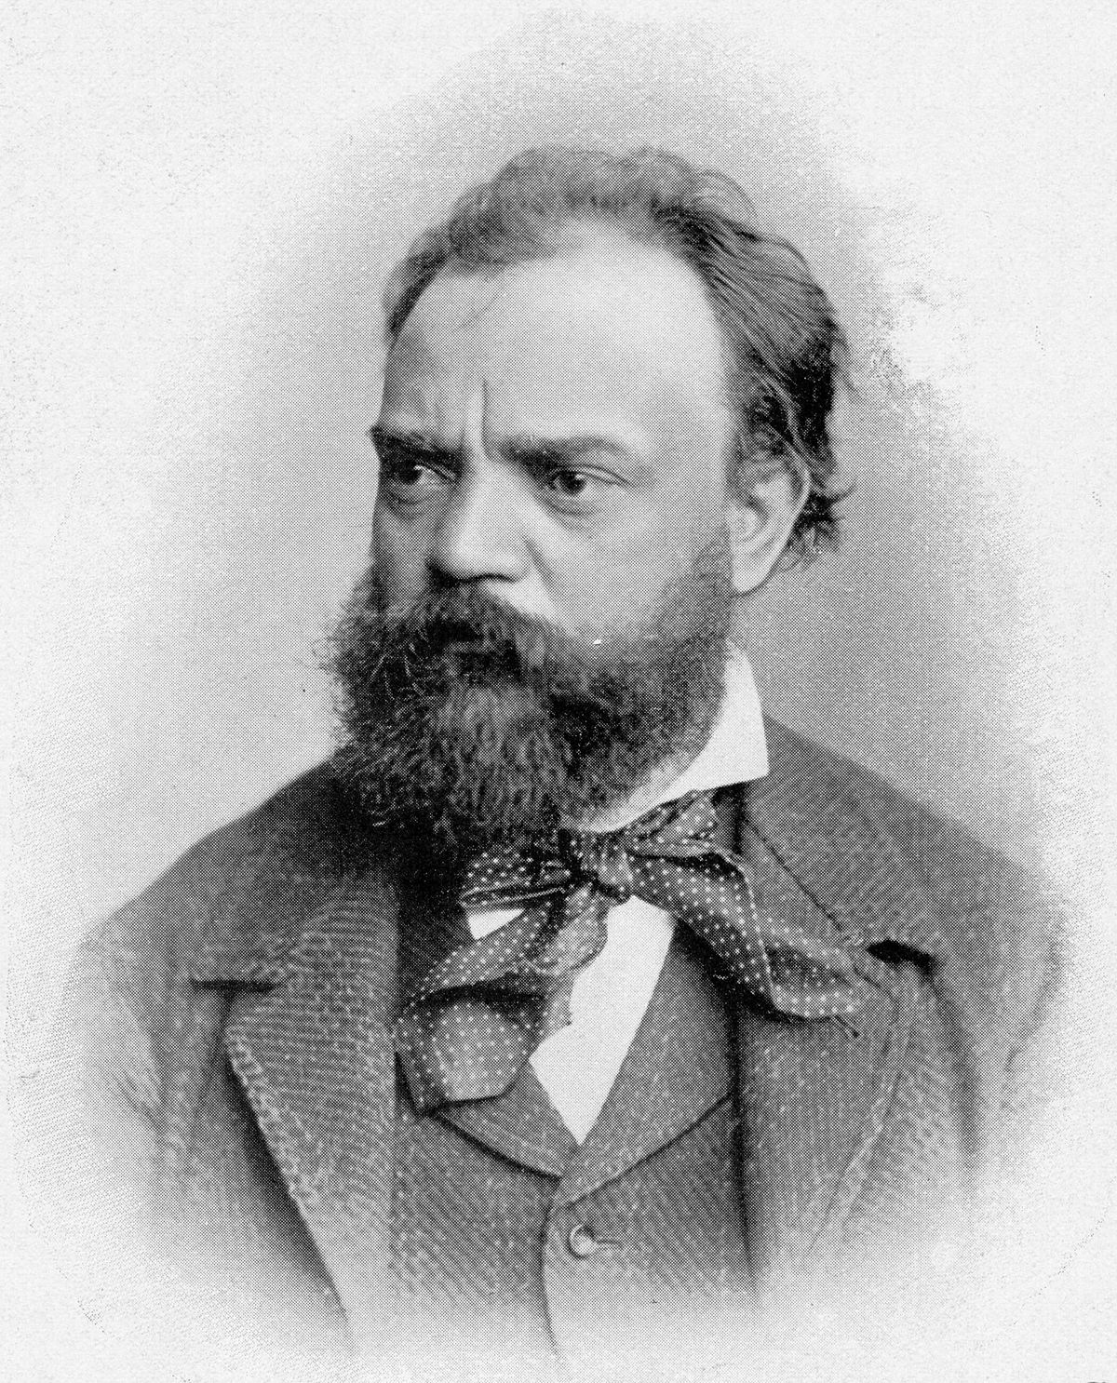
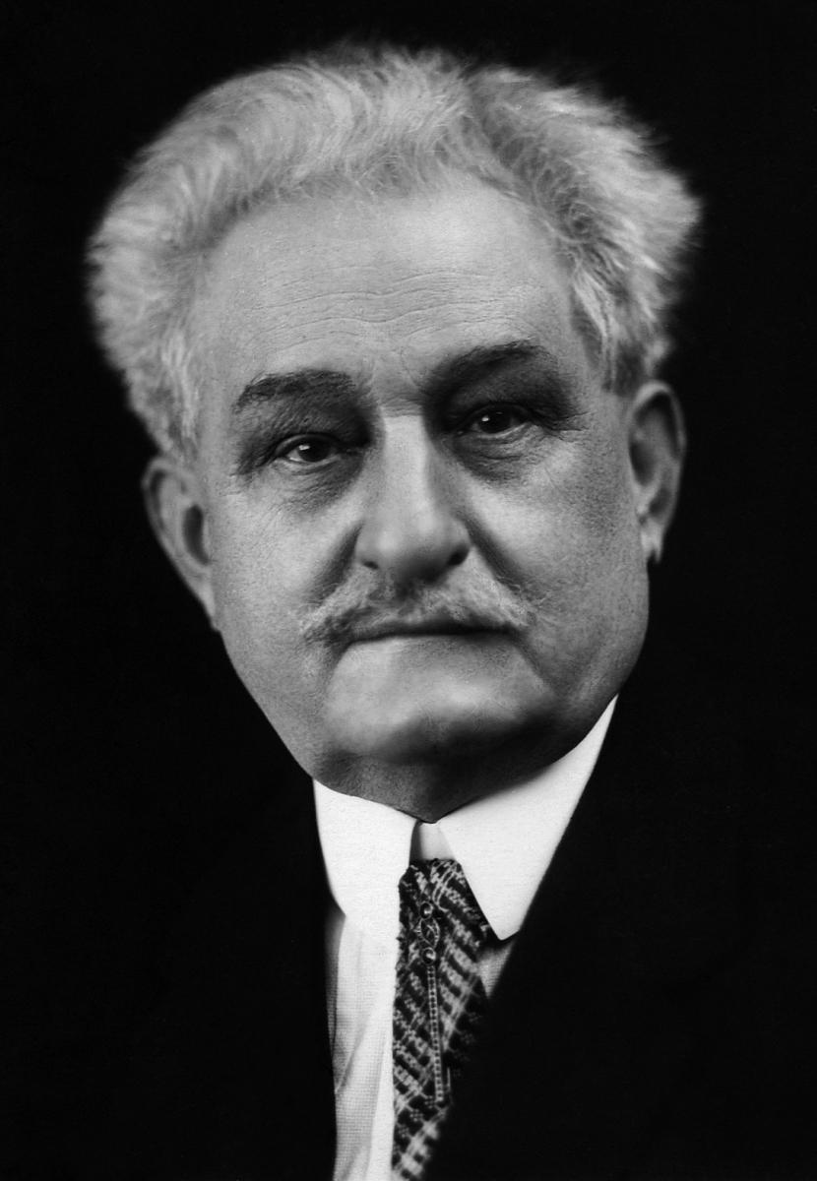
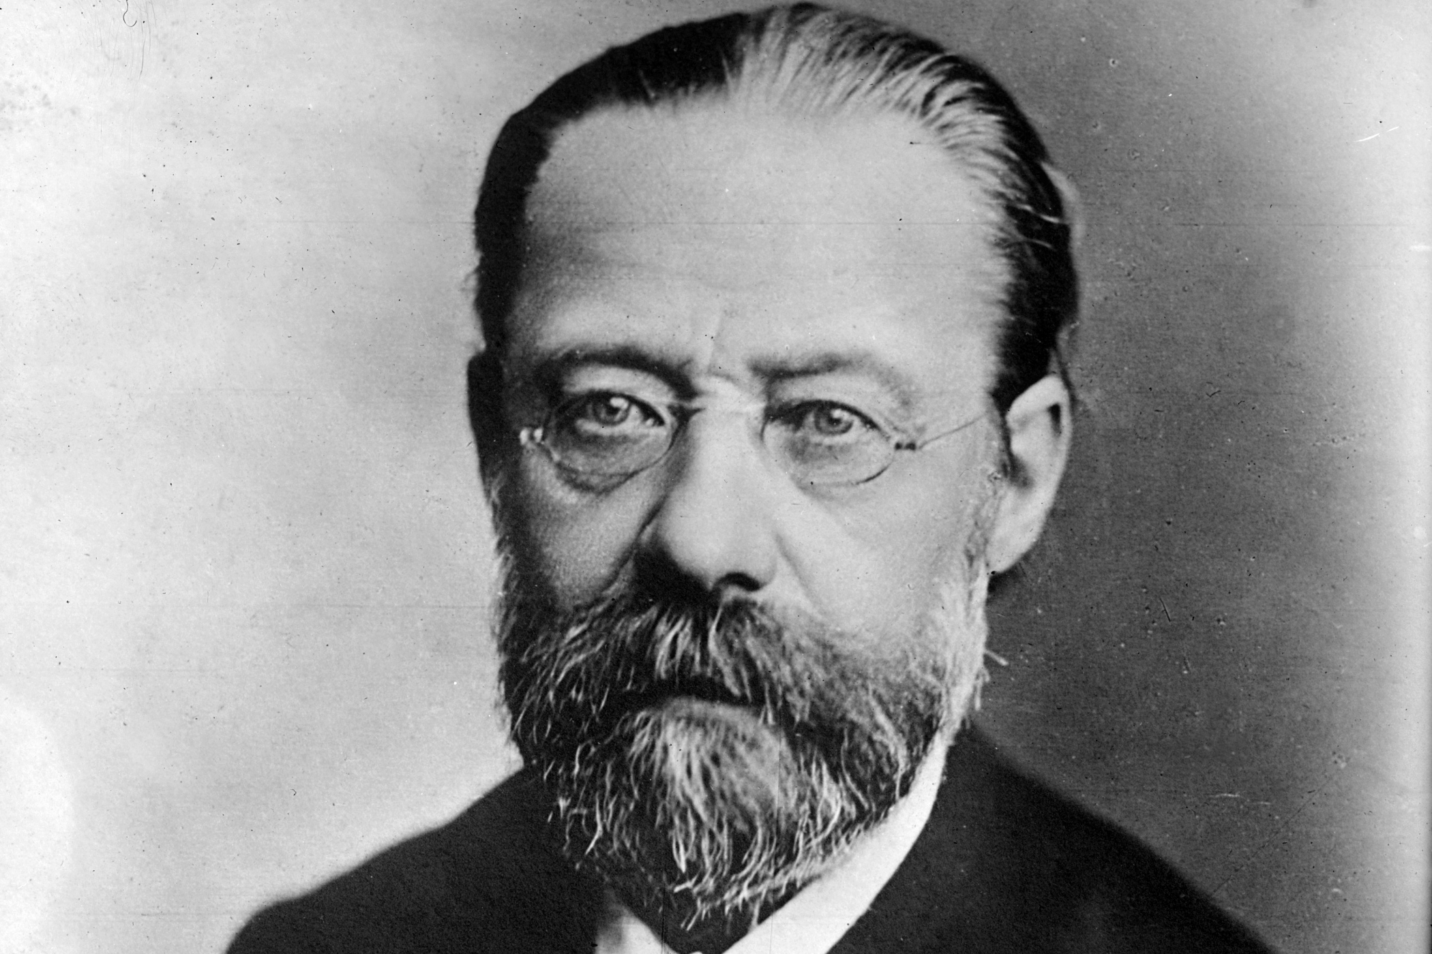
Czech composers
Leoš Janáček
Our song
Antonín Dvořák
Rusalka
Bedřich smetana
Vltava

Slide 11
malta

Slide 12
informal
also known as ghana maltija
sang by locals
sometimes sang with ´djalett´.
strange pronunciation
Ghana Maltija

Slide 13
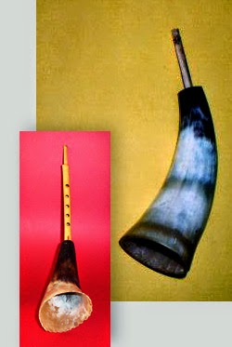
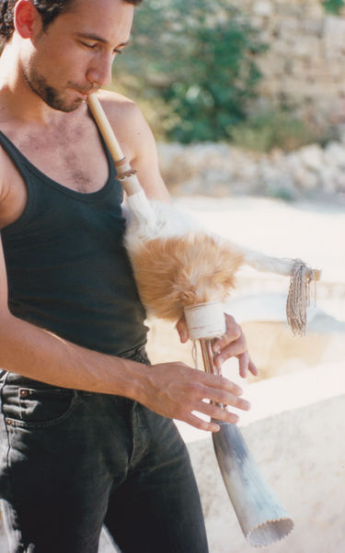
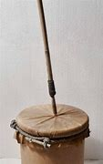
original maltese instruments
horn
zaqq
zafzafa

Slide 14
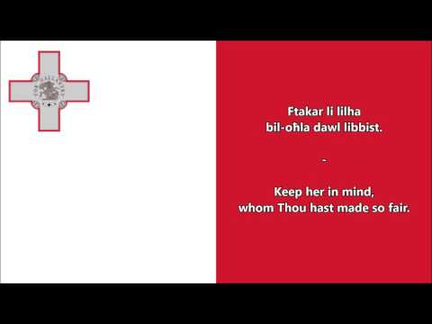
this is the Maltese national anthem

Slide 15
thank you for your attention

