Slide 1
Classical music in the Czech republic, Spain and Malta
Cerezo, Picaza, Ruprechtová, Uhnavá

Slide 2
Czech republic

Slide 3
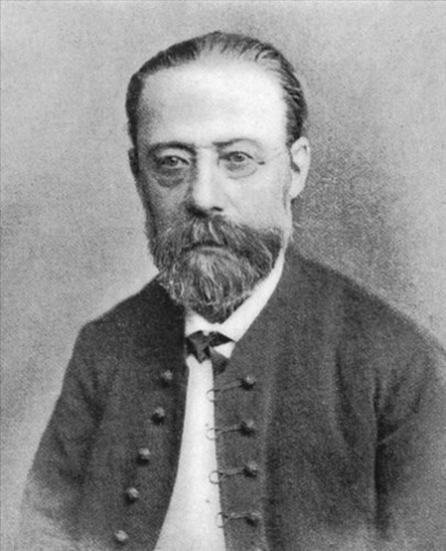
Bedřich Smetana (1824–1884)
Composer of classical music in the Romantic period
Devoted himself to music (piano)
Study at gymnasium
After study – a concert pianist and music teacher in Prague
1856–1861 – a music director and music teacher in Gothenburg (Sweden)
50 years – deaf (still composed more music) → death in institute for ill people

Slide 4
Works
Braniboři v Čechách (The Brandenburgers in Bohemia) – first opera
Dalibor
Dvě vdovy (The Two Widows)
Hubička (The Kiss)
Libuše
Má vlast (My Fatherland)
Prodaná nevěsta (The Bartered Bride) – reputation as a distinctively Czech composer

Slide 5
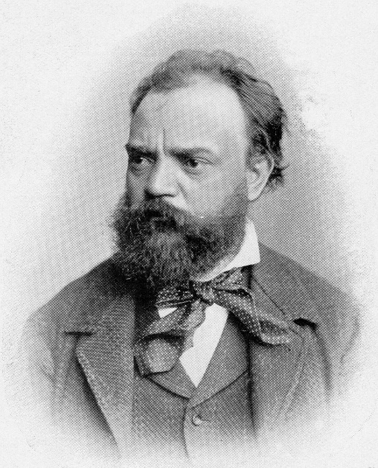
Antonín Dvořák (1841–1904)
One of the most important Czech composers (the world’s most played Czech composer ever)
Played the violin, piano and organ
Teacher at a music school (later – the principal of school like this in New York)
In America – inspired to compose the symphony „From the New World“
After three years – worked at the conservatory again

Slide 6
Works
9 symphonies – most famous No. 9 „From the New World“
Armida – based on fairy tales
Čert a Káča (The Devil and Kate)
Rusalka
The Jacobin

Slide 7
Spain

Slide 8
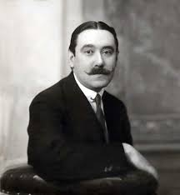
Joaquín Turina (1882-1949)
After studying in Sevilla and Madrid – to Paris
Promoted nacionalism in 20th century
Sevilla – native city
Composed a variety types of music
Played on piano
His compositions come from the Andalusia
(flamenco or gypsy traditions)

Slide 9
Works
Danzas fantásticas
Sinfonía sevillana
La procesión del Rocio

Slide 10
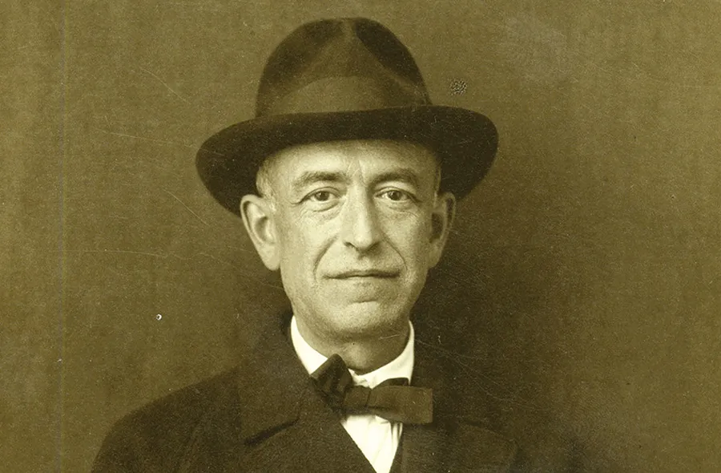
Manuel de Falla (1876-1946)
Born – Cádiz
Promoted nacionalism
Was a pianist
Only wrote a few works
He was one of Spain's most important musicians
of the first half of the 20th century

Slide 11
Works
Noches en los jardines de Espaňa
El amor brujo
El sombrero de tres picos

Slide 12
Malta

Slide 13
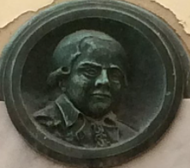
Francesco Azopardi (1748–1809)
Born in Notabile
Composer and music theorist
Worked at St. Paul's Cathedral
successes – setting of Metastasio's libretto La Passione di Gesù Cristo
Composed about 250 mostly sacred works

Slide 14
Works
Il Musico Prattico
Malta felice
La magica lanterna
Songs, hymns and psalms

Slide 15
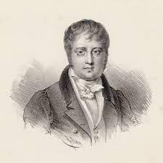
Nicolas Isouard (1773–1818)
Maltese-born French composer
Friends with Rodolphe Kreutzer
Masses, motets, cantatas, romances, and duos, along with over 45 operas
A bust – on one of the facades of both the Théâtre de l'Opéra-Comique and the Palais Garnier
Main squares in Paris – his name

Slide 16
Works
Cendrillon (Cinderella)
Les Rendez-vous bourgeois
Casaciello, perseguitato da un Mago (Casaciello, perseguitato da un Mago)
L'avviso a Maritati
Cimarosa
Michel-Ange
Le Petit page, ou La Prison d'état (The Little Page, or The State Prison)
Les Confidences

Slide 17
Thank you for your attention

