Slide 1
The Spanish language
From Jerome, Francesco, Enzo

Slide 2
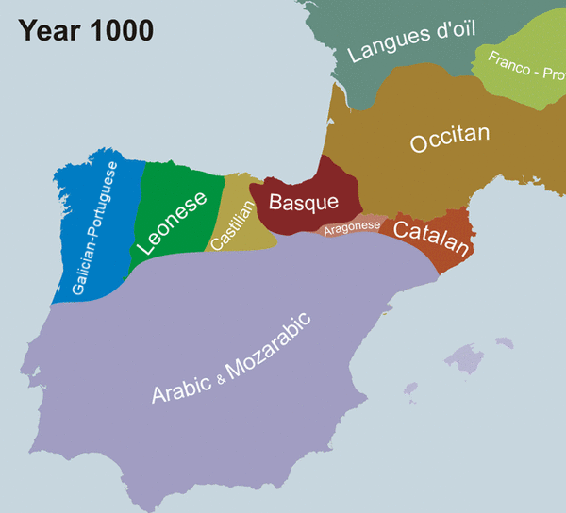
Origin of the language
Castilian Spanish originated as a continuation of spoken Latin in several areas of northern and central Spain. Eventually, the variety spoken in the city of Toledo around the 13th century became the basis for the written standard. With the Reconquista, this northern dialect spread to the south, where it almost entirely replaced or absorbed the local Romance dialects, at the same time as it borrowed many words from Andalusia Arabic and was influenced by Mozarabic and medieval Judaeo-Spanish . These languages had vanished in the Iberian Peninsula by the late 16th century.

Slide 3
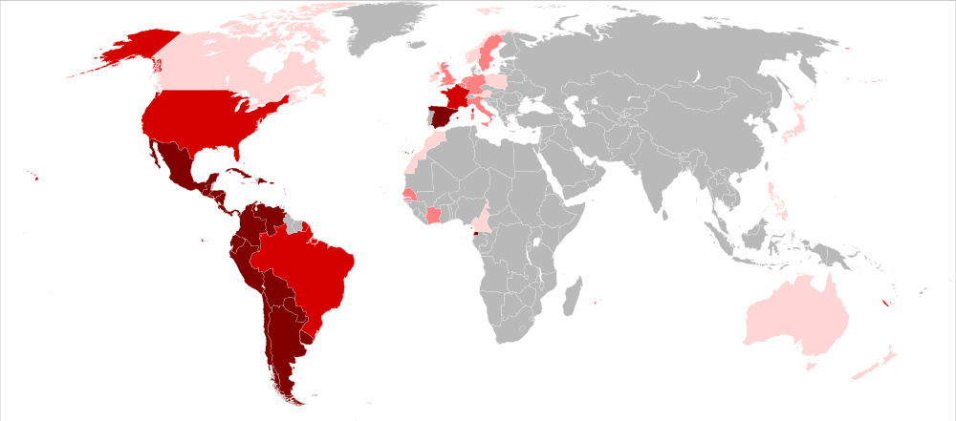
Where is Spanish spoken
The Spanish language is spoken in Spain, Latin America, the Philippines only speak dialect of Spanish and in Equatorial Guinea.

Slide 4
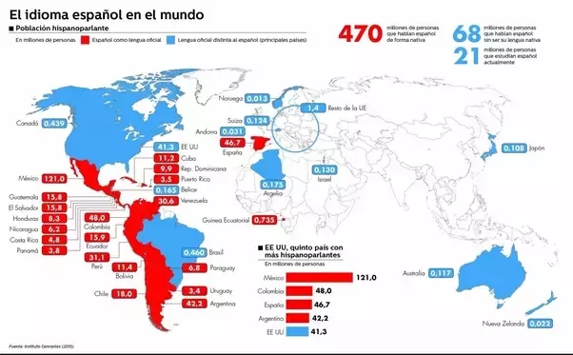
How many people speaks Spanish
The Spanish language is spoken from 580 million which is 7.6% of the worlds population. The main countries which speak it are Spain, Argentina, Bolivia, Chile, Colombia, Costa Rica, Cuba, Dominican Republic, Ecuador, El Salvador, Guatemala, Honduras, Mexico, Nicaragua, Panama, Paraguay, Peru.

Slide 5
Some examples of Spanish
Hello = Hola
Good morning = Buenos días
Good night = Buenas noches
Goodbye = Adiós
Thank you= Gracias
¿Dónde está el baño? = Where is the bathroom?

